Slide 1

Patterns for Mapping Conceptual Models to Logical Models and to Relational Schemas
Copyright © 2011-2020 by Khoury College of Computer Sciences.
No Duplication or Distribution Without the Express Permission of Khoury.

Slide 2
Mapping to Tables
Multiplicity Mapping Rules
Link Tables
Mapping Generalizations
Managing Normal Forms

Slide 3
Summary of Mapping Rules
Each entity becomes a table (relation)
Associations, aggregations, and composition are treated as relationships without any distinction
1:1 relationships:
optionally merge attributes or treat as 1:N
1:N relationships:
add the primary key from the “one” as a foreign key attribute to the “many”
M:N relationships:
create an association or junction table with rows as pairs of primary keys from both relations
Generalization relationships are represented as a single table with a type attribute or a set of tables with common primary keys
Notes:
In principle, each entity becomes a table, each relationship becomes a table, each attribute becomes a column, and each entity instance a row (tuple) in the relational table.

Slide 4
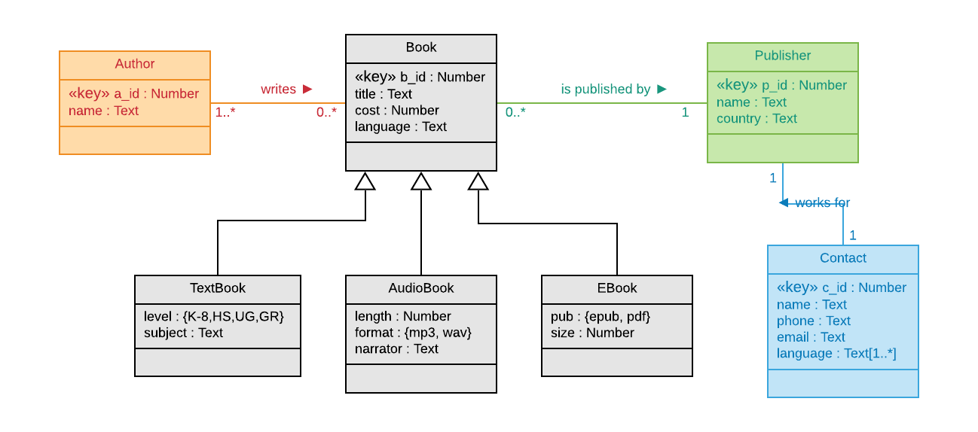
Mapping a Conceptual Model in UML
UML Class Diagram representing a conceptual model for a publishing domain
Contains associations with 1:1, 1:N, and N:M multiplicities plus generalization and multi-valued attribute
Note that aggregation and composition relationships are mapped like associations
UML to ERD & Schema: Lucidchart

Slide 5
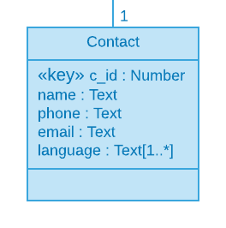
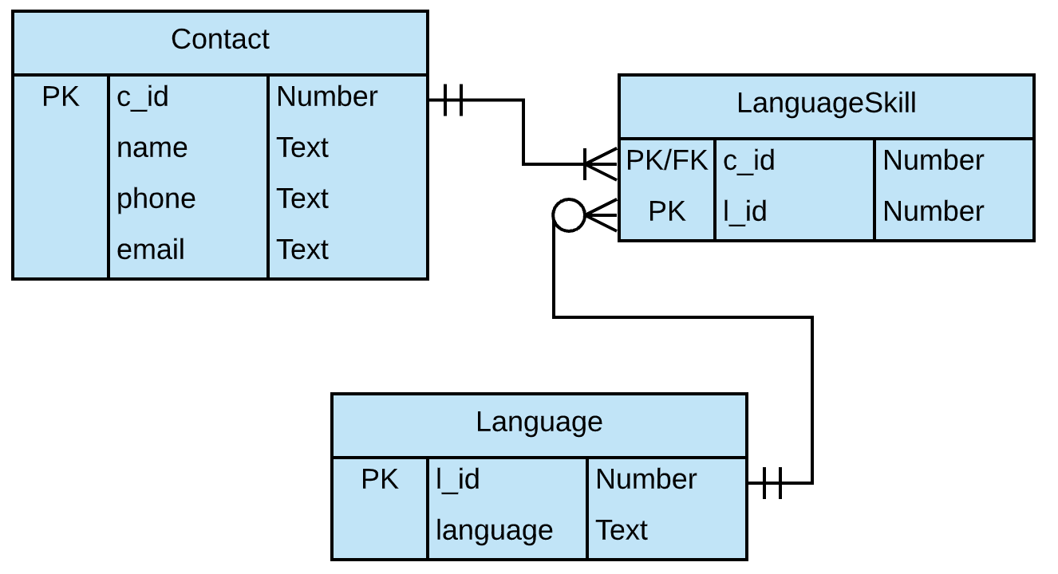
Mapping a Multi-Valued Attribute
Create a table containing all possible values of the multi-valued attribute’s domain
Create a link table with the primary keys of each table
Resulting table is in at least 1NF

Slide 6
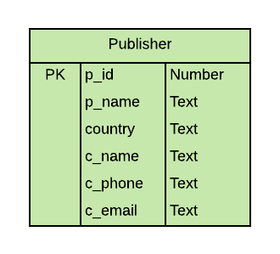
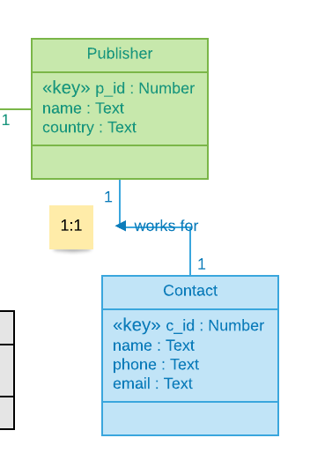
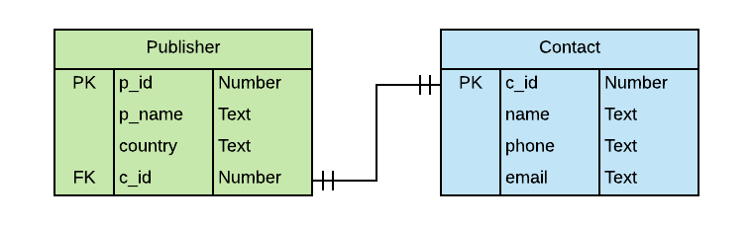
Mapping a 1:1 Association or Aggregation
Merge the two entities into a single table, although that precludes changing the multiplicity later and because it violates 3NF and leads to poor design it should be avoided
Create two tables with a foreign key in the dominant entity

Slide 7
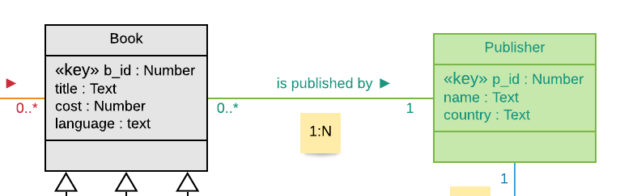
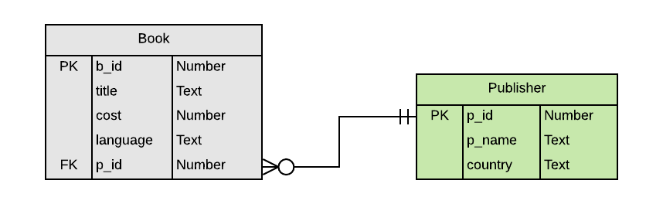
Mapping a 1:N Association or Aggregation
Create a table for each entity
Add the primary key of the entity on the side of the “1” in the relationship as a foreign key on the entity on the side of the “N”
The resulting relational schema is in 3NF if the two tables are each in at least 3NF

Slide 8
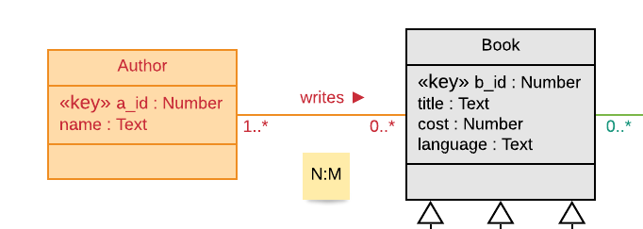
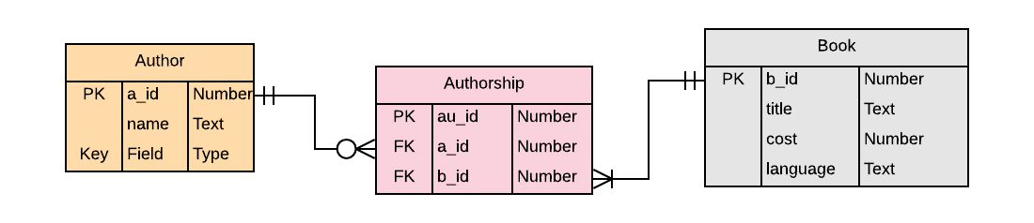
Mapping a N:M Association or Aggregation
Create a table for each entity
Create a new table containing the primary keys of each of the entities as foreign keys
Introduce a surrogate key as a primary key for the new table
The resulting relational schema is in 3NF if the two tables are each in at least 3NF

Slide 9
Mapping Generalizations
Generalization (type or inheritance) hierarchies representing taxonomies in a conceptual model cannot be represented directly in a relational model.
There are two approaches for representation:
Collapsed Superclass
Shared-Key Class Set

Slide 10
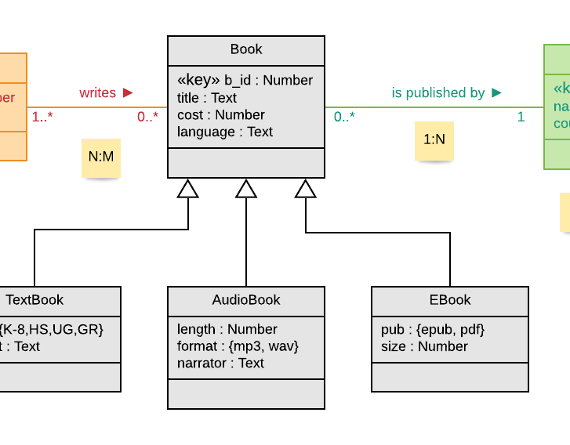
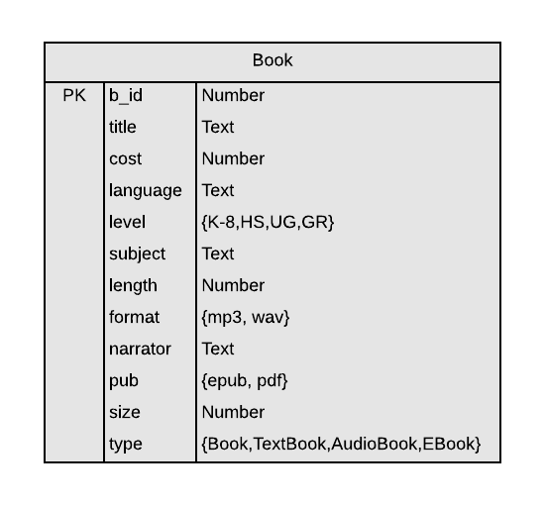
Mapping Generalization: Collapsed Superclass
Create a single class with superclass name containing the attributes of the superclass and all subclasses
Add a new categorical attribute called “type” with a domain that is the set of all classes, excluding the superclass if it is abstract
A row is an instance of the superclass or one of the subclasses; all attributes not belonging to that type of entity are null
This approach results in a sparse table with many null values

Slide 11
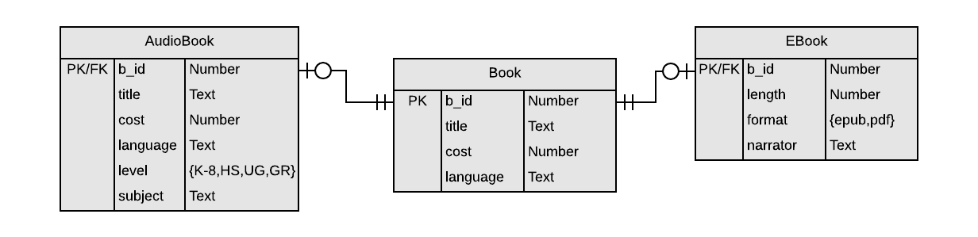
Mapping Generalization: Shared-Key Class Set
Create a table for each subclass class and for the superclass
Use the primary key of the superclass as the primary key of each subclass
The primary key of the subclass is also a foreign key linking to the superclass creating 1:1 relationships between the tables
An instance of a subclass is therefore split over at least two tables
If the superclass is concrete then the relationships to the subclasses are optional, otherwise concrete

Slide 12
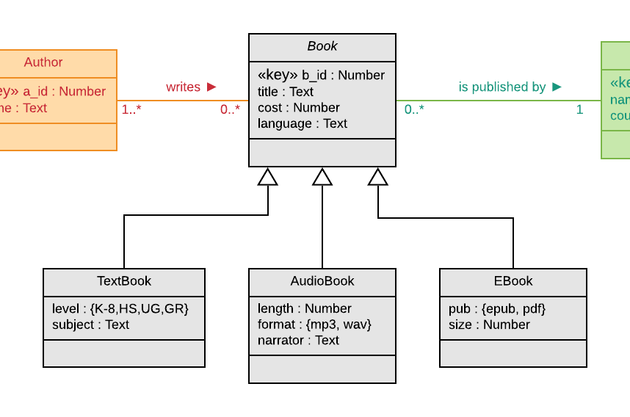

Mapping Generalization: Abstract Superclass
Implement the same as the in the Shared-Key Class Set patter except that for every primary key in the superclass table there must be a corresponding primary key in at least one subclass table
If the hierarchy is disjoint, then the same primary key cannot appear in sibling nodes

Slide 13
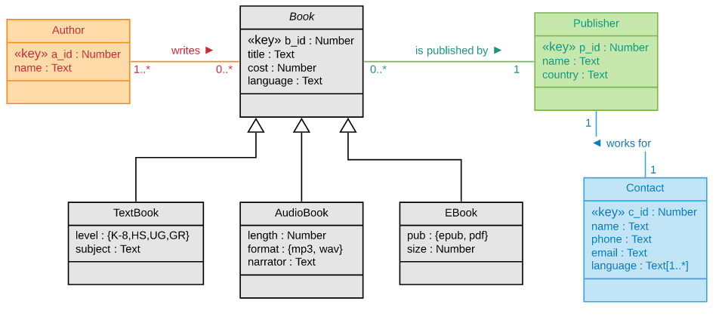
Full UML Conceptual Model: Abstract Superclass
In the model below, the Book class is abstract, i.e., all instances are either audio books or e-books.

Slide 14
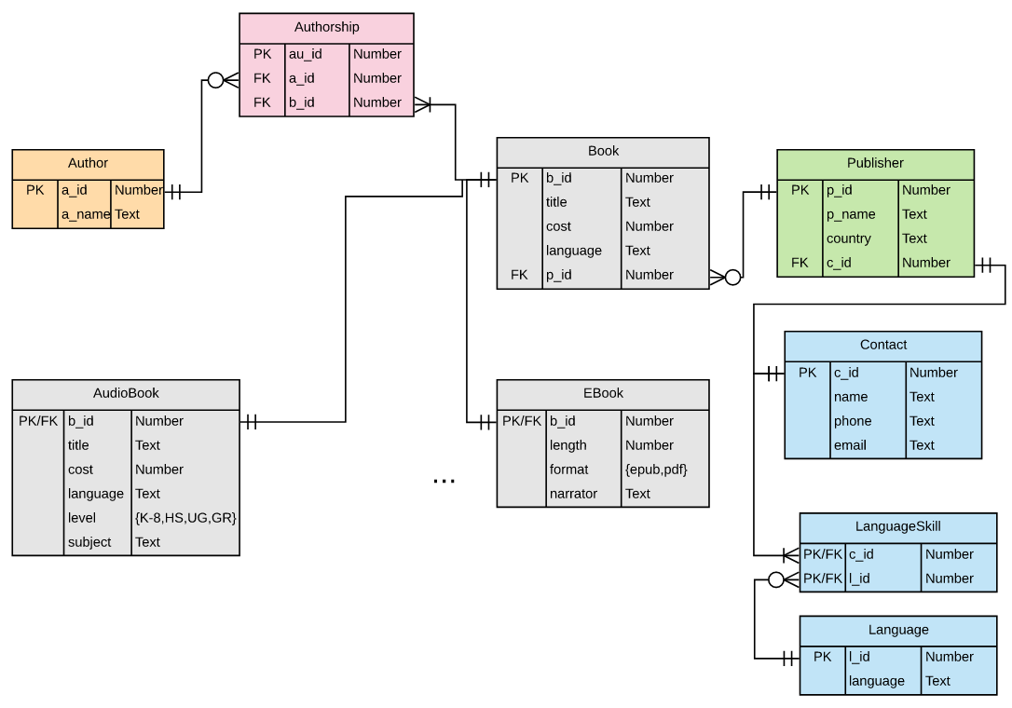
Full ERD Logical Model: Abstract Superclass
In the model below, the Book class is abstract.

Slide 15
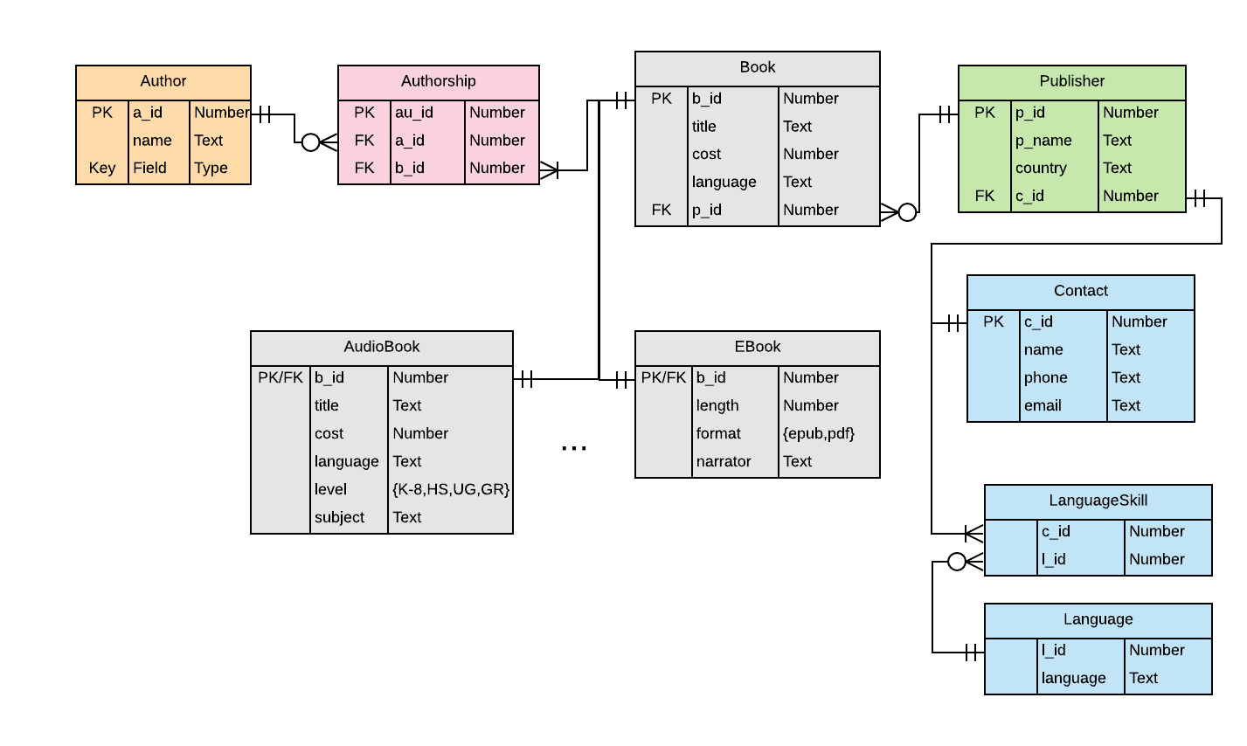
Some Issues with Model
What if a book is sold in different formats, e.g., on Kindle and paperback?
Would ISBN make a better primary key as it is a natural key?
What about hardcover vs paperback?
What about books without an author, e.g., the Bible?
What about country in publisher? Doesn’t that violate a normal form?

Slide 16
Sample Relation Instances
Author
Publisher
a_id
a_name
p_id
p_name
country
c_id
843
763
921
420
Smith, Adam
Kant, Emmanuel
Hegel, Georg
Descartes, Rene
321
332
303
394
Pearson
Elsevier
Random House
Putnam
India
UK
US
US
332
321
303
394
Authorship
Contact
au_id
a_id
b_id
c_id
c_name
phone
109
110
111
112
763
843
921
921
221
222
223
224
321
332
303
394
Ellen Learson
Anurag Jain
Cynthia Larson
Petra Cevjac
+44 99813201
+91 4457229
+1 5558873322
+1 5552331109
Book
b_id
b_title
cost
p_id
221
222
223
224
Critique of Reason
Wealth of Nations
Science of Logic
Philosophy of Right
48.99
29.00
9.99
4.99
303
303
394
394
EBook
b_id
length
format
221
222
223
224
2387
823
458
1097
epub
pdf
epub
epub
Some columns are renamed from attributes in order to make them unique, and thus simplify foreign key naming. This is not strictly necessary, but convenient. Some tables have non-relevant columns omitted for brevity.

Slide 17
Common Constraints
Common constraints:
Non-null values for attributes
Lower bound of 1 on multiplicity, e.g., 1..*
Specific upper bound on multiplicity, e.g., 1..5
Referential integrity of foreign keys
Deletion of classes from multiple tables in a generalization hierarchy

Slide 18
Enforcing Constraints
During table creation:
NOT NULL on attributes or foreign keys
ON DELETE CASCADE to force deletion of dependent entities
user defined constraints and domains
As business logic:
use BEFORE triggers to enforce multiplicity constraints
Transactions via application code or stored procedures

Slide 19

Summary, Review, & Questions…

