Slide 1
HabitationHotSpot.com
Project 1

Slide 2
What is it?
HabitationHotSpot.com
A fun way to search for places and amenities near you
Customize your search based on any location in the world
Set a radius of up to 50 miles to see results around your designated area
Customize the places and amenities you would like to see populate
Explore the map!

Slide 3
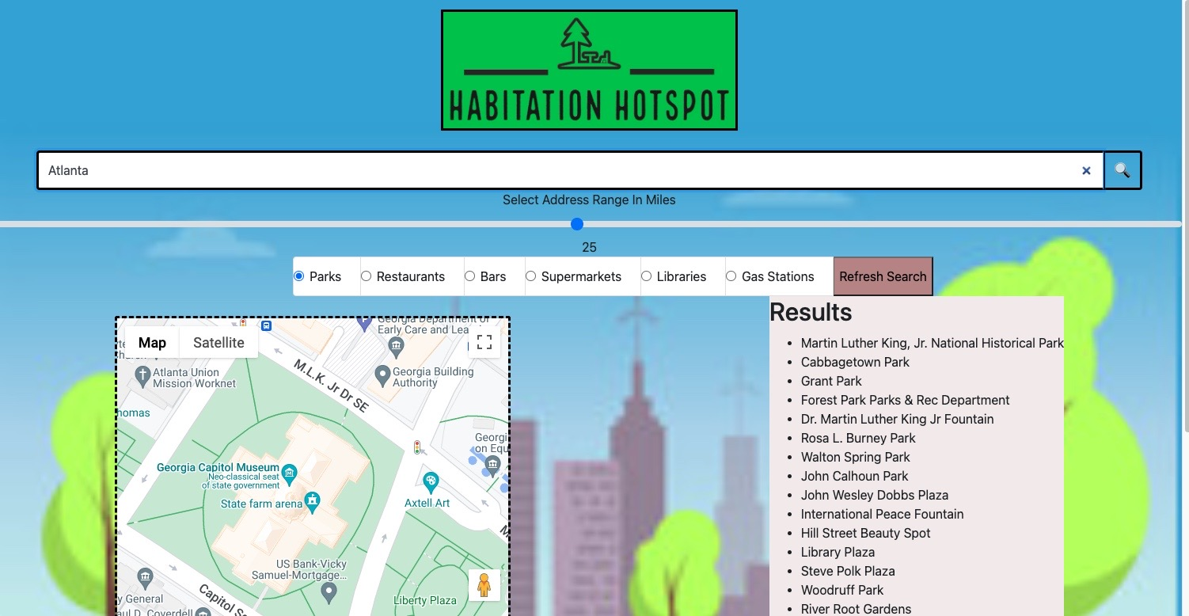
MVP: minimal viable product
Search refresh button
Search Bar
Search results
list
Places and Amenities List
Visual Map

Slide 4
Demo
Visit HabitationHotSpot.com

Slide 5
Alex Lin
Site framework
HTML layout
Site formatting and styling with CSS
Issue Assignment through GitHub
“simple solution” – Refresh button (MVP)
Researching and adding radius bar to the site (slider)

Slide 6
Trevor Dent
Linking our first API – google maps
-Javascript code linking API information to the page
“Enter button issue” – javascript code to allow a user to press “enter” instead of the search button to allow a search to populate
Cleaning our code up
Moving to Florida during a category 5 hurricane

Slide 7
Zach Schneider
Github central control: monitored github push reviews
Linked our second API: google search
Javascript code to have our targeted results populated from the search to display on our web page
Local storage: have our results store locally through the web page

Slide 8
Troy morgan
Logo Design and implementation
HTML formatting and framework
CSS design for specific HTML targets (search bar, results list, amenities list)
Formatting radius bar (slider)
Researched Javascript, assisting with implementing APIs on the site and configuring local storage

Slide 9
Josh adam
HTML formatting and framework
Wireframe Design, blueprint for the website
Background Image and attachment through CSS
Javascript research and implementation: working with team on writing our code, “enter” button issue, local storage
Finding available domain name and securing it
Linking domain through godaddy with proper IP addresses (github pages)
Presentation Outline/PP
README

Slide 10
Next Step: How can we improve?
Save results beyond local storage and allow users to ”share” populated data
Populated results appearing as hyperlinks to direct users to that particular site
Allowing users to customize their search list with multiple categories
Have search results “empty” when a new search is run instead of having user click the “refresh” button
Animations on background image and “backdrop in”
Additional categories for things such as “bodies of water” etc.
Weather tracker for the local area user searches

Slide 11
Credits
W3schools
StackOverflow
Google ☺
Bootstrap (thanks twitter!)
Our wonderful TA’s
Github…
Teamwork!

