Slide 1
HabitationHotSpot.com
Project 1

Slide 2
What is it?
HabitationHotSpot.com
A fun way to search for places and amenities near you
Customize your search based on any location in the US
Set a radius of up to 50 miles to see results around your designated area
Customize the places and amenities you would like to see populate
Explore the map!

Slide 3
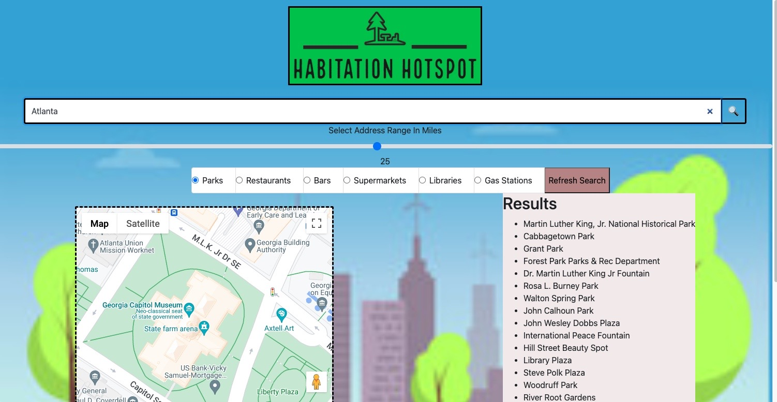
MVP: minimal viable product
Search refresh button
Search Bar
Search results
list
Places and Amenities List
Visual Map

Slide 4
Alex Lin

Slide 5
Trevor Dent

Slide 6
Zach Schneider

Slide 7
Troy morgan

Slide 8
Josh adam

