Slide 1
MULTI-AGENT MANIPULATOR CONTROL AND
MOVING OBSTACLE AVOIDANCE
George Birbilis
Nikos Aspragathos
Mechanical Engineering & Aeronautics Department, University of Patras

Slide 2
Introduction – the problem
planning the motion of a serial manipulator
workplace may contain unknown stationary or moving obstacles (time varying environment)
real-time reactive/adaptive behavior
focus on highly redundant planar manipulators

Slide 3
Introduction - Current approaches (1/2)
many approaches in Hwang & Ahuja, 1992
unknown moving obstacles case favors local planning (global re-planning expensive if many obstacles or highly redundant manipulator), Chen & Hwang, 1992, Challou et al., 1998
top-down centralized approach has increasing complexity and cost when number of joints and links rises
bottom-up, modular approach favored, modeled as a multi-agent system
Motion planning on each subpart, combining local solutions into solution for manipulator path planning problem
In most cases, composition implemented in real-time, via interaction (cooperation or contention) of agents controlling manipulator parts

Slide 4
Introduction - Current approaches (2/2)
Overgaard et al., 1996:
multi-agent system, both joint and link agents, control 25-DOF snakelike robot in environment with obstacles modeled using artificial potential field (Khatib, 1986)
Bohner and Lüppen, 1997:
7-DOF robot, only joints as agents, doing sensor-data integration and motion planning on a per-agent basis
Zavlangas and Tzafestas, 2000:
  fuzzy logic to escape local minima
Althoefer et al., 2001:
  neuro-fuzzy system

Slide 5
Introduction - a new approach
Proposed system:
multi-agent system
each software agent controls a specific part of the joint-link chain
agents interact with each other to adapt the manipulator configuration to external events and changing situations in real-time
Reduces motion planning of a manipulator to motion planning of a single part of it (e.g. tool tip):
other parts react and adapt or object (veto) to the moving part’s motion

Slide 6
The kinematic model
Planar manipulator
Can have both rotational and translational joints, any serial combination
Manipulator base may be fixed or may move freely or on predefined path
Base may be able to rotate around an axis perpendicular to manipulator plane
On 2D plane that may contain obstacles
Obstacles stationary or moving with speed comparable to joint motors speed
Case of moving obstacles includes the case of other manipulators or humans also working in the same environment, with no communication channel or common protocol for coordination
No a-priori knowledge of obstacles assumed
Incoming collisions detected either using touch sensors covering the manipulator body (Bohner and Lüppen, 1997), or range sensors detecting the closest obstacle at each side of the links (Zavlangas and Tzafestas, 2000)

Slide 7
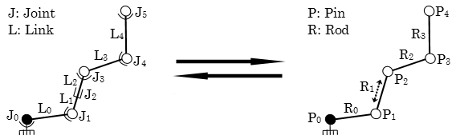
The conceptual model
potentially expandable rods (of length Li in [Li_{min}, Li_{max}])
interconnected at their endpoints using pins (rotation angle Ai in [Ai_{min},Ai_{max}])
forming a chain
behaves like a rope (given a high number of rods & pins)

Slide 8
Mapping kinematic to conceptual constraints
Kinematic model constraints mapped to conceptual model ones:
Rotational joint : [Pin_{i}Angle_{min}, Pin_{i}Angle_{max}]
Translational : [Rod_{i}Length_{min}, Rod_{i}Length_{max}]
Non-moveable manipulator [Pin_{i}Position=fixed]
Irregular geometry: e.g. simulate a 90-degrees angle shaped link using two links connected by a constrained (fixed angle) rotational joint

Slide 9
Master - Slave relationship
Master-Slave relationship:
two entities, “master” and “slave”
master emits change events for its state
slave listens for changes to master’s state
slave reacts to master’s state change by changing its own state
Listen & react to change also called observer pattern

Slide 10
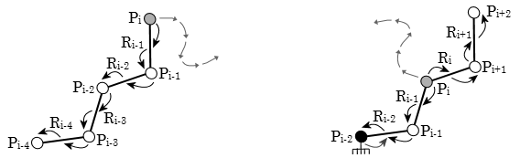
Change event propagation
Any chain part (not just the tool tip) can initiate motion, receiving its own motion commands from planner module or human operator (via higher application layer), so chain is split by the mover part into two sub-chains:
P_{i} master of slave P_{i-1} P_{i-1} master of slave P_{i-2} … | P_{i} master of slaves P_{i-1} & P_{i+1} P_{i+1} master of slave P_{i+2} …
a slave can have its own slaves (a master-slave chain/hierarchy, nested relationships)
state change events at the head of each Master-Slave sub-chain propagate towards the tail
each slave tries to react and adapt to its master’s state change event

Slide 11
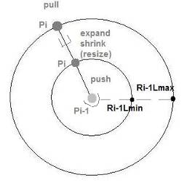
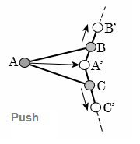
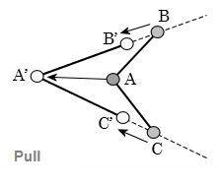
React to master’s state change events
Slave’s predefined rule set = rules reacting to changes of master entity’s state
Reactive rules try to preserve constraints imposed on slave and on the relation to its master:
by design (internal, hardware constraints)
decided on the fly at runtime (environmental constraints, obstacles or failure of subparts)
Two basic model constraint preservation behaviors (master Pi, slave Pi-1):
Push : distance (Pi’s new-pos, Pi-1’s current-pos) < Ri-1Lmin (min length of rod Ri-1)
Pull : distance (Pi’s new-pos, Pi-1’s current-pos) < Ri-1Lmax (max length of rod Ri-1)
Slave pin tries to move on the (Pi’s new-pos, Pi-1’s current-pos) guiding line (rod)

Slide 12
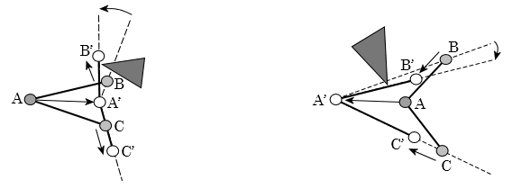
React to sensed obstacles
Master pin motion:
  Reaction of slave pin (move) & slave rod (resize) to motion of master pin
Push/Pull model constraint preservation behaviors (if slave rod can’t resize enough):
  new slave pin position
Obstacle – Rod collision may block new slave pin placement:
  Master-Slave’s Rod rotates around master pin, at “contact” point/side with obstacle (new guiding-line for slave motion)
Environmental constraint preservation behaviors named Push-Rotate and Pull-Rotate

Slide 13
Master - Vetoable slave relationship
Master – Vetoable slave relationship:
two entities, “master” and “slave”
master emits change events for its state
slave listens for changes to master’s state
slave reacts to master’s state change by changing its own state
Difference from classic Master-Slave relationship is that the slave can object to the state changing of the master (veto)
Listen & react+veto usually called a “Vetoable Change Listener” in Object Oriented Programming (OOP)

Slide 14
Veto back-propagation
Using Master - Vetoable slave relationship to support:
fixed base manipulators
replanning in case some slave part of the chain can’t adapt to its master’s motion because it’s trapped in some obstacles or malfunctioning
A slave part of the chain forced to react and adapt to an initial motion of a master neighboring part of the chain, can object (veto) to the motion of that master part …
… if itself cannot move to adapt to the master’s motion while still preserving the chain model and environmental constraints
e.g. the pin agent of a manipulator’s fixed base always objects to its relocation

Slide 15
The software model (1/2)
Agent = an entity that is: (Liu et al., 2002)
able to live and act in an environment
able to sense its local environment
driven by certain objectives
has some reactive behaviors
Multi-agent system = a system that has:
a set of agents
an environment =
  a space where the agents live
  set of reactive rules, governing the interaction between agents and their environment (laws of agent universe)

Slide 16
The software model (2/2)
Agent & Multi-agent system definitions:
  map directly to the pin & rod entities defined in the conceptual model
  straightforward implementation
Event & veto propagation can be implemented:
  as remote events and exceptions over a data channel at embedded platforms like Java or .NET
  as hardware interrupts at lower level implementations

Slide 17
Current development & plans
Conceptual model simulated in 3D space:
  3impact 3D graphics engine (www.3impact.com)
  Multi-agent logic in Microsoft Visual C++ .NET
Future plans:
  Use 3impact’s included Open Dynamics Engine (www.ode.org) to simulate physical model too
  Control robot simulators and physical robots via IPC and I/O channels (RoboTalk, Serial I/O etc.)

Slide 18
Conclusions (1/2)
Most important advantage:
  Reduces external path-planning only to the motion of the master (usually tool-tip)
  Other manipulator parts adjust in real-time to the master’s motion, reacting to sensed obstacles
Best applied to highly-redundant manipulators:
  Scales up efficiently, agents interact with their immediate neighboring agents only
Supports fixed and moving base manipulators

Slide 19
Conclusions (2/2)
If veto from slave agent back-propagates as far as the original mover agent (the rest of the manipulator chain can’t adapt to its movement):
Autonomous mover: replan its motion
Externally controlled mover: propagate veto to planner module or human operator

Slide 20
Simulation
Conceptual model 3D simulator…

