Slide 1

Exercise and Fitness Metrics: How to achieve your goals using data analytics
Project 3 – Group 3

Slide 2

Copyright Protections:
This license grants users certain rights to use and publish the data under specific conditions. Each Data Provider agree that Enhanced Data shall not be considered a work of joint authorship by virtue of its relationship to Data licensed under this Agreement and shall not require either any obligation of accounting to or the consent of any Data Provider. Each Data Provider represents that the Data Provider has exercised reasonable care, to assure that: (a) the Data it Publishes was created or generated by it or was obtained from others with the right to Publish the Data under this Agreement; and (b) Publication of such Data does not violate any privacy or confidentiality obligation undertaken by the Data Provider.

Slide 3

Fair Use Analysis:
The license explicitly outlines the rights and permissions granted to users, including the ability to use, modify, and publish the data. However, users must comply with the conditions outlined in the agreement, such as preserving attributions to the data providers and not imposing further restrictions on the data's use.

Slide 4

Data Collection:
the dataset is provided under a specific license agreement that grants users certain rights to use and publish the data, subject to compliance with the conditions outlined in the agreement. As long as users adhere to these conditions, their use of the dataset should be within the bounds of fair use and the terms of the license agreement.

Slide 5

Project Proposal:
Our project aims to provide valuable insights into the relationship between health indicators, exercise types, age, and gender, ultimately contributing to personalised and effective fitness strategies for individuals and informing industry practices.

Slide 6


Between exercise 1 and 2 which one amongst each gender causes the highest heart rate and Calories burn?
Exercise 1 - Outdoor
Exercise 2 - Indoor

Slide 7

How does weight, calories burn, heart rate, and BMI are linked with ageing?

Slide 8
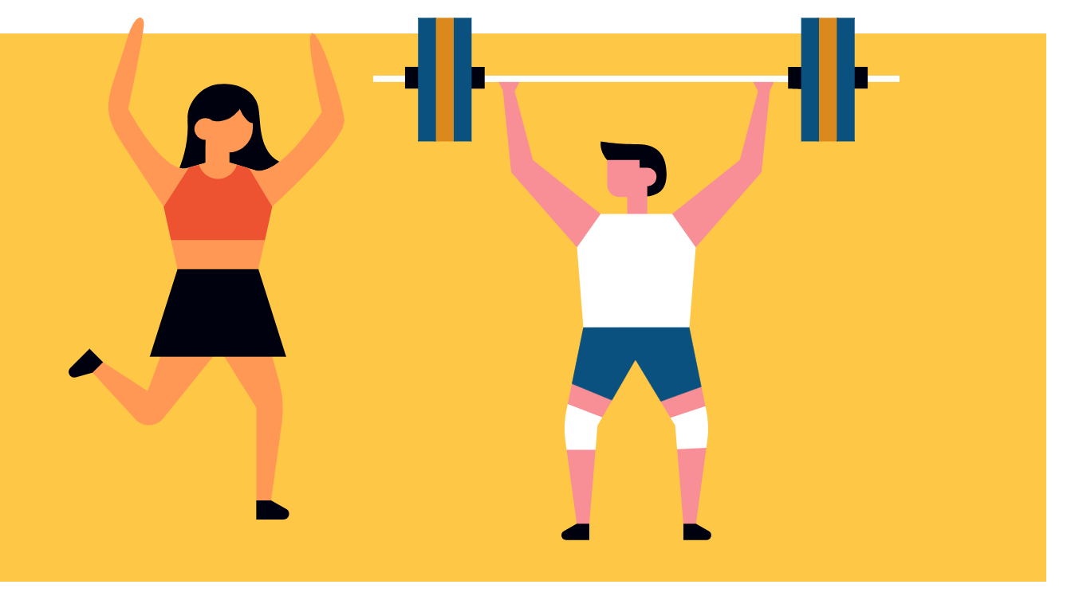
How does weight,calories burn, heart rate, and BMI are linked with genders?

Slide 9
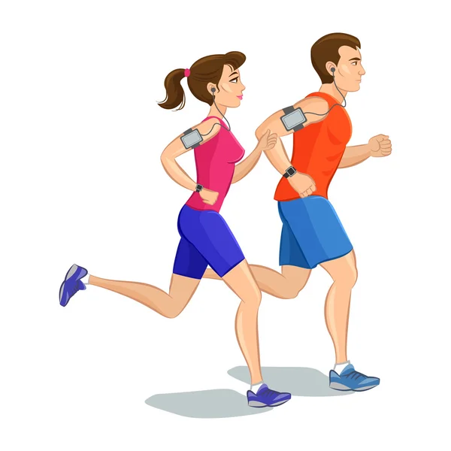

How does weight,calories burn, heart rate, and BMI for each gender compare together with ageing?

Slide 10
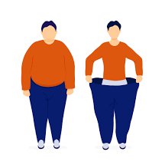

How does actual weight and dream weight correlate between different age groups?

Slide 11
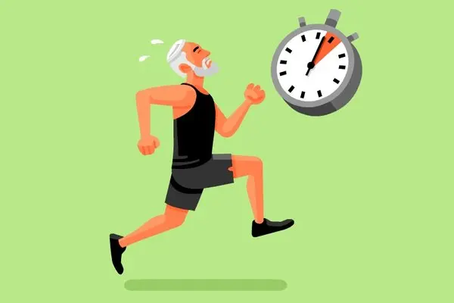
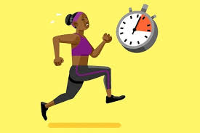
How does duration of exercise relate to age and gender ? could it indicate stamina level based on age/gender?

Slide 12
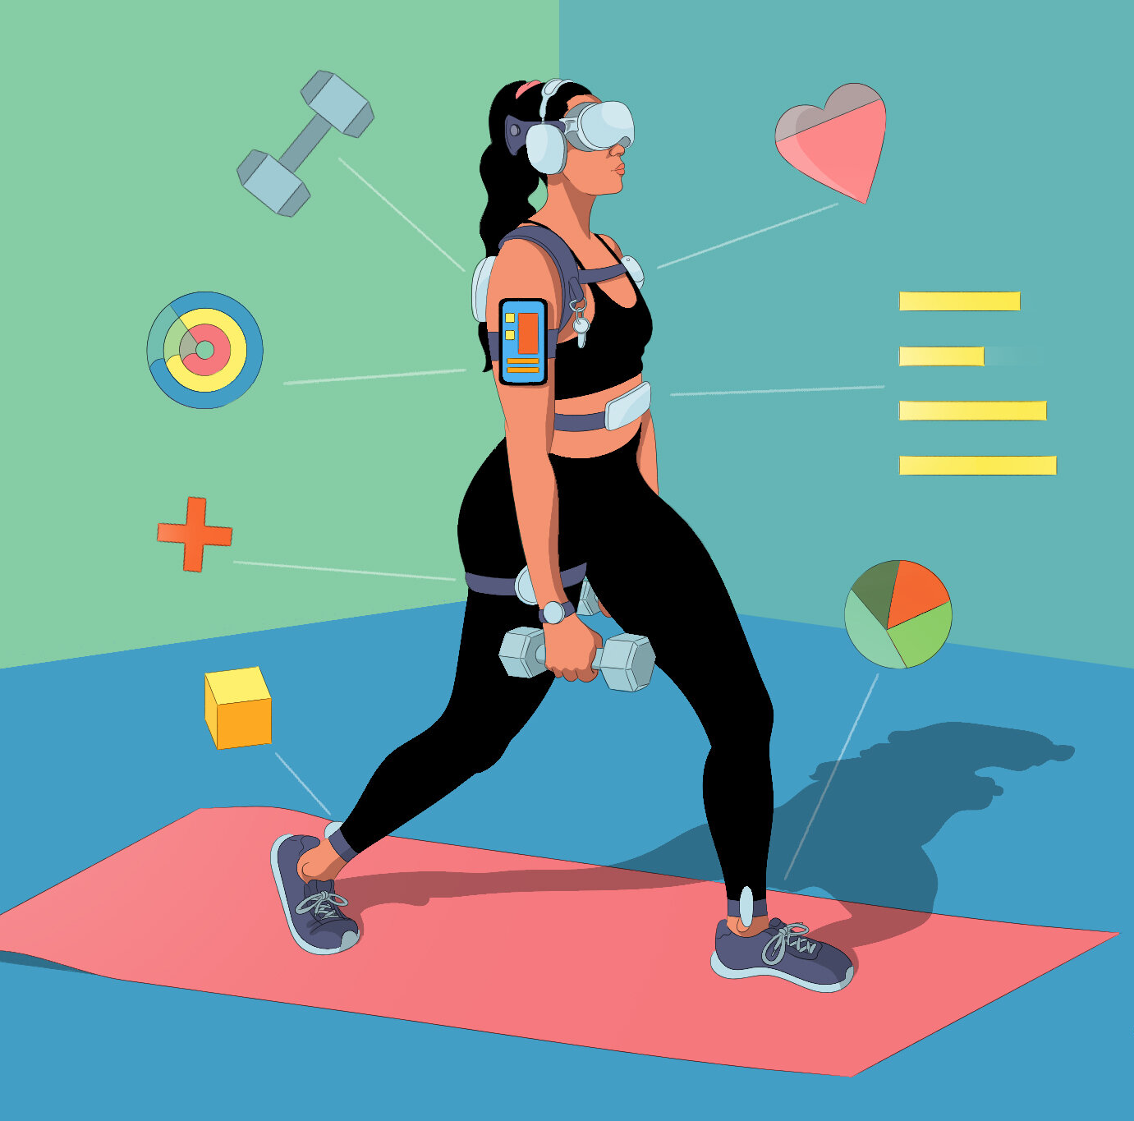
How does exercise intensity correlate with calories burned, heart rate?

Slide 13


Which exercise is more intensive? (consider the calories burn, duration, HR, Exercise intensity)
Exercise 1 - Outdoor
Exercise 2 - Indoor

Slide 14
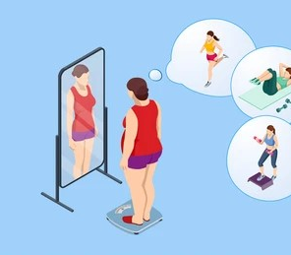
Which exercise will be more effective for achieving the dream weight?

Slide 15

Final Conclusions:
In conclusion, our final project has provided valuable insights into various aspects of exercise, weight management, and their relationship with age and gender. By understanding these relationships, we can develop more tailored and effective strategies for promoting health and well-being across diverse populations.

Slide 16
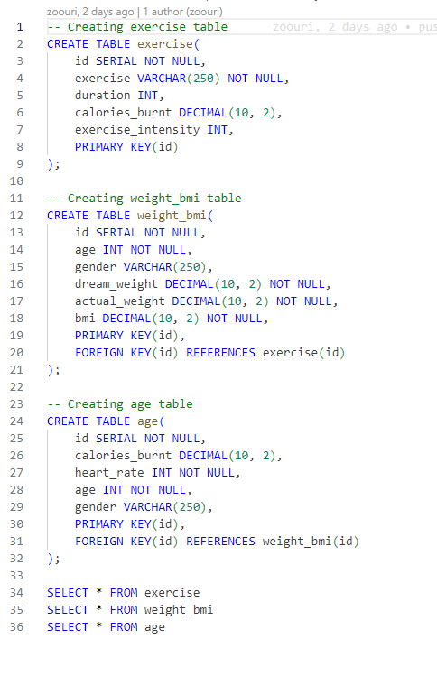
How did we get here?
This code creates three tables for tracking exercise, weight, and age-related data:
Exercise Table: Stores information about exercises performed, including exercise name, duration, calories burnt, and intensity.
Weight_BMI Table: Records data related to weight and BMI, including age, gender, dream weight, actual weight, and BMI. It is linked to the Exercise table through a foreign key relationship.
Age Table: Stores data related to age and calories burnt during exercise, along with heart rate and gender. It is linked to the Weight_BMI table through a foreign key relationship.
Queries at the end retrieve data from each table for analysis.

Slide 17
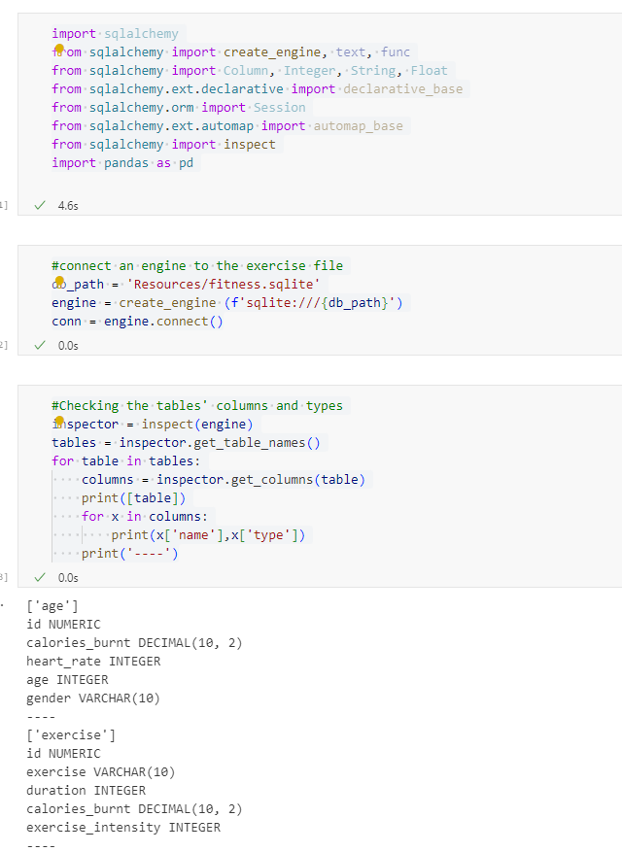
Digging deeper
Importing Libraries: Import necessary libraries including SQLAlchemy, pandas, and others.
Database Connection: Connects to a SQLite database file located at 'Resources/fitness.sqlite'.
Inspecting Tables: Utilizes the SQLAlchemy inspector to retrieve information about tables in the database, including their columns and data types.
Dataframe Creation: Creates pandas DataFrames from tables in the database (exercise_df, age_df, weight_bmi_df).
Data Inspection: Utilizes the .info() method to inspect the data types and structure of the DataFrames.
Printing DataFrames: Prints the DataFrames to display.

