Slide 1













Third Year Project Presentation
A WebGL educational website with Progressive Disclosure and AI Hint support for beginners.
-Xiao Fu

Slide 2

Why WebGL Matters
WebGL is a low-level graphics application programming interface (API) for the browser based on Open Graphics Library for Embedded Systems (OpenGL ES) 2.0, which allows developers to directly render interactive three-dimentional (3D) graphics in web pages without any plugins.
It powers many modern applications, such as online games, simulations, data visualizations, and virtual reality platforms.
Example Of 3D Model
Source:https://threejs.org/examples/#webgl_animation_skinning_additive_blending

Slide 3
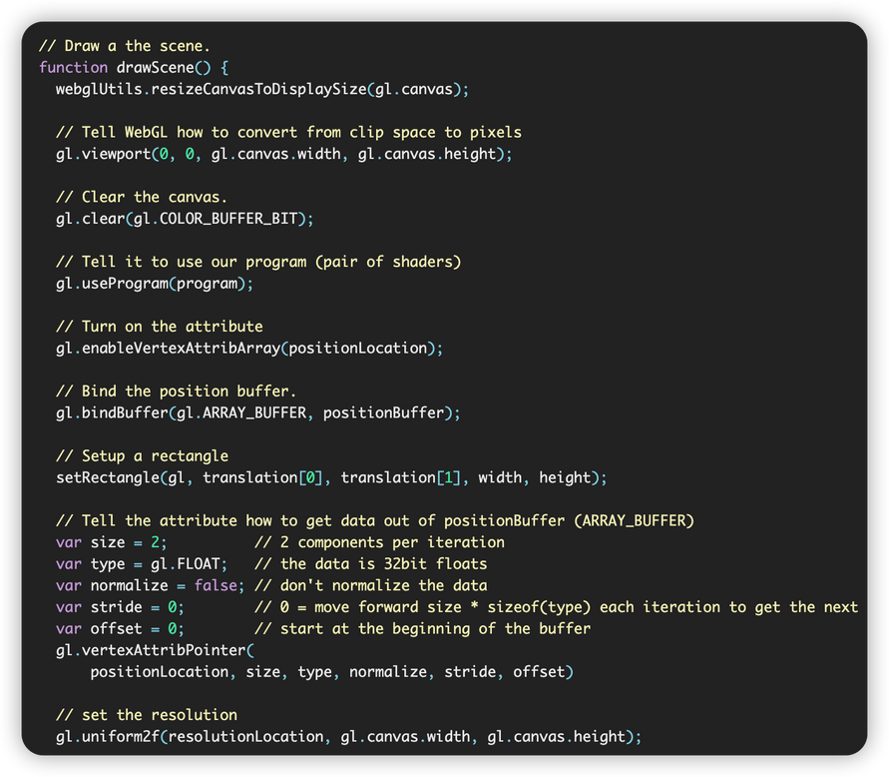
Challenges in Learning WebGL
Existing tutorials are too complex
Few beginner-oriented resources
High learning barriers
Complexed code snippets
Source: https://webglfundamentals.org/

Slide 4
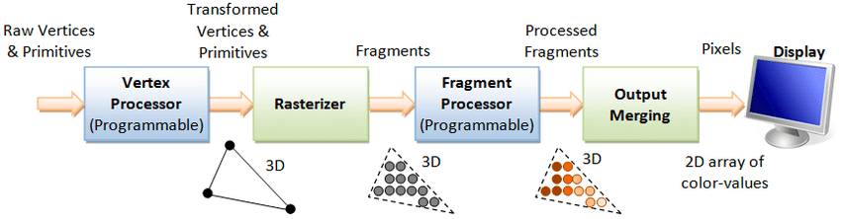
Why Start with Rendering Pipeline
Figure: OpenGL Rendering Pipeline. Source: He, Chaoyang & Li, Ming. (2019)
In computer graphics, the rendering pipeline is the core of all 3D graphics applications. It handles the critical task of converting geometric data into visual images on the screen and also serves as the first step for people to learn how to become skilled graphic programmers.
Key stages: Vertex Shader, Rasterizer, Fragment Shader, Output Merging and Displaying.

Slide 5
Project Highlights
Project Advantages: Beginner-friendly, Progressive Disclosure and Scaffolding prompts
Teaching Methods: Follow the rendering pipeline sequence, Step-by-step, Small-block Explanations, Small after-class exercises
Hint-GPT Prompt System: Stage-based Prompts and Scoring Feedback

Slide 6
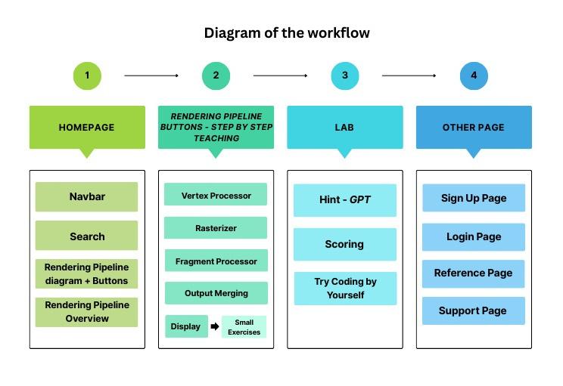
Website Structure Overview
Homepage: navbar, search box, entry point for rendering pipeline tutorials and some knowledge overview
Tutorials: step-by-step programming
Exercises: knowledge testing (short-answer and programming tasks)
Lab: code practice zone with instant AI Hint and Score mechanism

Slide 7
Website Function Demonstration
Navigation bar and search function
Step-by-step code Tutorial
Step switching function and file switching function
Run button mechanism and error console
Sign up and login module
GPT prompt System and Score Mechanism

Slide 8
Implementation Summary
Front-end: HTML, CSS, JavaScript
Backend: Use Node server to handle OpenAI GPT requests
Code editor: Import CodeMirror
Run mechanism: Via Blob + iframe to execute user-written code
Error console: Via rewrites some code in an iframe, like: "console.log", "console.error"
Staged Hint-GPT System: Use Node.js in backend to integrate OpenAI API; Via "static text + gradual AI hint system" to help beginners' learning
Scoring System: Deduct based on the Hint button clicks to encourage users' self-practice, improve gamification
User system: Create sign up & login pages via LocalStorage

Slide 9
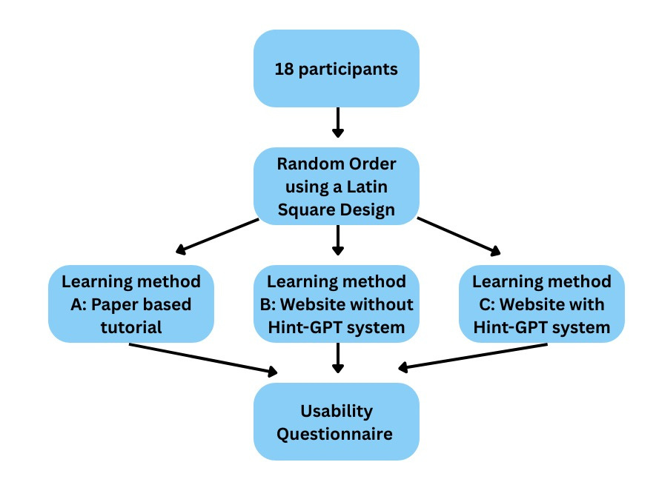
Experimental Validation
Fully-factorial within-participants design : small sample
& Latin square design: reduce order effects
18 participants, 3 learning methods:
Method A: Paper-based learning material
Method B: Using the website without the Hint system
Method C: Using the website with the Hint-GPT system
Use questionnaire (SUS+Self-rated background questions) after each method to test usability and learning experience
The results validated the effectiveness of the Hint-GPT assisted learning website
Questionnaire survey Flowchart

Slide 10
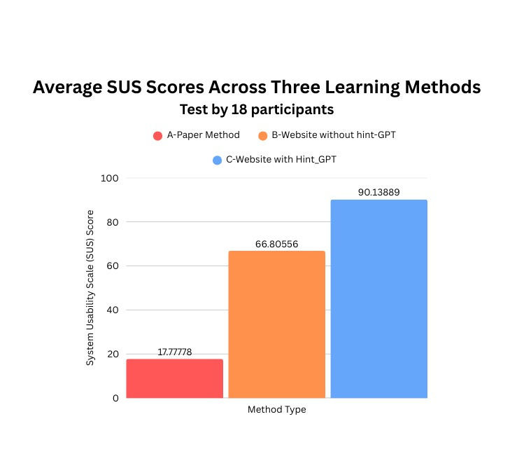
SUS Score Comparison
Method C (with Hint-GPT) scored 90.14.
Significantly higher than Method A and B.

Slide 11
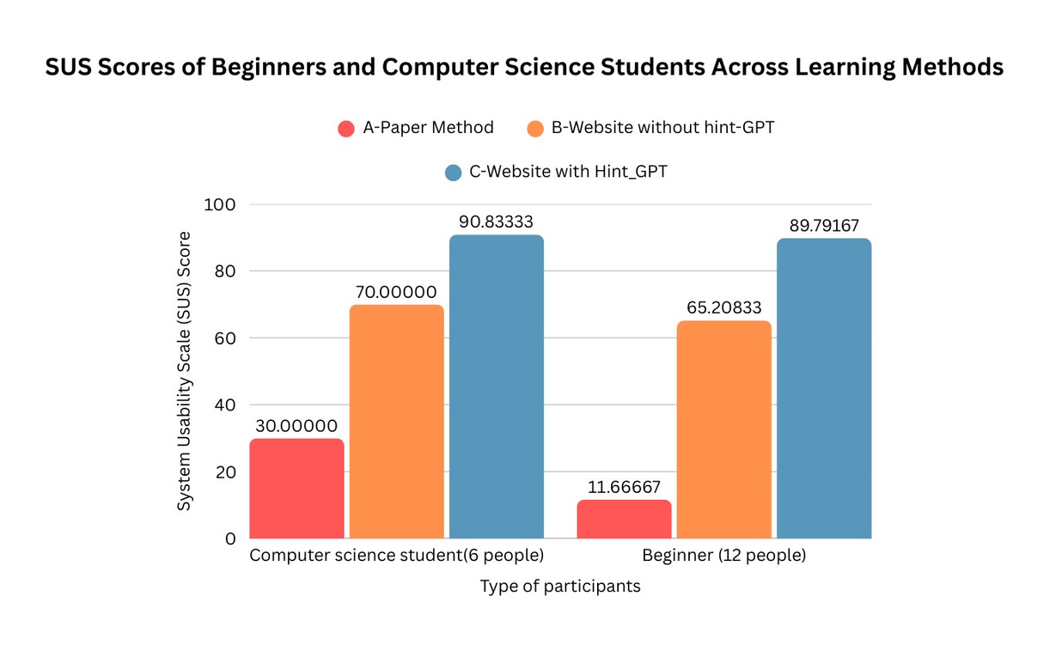
Group Analysis
Beginners vs Experienced Users
Beginners benefited significantly from AI Hint System.
Both erperienced and no experienced groups showed improvements.

Slide 12
Conclusion and Future Work
Summary:
The function of progressive disclosure and AI-assisted hint mechanisms effectively supports beginners and also benefits participants with a computer science background.
This project design improves both usability and accessibility for learners.
Future Improvements:
Integrate a real-time GPT-based Q&A system to provide instant support
Develop more advanced tutorials for users to learn
Expand the support for different file formats and coding tasks
Enhance the visual design, such as optimizing the colour scheme
Expanding Experiment Scale
Long-Term Learning Outcome Evaluation

Slide 13
Thank you very much!
Xiao Fu

