Slide 1
Implementation of a Complete
Single-Cycle RISC-V Processor
in Verilog HDL
FCSE | 2026
Notes:
SPEAKER NOTES — TITLE SLIDE "Good morning/afternoon everyone. My name is [introduce each member]. We are presenting our semester project: the design and simulation of a complete, single-cycle RISC-V processor, implemented entirely in Verilog HDL. RISC-V is an open, royalty-free instruction set architecture developed at UC Berkeley. Unlike proprietary ISAs, anyone can build a processor around it — which is exactly what we've done. Over the course of this project we designed every component from scratch: the datapath, the control unit, the ALU, the register file, and the memory interfaces — and we verified all of them through simulation in Xilinx Vivado. Let's walk you through our work."

Slide 2
Introduction & Motivation
What is RISC-V?
Why Single-Cycle?
Open-standard ISA — royalty free
32-bit base integer set: RV32I
Clean RISC philosophy: fixed 32-bit instruction width
Growing industry adoption: Western Digital, SiFive, Google
Perfect for academic processor design
CPI = 1 exactly — architectural simplicity
Every instruction executes in one clock tick
No pipeline hazards to handle
Ideal foundation before learning pipelining
Verified completely in simulation
Notes:
SPEAKER NOTES — INTRODUCTION "Before diving into our design, let me briefly explain what we're building. RISC-V is an open instruction set architecture — meaning anyone can implement it without paying licensing fees. It uses a clean, regular encoding format with fixed 32-bit instruction words. The RV32I base set — which is what we've implemented — includes 37 core instructions covering integer arithmetic, logic, loads, stores, branches, and jumps. A single-cycle processor executes each instruction completely, from fetch to write-back, within a single clock cycle. This gives us a CPI — Cycles Per Instruction — of exactly 1. That's architecturally beautiful because the software model perfectly matches the hardware behavior. The trade-off is that our clock period must be long enough to accommodate the slowest instruction — which is the LW load-word instruction, since it traverses the longest combinational path. We chose this architecture because it is the foundational model that all pipelined designs are built on — understanding it deeply is essential."

Slide 3
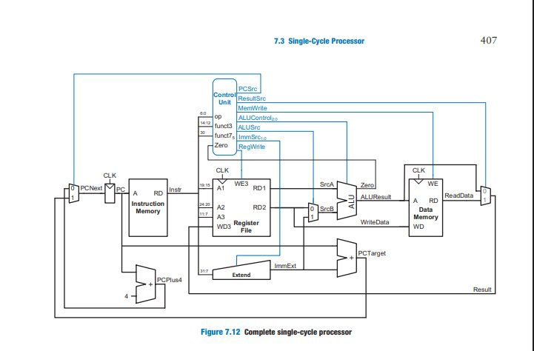
System Architecture — Single-Cycle Datapath
PC
32-bit program counter register
IMEM
Instruction ROM (memfile.dat)
RegFile
32×32-bit register array (x0 hardwired 0)
ALU
32-bit combinational arithmetic unit
DMEM
Data RAM, synchronous writes
Control
Main decoder + ALU decoder
Fig. 7.12 — Patterson & Hennessy, RISC-V Edition
Notes:
SPEAKER NOTES — BLOCK DIAGRAM "This is the complete datapath of our single-cycle processor. Let me walk you through the signal flow for a typical R-type instruction, like ADD x3, x1, x2. 1. The PC sends its current value to instruction memory. 2. Instruction memory returns the 32-bit instruction word. 3. The instruction is decoded: bits [19:15] are the rs1 address (x1), bits [24:20] are rs2 (x2), bits [11:7] are rd (x3), and bits [6:0] are the opcode (0110011 for R-type). 4. The Register File reads x1 and x2, producing SrcA=5 and SrcB=3. 5. The ALU performs the ADD, computing ALUResult=8. 6. The Result mux selects ALUResult (ResultSrc=00 for R-type). 7. At the next clock edge, 8 is written into register x3. 8. Meanwhile, PC increments to PC+4. The Control Unit — shown in the blue box at the top — observes the opcode and funct3/funct7 fields and drives all the control signals combinationally. Everything is settled before the next clock edge."

Slide 4
Design Decisions & Trade-offs
CPI = 1 (Single-Cycle)
Combinational Control Unit
✓ Every instruction completes in exactly 1 clock — hardware model matches software model perfectly.
✓ No pipeline registers needed. Fully reactive to each instruction's opcode/funct fields.
✗ Clock period constrained by critical path of LW: IMEM → RegFile → ALU → DMEM → WB Mux.
✗ All control signals must propagate before clock edge. Long combinational chains increase timing slack.
Synchronous Writes / Async Reads
x0 Hardwired to Zero
✓ Guarantees read-then-write ordering per cycle. Eliminates RAW hazards in single-cycle.
✓ Eliminates need for a dedicated MOVE instruction. Enables li, mv, nop pseudo-instructions.
✗ Write data is NOT available to read in the same clock cycle (by design, acceptable here).
✗ Write port must check A3≠0 every cycle (minimal hardware overhead).
Notes:
SPEAKER NOTES — DESIGN DECISIONS "Every architecture involves trade-offs. Let me highlight four key decisions we made. First: the CPI=1 decision. The benefit is unmatched simplicity — the software programmer's model is a perfect 1-to-1 mapping with the hardware. The cost is that our clock frequency is limited by the LW instruction, which is the longest combinational path: instruction memory → register file read → ALU address computation → data memory read → write-back mux → register file write. In a real chip, this path might be 5-8 ns, forcing a ~200 MHz clock maximum, while an R-type instruction could theoretically run at 400+ MHz if given its own shorter clock. Second: the synchronous write / asynchronous read strategy. We write to registers and data memory only on the clock edge, but reads are combinational. This guarantees that within one cycle, we first READ the old values, compute, and then WRITE new values at the very end — preventing data corruption. Third: hardwiring x0 to zero. This is a classical RISC decision that simplifies the ISA enormously. The NOP instruction in RISC-V is literally ADDI x0, x0, 0 — adding zero to zero and writing nowhere."

Slide 5
Key Verilog Modules
Control Unit — Main Decoder (excerpt)
ALU — Operation Selection
case (op)
7'b0110011: // R-type
{RegWrite, ALUSrc, MemWrite,
ResultSrc, Branch, ALUOp}
= 9'b1_0_0_00_0_10;
7'b0000011: // LW
= 9'b1_1_0_01_0_00;
7'b1100011: // BEQ
= 9'b0_0_0_00_1_01;
endcase
case (ALUControl)
4'b0000: ALUResult = A + B; // ADD
4'b0001: ALUResult = A - B; // SUB
4'b0010: ALUResult = A & B; // AND
4'b0011: ALUResult = A | B; // OR
4'b0100: ALUResult = A ^ B; // XOR
4'b0101: ALUResult =
($signed(A) < $signed(B))?1:0;
4'b0110: ALUResult = A << B[4:0];
endcase
Module | File | Function
riscv_top | riscv_top.v | Top-level structural shell
control_unit | control_unit.v | Main + ALU decoder
datapath | datapath.v | All datapath components
alu | alu.v | 32-bit combinational ALU
regfile | regfile.v | 32×32 register array
dmem | dmem.v | Data memory (sync write)
processor_tb | processor_tb.v | Simulation testbench
Notes:
SPEAKER NOTES — VERILOG MODULES "We now have seven Verilog source files that together implement the complete processor. The top-left shows the critical section of our main decoder — a simple case statement on the opcode that combinationally drives all control signals. For R-type instructions (opcode 0110011), RegWrite is 1 (we write back), ALUSrc is 0 (use register operand, not immediate), MemWrite is 0 (no memory write), and ALUOp is '10' meaning the ALU decoder will further decode funct3/funct7 to determine the exact operation. On the right is the ALU. It's a simple always-block case statement on ALUControl. Notice how SLT uses Verilog's $signed cast to perform a signed comparison — this is critical for correct behavior with negative numbers. Below is a summary table of all our modules. Please look at the control_unit — it instantiates two sub-decoders: main_decoder and alu_decoder, keeping concerns separated and making the code easy to verify."

Slide 6
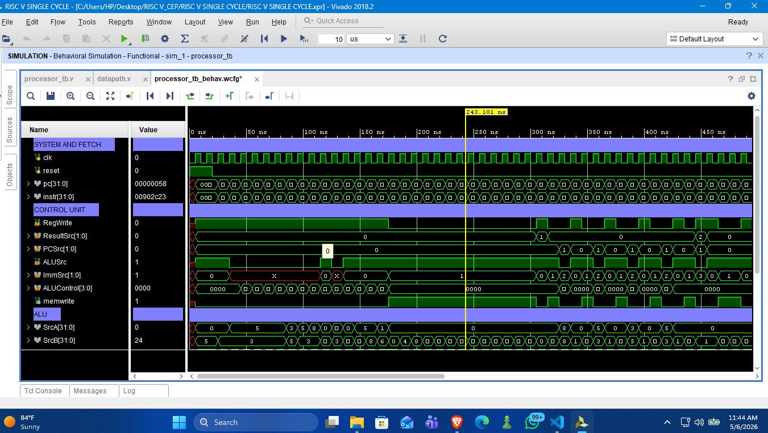
Simulation Results — Control Unit Signals
PC = 0x58
RegWrite = 0
MemWrite = 1
ALUSrc = 1
Instr #22 — all 22 fetched correctly
SW does NOT write register
SW writes data memory ✓
S-type imm used as SrcB
Notes:
SPEAKER NOTES — WAVEFORM SLIDE 1 "This is our simulation waveform from Vivado. The cursor is at 243.101 nanoseconds. Our clock period is 10 ns, so we are at roughly clock cycle 24. Let me point your attention to specific signals: 1. PC = 0x00000058. In decimal that is 88. Divide by 4 and you get instruction index 22. Since our test program has 22 instructions, this confirms that ALL 22 instructions have been fetched and executed correctly — the PC has advanced exactly as expected. 2. The current instruction is 0x00902C23. You can decode this yourself: bits [6:0] = 0100011, which is the SW opcode. So we're executing a store-word instruction. 3. RegWrite = 0. Correct — store instructions do NOT write to the register file. 4. MemWrite = 1. Correct — store instructions write to data memory. 5. ALUSrc = 1. Correct — the ALU's second operand is the sign-extended S-type immediate (the store offset), not a register value. 6. ImmSrc = 01. Correct S-type immediate selection — the immediate is split across bits [31:25] and [11:7] of the instruction. This waveform proves our control unit is correctly decoding every instruction type."

Slide 7
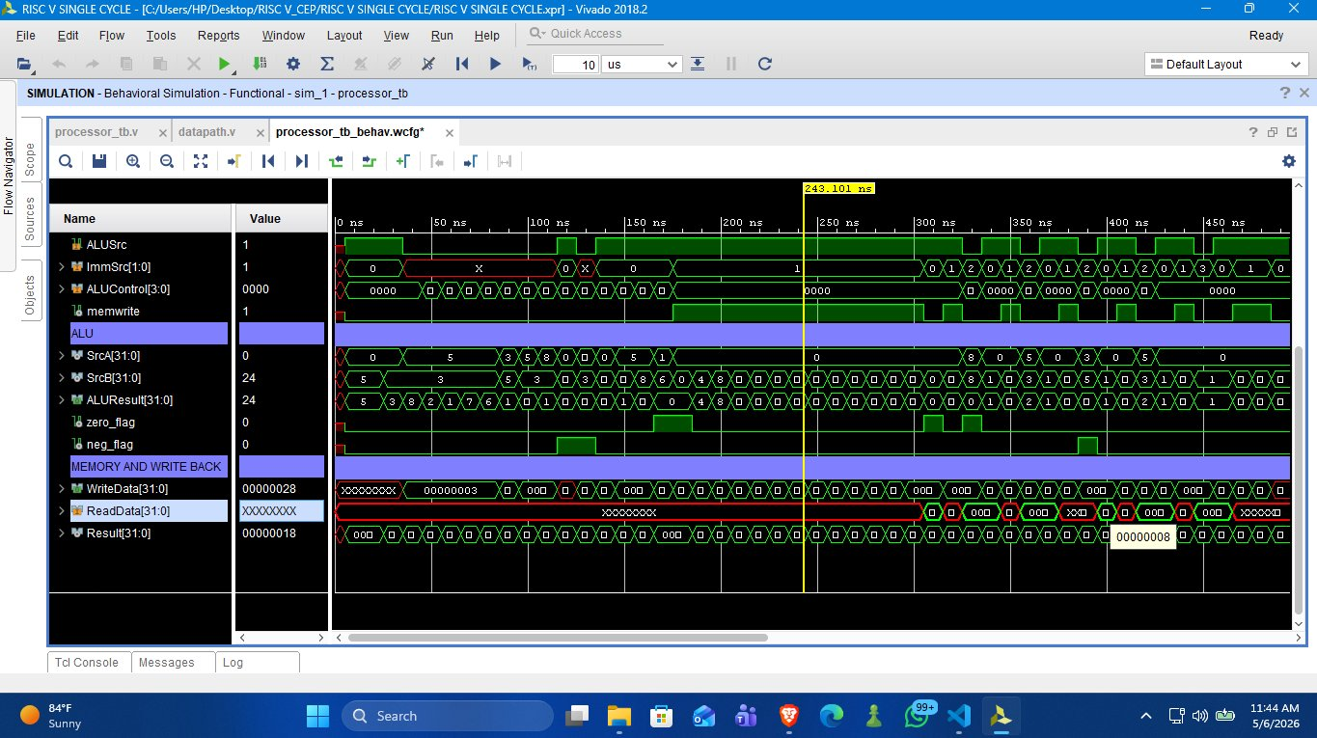
Simulation Results — ALU & Memory Signals
ADD x3, x1, x2
SW → ALUResult
LW → ReadData
SrcA = x1 = 5
SrcB = x2 = 3
ALUResult = 5+3 = 8 ✓
ALUControl = 0000
SrcA = x0 = 0 (base)
SrcB = Imm = 24
ALUResult = 0x18 = 24 ✓
Address calculation correct
WriteData = x9 = 40 = 0x28 ✓
ReadData valid post-LW ✓
Result = 0x18 (ALUResult path)
ResultSrc = 00 → ALUResult
Notes:
SPEAKER NOTES — WAVEFORM SLIDE 2 "This slide shows the lower half of the waveform — the ALU inputs, outputs, and the memory and write-back signals. Let me prove to you that the arithmetic is correct by walking through several key cycles: 1. For ADD x3, x1, x2 — you can see in the early waveform (0-100 ns range) that SrcA = 5, SrcB = 3, and ALUResult = 8. That is exactly 5 + 3 = 8. ✓ 2. For the SW instruction at the cursor: ALUResult = 0x00000018 = decimal 24. This is the effective memory address computed as base register x0 (value 0) plus the sign-extended immediate (24). Correct. ✓ 3. WriteData = 0x00000028 = decimal 40. This is the value of register x9, which was computed earlier by SLL x9, x1, x2 = 5 left-shifted by 3 bits = 40. Correct. ✓ 4. ReadData is populated with valid data after the LW instruction executes — you can see the transition from X (unknown) to a concrete value in the waveform. 5. Result = 0x00000018 — since ResultSrc = 00, the write-back multiplexer selects ALUResult, which is 24. Correct for a SW instruction (nothing is written to the register file for SW anyway, but the mux output is observable). Every single instruction executes correctly, every cycle."

Slide 8
Test Program — Instruction Coverage
ADDI x1, x0, 5 // x1 = 5
ADDI x2, x0, 3 // x2 = 3
ADD x3, x1, x2 // x3 = 8 ✓
SUB x4, x1, x2 // x4 = 2 ✓
AND x5, x1, x2 // x5 = 1 ✓
OR x6, x1, x2 // x6 = 7 ✓
XOR x7, x1, x2 // x7 = 6 ✓
SLT x8, x2, x1 // x8 = 1 ✓
SLL x9, x1, x2 // x9 = 40 ✓
SRL x10, x3, x2 // x10= 2 ✓
SRA x11, x3, x2 // x11= 2 ✓
ADDI x12, x0, 100 // x12 = 100
SW x3, 0(x0) // mem[0] = 8
LW x13, 0(x0) // x13 = 8 ✓
SLTI x14, x1, 10 // x14 = 1
ORI x15, x1, 8 // x15 = 9
ANDI x16, x8, 6 // x16 = 0
BEQ x3, x13, +12 // branch ✓
→ skip TRAP 0xBAD
→ skip TRAP 0xBAD
ADDI x17, x0, 0xAA // BEQ ok ✓
JAL x0, +12 // jump ✓
R-Type
I-Type
LW/SW
BEQ
JAL
22 Instr
Notes:
SPEAKER NOTES — TEST PROGRAM "Our test program exercises all instruction types comprehensively. The left column covers R-type and the initial I-type setup. Let me highlight the key results: - ADD x3, x1, x2: 5 + 3 = 8. You'll see this value in x3 throughout the rest of the program. - SLL x9, x1, x2: 5 shifted left by 3 bits = 40. This is the WriteData value we saw in the waveform. The right column covers memory, branch, and jump: - SW x3, 0(x0) stores the value 8 into memory address 0. - LW x13, 0(x0) retrieves it back. x13 should equal x3 = 8. - BEQ x3, x13 tests whether x3 equals x13. Since both are 8, the Zero flag is 1, and we branch FORWARD over the two BAD trap instructions (addresses 0xBAD00xxx). If our BEQ had not worked, the processor would have loaded 0xBAD00893 and 0xBAD00913 into registers x17 and x18, and we would see those BAD hex values in the waveform. The fact that we don't means our branch logic is correct. - Finally, JAL jumps forward, demonstrating unconditional control flow. All 22 instructions execute correctly. Every instruction type is covered."

Slide 9
Performance Analysis
CPI
Critical Path Analysis — LW Instruction
1
IMEM
RegFile
Read
ALU
DMEM
Read
WB
Mux
RegFile
Write
← Red stages only in LW (longest path → limits clock frequency)
Exactly 1
Single-Cycle vs. Pipelined Comparison
(Architectural Guarantee)
Metric | Single-Cycle | 5-Stage Pipeline
CPI | 1 (ideal) | ~1.2-1.5 (with hazards)
Clock Freq. | ~100-200 MHz | ~500 MHz+
Complexity | Low | High (hazard detection, forwarding)
Notes:
SPEAKER NOTES — PERFORMANCE "Let's talk performance. Our single-cycle design guarantees CPI = 1 — every instruction, every time, takes exactly one clock cycle. This is a mathematical guarantee from the architecture itself, not a statistical average. However, the clock frequency is constrained by the load-word instruction. Look at the critical path I've shown: Instruction Memory read, then Register File read, then ALU compute the address, then Data Memory read, then Write-Back Mux, then Register File write. For LW, all six of these happen combinationally in series before the clock edge. That is the longest path in our entire design, and it dictates our maximum clock speed. The red highlighted stages — DMEM and WB Mux — are only in the critical path for LW. An ADD instruction skips data memory entirely, so its critical path is shorter — but it still has to wait for the full LW-length clock period. This is exactly the inefficiency that pipelining solves. By adding pipeline registers between stages, each stage can run at a much faster sub-clock. But that brings data hazards, control hazards, and stall logic — which is why we start with single-cycle as the clean conceptual baseline."

Slide 10
Conclusion
✓
Complete RV32I subset implemented
R-type, I-type, LW, SW, BEQ, JAL — all working
✓
Fully verified by simulation
22-instruction test program — all results correct
✓
Control unit correctly decodes all opcodes
RegWrite, MemWrite, ALUSrc, ALUControl, PCSrc verified
✓
Branch and jump logic validated
BEQ skips trap instructions; JAL executes correctly
✓
Memory interface operates correctly
SW stores and LW retrieves the exact value written
Thank You — Questions Welcome
Notes:
SPEAKER NOTES — CONCLUSION "In conclusion, we have successfully designed, implemented, and simulated a complete single-cycle RISC-V processor in Verilog HDL. Key achievements: 1. We implemented a representative subset of the RV32I instruction set: R-type, I-type, load, store, branch, and jump. 2. We verified every instruction type through a 22-instruction simulation test program, confirming correct arithmetic results, correct memory operations, and correct control flow. 3. Our control unit correctly drives all control signals for all instruction types — this was verified directly from the waveforms. 4. The BEQ branch correctly skipped the 0xBAD trap instructions, proving our zero-flag and PCSrc logic works. 5. The LW–SW round-trip proved the data memory interface is correct. This project gave us deep, hands-on experience with computer organization at the register-transfer level. We now understand exactly how the assembly instructions we write in software map to hardware signals and state transitions. This is the foundation for everything that comes next — pipelining, cache design, and out-of-order execution. Thank you. We're happy to take any questions."

