Slide 1

CS 532 Intelligent computing
“GA-ANFIS and CRNN for Mental Attention State Classification using Passive BCI-based EEG data”
Zoraiz Qureshi (21100130) & Syed Ali Hassan Bukhari (21100187)

Slide 2
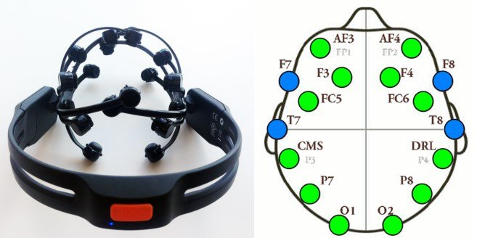
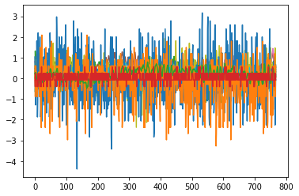
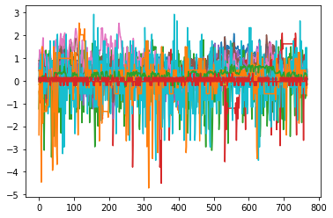
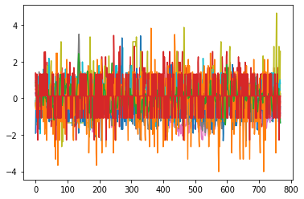
INTRODUCTION
Frequency bands at certain lobes of the brain associated to mental attention states
EEG-based Brain Computer Interface (BCI) data from Brainwear devices/headsets from simulations/experiments
Classify attention states as ‘focused’, ‘unfocused’ or ‘drowsy’ from EEG signal data trials
focused unfocused drowsy

Slide 3
MOTIVATION & LITERATURE REVIEW
Monitoring control tasks where high focus and concentration levels
Detection of driver fatigue or classroom student attention
Stress states - LDA, KNN, SVM, Naive Bayes, and Decision Trees (Bozhkov et. al.)
Attention state classification with SVM (96.7% best 91.72% avg) with dataset (C.I. Acı et. al.)
Realtime 4-class emotion recognition with SVM (Mian M. Awais et. al.)
End-to-end convolutional neural networks (Fahimi F et. al.)
Different preprocessing techniques – HFD, STFT, dimensionality reduction with SFS, data augmentation with GANs

Slide 4
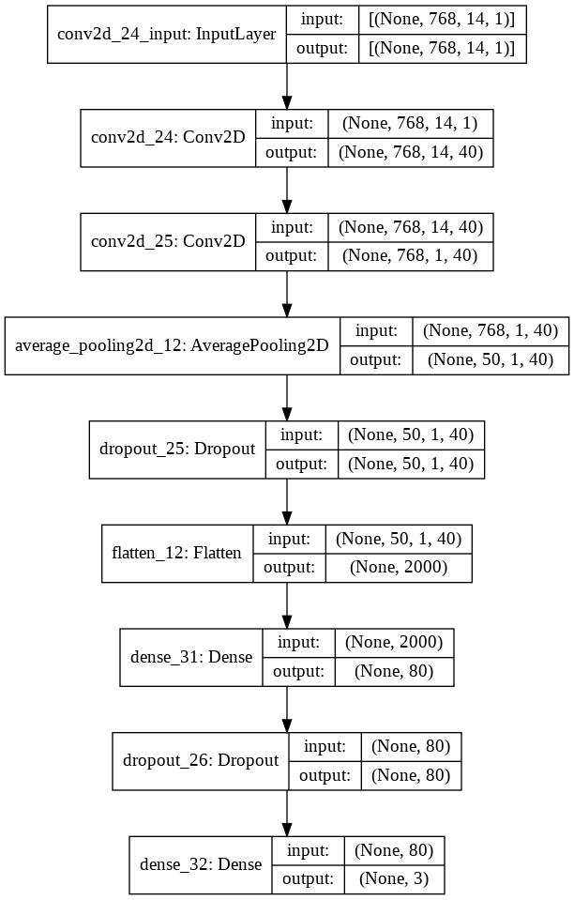
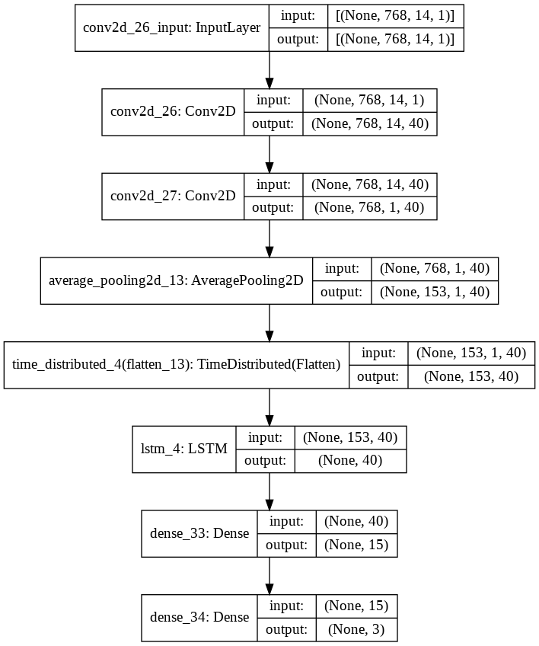
CNN & CRNN Design
Shallow 2D CNN & CRNN network variants (tested on MI-EEG data by Hauke Dose et. al)
6s (768 steps) 14-channel trials from 24 experiments for 5 associated subjects shuffled class-wise (dataset C.I. Acı et. al.), categorical cross-entropy
Pool strides, regularization, dense layers, lr, epochs, filter numbers, LSTM cells
80-20 train-test, batch size 16, ~430 samples per class except drowsy 3x
Per-channel mean-std feature scaling

Slide 5
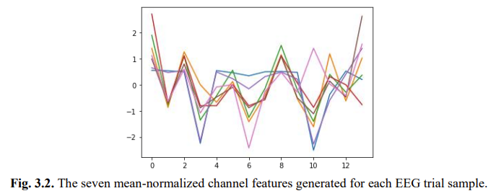
HYBRID ANFIS Design
Gaussian membership functions, Takagi-Sugeno ANFIS model, RMSE loss
7 features generated from per-channel pre-processing: Number of zero crossings, SVD entropy, Perm entropy, App entropy, Petrosian’s and Higuchi’s fractal dimension.
Single or combinations of features used for each channel (14, 28 … inputs).
Genetic algorithm used to determine the number of rules – with training as a loss minimization function
Binary classification (focused vs unfocused)

Slide 6
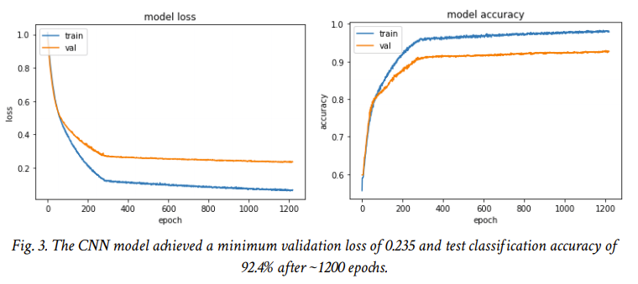
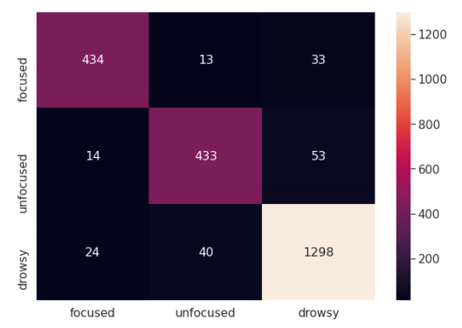
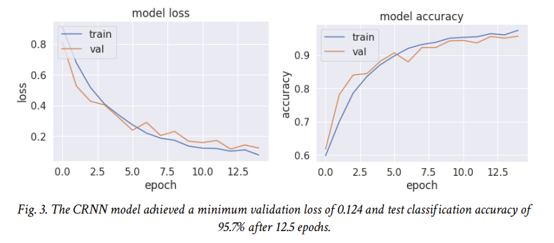
RESULTS – CNN & CRNN

Slide 7
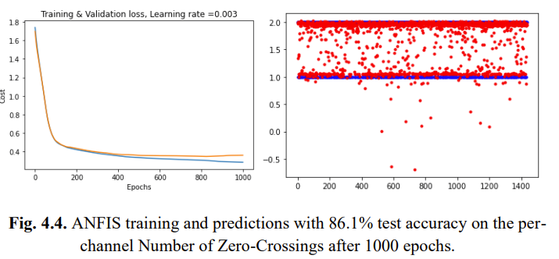
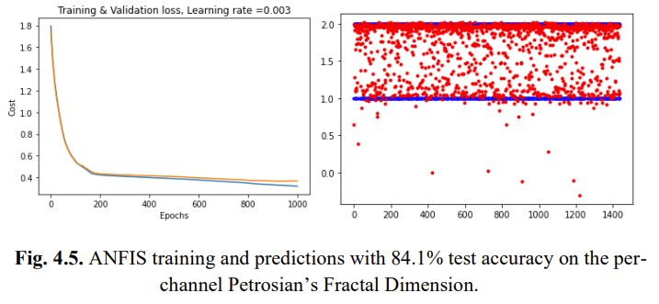
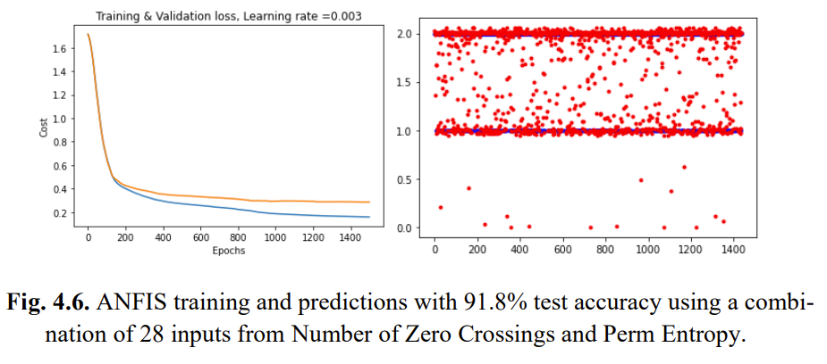
RESULTS – HNGFS

Slide 8
DISCUSSION & FUTURE WORKS
C.I. Acı et. al. achieved 96.70% (best) and 91.72% (avg.) – experimental classification accuracy using SVM on 3-class
Shorter time length trials quicker and responsive predictions - real time mental attention state classification. Optimization can be further done
5-fold cross validation and denoising filters such as high band pass ones can be tested.
More membership function types beyond Gaussian to be tested for HNGFS.
L1 regularization, and other optimization e.g. ABC, more optimizers other than Adam
More combinations of pre-processing must be tested for the HGNFS

Slide 9
CONCLUSION
Hybrid neuro-genetic fuzzy - 91.8% test accuracy for binary classification (focused vs unfocused).
Used various pre-processing techniques and a combination of Zero Crossings, Perm Entropy and PFD was used, with Zero Crossings + Perm Entropy performing the best.
Shallow CNN and CRNN – CRNN with 95.7% on 3-class classification with focused, unfocused and drowsy states.
Used raw EEG signal data.
Responsive: Trial lengths of 6 seconds.

