Slide 1
Color Descriptors
Zoran Kostovski 221522

Slide 2
Types of Color Descriptors
Color Moments
Color corellogram
Color Histogram

Slide 3



Testing Phase
Scaling results in a range of (0,1]
Transforming raw results into quantifiable and easy to understand scale.
3 Methods for 3 Models

Slide 4
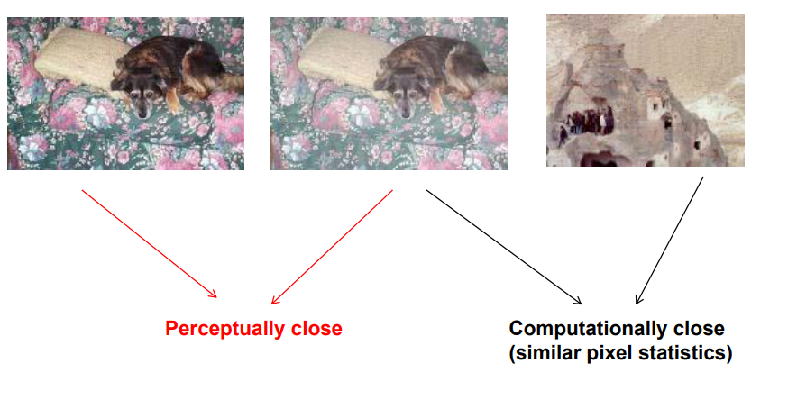
Computational Similarity Vs Perceptual Similarity
Computational similarity relies on comparing data or parameters in order to give result
Perceptual similarity is how people perceive the share likeness of images.
Often Computational similarity is different from perceptual and in some cases images can be almost identical to a person but will yield terrible results when compared using an algorithm.

Slide 5
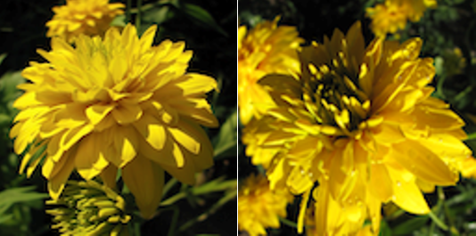
Model 1 Results

Slide 6
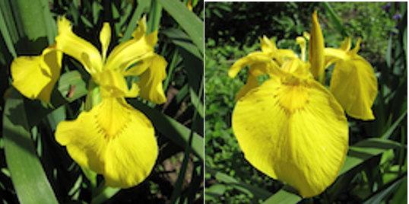
Model 2 Results

Slide 7
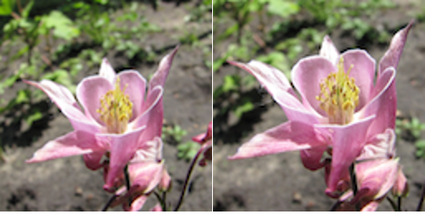
Model 3 Results

Slide 8
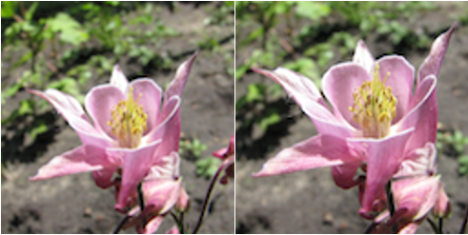
Combined Results
Scale is [0,3)

Slide 9
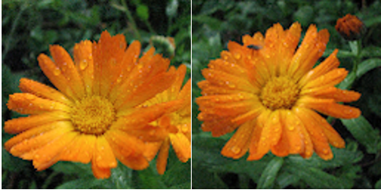
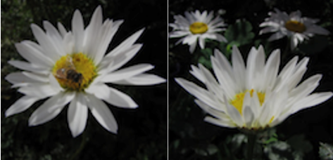
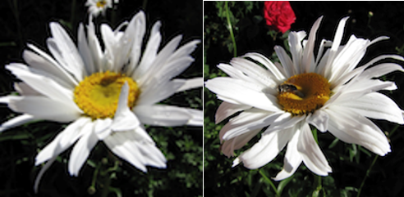
Combined Results

Slide 10
Advantages and Drawbacks
Good at images shot in similar way
Good at images whose defining factor is color ( eg. Flowers)
Can be bad at determining perceptually close images

Slide 11
How to Get Better Results
Add weights to the models
Combine other algorithms that focus on different aspects ( shape, texture, pattern, etc.)
Use a learning algorithm and train it

Slide 12
Thank You for Your Attention!

