Slide 1

Welcome
To
EXPERT

Slide 2
ABOUT EXPERT APPLICATION
We are looking to create an app which makes a good connection between students, Parents and teachers. We are building an app which is reliable for teachers, students & parents. You can use this app in school, colleges and universities. Using this app teacher can give assignments and other study materials to the students. It is the fast way to take attendance of the students, to share study problem with teachers, to check the grades etc.

Slide 3
WHY WE MAKE THIS
In this app teacher can give assignments to students anytime ,even if teacher is absent .
This app is time saving for Students ,Teachers and Parents.
We are making this app not only for students and teachers but also for PARENTS of students . In this app parents can check the grades , attendance etc of their children. Parents can chat with their children teachers .
Teachers also provide notes and study materials to students for their exam . So that can easily prepare their exam .

Slide 4
GOAL OF APPLICATION
What are we trying to solve ?
We are trying solve the gap among parents, students and teacher. Now a
Days we see that parents don’t have enough time know about their children
Performance in School, College etc.
Clear Goal :
Goal of our app to make study more convenient . Student get every information about their study at one click he/she not have to make any note. Parents get every single updates about their children performance in the study. Students cannot hide anything from their parents .

Slide 5
STAKEHOLDERS KNOWN
Who will use your app ?
Student use this app because this app is very useful for their study. They also get every single detail about college, course, teachers etc
Teachers use this app to give things online to their student and they can easily get connected any student parents .They can also take attendence in easy way.
This app is very useful for parents . Parents can easily check the performance of their children and they can get monthly overview of teacher that teach in the class.

Slide 6
STAKEHOLDERS KNOWN
Why would they use your app ?
It will save a lot of time .
Parents do not need to go their children school . They can check their children activities in single click.
Students get information about their course subjects and assignment .
To know the latest news and other activities of the college .

Slide 7
COMPETITION KNOWN
Who made what ?
Name : OMNIVOX
Seller : Skytech Communications Inc.
Category : Education
Compatibility Requires : iOS 8.0 or later. Compatible with iPhone, iPad and iPod touch.
languages :French, English, Spanish
Our Application
Name : EXPERT
Team : PerfectMates Communication Inc.
Category : Education
Compatibility Requires : iOS 8.0 or later. Compatible with iphone,iPad and iPod touch
Languages : French, English, Spanish Etc.

Slide 8
COMPETITION KNOWN
What is good about Omnivox ?
Omnivox has a lot of features like :
1) Your course schedule 2) Lea features, such as: - lesson plans - class documents - assignments - class calendars - evaluation notes 3) Mio messages with your teachers and fellow students 4) final grades 5) The latest news and activity calendar of your institution

Slide 9
COMPETITION KNOWN
What is bad about theirs ?
No doubt Omnivox has a lot of features But we know that every thing in this world
Has same pros and cons so, Omnivox has some cons :
Design is not good
Don’t have option to log in as parent
Student can not know about teacher education and experience.
Don’t have feature to take attendance.
It contains only 3 languages.

Slide 10
Features
New features
Course Schedule
Message Box
Calendar with everyday college
schedule
Course Document
Grades
Latest News & Events
Feedback to teacher by students
College and course details
Know about teacher
Login as parent
Reminder
Attendance
Suggestion Box
Teacher Updates
Assignment
Details about Teacher

Slide 11
MORE ABOUT NEW FEATURES
Login as parent :
Parents can check the every activity of their children like GRADES, BEHAVIOUR, CLASS ACTIVITIES and also CHAT with the teachers about their children.
Reminder :
Reminder is very helpful for students, Parents and Teacher. If any student forget to submitted the assignment then he/she get a notification sometime before the deadline and Exam. Teacher also get notification if teacher set any type of remainder NOT personal.

Slide 12
MORE ABOUT NEW FEATURES
Attendance :
Teacher do not need to say every student name in the class and mark their attendance. Teacher just write a code on board and set time and date. Then student mark their attendance by sending that particular code.
Suggestion Box :
If any student not doing well in the studies or any issue regarding student then teacher can give suggestion to their parents.
For example: if the behavior of student is not good in class then teacher can Inform to their parents that “Behavior of your child not good please ask him/her why he/she behave like this.”

Slide 13
MORE ABOUT NEW FEATURES
Teacher Updates :
Teacher have to give every monthly report to the parents, things that he/she teach in the class and When ever parents required.
Assignment :
If any student is absent in the class when teacher give the assignment then he/she can’t get that assignment. It is up to teacher if he/she want to send assignment to all students or present students in class.

Slide 14
MORE ABOUT NEW FEATURES
Details about Teacher :
Teachers Fill some personal detail about them like name, their education, experience . So, parents and student know about teacher experience and education.

Slide 15
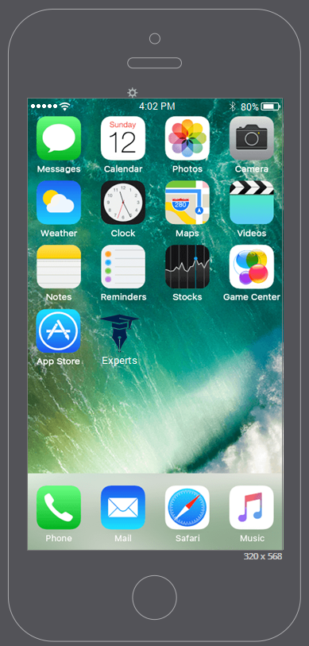
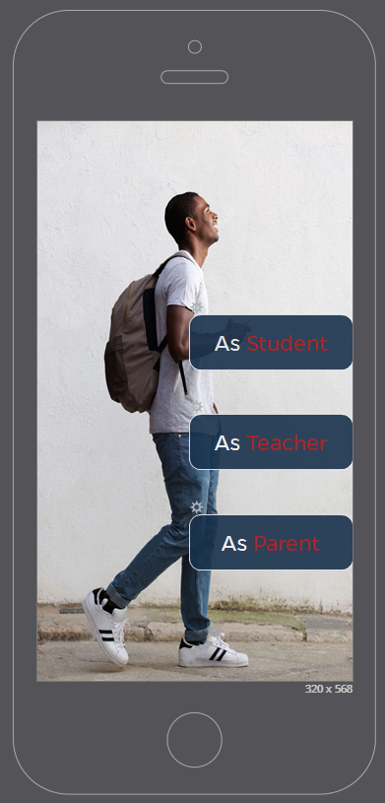
SOME SCREENSHOTS
Screen
First Page

Slide 16
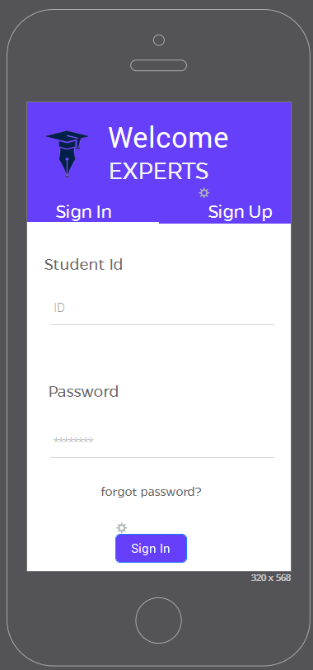
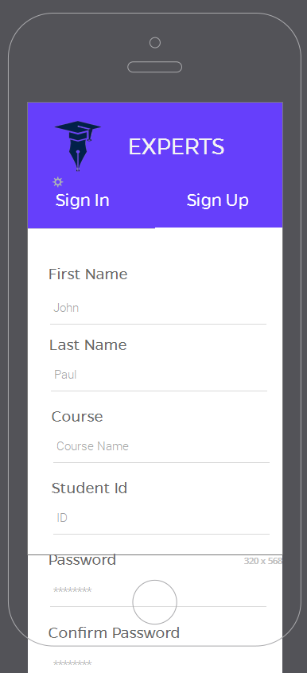
SOME SCREENSHOTS
Sign in
Sign up

Slide 17
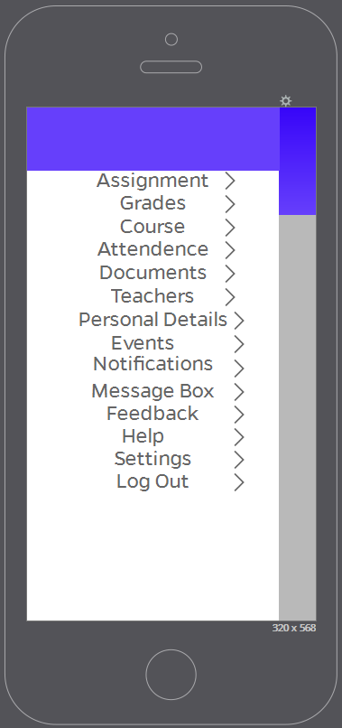
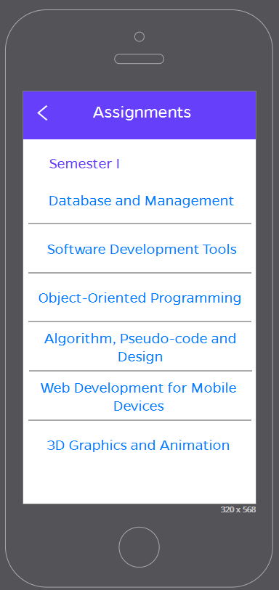
SOME SCREENSHOTS
Side Bar
Assignment

Slide 18
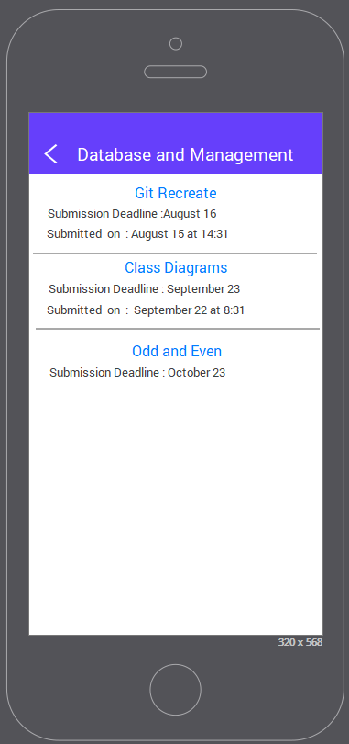
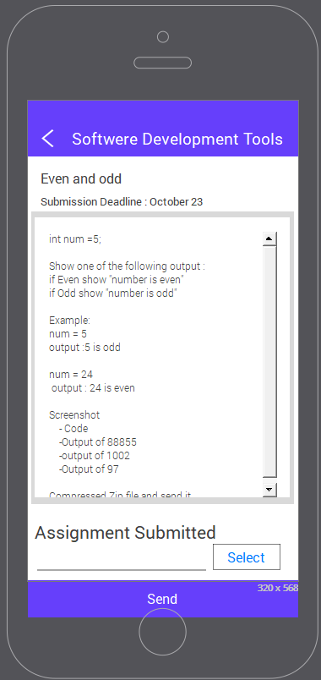
SOME SCREENSHOTS
Subject Assignment
Particular Assignment

Slide 19
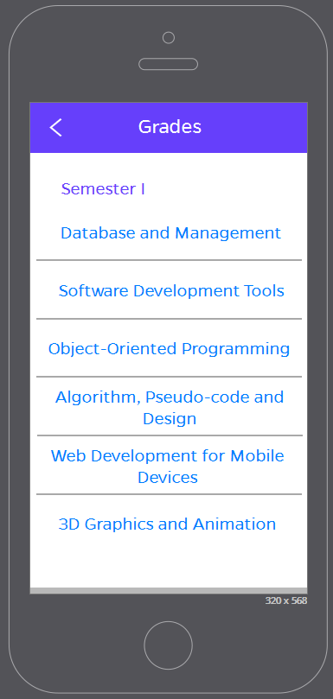
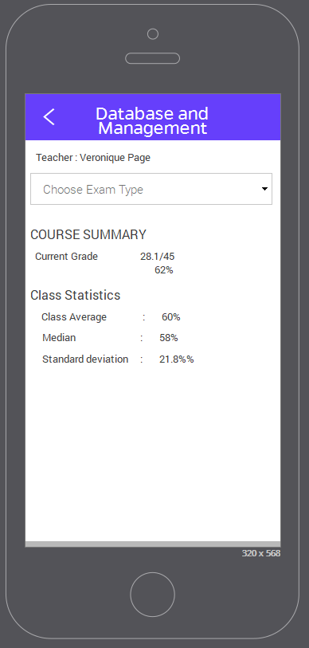
SOME SCREENSHOTS
Grades
Grades of single subject

Slide 20
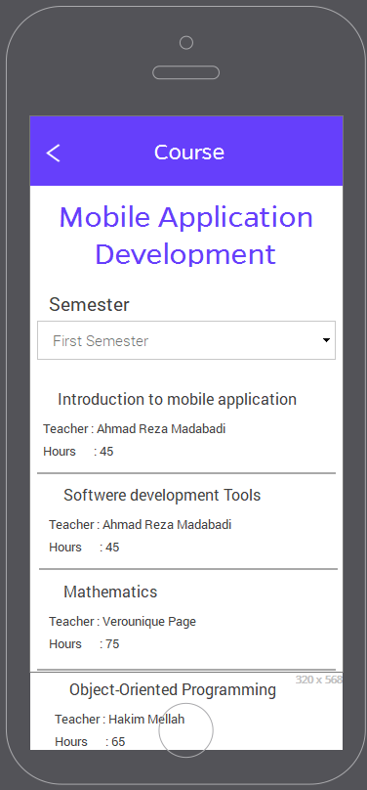
SOME SCREENSHOTS
Here Students check about their course subjects
like how many subjects in this course, how many hours.

Slide 21
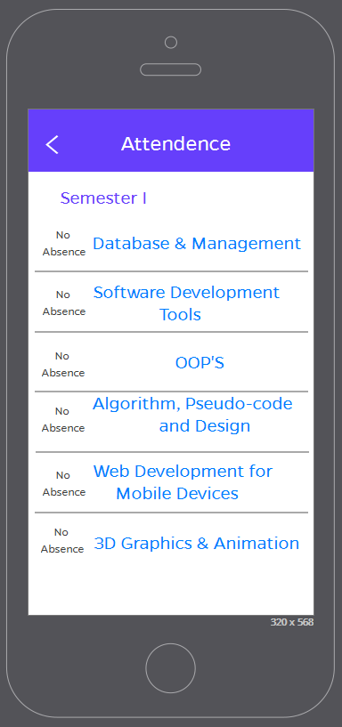
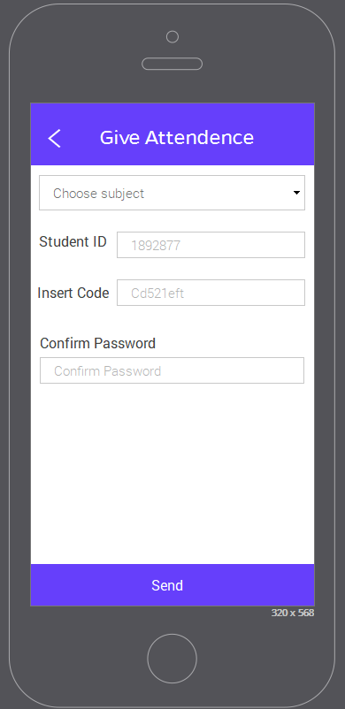
SOME SCREENSHOTS
Attendance
Give attendence

Slide 22
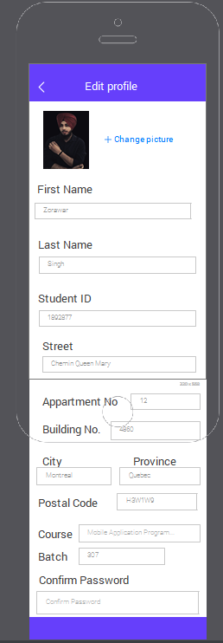
SOME SCREENSHOTS
This is profile page of Student ,here student can fill
His/her basic details.
For example – name, student Id ,address ,course etc.

Slide 23
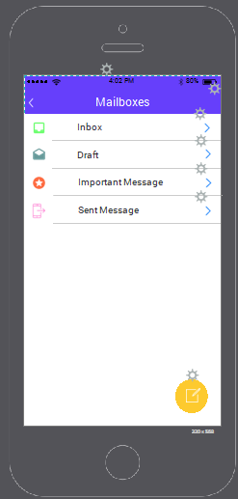
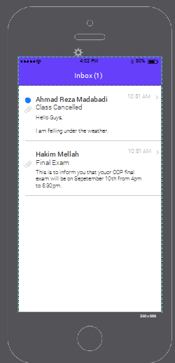
SOME SCREENSHOTS
Mailbox
Inbox

Slide 24
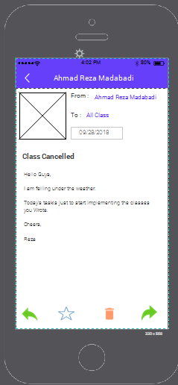
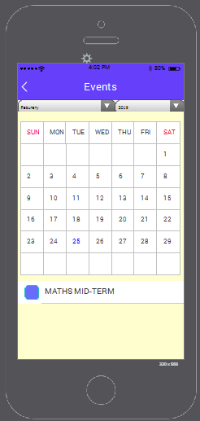
SOME SCREENSHOTS
Particular Screen
Calender and events

Slide 25
Who Does What
Anmol Devgan UML, Prototype
Hanish Kumar Use Case,Prototype & Design
Zorawar Singh Wireframe , Prototype

Slide 26
CREATED BY
Anmol Devgan 1892784
Hanish Kumar 1892492
Zorawar Singh 1892877

