Slide 1
Iot’s analytics
José Conceição

Slide 2
Topics :
IOT’s
Your Goals as a company
Smart Homes
DashBoard prototype
Initial data exploration and vizualization
Project Schedule
Business reccomendations
Data improvement reccomendations

Slide 3


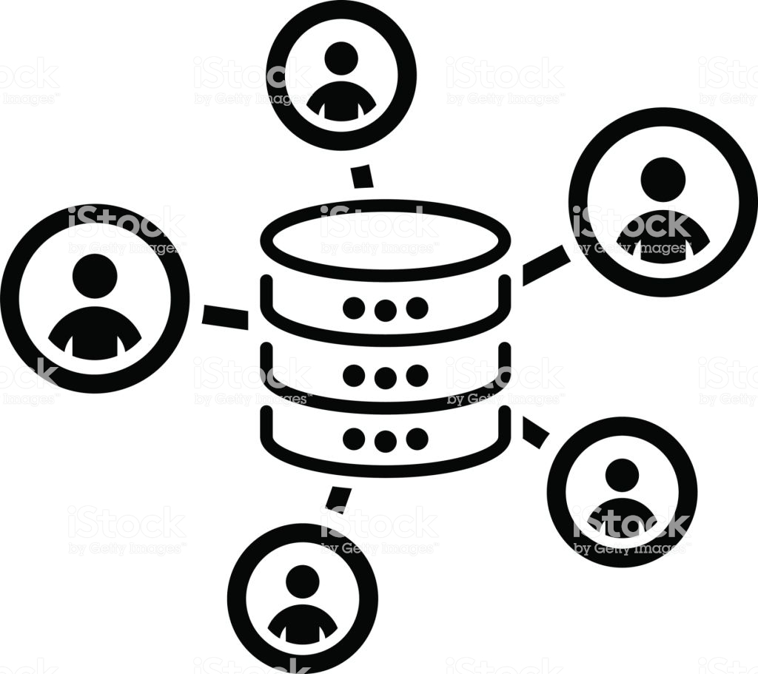

Who are we ?

Slide 4

Your Goal :
Offer highly efficient smart homes

Slide 5
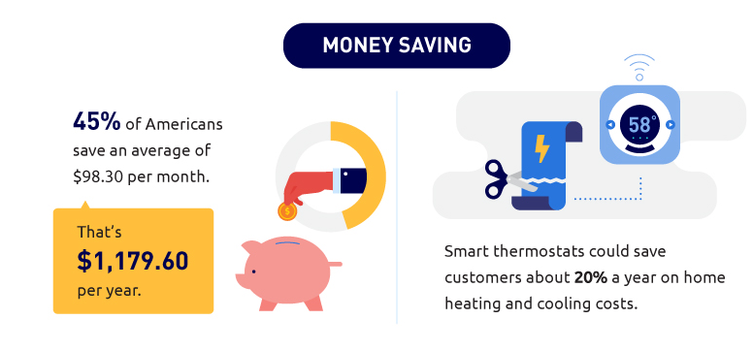

Why Smart Home ? (Your Customer)
Time management
Acessibility
Safety
Savings
Green living
Staying current
LifeStyle
Commodity

Slide 6

Why SmartHome ? (You)
Increase the house’s overall money apreciation
Easier to sell
Low investment , high-value gain.
It’s the future (evolve or die)

Slide 7
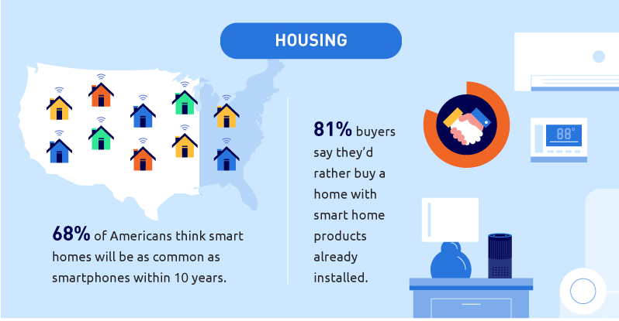

Slide 8





Initial exploration
HouseHold living in Sceaux (7km of Paris, France),47 weeks
Laundry Room
Heating
Kitchen

Slide 9
Insights on the data
Help us uncover trends and behaviours
Peak energy usage patterns
Appliance degradation or unusual energy consumption.

Slide 10
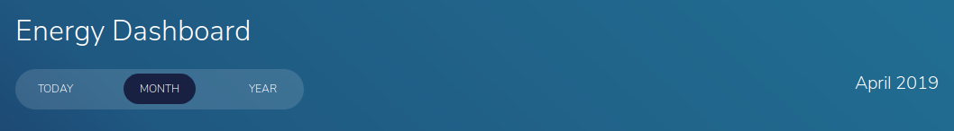
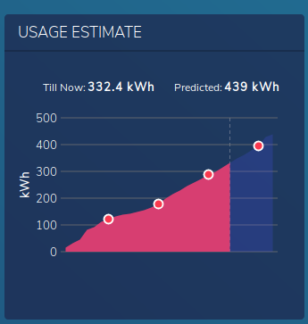
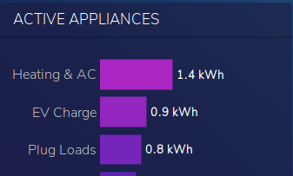
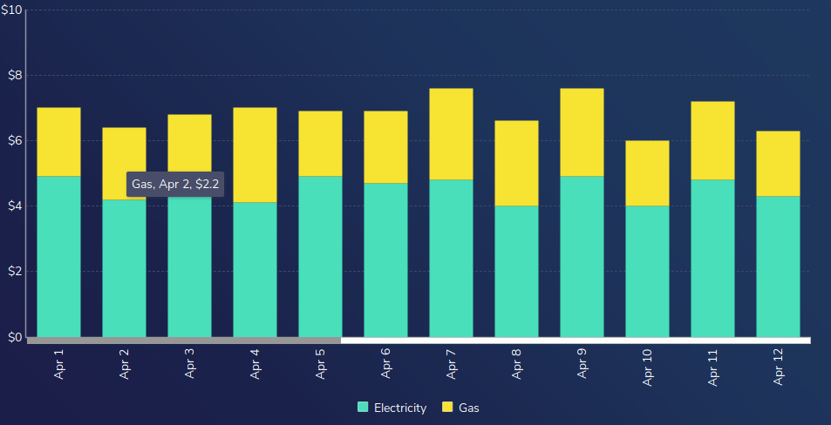
The concept
1
1
Cost $$

Slide 11
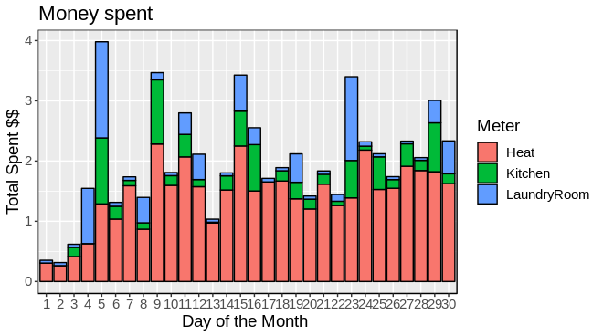
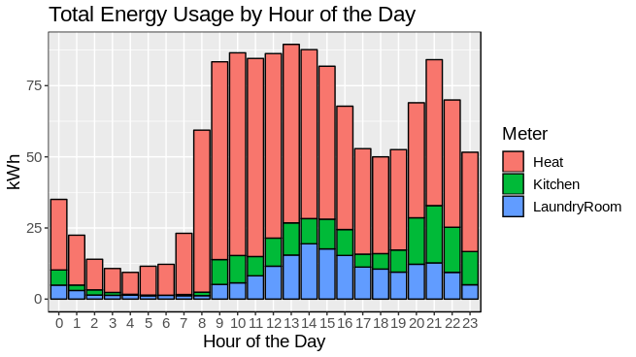
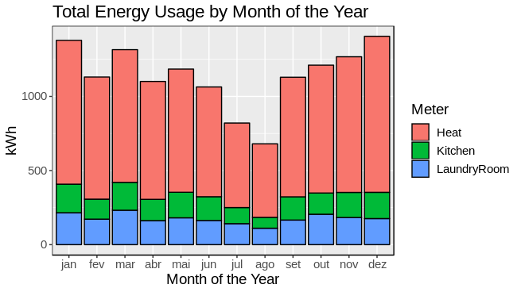
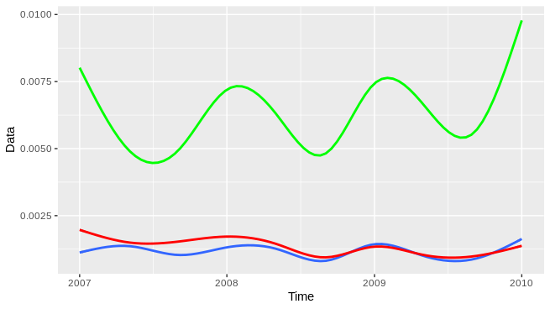

Slide 12



Business format

Slide 13
Schedule
 | 1 | 2 | 3 | 4 | 5 | 6 | 7 | 8 | 9 | 10
Data Exploration
Automatize code
Dashboard
Modelling

Slide 14
Business reccomendations
More than 3 submeters
Focus on security aspect
Make a smartphone app

Slide 15
Data reccomendation
Real life cost per KwH
More data
Reliable data
Uncessary data

Slide 16
Thank you
Bonus : Data security suggestions

Slide 17

Data security issues
Data confidentiality (leaks)
Data integrity (falsification)
Device authentication
(The real threath)

Slide 18




Does all the computing, and storage

Slide 19


Sure,ID and Password, please
Correct,have this key for future access
Hi ! Can
I join your
Group ?
Note: When registering the new device, we need
To set up permissions (storage only,download only,both)
Type of data it can access(in this case there is only one type
ID:001023
PW:ABDFRE

Slide 20


Let me see if you are on the guest list
Are you carrying any malware ?
Hi ! I need
To store data
Security
Check tool
.
.
.

Slide 21
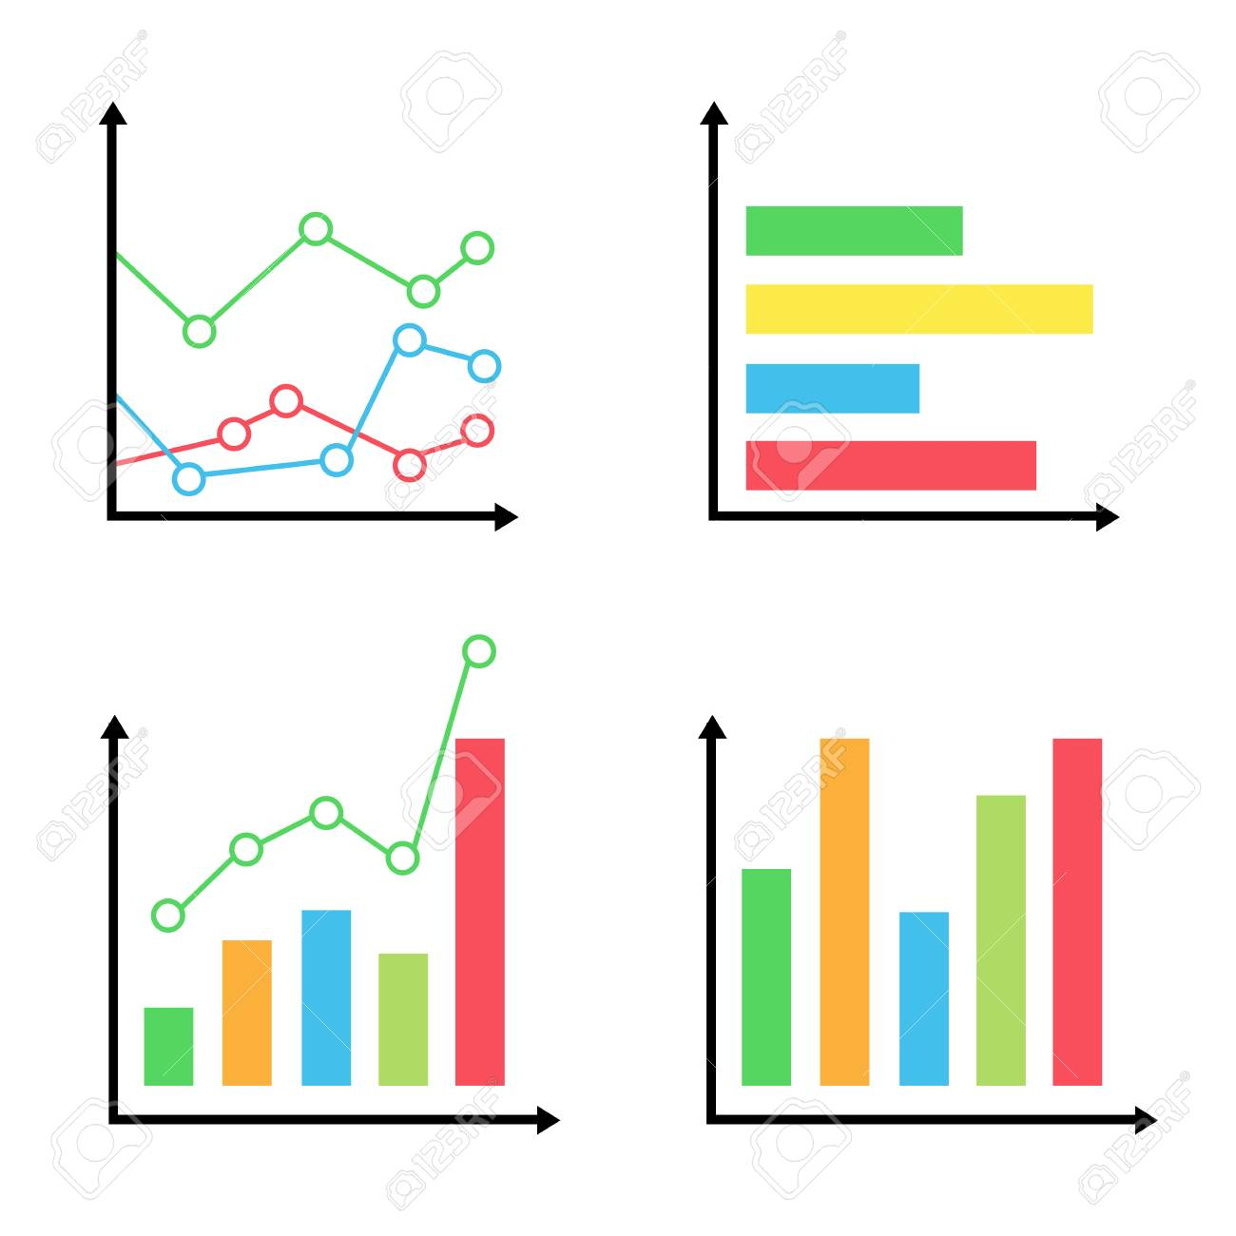
Okay, you are in the guest list, but ...
Let me see if you have permission for that…
Hmm you do , but give me the credentials just to be sure
Hi ! I want to
see some
graphs
ID:001023
PW:ABDFRE
http://worldcomp-proceedings.com/proc/p2015/SAM9737.pdf#page=1&zoom=auto,-80,792

Slide 22
Monday | Tuesday | Wednesday | Thursday | Friday
Data exploration | Data exploration | Data exploration | Data exploration/predictive modeling | Predictive modeling
Automatize code | Decide on the Dashboard | Start dashboard implementation | Finish dashboard prototype | Showcase of the dashboard implementation
Data Exploration | Early functional experiment |  |  | Feedback on the project só far
Explore Dashboard options | Dashboard on a sheet of paper |  |  | Final decisions on how we want our dashboard to look like

Slide 23
Monday | Tuesday | Wednesday | Thursday | Friday
Predictive modeling | Finish all predictive modelling | Dashboard testing,fine tuning | Dashboard testing and fine tuning | Wrap up the whole project
Implementing Predictive data on the dashboard | Dashboard work | Data management Testing | Finish final version | Launch Live version
 | Testing Dashboard

