Slide 1

Microsoft Fabric POC Overview

Slide 2
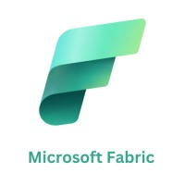
Agenda Overview
A. Introduction to Microsoft Fabric
  We will start with an overview of Microsoft Fabric and its key functionalities that set it apart in the market.
B. What is Microsoft Fabric?
  Next, we will explore the various features and benefits that Microsoft Fabric provides to organizations looking to enhance their operations.
C. Key Areas of Evaluation
  1. Data Ingestion Speed
  2. Cost Analysis
  3. Migration from Azure Synapse
  4. Security & Access Control
  5. CI/CD & Environments
  6. Monitoring & Purview Integration
  7. Common Issues & Solutions
Objective
The Proof of Concept (POC) for Microsoft Fabric focuses on evaluating its capabilities in terms of data ingestion speed, cost efficiency, and migration feasibility from existing systems like Azure Synapse Analytics.

Slide 3
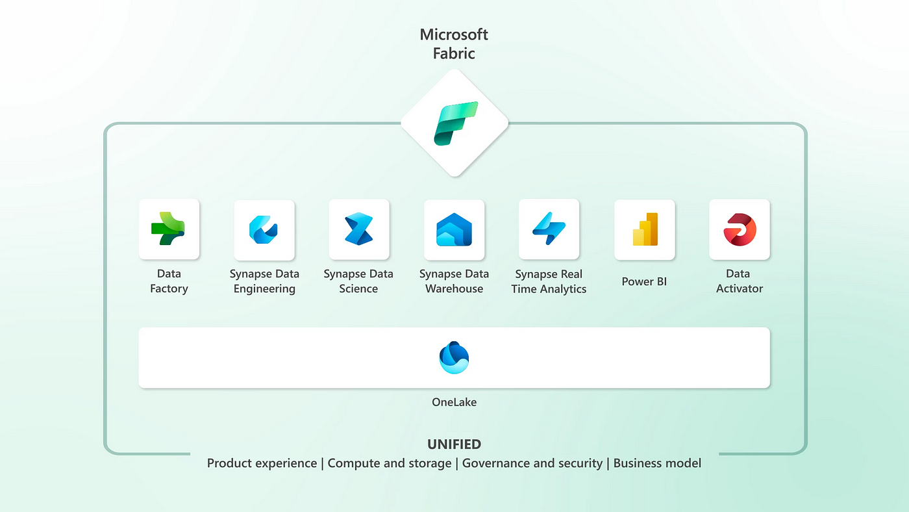
Introduction to Microsoft Fabric
Unified Analytics Platform
  Microsoft Fabric serves as a unified analytics platform that integrates multiple data services and tools for analytics.
Empowering Organizations
  The platform empowers organizations to effectively harness data analytics for improved decision-making and streamlined operations.
Streamlined Operations
  Microsoft Fabric helps organizations streamline operations by making data analytics more accessible and actionable.

Slide 4
What is Microsoft Fabric?
Integrated Data Platform
Microsoft Fabric combines multiple data functions into one cohesive platform, simplifying data management.
Collaboration Across Departments
The platform enables collaboration between different departments, fostering teamwork and data sharing.
Harnessing Insights
Organizations can derive valuable insights from their data, enhancing decision-making processes.

Slide 5
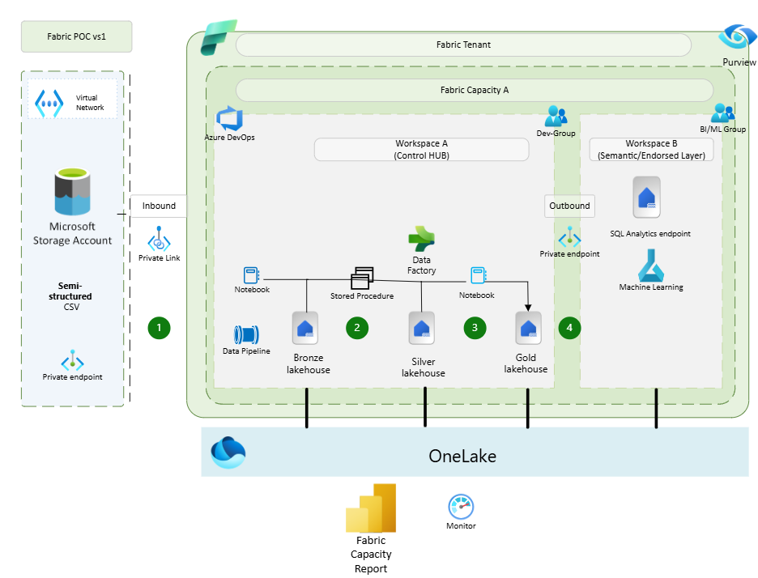
Core Components of Microsoft Fabric
Layout of standard Ingestion Model
Data Factory
  Data Factory is essential for orchestrating data processes and workflows, ensuring efficient data movement and transformation.
Synapse Analytics
  Synapse provides powerful data warehousing solutions, enabling organizations to store and analyze large volumes of data effectively.
Power BI
  Power BI facilitates data visualization, allowing users to create interactive dashboards and reports for data insights.
  ML
  Microsoft Fabric integrates machine learning (ML) capabilities as part of its unified analytics platform, enabling data scientists and engineers to build, deploy, and manage ML models seamlessly. Below are the core ML components in Microsoft Fabric:

Slide 6
POC Assessment

Slide 7
1. Data Ingestion Speed
Performance Metrics:
Load data into OneLake tables from Azure Blob Storage, where no public access to Azure.
IngestFile_TPP_SRCode_NB: Ingested 1.3 billion rows in 37 minutes using 16 vCores.
IngestFile_TPP_SRPatient_NB: Ingested 7.1 million rows in 22 minutes with 16 vCores.
RainbowCode Table: Ingested 818 million rows in 24 minutes using 16 vCores.
Overall Performance: Fabric demonstrates strong data ingestion capabilities, efficiently handling large datasets with high throughput.
Task | 16 vCores Time (minutes) | 4 vCores Time (minutes) | SQLMI Time (minutes) | Improvement (16 vCores vs 4 vCores) | Improvement (16 vCores vs SQLMI)
IngestFile_TPP_SRCode_NB | 37 | 155 | 480 | 76% | 92%
IngestFile_TPP_SRPatient_NB | 22 | 70 | 240 | 68% | 90%
RainbowCode Table | 24 | 95 | 480 | 74% | 95%
Notes:
Microsoft Fabric consists of several key components, including Data Factory for orchestration, Synapse for data warehousing, and Power BI for visualization. Together, these components provide a comprehensive environment for managing data analytics needs.

Slide 8
2. Cost Analysis
Fabric Capacity Units:
  F64 Capacity: 32 vCores, 64 CU/sec, 5.5 million CU/day.
  Monthly/Yearly Costs:
    64 CU: £7,513.51/month, £90,162.12/year.
Azure Estimate:
  Fabric Analytics: £7,894.75/month (F64, 64 CU, 5,000 GB OneLake storage).
  Azure Databricks: £303.64/month (Standard Tier, 1.5 DBU, 730 hours).
  Total Estimated Monthly Cost: £8,198.38.
  Note this cost includes the P1 Power BI Subscription Tier
Microsoft Azure Estimate
Your Estimate
Service category | Service type | Region | Description | Estimated monthly cost
Analytics | Microsoft Fabric | UK South | F64, 64 Capacity units x 730 Hours, OneLake storage 5,000 GB | £7,894.75
Analytics | Azure Databricks | UK South | Jobs Compute Workload, Standard Tier, 1 F8SV2 (8 vCPU(s), 16 GB RAM), 1 Year Savings Plan, 1.5 DBU x 730 Hours | £303.64
Support |  | Support |  | £0.00
 |  | Licensing Program | Microsoft Customer Agreement (MCA)
 |  | Billing Account
 |  | Billing Profile
 |  | Total |  | £8,198.38
Notes:
Microsoft Fabric consists of several key components, including Data Factory for orchestration, Synapse for data warehousing, and Power BI for visualization. Together, these components provide a comprehensive environment for managing data analytics needs.

Slide 9
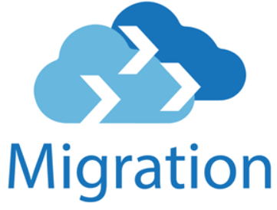
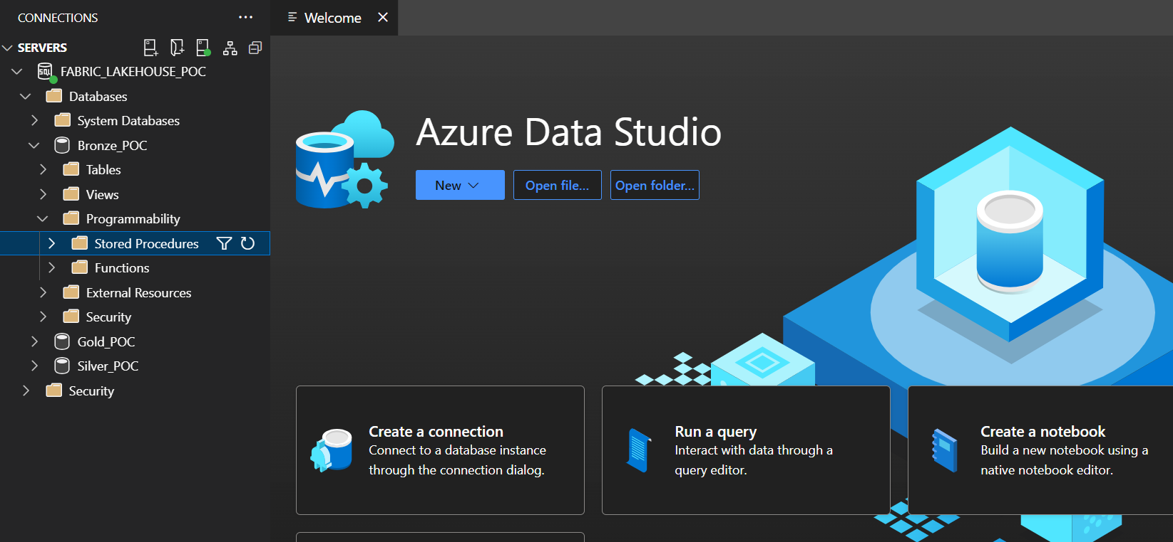
3. Migration from Azure Synapse
Notebook Migration:
  Option 1: Manually export/import notebooks (.ipynb) from Synapse to Fabric.
  Option 2: Use scripts and APIs for automated migration.
Data Migration:
  Option 1: Use OneLake shortcuts to avoid data copying if already using ADLS Gen2.
  Option 2: Migrate data to OneLake as the default storage layer and update notebooks/Spark jobs to read/write from OneLake.
  Insert Stored procedures in the Lakehouse using the SQL endpoint.Access can be done in Vscode/Azure Data Sudio
This Photo by Unknown Author is licensed under CC BY-NC-ND

Slide 10
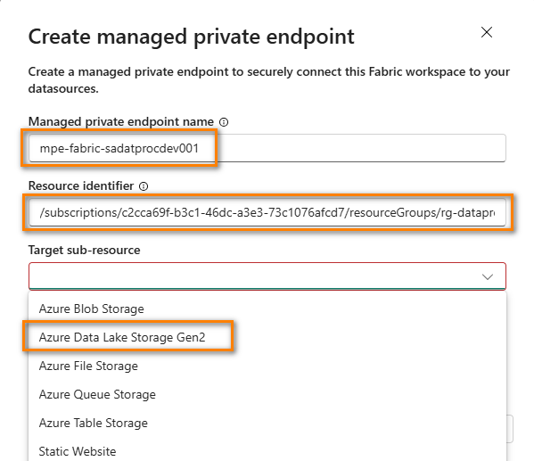
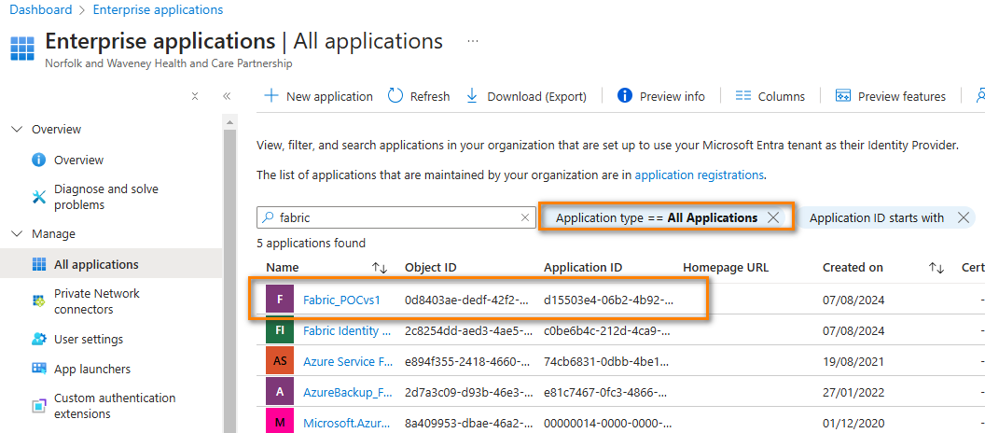
4. Security & Access Control
Managed Entra ID: Granular access control at the workspace and resource level.
RBAC Role: Assign Storage Blob Data Contributor role to Fabric Managed Identity for secure access.
Private Endpoints are created to allow for outbound and inbound data access

Slide 11
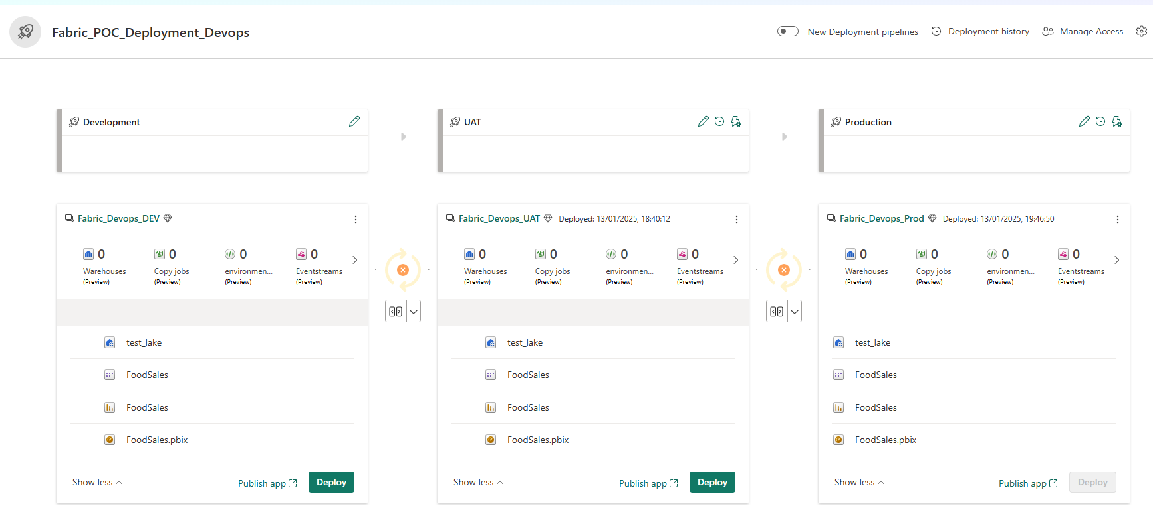
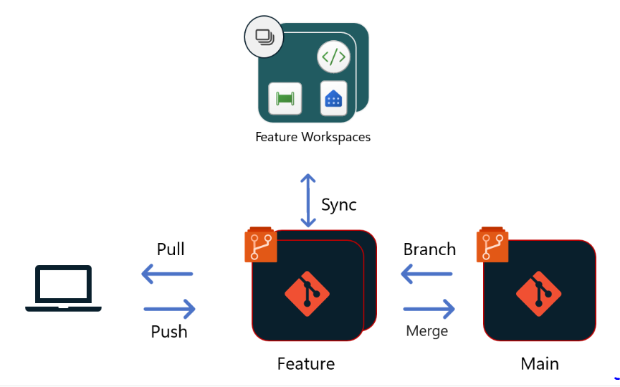
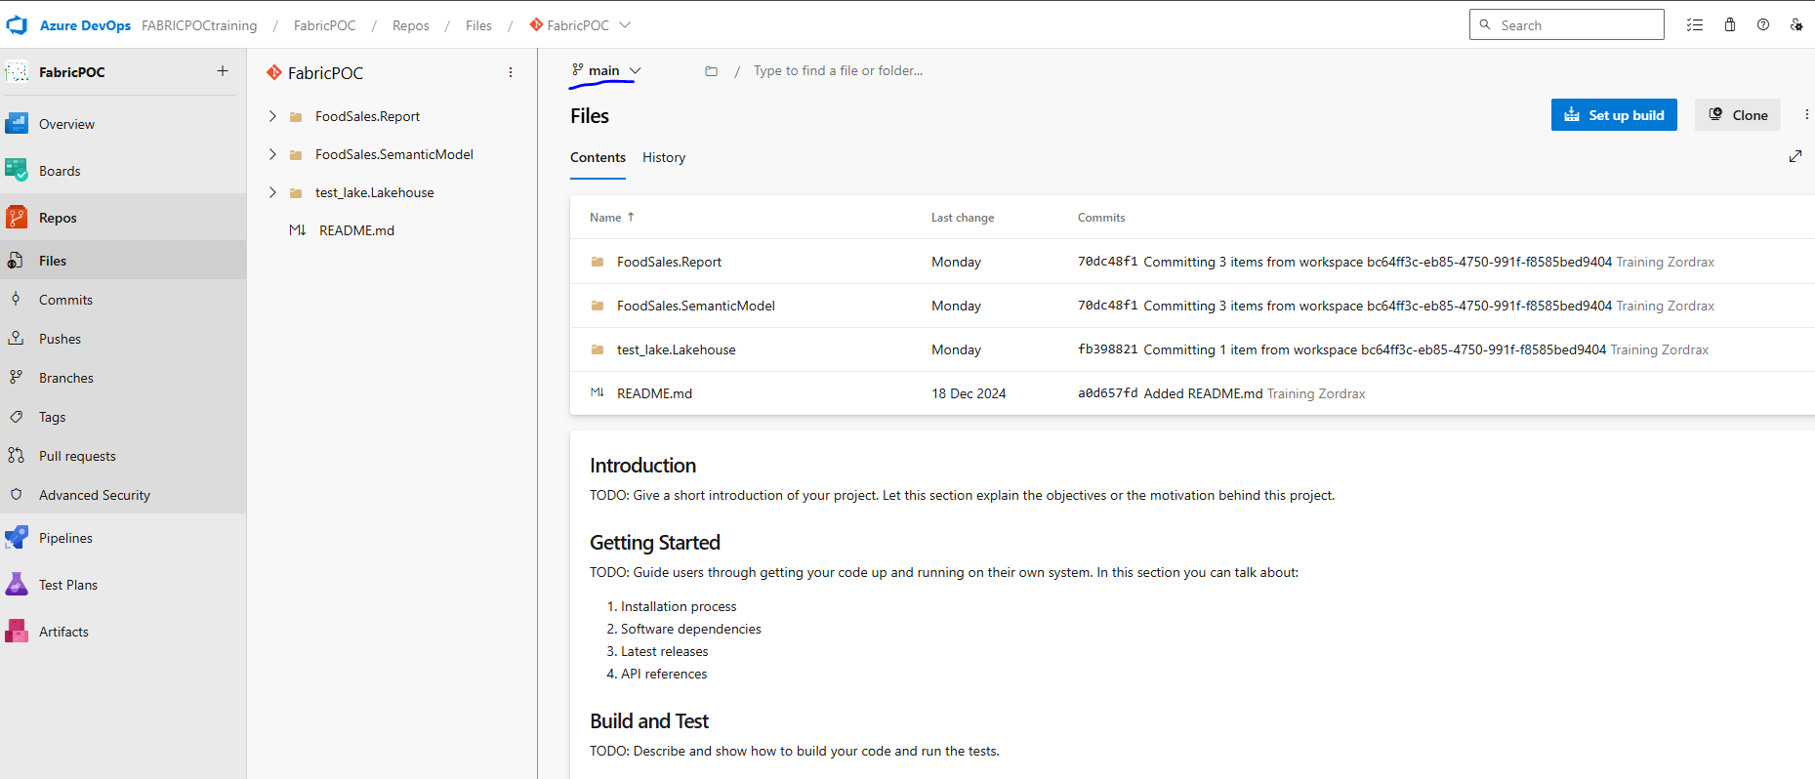
5. CI/CD & Environments
Development Process: Developers can work in isolated environments (local IDE or Fabric workspace).
CI/CD Integration: Environments support CI/CD processes, enabling smooth deployment of updates to production.

Slide 12
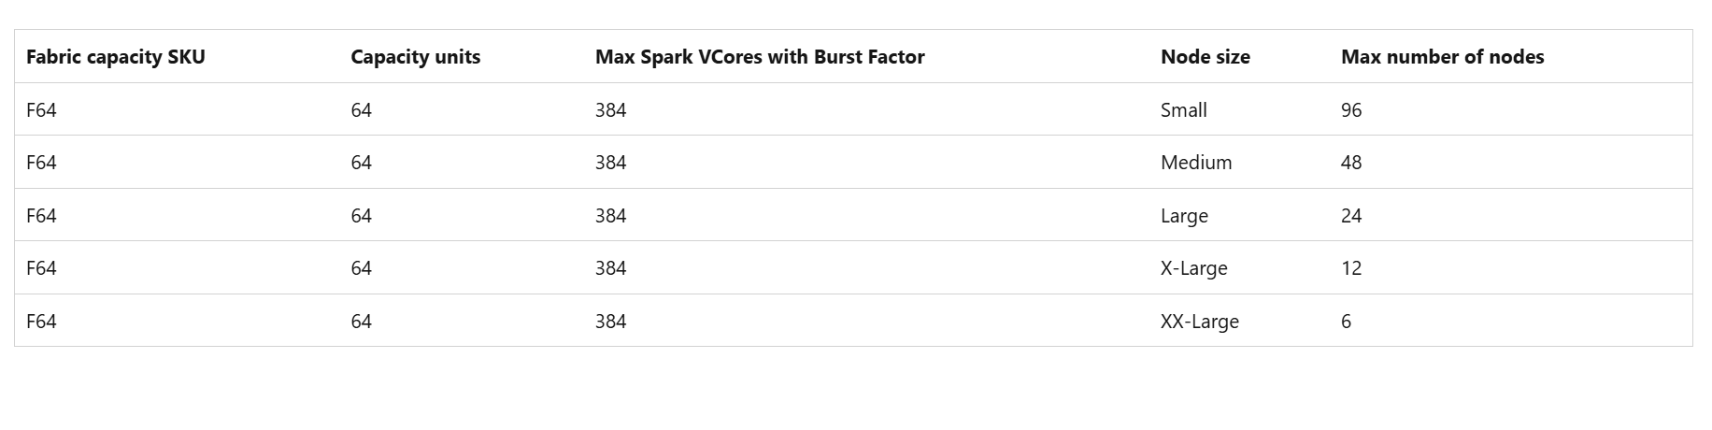
Dedicated Workspaces per Environment
Keep separate Fabric workspaces for Dev, Test, and Prod to avoid cross-contamination.
Separate Spark Pools per Environment
Assign different Spark Pools (Dev-Spark-Pool, Test-Spark-Pool, Prod-Spark-Pool) based on the environment to control performance, compute resources, and access levels.
Resource Allocation Strategy
Dev: Lower compute resources
Test: Moderate compute resources
Prod: High compute resources, autoscaling enabled
Access Control & Security
RBAC (Role-Based Access Control) ensures only relevant teams access the right environment.
Environments & Spark pool Cluster
In Microsoft Fabric, you can logically segregate environments and Spark pool clusters using a structured approach that aligns with best practices for governance, scalability, and security. Below is a visual layout that illustrates this segregation
Environment
Production
Fabric_POC_vs1
Lakehouse/Warehouse
Spark Pool Cluster
Development
Dev-Workspace
Dev-Lakehouse
Dev-Spark-Pool
Testing
Test-Workspace
Test-Lakehouse
Test-Spark-Pool
Prod-Workspace
Prod-Lakehouse
Prod-Spark-Pool
Spark compute configuration This configuration applies to all notebooks and Spark job definitions in this environment. When you select a pool, the settings in that pool serve as limits for any environment-level pool details you customize.

Slide 13
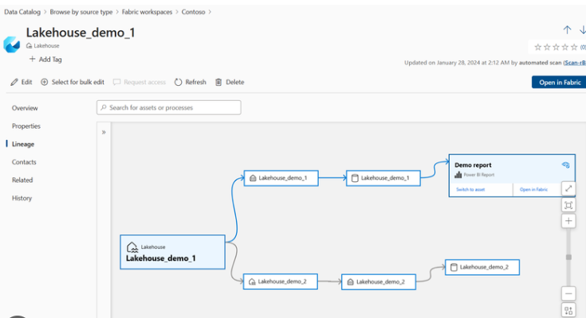
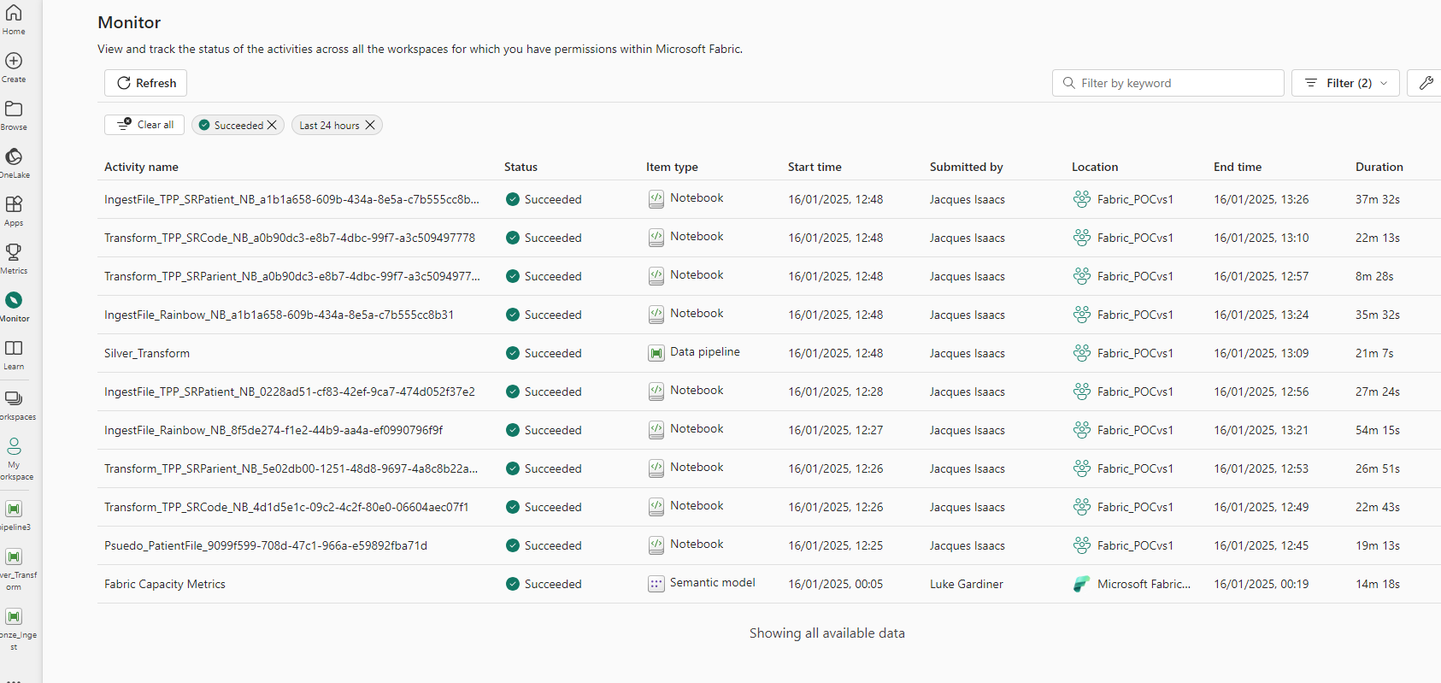
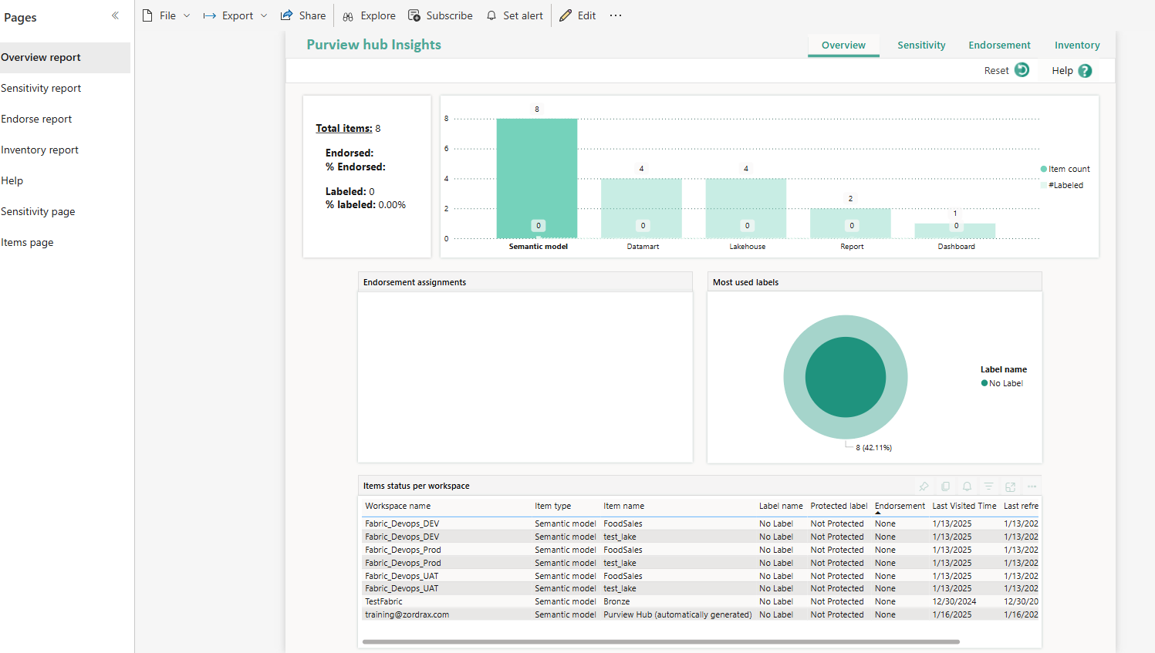
6. Monitoring & Purview Integration
Purview: Data cataloguing, lineage tracking, and permission management.
Monitoring: Built-in monitoring for pipeline performance and script optimization.
7. Common Issues & Solutions
Throttling: Solved by creating designated Spark pools to segregate usage and testing.
Compute Queue: Scheduled runs can be managed through specific pools.

Slide 14
Features and Benefits

Slide 15
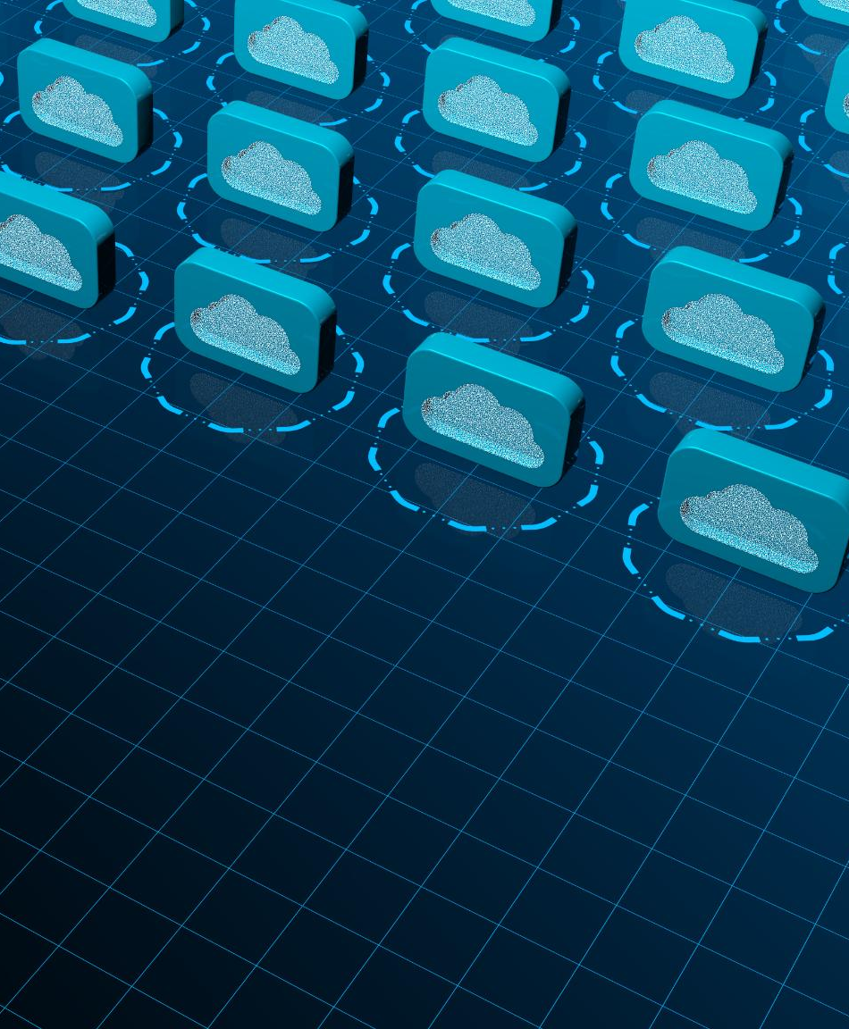
Features and Benefits
Seamless Azure Integration
  Microsoft Fabric provides seamless integration with Azure, allowing organizations to leverage cloud capabilities effortlessly.
Scalability
  The platform offers scalability that enables organizations to grow their data strategies in line with business needs.
Advanced Analytics Support
  With support for advanced analytics, Microsoft Fabric helps organizations derive actionable insights from their data.

Slide 16
Conclusion

Slide 17
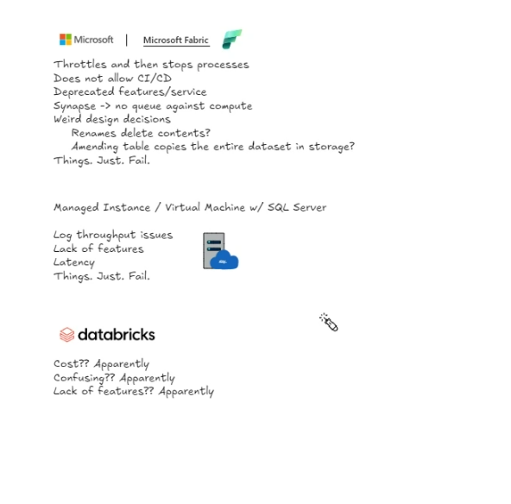
Common Issues
Below was highlighted within the Data Meeting which was initially our main concern when using Fabric
Throttle Problem
Solution creating designated spark pool within an environment allows us to segregate usage and test.
Environments also works within the CI/CD process this is now in production for MS Fabric
No Queue against the compute
Scheduled runs can be done through specific pools and then run.

Slide 18
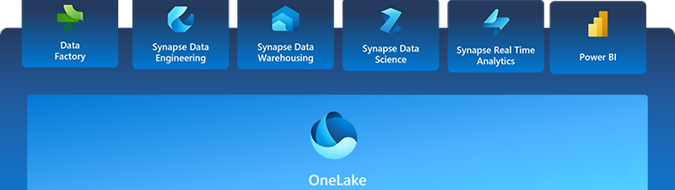
Conclusion and Next Steps
Microsoft Fabric offers high-speed data ingestion, cost-effective scalability, and seamless migration options from Azure Synapse. With robust security, CI/CD integration, and monitoring capabilities, Fabric is a strong candidate for modern data analytics workloads. The POC highlights its ability to handle large-scale data processing efficiently while maintaining cost control.
This Photo by Unknown Author is licensed under CC BY

