Slide 1

EEE 4518 Electrical and Electronic Workshop
Team Quantaphy
1. Mizanur Rahman – 190021109
2. Redwan-Ul-Bari – 190021119
3. Md. Faiyaz Abrar Fahim – 190021137

Slide 2
Prediction of Mortality among ICU admitted patients using Machine Learning Algorithms

Slide 3
Objective
The goal of our project is to predict the mortality of ICU admitted Heart failure patients on the basis of different vital counts. We aimed to develop and validate a prediction model using Machine Learning Algorithms. We observe how different training models fare with the provided bio-medical data.

Slide 4
Resource Collection
This Dataset was last updated one year ago
https://www.kaggle.com/datasets/saurabhshahane/in-hospital-mortality-prediction?resource=download
Demographic characteristics and vital signs extracted were recorded during the ﬁrst 24 hours of each admission and laboratory variables were measured during the entire ICU stay.
Attributes: 51 | Data: 1177
Missing value: Yes | Target Variable: “Outcome”
Classification of Alive represented by 0 or Death represented by 1

Slide 5
Summary of Previous Works
Prediction model of in-hospital mortality in intensive care unit patients with heart failure: machine learning-based, retrospective analysis of the MIMIC-III database
Mortality prediction of patients in intensive care units using machine learning algorithms based on electronic health records
Early hospital mortality prediction using vital signals.
Machine Learning-based Short-term Mortality Prediction Models for Cancer Patients Using Electronic Health Record Data: A Systematic Review and Critical Appraisal
Using machine learning methods to predict in-hospital mortality of sepsis patients in the ICU

Slide 6
Implementation Strategy
Collect the data
Prepare the data
Train a model
Improve
Evaluate the model

Slide 7
Implementation Strategy
Data Collection
01
Importing Data
02
Data Preparation
03
Data Preparation
04
Kaggle
Google Collab
Data Standardization & NaN Value Handling with KNN Imputer
Correlation Heatmap
In Hospital Mortality Prediction
Parameter Tuning
Voting ensemble
Classification report improvement
05
Model Training
06
Model
Evaluation
07
Model
Improvement
08
Data Preparation
Oversampling Using BorderlineSMOTE
Train Test Split (25% Test)
Stratified K folds (10 folds)
Confusion Matrix
Classification Report
ROC Curve and AUC

Slide 8
Machine Learning Models Used
01 | Logistic Regression
02 | KNN
03 | Random Forest
04 | SVM
05 | Adaboost
06 | Gradient Boosting

Slide 9
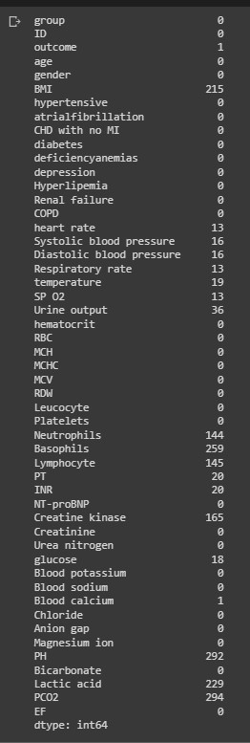
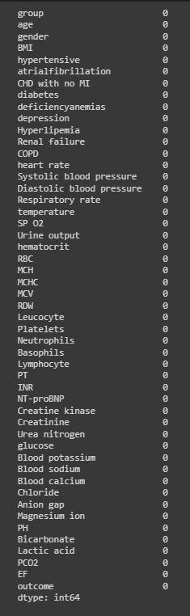
Before and After NaN Value Handling with KNN Imputer

Slide 10
Correlation Heatmap

Slide 11
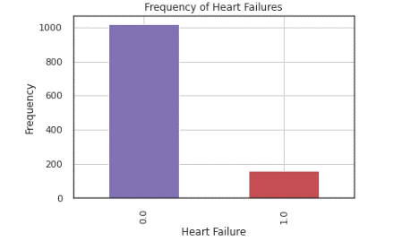
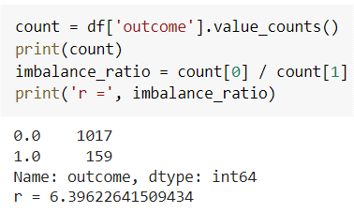
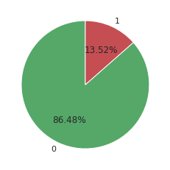
Imbalanced Data

Slide 12
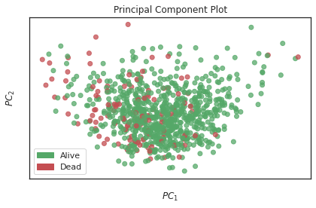
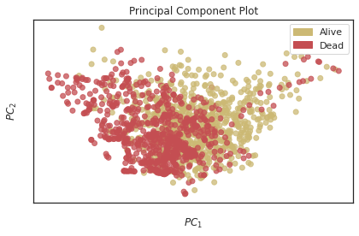

Before and after Oversampling (BordelineSMOTE)

Slide 13
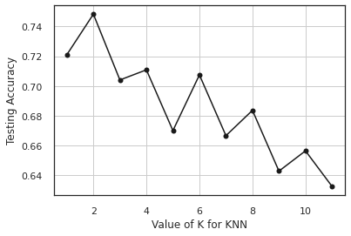
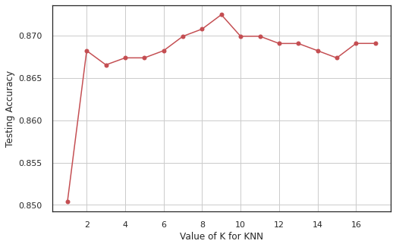
Accuracy Plotting for KNN (SMOTE and K fold)

Slide 14
Results using Oversampleing
 |  | Accuracy | Precision | Recall | F1-score | AUC
01 | Logistic Regression | 0.80 | 0.37 | 0.70 | 0.48 | 0.778
02 | KNN | 0.75 | 0.23 | 0.35 | 0.27 | 0.672
03 | Random Forest | 0.85 | 0.40 | 0.20 | 0.27 | 0.818
04 | SVM | 0.79 | 0.37 | 0.72 | 0.49 | 0.806
05 | Adaboost | 0.85 | 0.45 | 0.47 | 0.46 | 0.737
06 | Gradient Boosting | 0.83 | 0.42 | 0.62 | 0.50 | 0.80

Slide 15
Results using K fold
 |  | Accuracy | Precision | Recall | F1-score | AUC
01 | Logistic Regression | 0.88 | 0.64 | 0.30 | 0.41 | 0.80
02 | KNN | 0.87 | 0.82 | 0.06 | 0.11 | 0.74
03 | Random Forest | 0.88 | 0.81 | 0.14 | 0.24 | 0.79
04 | SVM | 0.87 | 0.76 | 0.08 | 0.15 | 0.80
05 | Adaboost | 0.85 | 0.43 | 0.29 | 0.34 | 0.74
06 | Gradient Boosting | 0.88 | 0.63 | 0.21 | 0.32 | 0.80

Slide 16
Voting Ensemble Results
 |  |  | Accuracy | Precision | Recall | F1-score
01 | Oversampling | Soft Vote | 0.85 | 0.44 | 0.45 | 0.44
02 |  | Hard Vote | 0.86 | 0.49 | 0.45 | 0.47
03 | Stratified K Fold | Soft Vote | 0.92 | 0.94 | 0.42 | 0.59
04 |  | Hard Vote | 0.91 | 0.93 | 0.35 | 0.51

Slide 17
Discussion
In this project the data we used represented a classification problem. Processing the data was a challenge, filling out the null values was of significance as the raw dataset was not that big to ignore any instances. We then implemented six machine learning classifier models. We analyzed the accuracy, precision, recall, f1-score, confusion matrix, ROC AUC curve and score. The target of our model simulations was to predict the death of patients under ICU conditions correlated to their Bio-medical data. For this reason false negative values was detrimental to our final predictions. That is why we aim to get higher recall values in our performance parameters.
To further improve our performance scores we applied ‘Voting ensemble’ algorithms. Using soft and hard voting techniques we have achieved significant improvements in our classification scores.

Slide 18
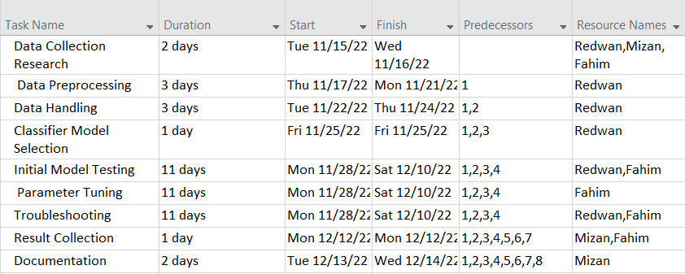
Member Contribution

Slide 19
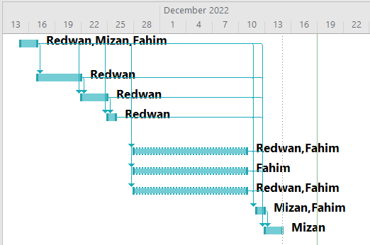
Member Contribution

