Slide 1
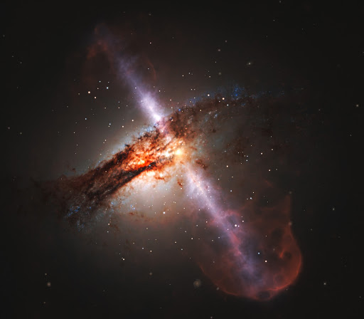
Spectroscopic Analysis of BL Lacertae
Zachary Stone

Slide 2
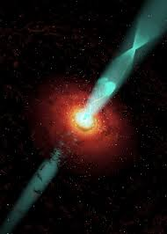
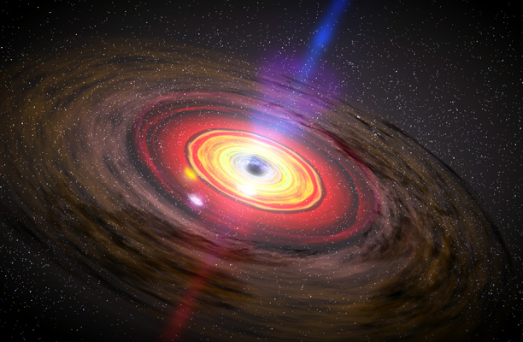
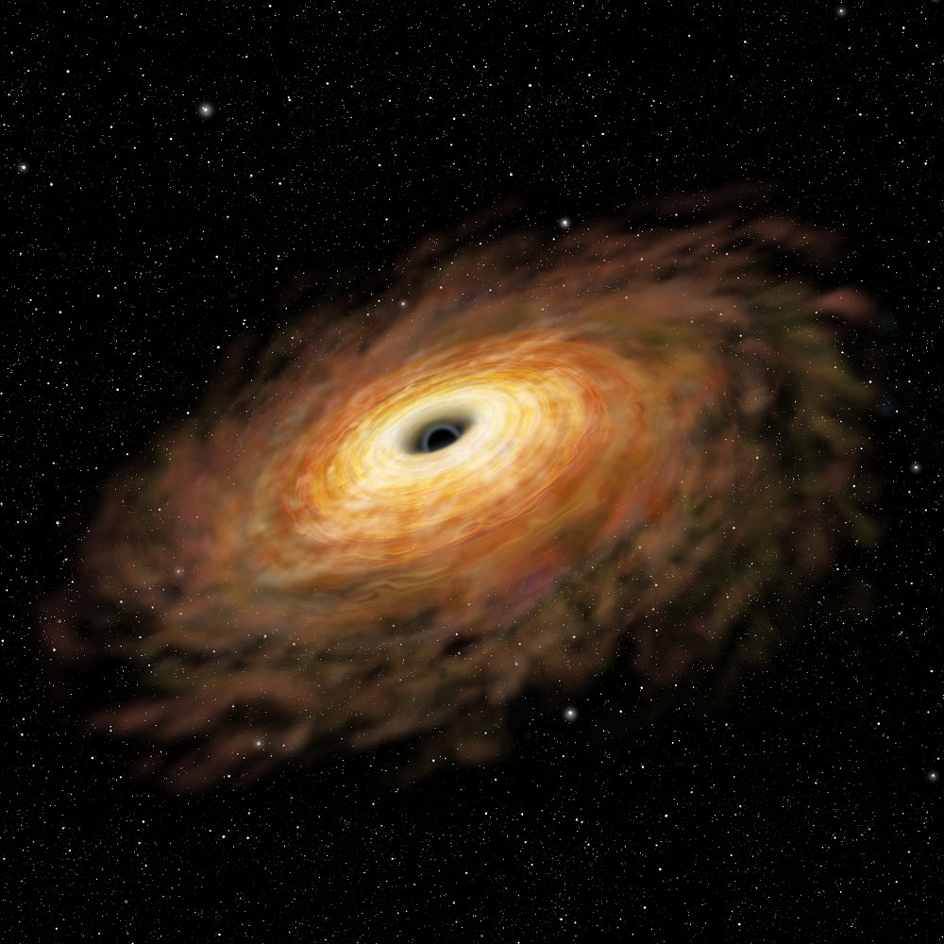
Background: Active Galactic Nuclei

Slide 3
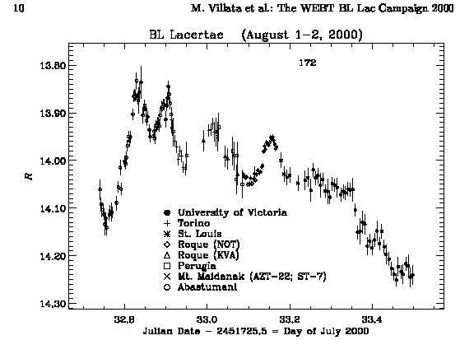
Background: BL lacs
Blazars
Relativistic jets
Almost featureless because of the jet (non-thermal/synchrotron emission)
Jet emission much stronger than galaxy emission
Rapidly varying brightness and polarization
Courtesy of Villata et al. (2000)

Slide 4
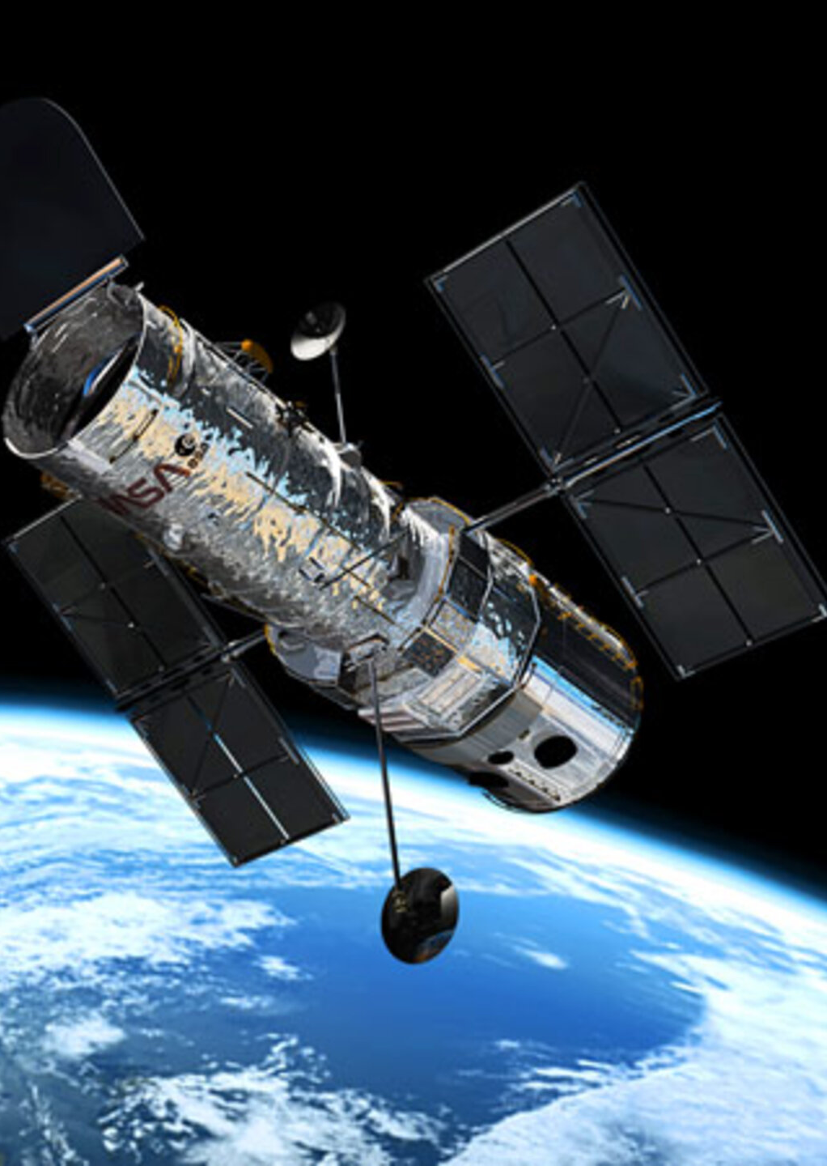
FIRST set of data
Courtesy of the MAST database
In the UV band (around 1500-2500 A)
Taken from Hubble Space Telescope with the G190H filter of the Faint Object Spectrograph
R ~ 1300
Exposures of 1440s
Dated 5/12/1992, by Angel

Slide 5
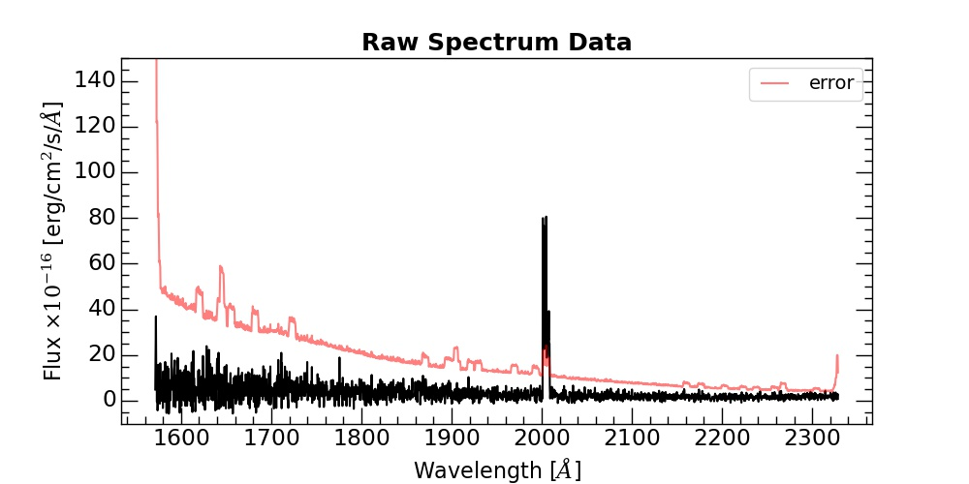
FIRST SET OF DATA
Downloaded as FITS files
Files given for raw data, background, wavelengths of spectrum, error and flat-fielded data
Average taken over each column, meaning each pixel
Variations in spectra from row-to-row from spatial variation in the AGN
Coadded afterwards to increase clarity
Portion of one of the FITS files downloaded. Emission line can be seen in the center.

Slide 6
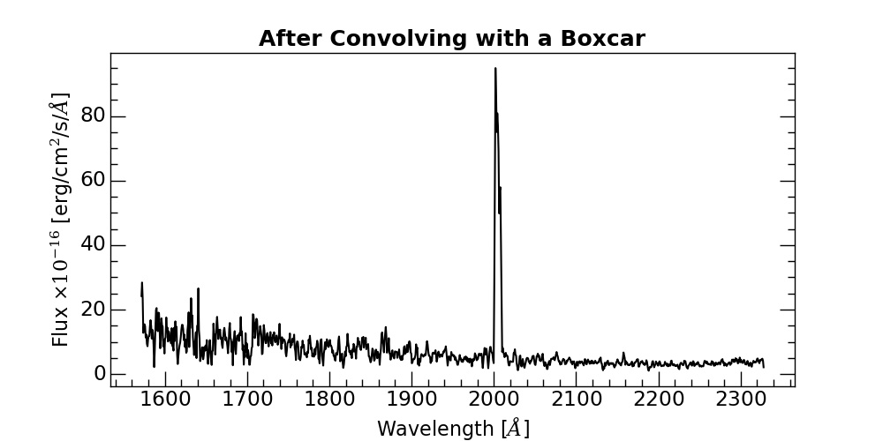
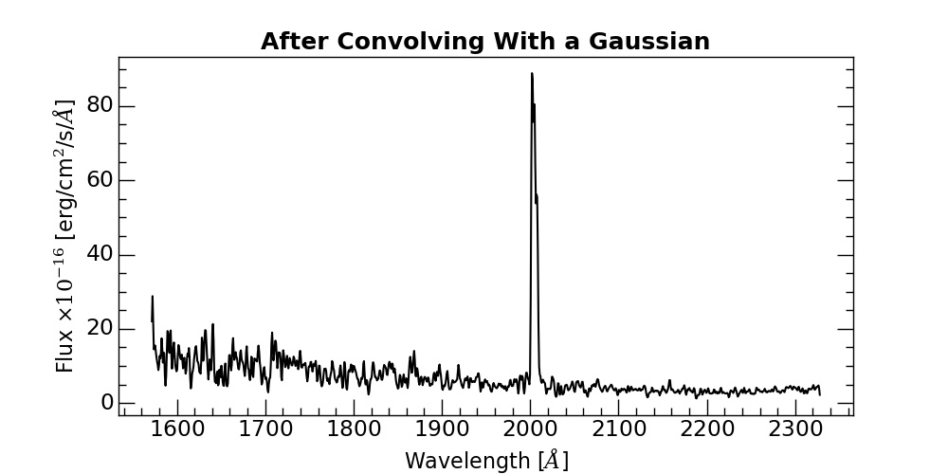
First set of data
The Boxcar has a FWHM of 3
The Gaussian has a FWHM of 1
The lines are clearer after the Gaussian convolution

Slide 7
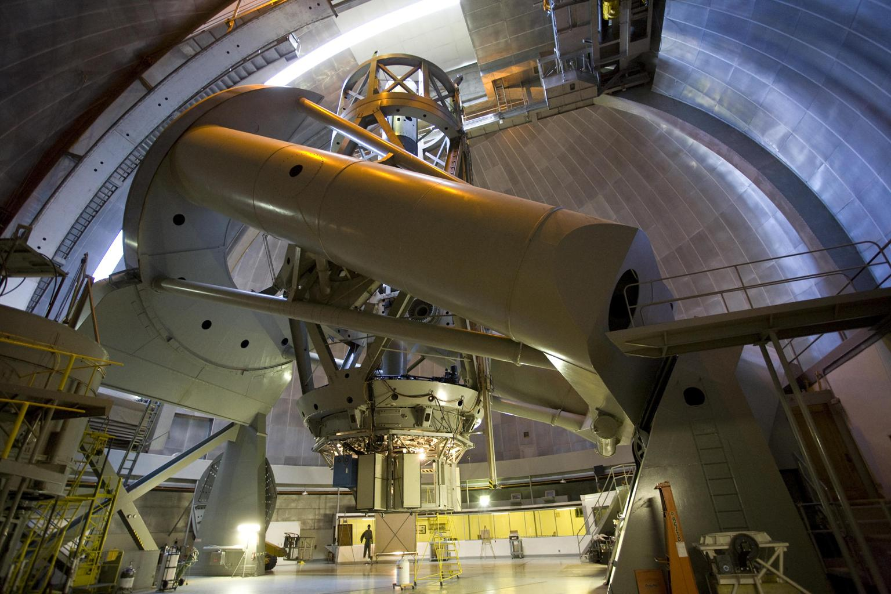
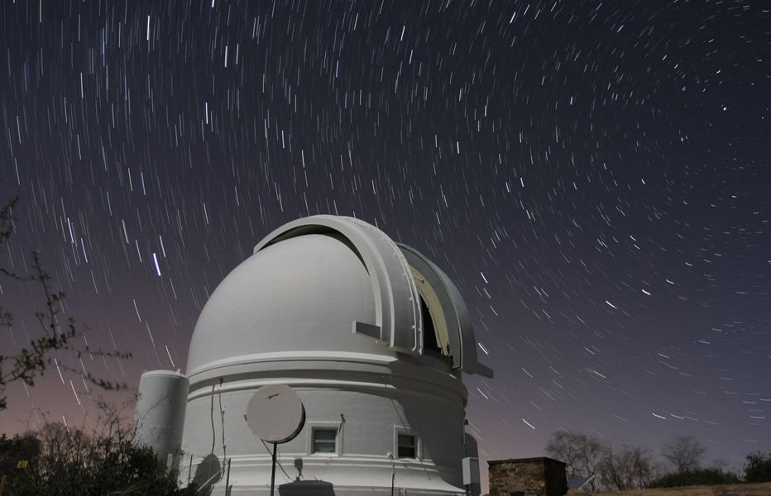
Second SET of data
Courtesy of NED
In the Optical (H-beta) band (around 4500-5500 A)
Taken from the Palomar 200 in. telescope with blazed-grating
R ~ 549, resolution of 9 A
Exposures of 6035s
Dated 1996, by Lawrence, Zucker, Readhead, Unwin, Pearson, and Wu

Slide 8
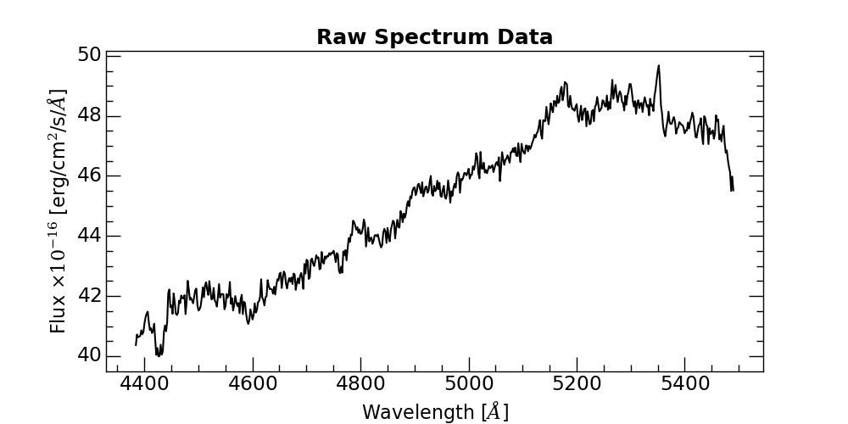
Second set of data
Data given as a text file
Already processed
No error given
Presented in physical units

Slide 9
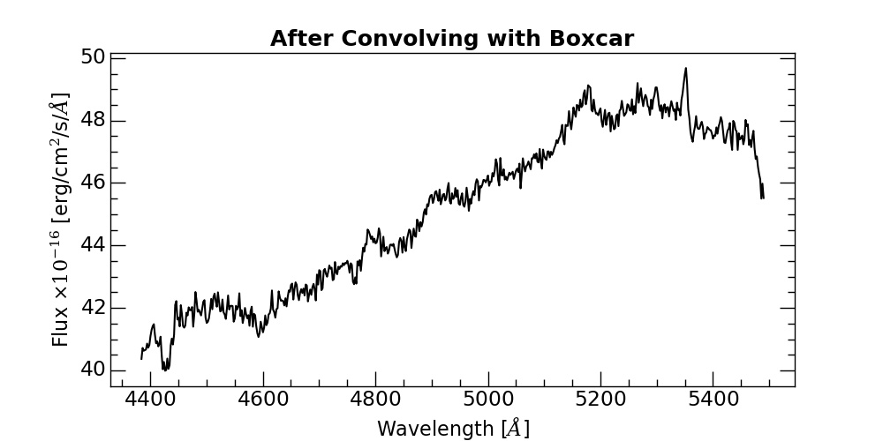
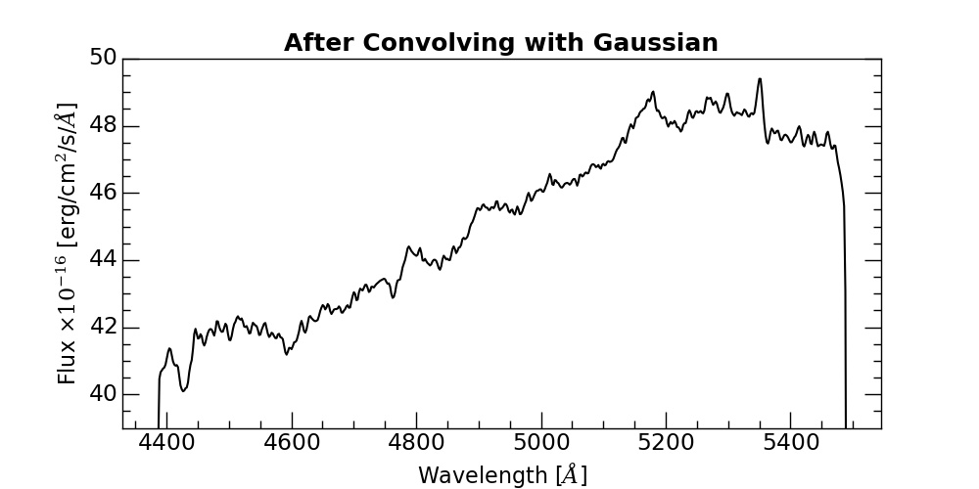
Second set of data
Both the Boxcar and Gaussian have FWHM of 1
No coaddition needed
Gaussian convolution causes steep falloff on either side of spectrum

Slide 10
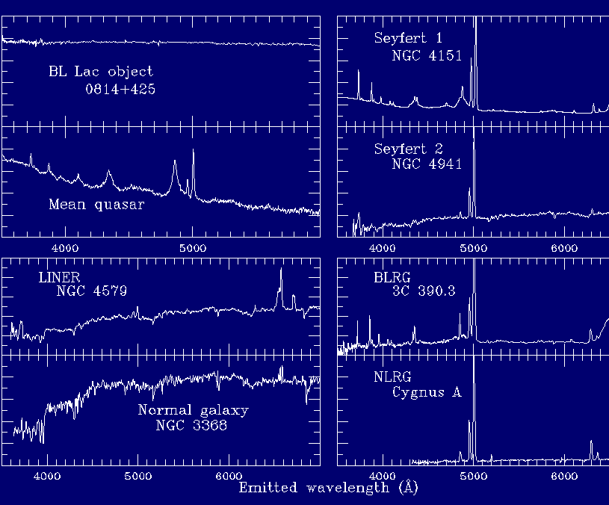

Spectral lines
Typical spectral lines for galaxies considered
Expect there to be minimal amounts of absorption/emission, as BL Lacs are very quiet and lack features
Test several values of z for each set of data
Expect data sets to match in z
$z=\frac{λ_{obs}−λ_{em}}{λ_{em}}$
where z is the redshift, $λ_{obs}$ is the observed wavelength, and $λ_{em}$ is the wavelength emitted in a vacuum

Slide 11
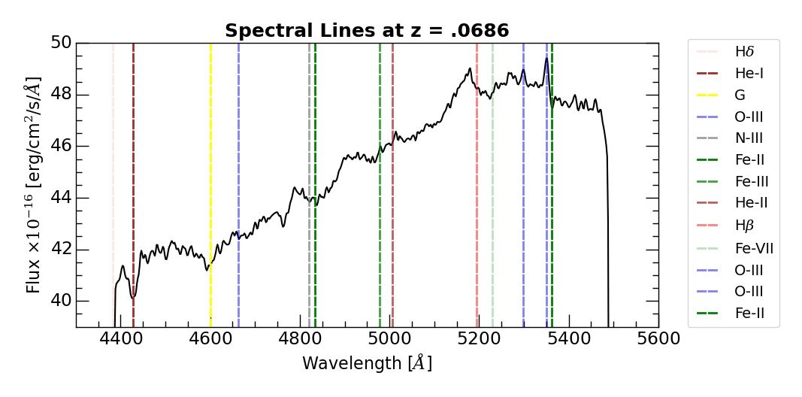
Optical spectrum
Strong emission for O-III at 4959A and5007A
Strong absorption for Fe-II and He-I
Weak emission from He-II and Fe-III
Weak absorption from Fe-VII, G
Broad emission at ~5150A unaccounted for
Maybe something in front?

Slide 12
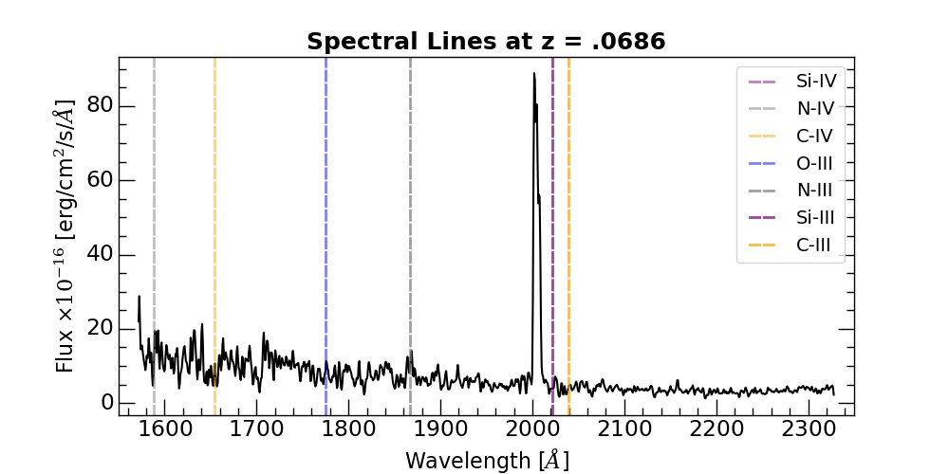
UV Spectrum
Using z = .0686, absorption lines roughly match for N-III, Si-III, and N-IV
Absorption at ~1650A for C-IV
From before, high uncertainty at lower wavelengths, and large variations
Large spike in the center unaccounted for
Maybe something in front of AGN?

Slide 13
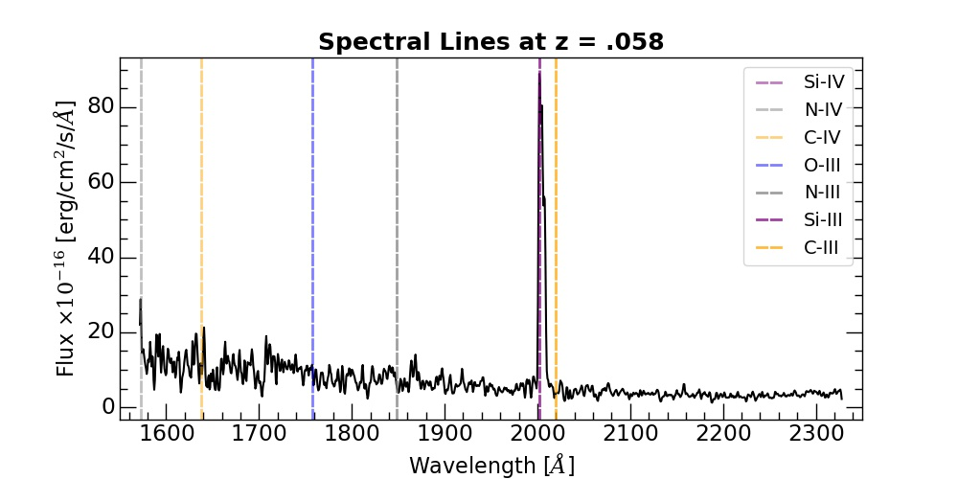
UV Spectrum
Very strong Si-III emission at 2000A
Weaker N-IV and C-IV emission at higher wavelengths
Redshifting by a lower amount would grant strong C-III emission
Suggests large amount of Si-III or C-III in front of the AGN

Slide 14
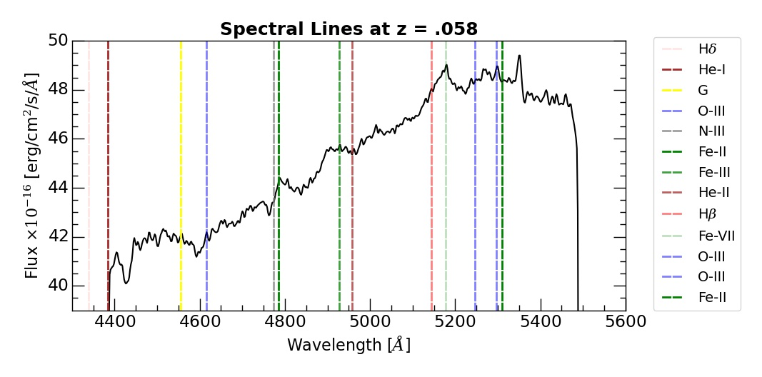
Optical Spectrum
Compare to Si-III/C-III emission from UV spectrum
Emission from Fe-II, Fe-VIII, and O-III
In both cases, see O-III emission
Larger emission unaccounted for
Broad emission probably not Fe-IV
Absorption at ~4450A unaccounted for

Slide 15
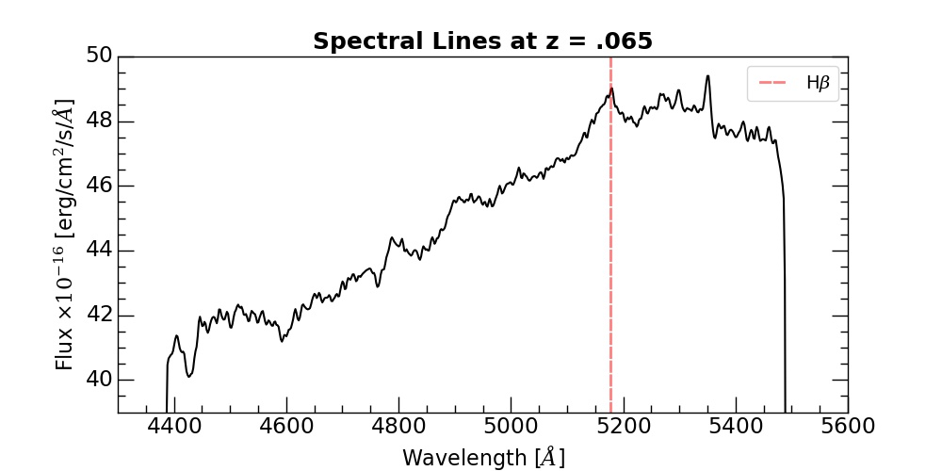
Optical spectrum
Expect strong Hydrogen emission
H-beta fits best for z = .065
Suggests a significant amount of Hydrogen in front of AGN

Slide 16
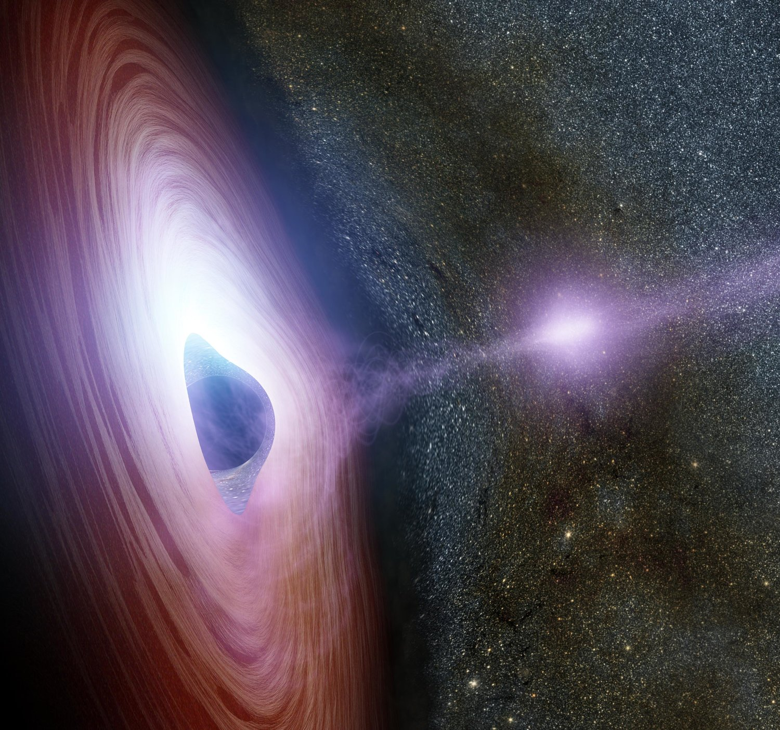
The big picture
Presence of unaccounted for emission suggests material in front of the AGN
BL Lacs are a subset of the blazar category, meaning they will likely have jets of material coming toward our line of sight
This material can be Si-III or N-III, shown by z = .058
The energetic particles coming from this jet can heat up Hydrogen in the IGM
This explains the H-beta feature in the optical spectrum

Slide 17
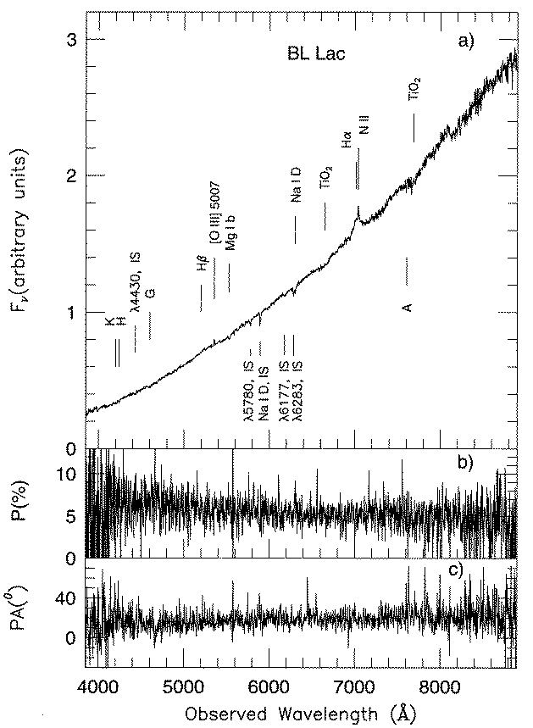
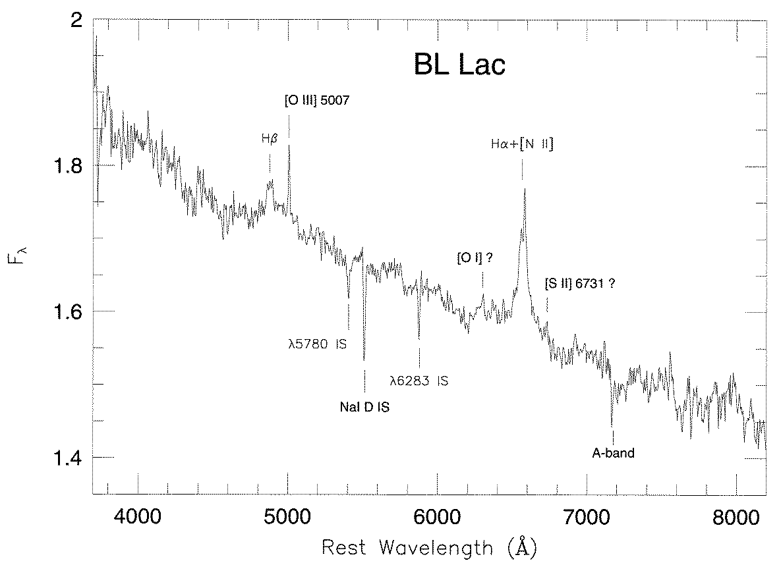
comparison
Courtesy of Vermeulen et al. (1995)

Slide 18
comparison
All studies of BL Lacertae have agreed upon a redshift of .0686
O-III emission is much stronger than H-beta
Emission could be dampened by jet activity, extinction, or sky absorption
All studies have verified O-III and H-beta emission
Very strong UV emission could be from variation in jet/ material in accretion disk

Slide 19
References
Lawrence, C. R., Zucker, J. R., Readhead, A. C. S., Unwin, S. C., Pearson, T. J., and Xu, W., “Optical Spectra of a Complete Sample of Radio Sources. I. The Spectra”, The Astrophysical Journal Supplement Series, vol. 107, p. 541, 1996. doi:10.1086/192375.
Vermeulen, R. C., “When Is BL Lac Not a BL Lac?”, The Astrophysical Journal, vol. 452, p. L5, 1995. doi:10.1086/309716.
Villata, M., “The WEBT BL Lacertae Campaign 2000”, Astronomy and Astrophysics, vol. 390, pp. 407–421, 2002. doi:10.1051/0004-6361:20020662.

