Slide 1
TEMG 4000K Weekly Updates--10/5
Xinjie Yao(Abby), Jiaxin Bai(Mark)

Slide 2
Agenda
Literature Review
Proposed Methodology
Weekly Summary
Results & Discussions

Slide 3
Literature Review
A Critical Review of Recurrent Neural Networks for Sequence Learning, Zachary et al. 2015.
Long Short-Term Memory, Hochreiter and Schmidhuber. 1997.
Empirical Evaluation of Gated Recurrent Neural Networks on Sequence Modeling, Chung et al. 2014.
An Introduction To Hidden Markov Models And Bayesian Networks, Ghahramani. 2001.
Predicting the Outcome of Startups: Less Failure, More Success, Krishna et al. 2016.
A Supervised Approach to Predict Company Acquisition with Factual and Topic Features Using Profiles and News Articles on TechCrunch, Xiang et al. 2012.

Slide 4
Methodology
We formulated the question as a sequence classification problem
Given a sequence of events of a start-up company, develop a model that can predict whether it can get further funding in the following 6 months.
From the database we extract features, to formulate different events that happened to a company
The events are vectorized, in order to feed to the recurrent neural network.

Slide 5
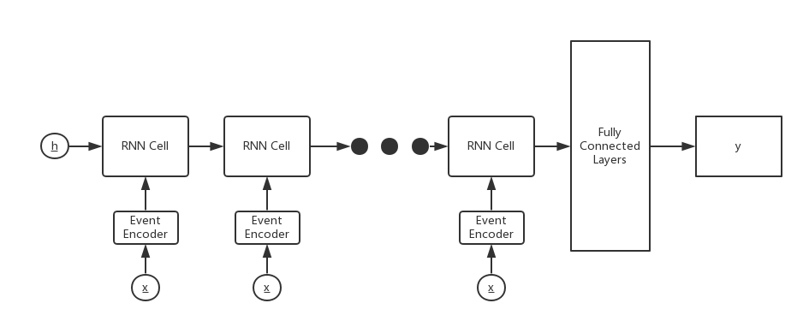

Slide 6
Weekly Summary
Feature Extraction
events vectorization
Product Launch
Series B
found
Series A
Milestone
Acquiring

Slide 7
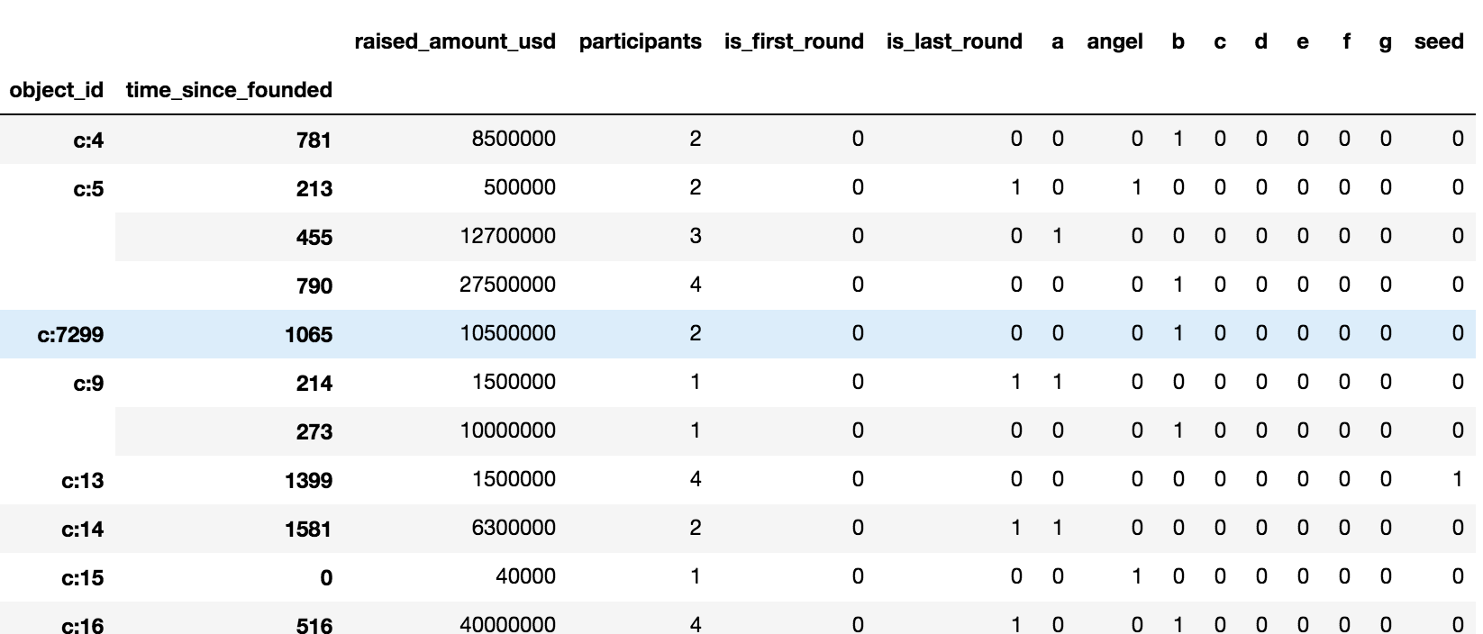
Time Relevant Features -- Funding
Before vs. after removing invalid entries of duration: 31939 -> 14691 companies

Slide 8
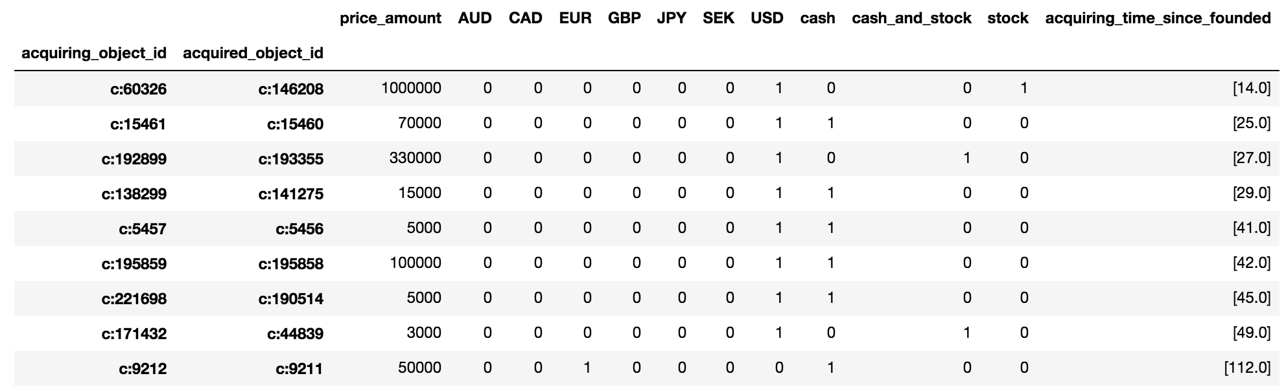
Time Relevant Features -- Acquiring
Before removing the negative durations
- 9532 rows × 4 columns
After removing the negative durations
- 6866 rows × 4 columns
After dropping entries with missing values ['price amount']
- 1875 rows × 4 columns

Slide 9
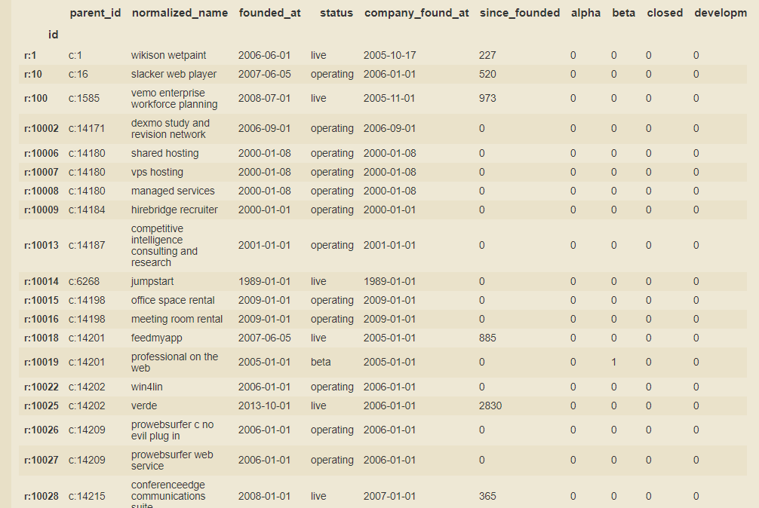
Time Relevant Features -- Product
27738 -> 22087

Slide 10
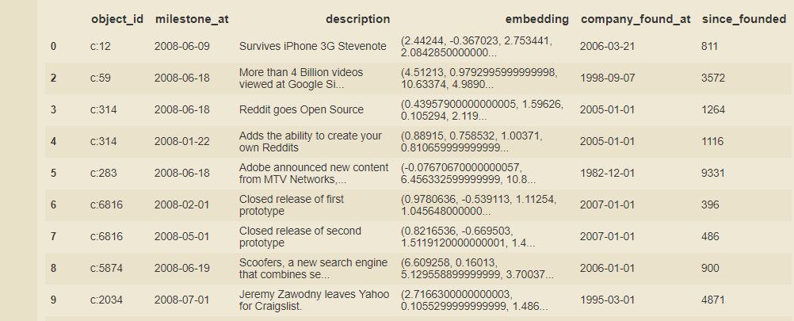
Time Relevant Features -- Milestones
28707-> 22923

Slide 11
Time-invariant features
Treat the followings coupled with the founding date
# Employees
# Company Offices
Industry Category
status
…

Slide 12
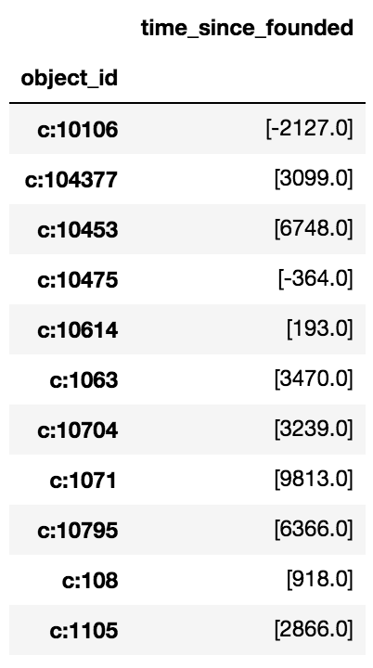
Time Relevant Labels -- Acquired & IPO
Acquired:
Before removing the negative & null durations
9532 rows
After removing the negative & null durations
4821 rows
IPO:
Before removing the negative & null durations
1254 rows
After removing the negative & null durations
426 rows

Slide 13
Discussions
How to cope with entries having negative duration/ no date record given each scenario?
-1? 0? drop?
How to prevent overfitting of the data given such a relative deep NN?

