Slide 1
TEMG4000 Weekly Updates--9/20
Xinjie Yao(Abby)
Jiaxin Bai(Mark)

Slide 2

Agenda
Weekly Summary
Findings
Potential Barriers
Proposed Solution

Slide 3

Weekly Summary
Exported raw data into .csv file
01
Understood the relationship among tables
02
Discussed possible extraction approach
03

Slide 4
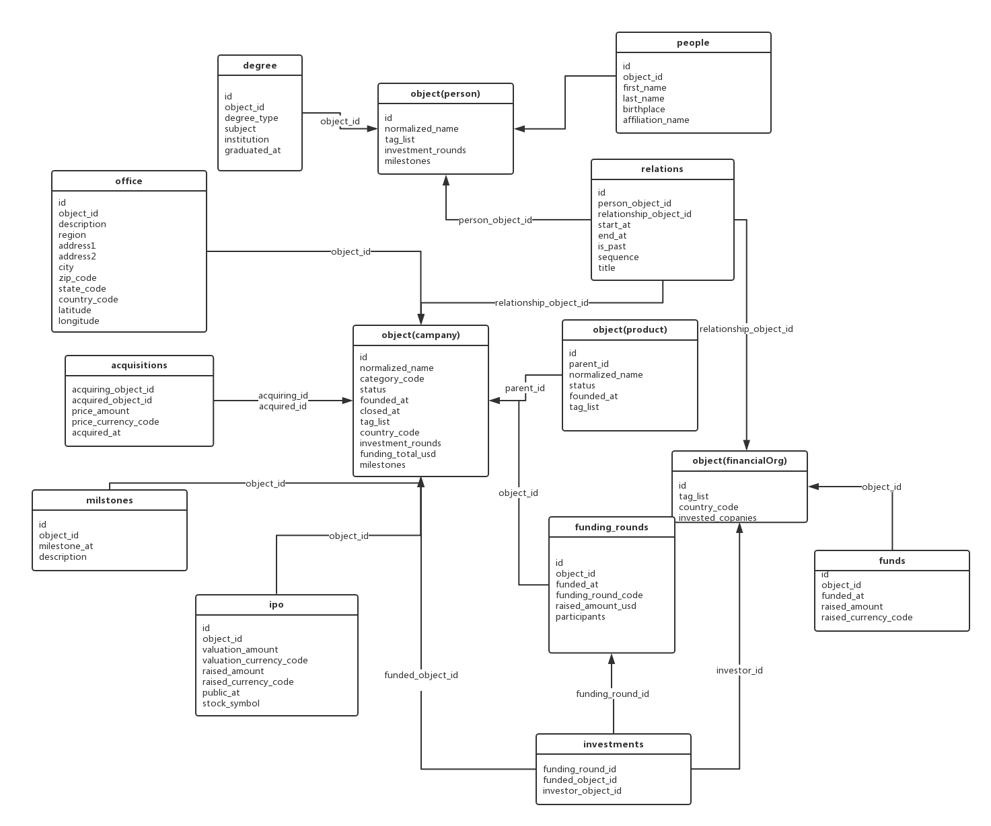

Slide 5
Available Features
Basic Features
#products | company age | #milestones | #offices
#articles on techcrunch | #revisions on profile | #competitors | #competitors acquired
#service providers | #employees
Financial Features
#funding rounds | #acquisitions by the company | #VCs and PEs investing | #finance person investing
#investments by the company | #leaders with financial background | #investors per round | Funding per round (K$)
Managerial Features
#companies by founders | #successful companies by founders | Founder experience (months)

Slide 6
Findings
Large amount of data (over 200k companies)
Missing values -- data screwness
Missing crucial(maybe) information: competitors & company size etc.

Slide 7
Proposed Solution
Embedding timestamp into features: timeline of a company on critical events

