Slide 1

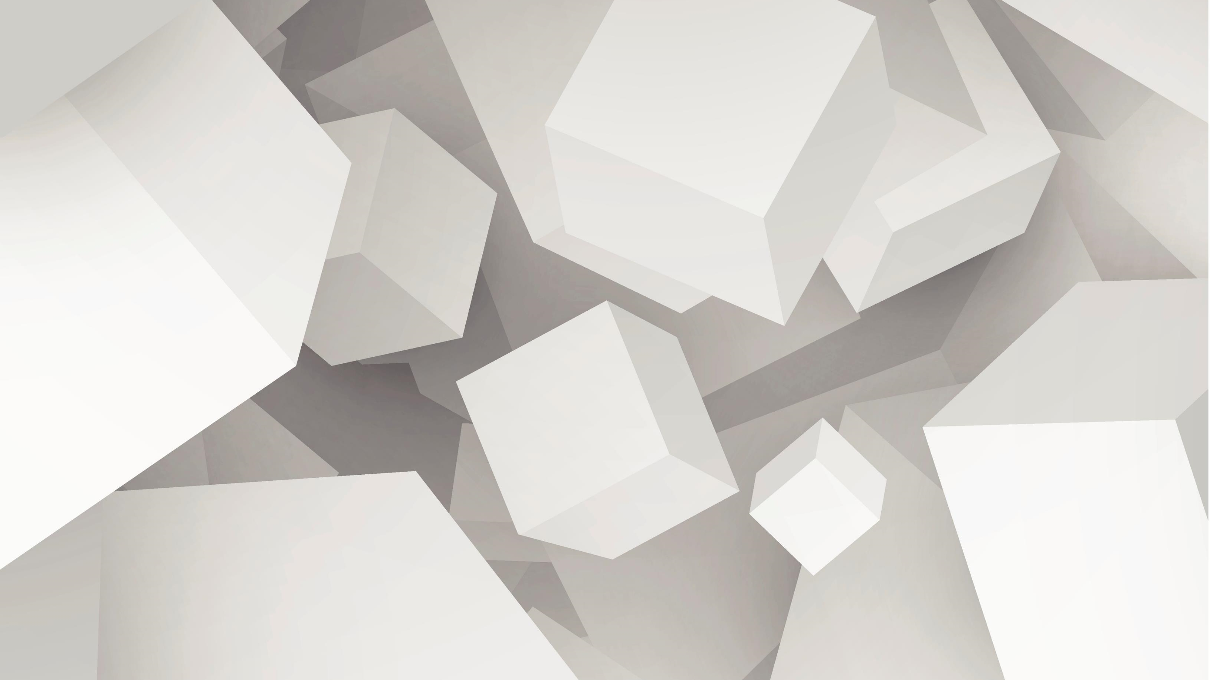
MORTION
Bora GÜNERAL
Dinçer İNCE
Barkın ZORLU

Slide 2


What is Mortion?
3D
Single player
Rouge-lite
Fast paced

Slide 3
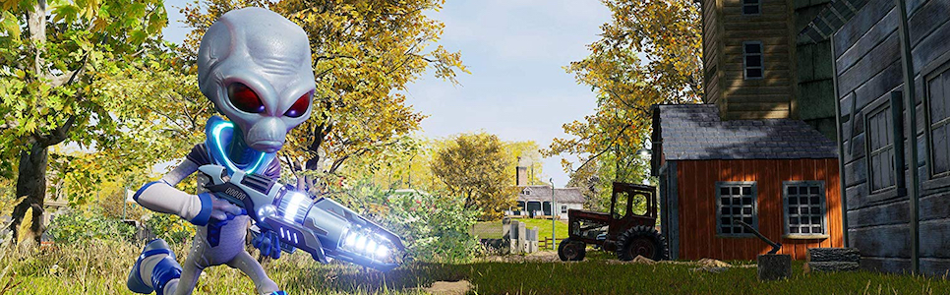
Concept and Environment
Destroy All Humans! (Inspiration)
The character is an alien
Superhuman abilities
Alien guns
Everything around us is hostile.
Main point is survive and finish the stage.

Slide 4
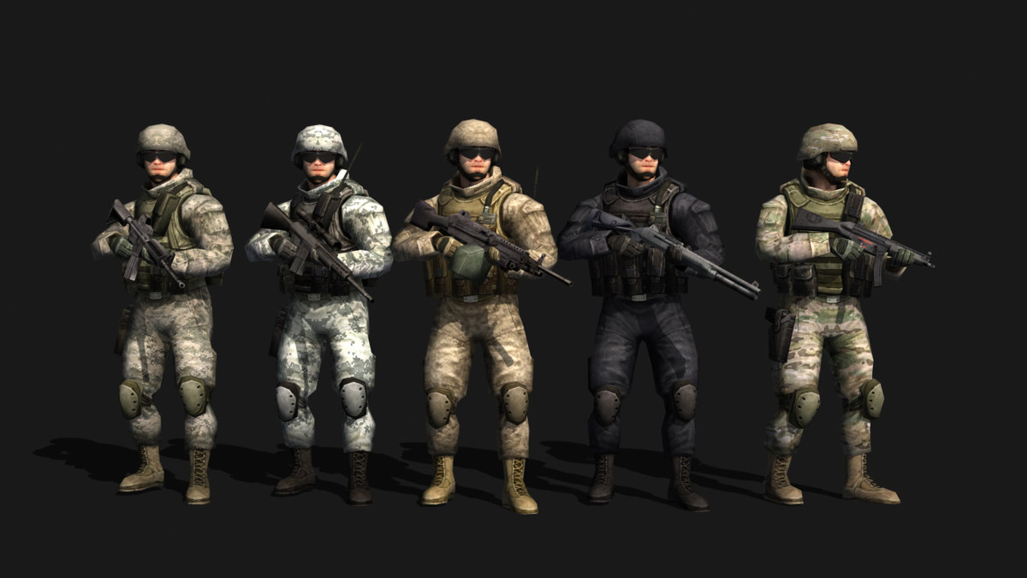
Enemies
The enemies will search for us.
They have slow bullet so that we can evade them.
They give XP once they killed.

Slide 5
Movement
Fast paced movement.
Based on evasion.
Skill based movement.

Slide 6
Shooting
Alien guns.
Unlimited ammo (aliens invented that).
Varity in guns.
Hit scan, traces (after hit).
Some weapons are projectile-based.

Slide 7
Level, XP and Skills
Basic leveling system.
Unlock abilities.
Improve abilities.
Keep XP after death.
Fear system.

Slide 8
Additional Properties
Minimal UI.
Fps limiter.
V-Sync.

