Slide 1

CS209:Artificial Intelligence
Course Project Title:Analysis of Public Sentiment in the
2024 U.S. Presidential Election
Submitted by: Team-11
Tapash Hiren Darji CS23BT036
2. Dileepan S K CS23BT049
3. Gaddam Viswavijeth CS23BT076
4. Reddimalla Ganesh Reddy CS23BT002
Course Instructor:
Prof. Dileep. A.D Mentor Name: Suraj

Slide 2
Outline
Introduction
Methodology
Dataset Description
Experimental Setup
Evaluation Metrics Used
Models
Results
Conclusion

Slide 3
Introduction
Social media, particularly Twitter (X), is a powerful medium for political discourse.
This study investigates how public sentiment evolved during the 2024 U.S. Presidential Election.
We use statistical and machine learning methods to analyze tweets collected from Dec 2024 to Jan 2025.
Objective: Predict sentiment using engagement metrics and textual features of tweets.

Slide 4
Methodology
Step-by-step process including:
1. Data Collection: Tweets on political topics during Dec 2024–Jan 2025.
2. Preprocessing: Cleaned data, standardized formats, and encoded sentiments numerically.
3. NLP: Tokenized tweets, removed stopwords/special characters, used Vectorisation ,applied TF-IDF/BERT.
4. Modeling: Implemented regression and classification models with/without NLP features.

Slide 5
Dataset Description
Attributes: Tweet text, timestamp, user handle, sentiment, likes, retweets.
Includes party affiliation and candidate names.
Sentiment labels: Positive, Neutral, Negative.
Time span: December 2024 – January 2025.

Slide 6
Experimental Setup
Models Used:
Linear & Polynomial Regression
Neural Networks (Regression & Classification)
K-Nearest Neighbors (KNN) Classifier
Two feature settings: with NLP and without NLP (using only likes/retweets).
Train-test splits applied for model validation and comparison.

Slide 7
Evaluation Metrics Used
Regression: Mean Squared Error (MSE), R-Squared (R²).
Classification: Accuracy, Precision, Recall, F1-Score.
Metrics assess model accuracy and generalization.
Used across all models and configurations.

Slide 8
Linear Regression
Analyzed relationship between tweet sentiment and features
Used numerical tweet vectors + engagement metrics (likes, retweets, etc.)
Selected key features (engagement stats, tweet )
Fit a linear equation (hyperplane) to model sentiment
Visualized prediction vs. actual plots

Slide 9
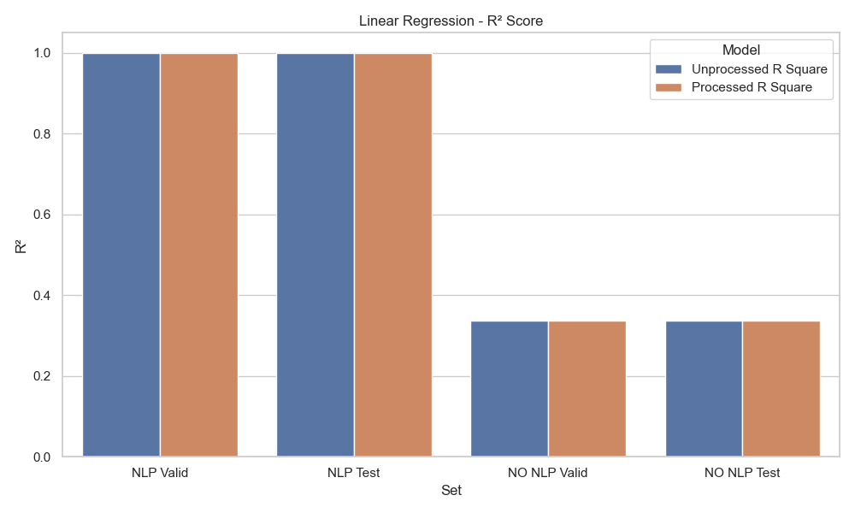
Linear Regression Performance

Slide 10
Neural Network Regression
Captures complex, non-linear relationships in data
Learns feature interactions through hidden layers
Trained on numerical tweet vectors + engagement metrics
Used ReLU activation in hidden layers for non-linearity
Optimized using backpropagation and the Adam variant of gradient descent.

Slide 11
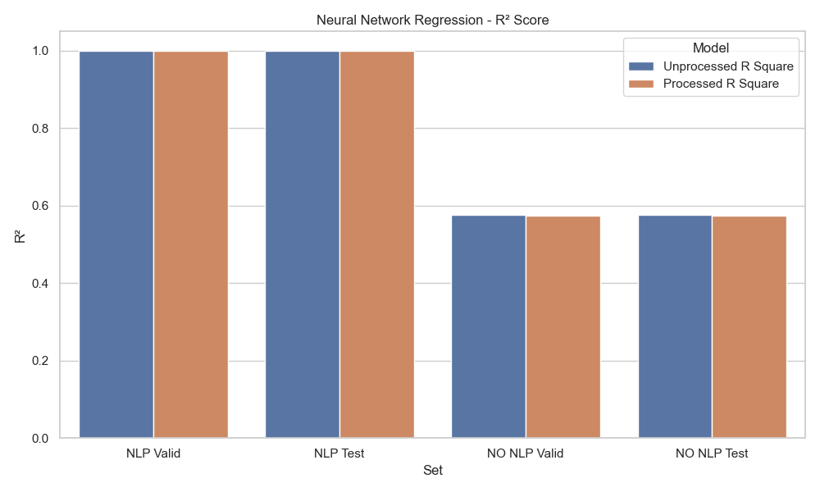
Neural Network Performance

Slide 12
Polynomial Regression
Models non-linear relationships in sentiment trends.
Fits a polynomial curve to engagement & sentiment data.
Useful for capturing patterns over time.
Equation includes higher-order terms (x², x³...).

Slide 13
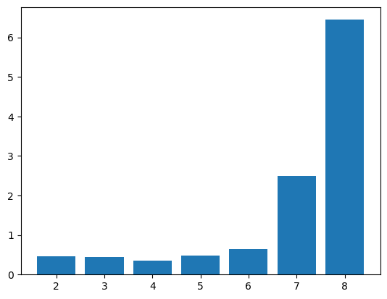
MSE->
MSE with different degree curve
degree ->
Overfitting: A high-degree polynomial can start fitting the noise in the training data rather than capturing the underlying trend. This makes the model perform poorly on unseen data, leading to a higher MSE.

Slide 14
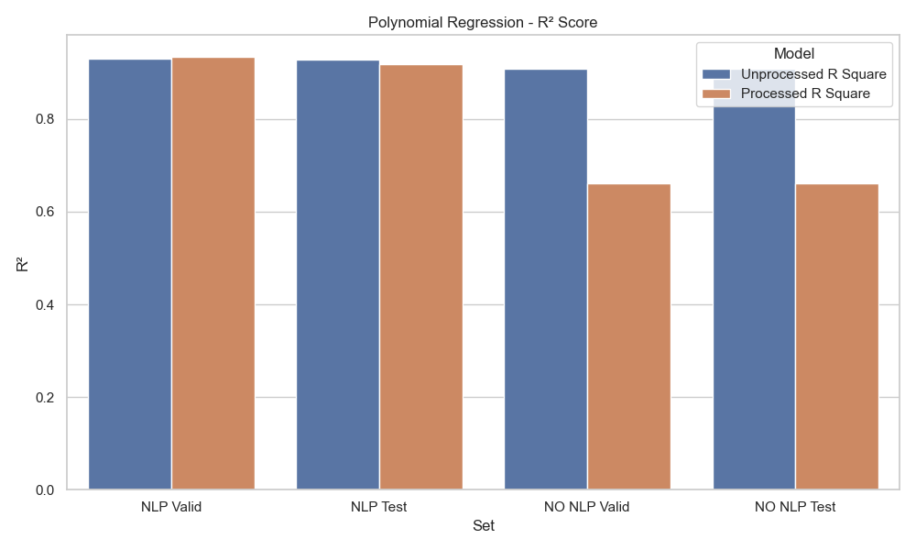
Polynomial Regression Performance

Slide 15
Comparison of Regression Models
With NLP: Linear & Neural Networks show high R² (~1.0).
Polynomial performs slightly below but consistently.
Without NLP: Polynomial is the best.
Textual features crucial for sentiment prediction.

Slide 16
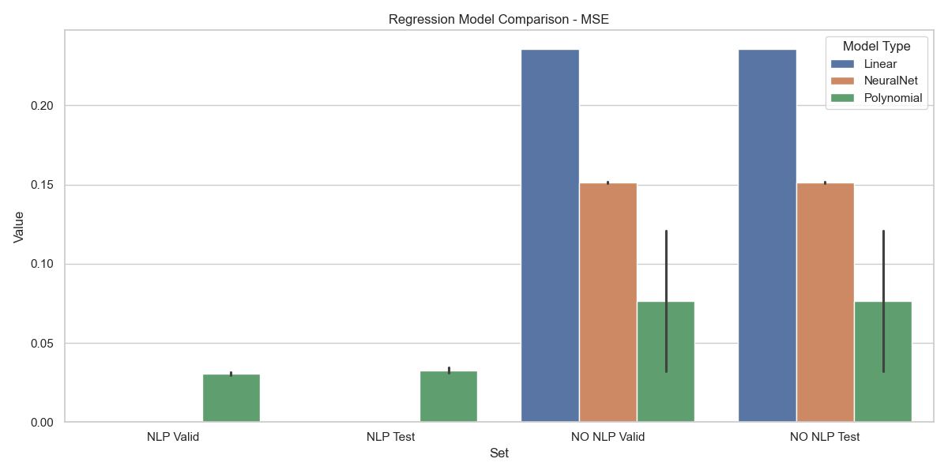
Regression Comparison: MSE

Slide 17
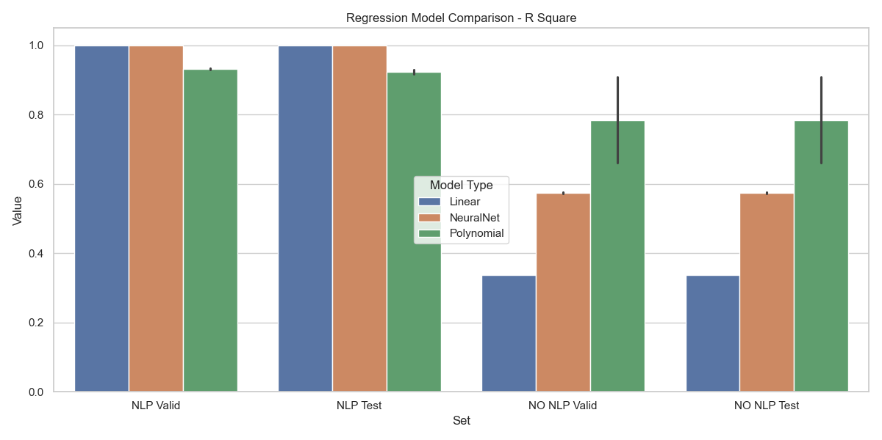
Regression Comparison: R² Score

Slide 18
KNN Classifier
General idea : KNN Classifier predicts the class of a data point based on the majority vote of its k nearest neighbors. It’s simple, effective, and works well for classification tasks.
Key Features Extracted:
Tweet Text – Raw textual content
Retweets – Number of retweets (numeric)
Likes – Number of likes (numeric)

Slide 19
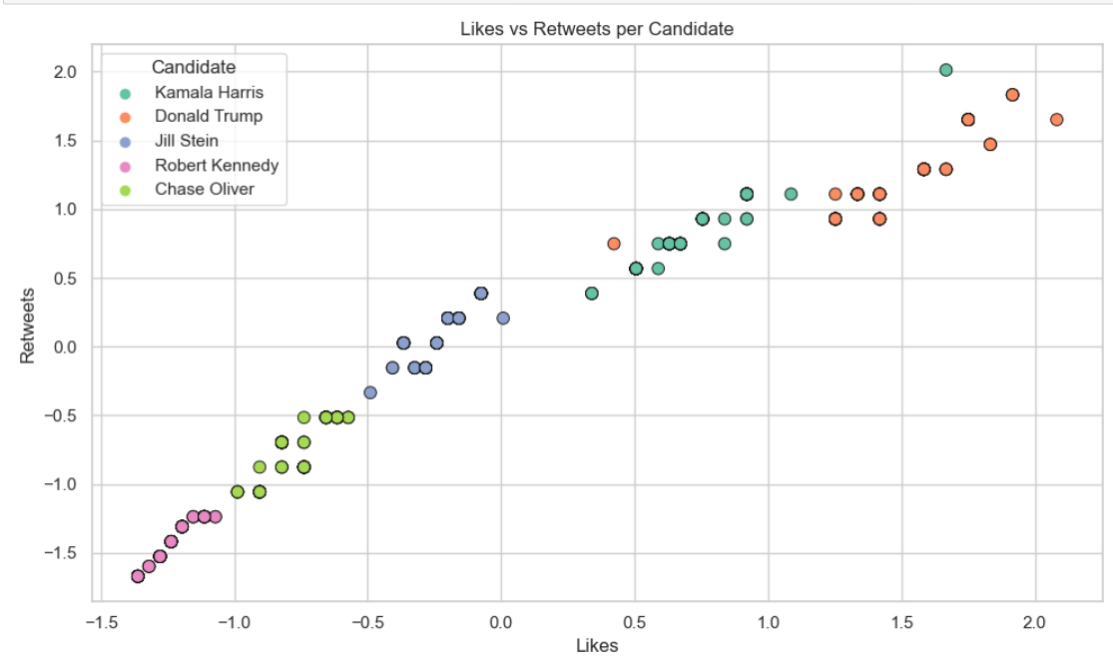
Interesting Observations:

Slide 20
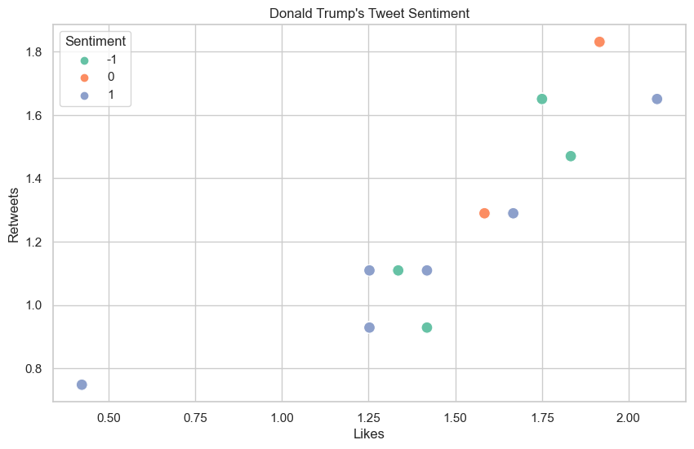

Slide 21
Accuracy using independent columns ‘retweets’ and ‘likes’ : 98%
BERT (Bidirectional Encoder Representations from Transformers) is a deep learning model developed by Google that understands language context by looking at words in both directions. It helps convert tweets into meaningful numeric representations for better sentiment analysis.
Accuracy using independent columns ‘retweets’, ‘likes’ and vectorized ‘tweet text’ : 100%

Slide 22
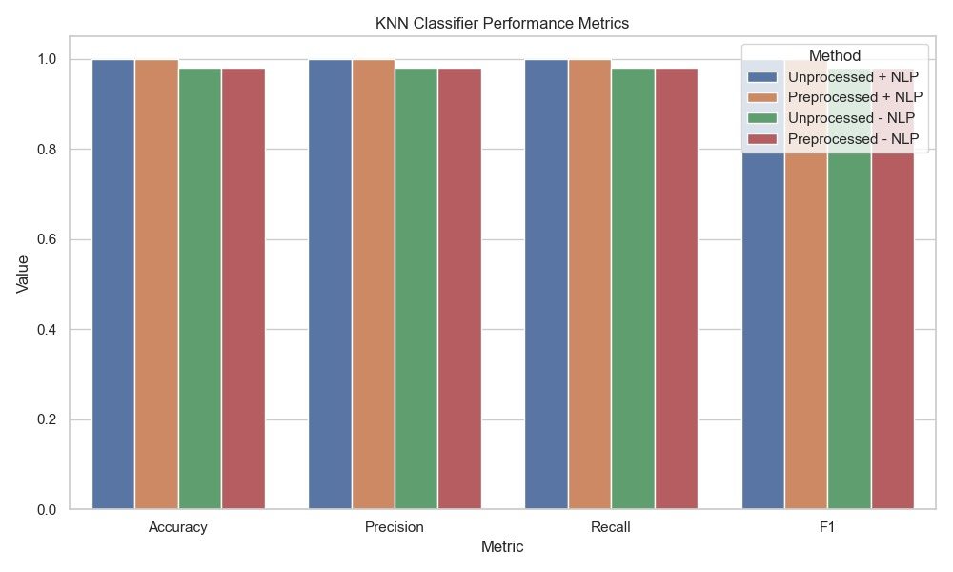

Slide 23
Neural Networks Classifier
Architecture: Utilized a feedforward neural network with one hidden dense layer for sentiment classification.
Input Layer: Text inputs were transformed using TF-IDF vectorization to create fixed-length feature vectors.
Two Hidden Layers: First Layer with 64 neurons, and the second with 32 neurons each using the ReLU (Rectified Linear Unit) activation function.
Output Layer: Contains 3 neurons with a Softmax activation function to output class probabilities.
Classification Objective: Predict sentiment classes — positive, negative, or neutral, based on input text.

Slide 24
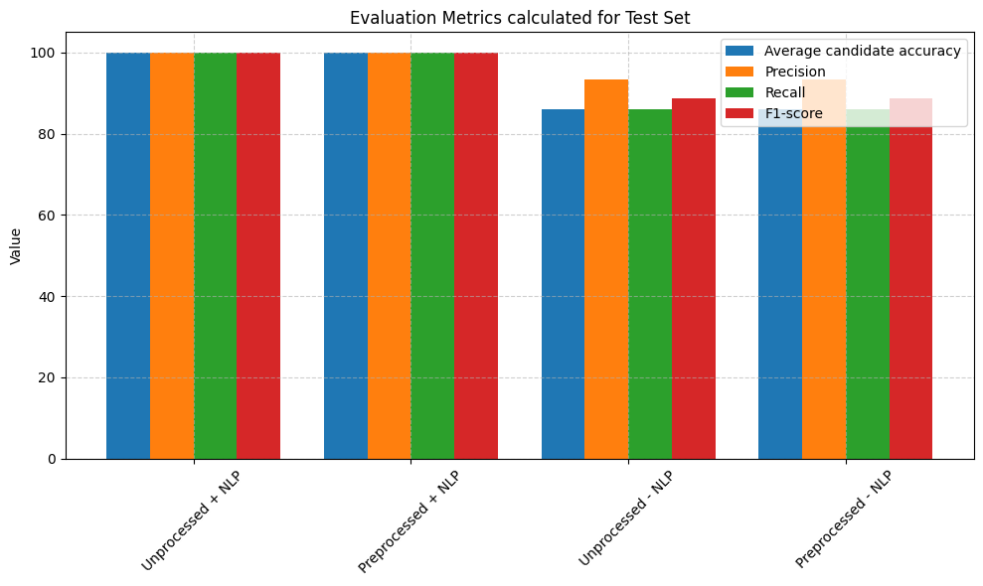
Evaluation Metrics for the Test Set

Slide 25
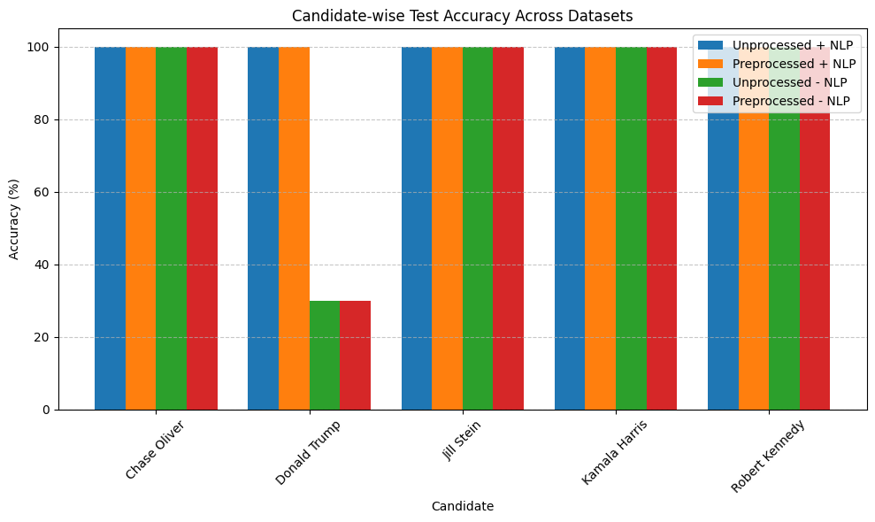
Candidate Wise Test Accuracy

Slide 26
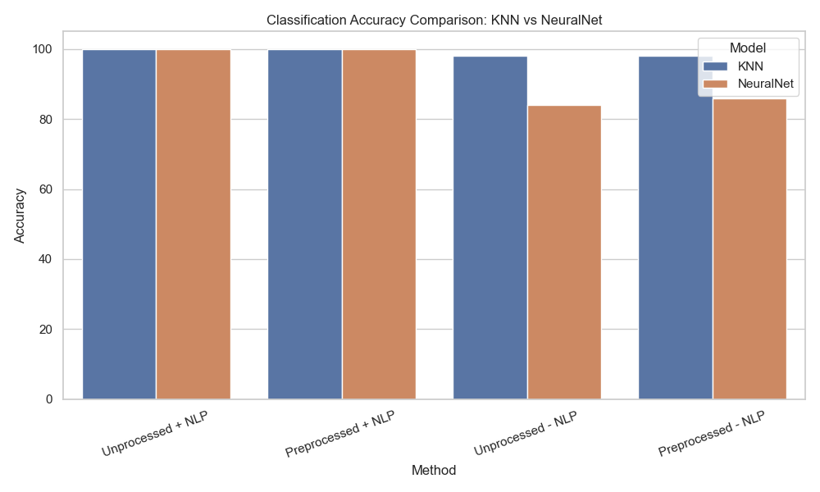
Classification Accuracy Comparison

Slide 27
Comparison of Classification Models
With NLP: All models achieve near-perfect accuracy.
Without NLP: KNN outperforms Neural Network slightly.
Preprocessing has minimal impact – NLP is key factor.
Simpler models perform well in low-feature settings.

Slide 28
Results Summary
Regression:
Polynomial Regression yielded the lowest MSE and highest R² scores.
NLP features dramatically improved regression accuracy.
Classification:
Neural Networks achieved ~100% accuracy across all configurations.
KNN performance was the best with almost 100% accuracy across all models.

Slide 29
Sentiment Trends Over Time
Chase Oliver, Kamala Harris, Jill Stein: Consistently positive (1.0).
Robert Kennedy: Flat sentiment (0.0).
Donald Trump: Fluctuates significantly – controversy driven.
Time-series plots reveal evolving public mood.

Slide 30
Key Observations
Textual data (NLP) greatly improves model performance.
KNN is robust even without NLP features.
Neural Networks shine with rich features.
Simple models still perform well in sparse settings.

Slide 31
Conclusion
• NLP-based feature engineering boosts model performance.
• Simple models like KNN and Polynomial Regression outperform complex models.
• Engagement features alone insufficient for reliable sentiment prediction.
• Highlights the importance of textual context in social media analysis.

Slide 32
Thank You!

