Slide 1
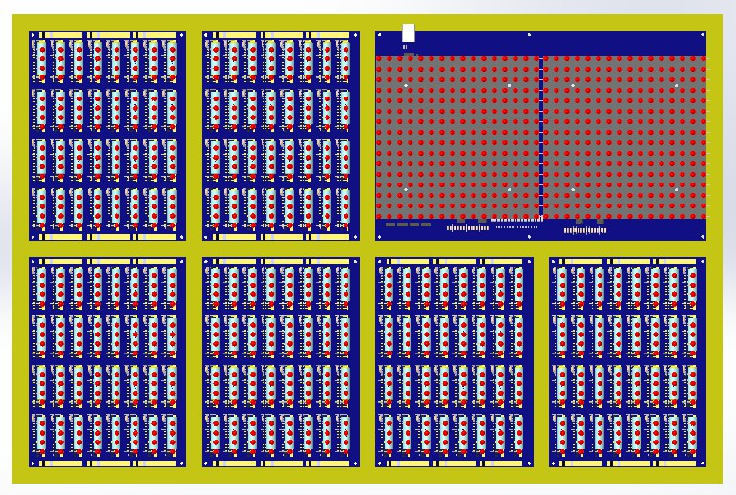
16-bit
FULL ADDER with CARRY
IP REG
AP REG
(16bit)
RAM, CIN, COUT
MCU loader, LED display,
Wi-Fi& USB Connection
TMP REG
(16bit)
CMD REG
(12+4bit)
SEQUENCER,
CMD SELECTOR
and some other logic

Slide 2
16 bit ADDRESS BUS
TMP
REG
16bit
IP
REG
16bit
RAM
64K
x16bit
ADDER
+
CARRY
AP
REG
16bit
COUT
CMD
REG
12bit
CIN
4bit
CMD LOGIC
16 bit DATA BUS

Slide 3
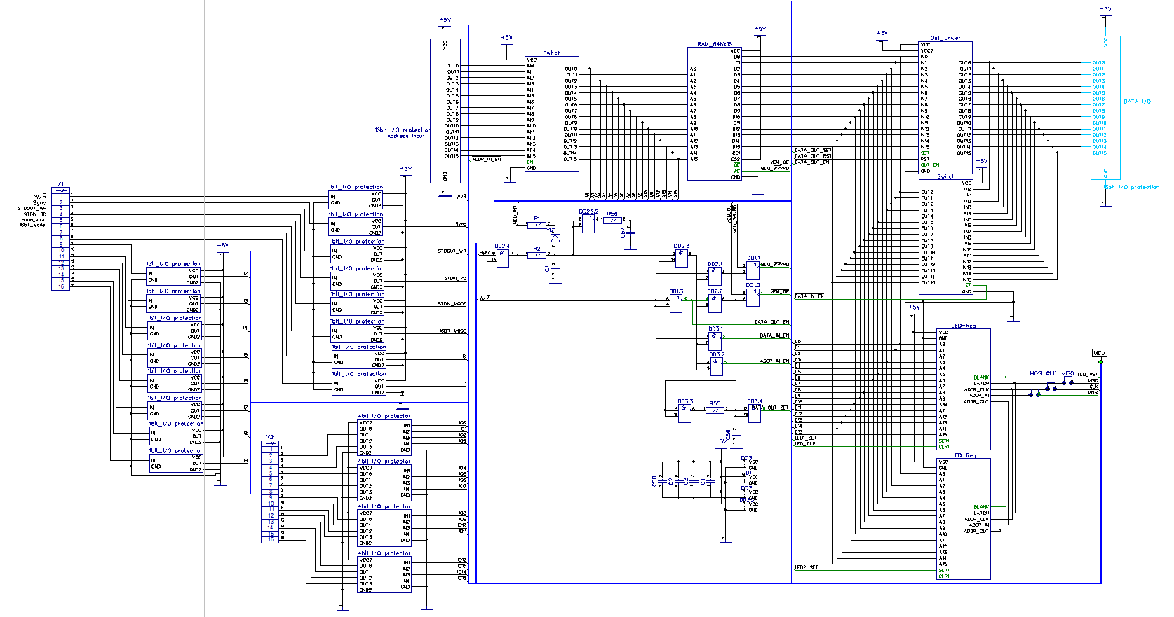
RAM Main Flow
Address input buffer

Slide 4
Word-length register
IP Cache
Cache
valid
Cache
invalid
<<[>[>+>+<<-]>>[<<+>>-]<<<-]
Cache
Invalidated here
*AP==0?
Yes
No
Invalidate
Cache
IP = IP + 1
IP Cache is valid?
Yes
No
IP = IP Cache + 1
Left IP Lookup

Slide 5
Cache
valid
Cache
invalid
<<[>[>+>+<<-]>>[<<+>>-]<<<-]
innerLoop1
innerLoop2
outterLoop
need to find
This IP address
*AP==0?
No
yes
Cache
invalid
Left IP Lookup
IP = IP + 1

Slide 6
IP Cache
Cache
valid
Cache
invalid
<<[>[>+>+<<-]>>[<<+>>-]<<<-]
IpStack=0
IpStack=1
IpStack=2
IpStack=1
IpStack=2
IpStack=1
do
{
IP = IP-1;
if (‘]’)
IpStack++;
if (‘[’)
IpStack--;
}while(IpStack!=0)
Left IP Lookup

