Slide 1
SKYHACK 2.0
Vaibhav Gupta (2K21/EP/105)
Kshitij Agarwal
(2K20/EP/66)
THEME:
Optimizing Call Center Performance
Repository link: GitHub

Slide 2
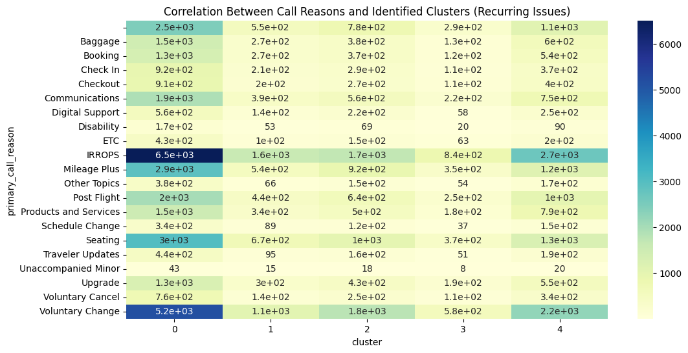
Data Overview and predicting primary call reasons
Dataset Size: 71,810 records
Missing Data: 5,157 records with missing primary_call_reason, which we predicted using machine learning.
Clustering of Call Transcripts: Grouped similar call types to identify common patterns and themes using NLP.
Predicting Missing Call Reasons: Used TF-IDF for text vectorization and Random Forest for classification to predict missing primary_call_reason.
Predicted call reasons are stored in Test.csv

Slide 3
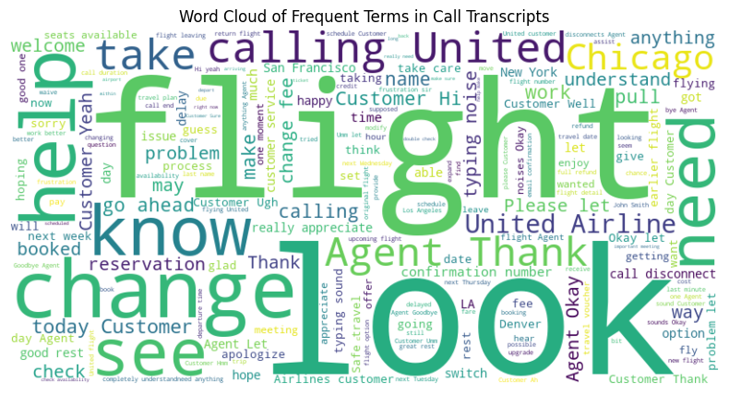
Key Findings for self solvable issues
Top Call Reasons by Volume: IRROPS, Seating, and Mileage Plus accounted for a significant portion of calls.
Common Themes in Call Transcripts: Terms like "flight", "agent", and "refund" appeared frequently across clusters, indicating frequent issues with flight changes and refunds.
Clustering Results: Revealed key categories (flight changes, delays, baggage issues) that could be optimized through self-service.
92.63% of Calls Could be Solved via IVR.

Slide 4
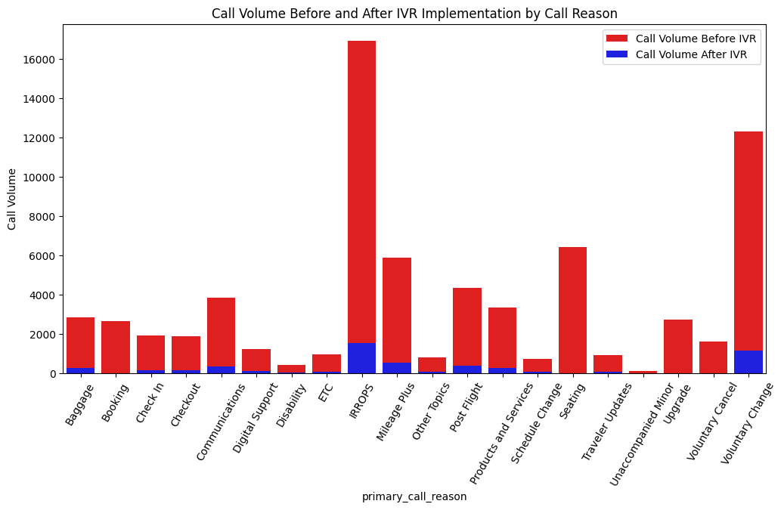
Recommendations for Optimizing Call Center Performance
Enhance IVR System by providing self service options for:
Booking and Check-in
Flight Status and Baggage Tracking
Proactive Customer Communications for common issues (e.g., flight delays, cancellations) via text or email to reduce call volume.

Slide 5
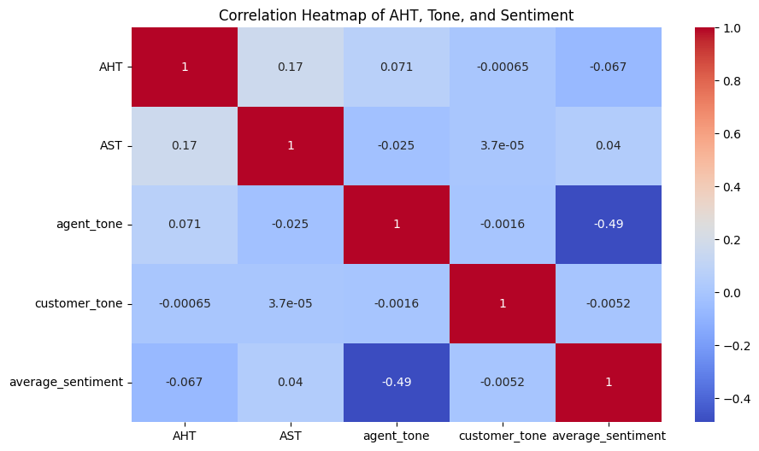

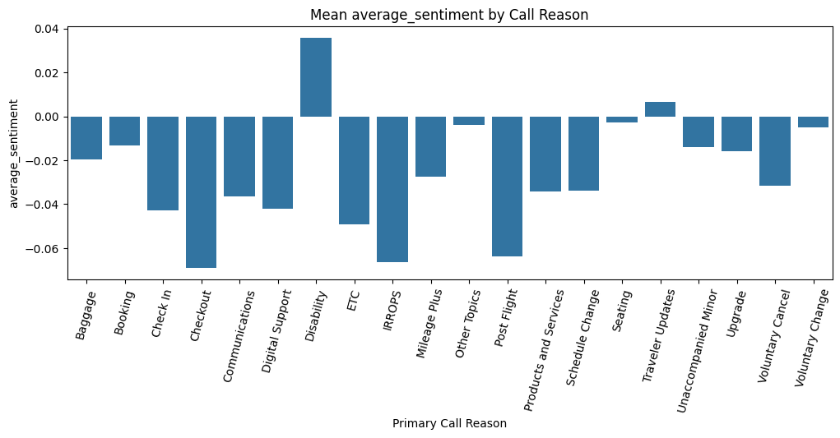
3. Agent Training:
Improve agent training on handling complex issues like IRROPS and Voluntary Change to reduce AHT.
Use sentiment analysis data to improve customer interactions and reduce negative experiences.

Slide 6
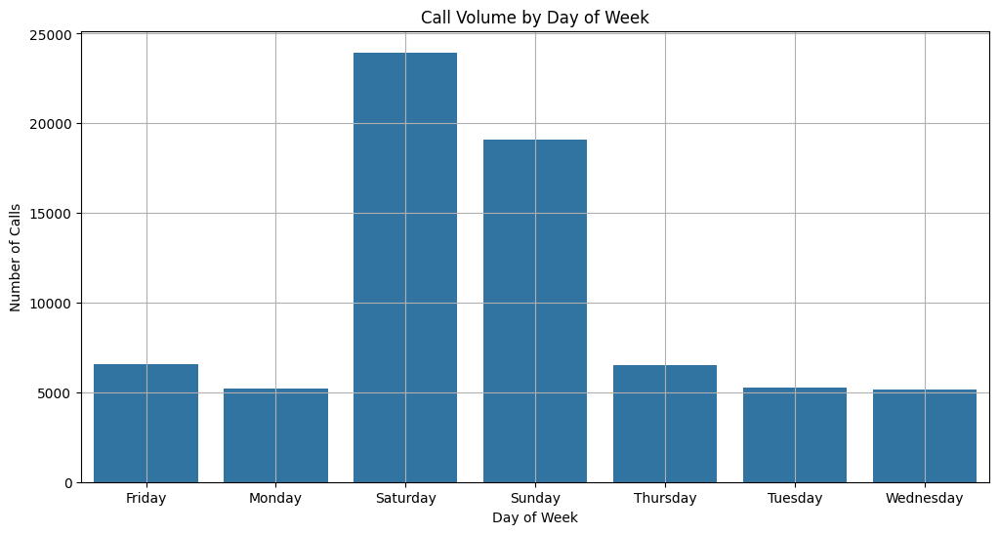
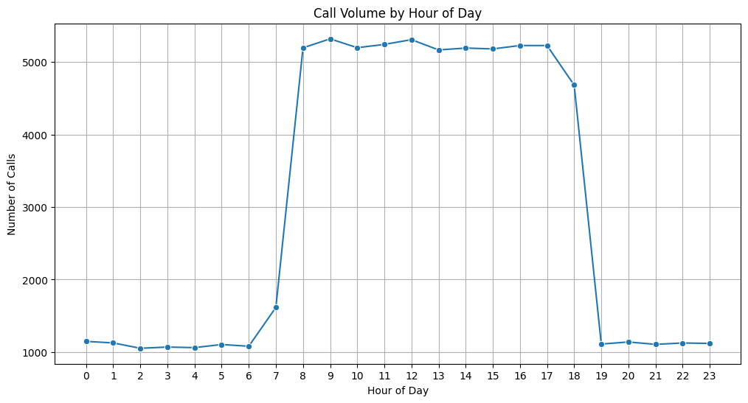
4. Peak Hour Optimization and Agent Allocation:
Ensure more agents are available during peak times, such as early morning and weekdays.
Flexible Scheduling: Use part-time or on-call agents to accommodate surges in call volume.
Reduced AHT and AST: More agents during peak hours ensures quicker response times and faster resolution.

Slide 7
5. Key Factors Contributing to Extended AHT:
Complex Call Reasons: Calls related to IRROPS (Irregular Operations) or Refunds tend to have longer handling times.
Volume of Calls: Increased call volume can lead to rushed conversations, resulting in longer AHT.
Percentage difference between the average handling time for the most frequent and least frequent call reasons: -5.3%
Average Speed to Answer (AST): Time spent by the customer in the queue until the agent answers the call.
Formula:
AHT = Total Handle Time / Total Number of Calls
Average Handle Time (AHT): Time from when an agent picks up the call to when they hang up.
Formula:
AST = Total Waiting Time / Total Number of Calls

Slide 8
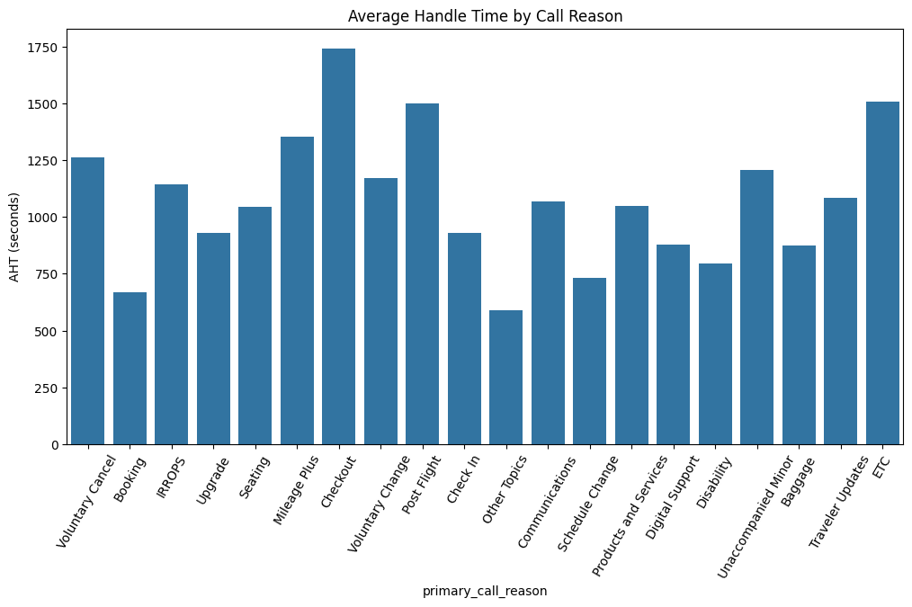
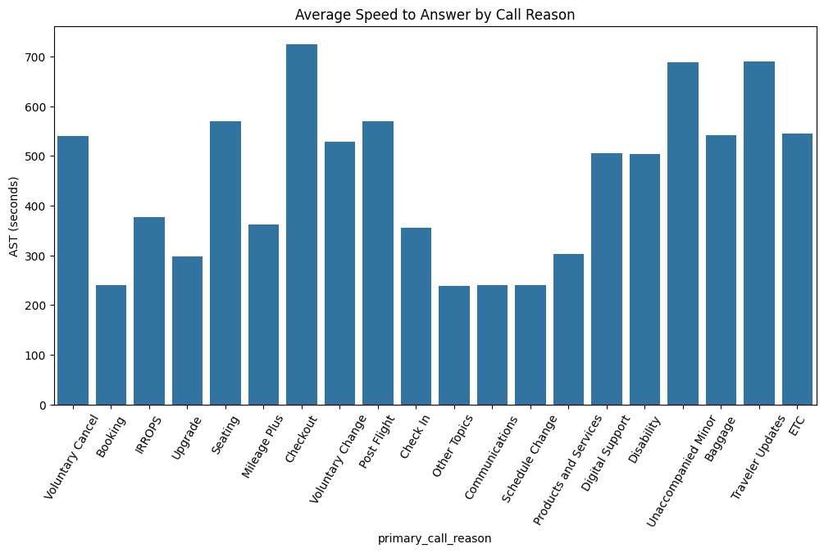
Average Handle Time (AHT) by Call Reason
Average Speed to Answer (AST) by Call Reason

