Slide 1


File organiser
System Programming(002), Fall 2019

Slide 2
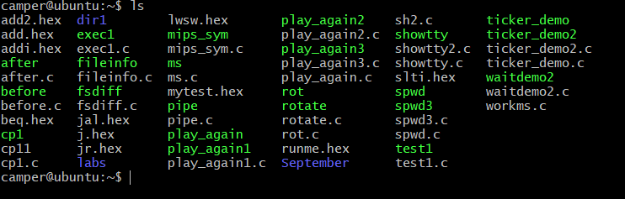
File organiser on Linux
We noticed the problem with file organisation on our VM machines. There are a lot of files in different places. And we don’t have a time to organise it.
That’s why we wanted to make a program which handle this disorganisation of files.
This includes grouping the files and deleting existing directories if those one are messy as well.
Useful for lazy/unorganized people, which includes most of the students.

Slide 3
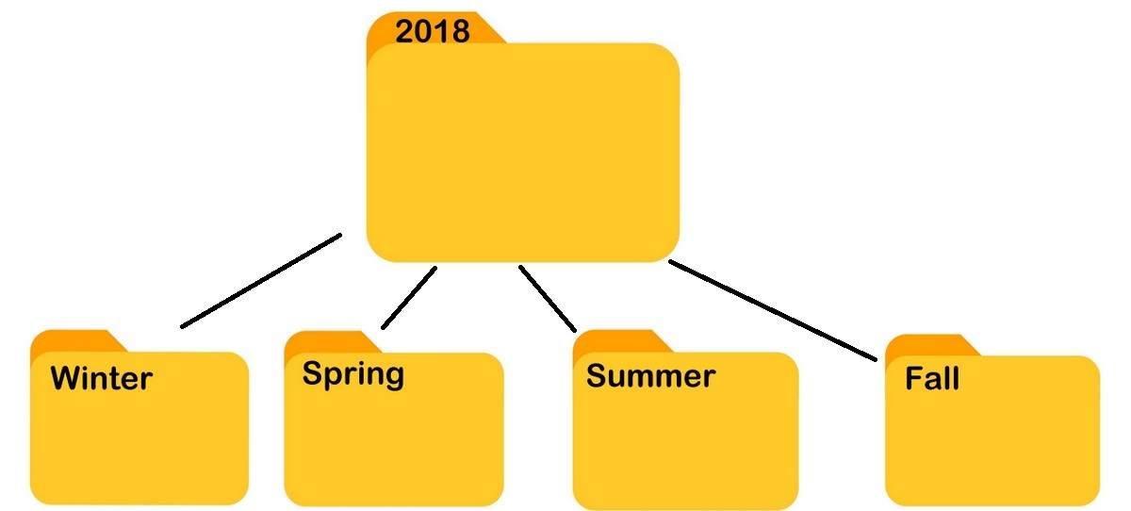

Program description
Our program has a few options:
Delete all children directories and put all files in one place to be able to organise them properly
Assign all files to directories by date of creation, e.g. folder 2018, 2019 each of them consisting of directories with months
Assign all files to directories by type of file ( .c, .txt, .mp3)
Assign all files to directories by alphabetical order ( directories A-J, K-R, S-Z)
Assign all files to directories by type of group or owner

Slide 4

System calls used
Mainly those linked to the directories :
Opendir, readdir, closedir, rmdir, mkdir
And those linked to the files :
Stat, rename
Others :
chdir

Slide 5

Work repartition
Team number #15
- Zofia Matyjewska : grouping the files
- Jean de Malliard : deleting existing directories

