Slide 1
Re-implementation of the Boogie verification condition generator
Böhm Simon
Danger Daniel
Roob Julius

Slide 2
Content
Boogie
Parsing
Verification
Future work

Slide 3
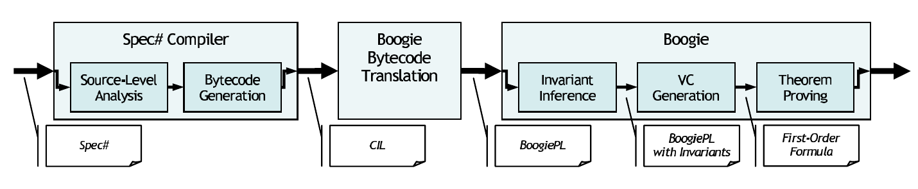
Boogie
Intermediate Verification Language
by Microsoft Research
Original to verify Spec# programs
Meanwhile also translation from c code to Boogie

Slide 4
Boogie - Example
procedure Find(a: int, b: int) returns (k: int)
requires a <= b;
requires (forall j: int :: a < j && j < b ==> f(j) != K);
ensures f(k) == K;
{
goto A, B, C; // nondeterministically choose one of these 3 goto targets
A:
assume f(a) == K; // assume we get here only if 'f' maps 'a' to 'K'
k := a;
return;
B:
assume f(b) == K; // assume we get here only if 'f' maps 'b' to 'K'
k := b;
return;
C:
assume f(a) != K && f(b) != K; // neither of the two above
call k := Find(a-1, b+1);
return;
}

Slide 5
Parsing
PLY (Python Lex-Yacc)
  Python implementation of the compiler construction tools lex and yacc
Lex
  generates a lexical analyzer (lexer)
  divides the Boogie source code into single tokens
Yacc
  Generates a parser
  Costs the most time because time-consuming conversion of all the Boogie grammar rule to the notation of yacc

Slide 6
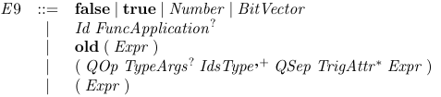
Parsing - Example
def p_E9_number(p):
''' E9 : NUMBER '''
p[0] = Number(p[1])
def p_E9_id(p):
'''E9 : ID
| ID '(' ')'
| ID '(' exprlist ')' '''
if len(p) == 2:
p[0] = Variable(p[1])
else:
pass
def p_E9_bool(p):
'''E9 : FALSE
| TRUE '''
if p[1] == 'true':
p[0] = Boolean('true')
else:
p[0] = Boolean('false')
def p_E9(p):
'''E9 : BITVECTOR
| OLD '(' expr ')'
| '(' FORALL typeargs idstypelist QSEP expr ')'
| '(' FORALL idstypelist QSEP expr ')'
| '(' EXISTS typeargs idstypelist QSEP expr ')'
| '(' EXISTS idstypelist QSEP expr ')'
| '(' FORALL typeargs idstypelist QSEP trigattr expr ')'
| '(' FORALL idstypelist QSEP trigattr expr ')'
| '(' EXISTS typeargs idstypelist QSEP trigattr expr ')'
| '(' EXISTS idstypelist QSEP trigattr expr ')' '''
pass
def p_E9_bracket(p):
'''E9 : '(' expr ')' '''
p[0] = p[2]

Slide 7
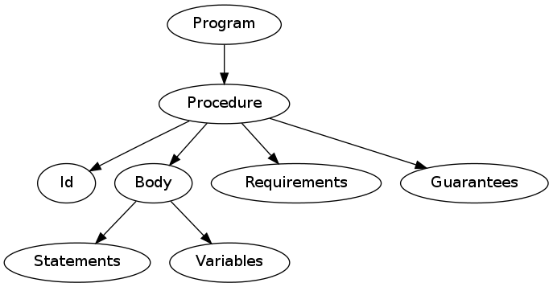
AST

Slide 8
Verification
Generate formulas for variable assignments
Single assignment form
Pass them to Z3
procedure p(z:int){
requires z>=3;
var x:int;
x = 2;
x = x+z;
assert x < 42;
}
E = {z_0 >= 3}
E = E U { x_0 = 2}
E = E U { x_1 = x_0 + z_0}
sat(E ^ not( x_1 < 42))

Slide 9
Future work
Lexer and Parser completion
Building of the AST still requires work
  We build only the parts necessary for simple programs

