Slide 1
Eye Blink Prediction using EEG
Yao Zou & Zuchen Zhang

Slide 2
Introduction – two main application
Autonomous driving --- monitoring driver’s fatigue
Based on computer vision and image pattern recognize
Medical assistance --- the important way for impaired person to communicate with the world
EEG signal prediction

Slide 3
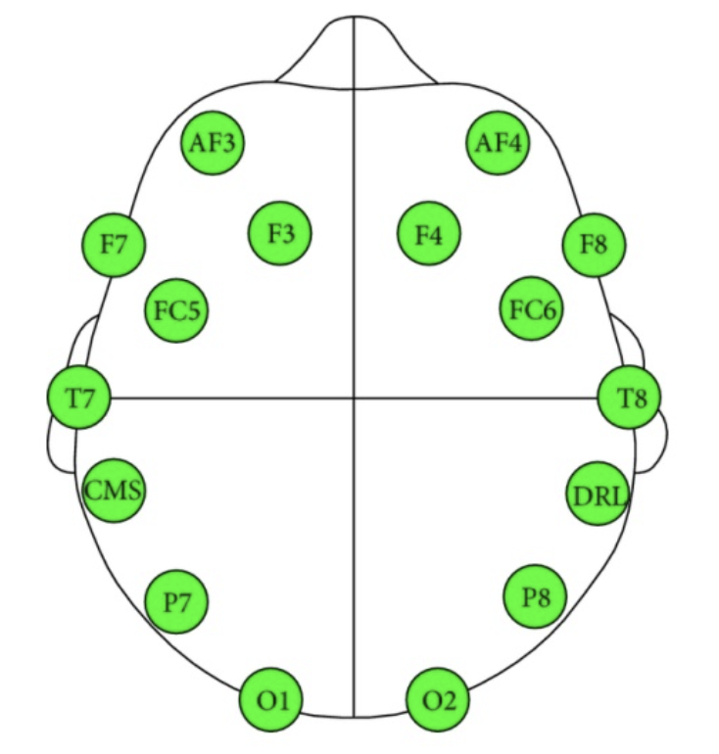
Introduction– EEG signal
EEG generated from brain electrical activity sensor can represent eye state, simply the open and close state
Sensor position

Slide 4
Method – Feature Selective(FS)
System will generate a 14-dim data, but whether all those data can be useful, we will implement a feature selective method to generate new sequences of data from train data set, algorithm as follows
14 dim original measurement
Sliding windows
The
sequence
of
new
feature
.
.
.

Slide 5
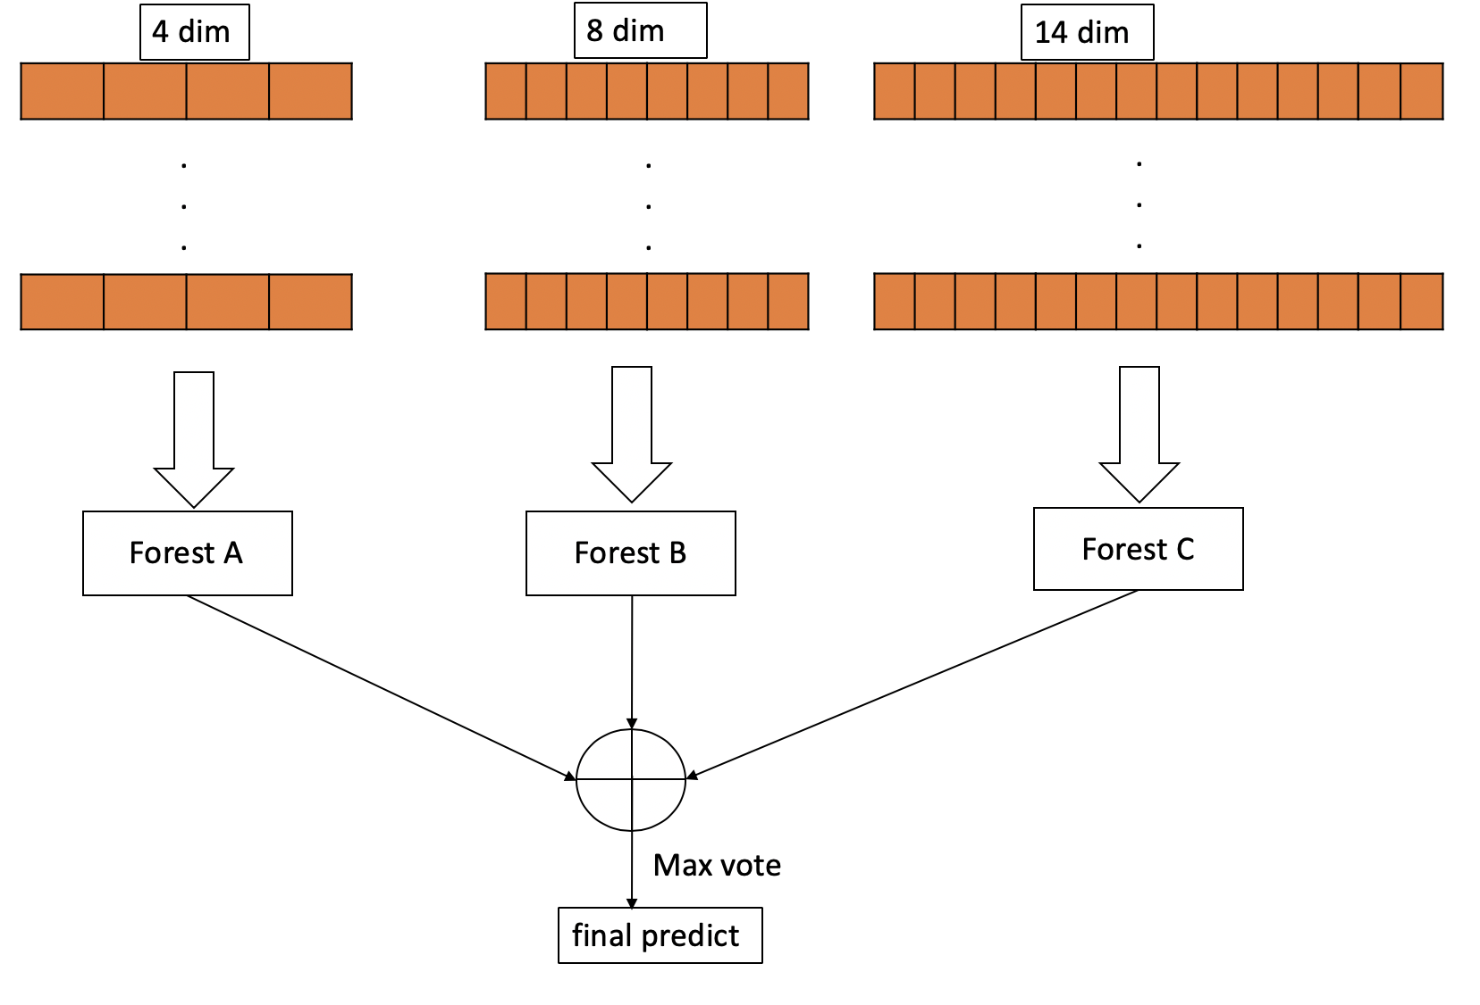
Method – FS with single decision tree
Feature Selective algorithm generate new training data set, each data set will be implemented with a single decision tree, by using the max vote principle we can get the final prediction result

Slide 6
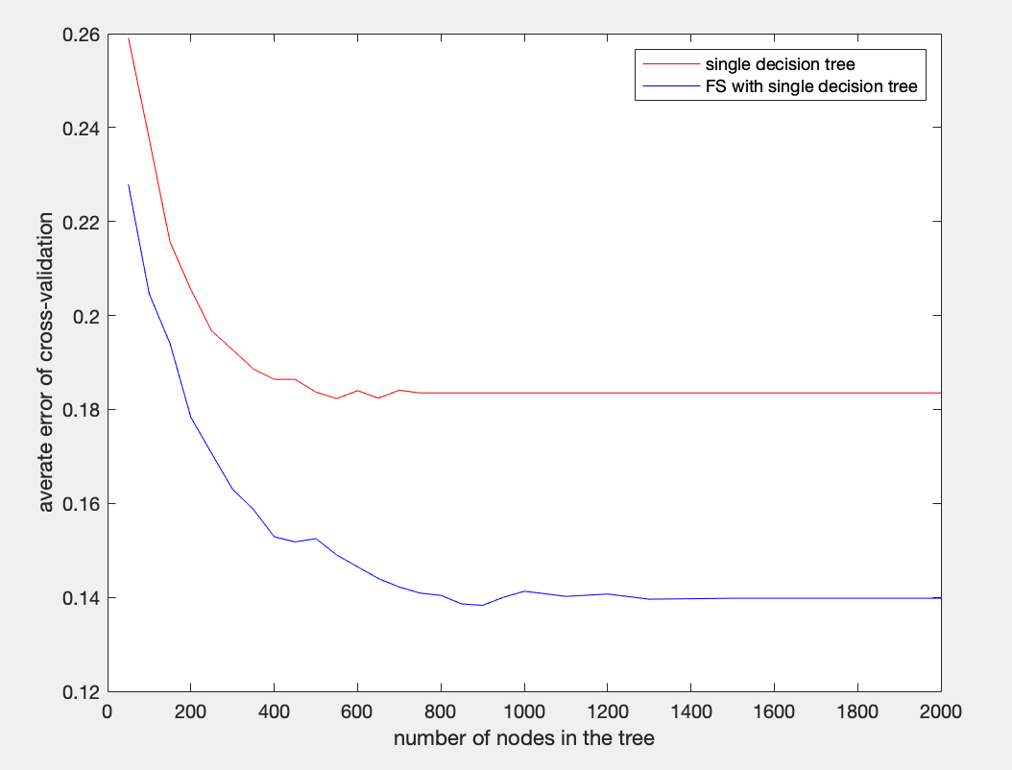
Experiments
Using 10-fold cross-validation on the training data, average error rate is the metric
For the same split nodes in the decision tree, with feature selective algorithm, single decision tree will perform better

Slide 7
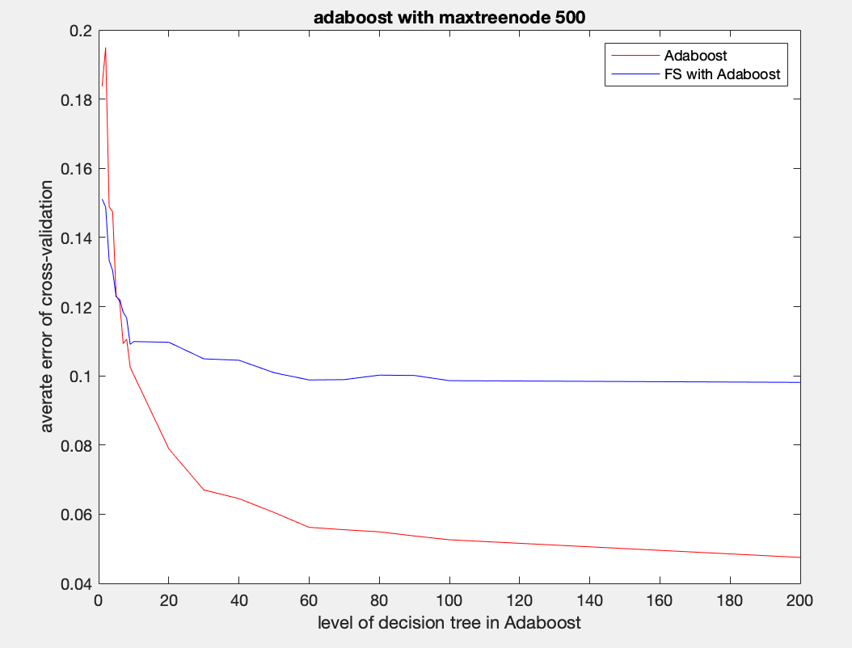
Experiments
In this experiment, we devise the Adaboost algorithm with 500 split nodes for each tree, but with different level.
When level is less then 5, FS algorithm can help to augment predict ability, but when level gets bigger, FS will be useless.

Slide 8
Test in Kaggle
We fully test models of SVM, single decision tree, FS single decision tree, Adaboost.
model | SVM(Linear) | FS&SVM(Linear) | Single tree( 500 splits) | FS & Single tree(500 splits) | Adaboost(500 levels)
score | 0.5 | 0.53962 | 0.80899 | 0.83138 | 0.95611

Slide 9
conclusion
By predicting the test data set, we can conclude this new feature selective method can help to improve the performance of some weak classifiers.
The Adaboost performs best among all the models, as well as it has much more complex structure.

