Slide 1
Eye Blinking Prediction using electroencephalography(EEG)
Name : Yao Zou & Zuchen Zhang
NUID : 001352361 & 001302761

Slide 2

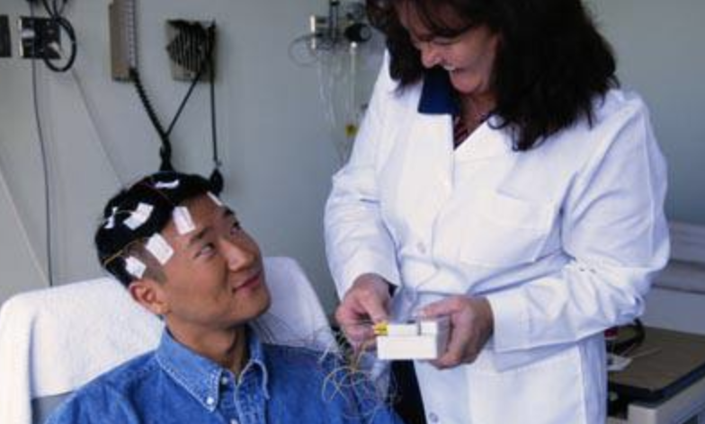
Introduction – motivation
application
Autonomous driving --- monitoring driver’s fatigue to improve driving safety
Medical assistance --- an important way for impaired people to communicate with the world
Prediction methods
EEG signal prediction
Approaches based on computer vision and image pattern recognition. However, images are easily affected by illumination, image scale and glasses people wear, etc.
https://blog.safetyglassesusa.com/fighting-driver-fatigue/
https://www.myvmc.com/investigations/electroencephalogram-eeg/
Nassr Alsaeedi* and Dieter Wloka “Real-Time Eyeblink Detector and Eye State Classifier for Virtual Reality (VR) Headsets (Head-Mounted Displays, HMDs)” Sensors (Basel). 2019 Mar; 19(5): 1121.
Królak, A. & Strumiłło, P. Univ Access Inf Soc (2012) 11: 409. https://doi.org/10.1007/s10209-011-0256-6

Slide 3
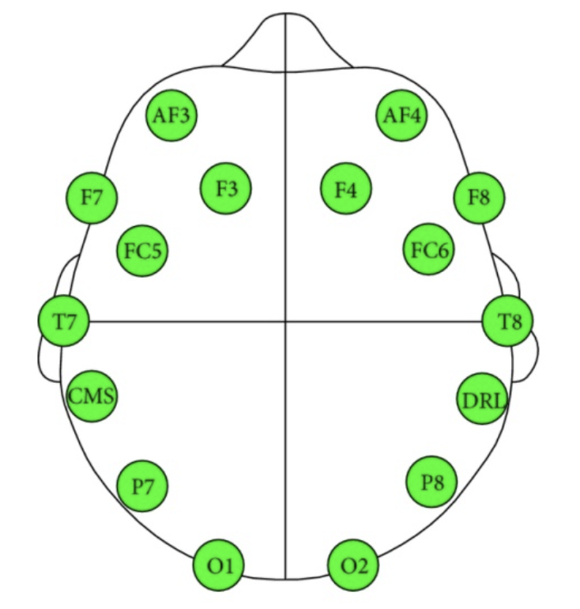
Introduction– Data
The objective of our project is to train an optimal model for eye blinking prediction based on 14-dimensional EEG signals. There are only 2 states of eye blinking which are open and closed, so basically we should construct a binary classifier to predict eye blinking.
Training data set consists of 10000 14-dimensional observations with labels. 10-fold and leaving out first 10% cross validation methods will be implemented on it. Besides, testing data set with 4980 observations (unlabeled) is provided by Kaggle.
schematic of data collection
S. Vachiravel, Eye State Prediction using EEG Signal and C4.5 Decision tree algorithm, March 2016.

Slide 4
Method – Feature Selective(FS)
Our training data are 14-dimensional, but to determine whether all dimensions are useful, we implement a feature-selective method to generate new sequences of data from training data, and the algorithm is shown as follows:
14-dimensional original measurement
Sliding windows
The
new
sequence
of
selected
features
.
.
.
Zhou, Zhi-Hua, and Ji Feng. "Deep Forest." arXiv preprint arXiv:1702.08835 (2017).
Figure A: diagram of feature-selective algorithm

Slide 5
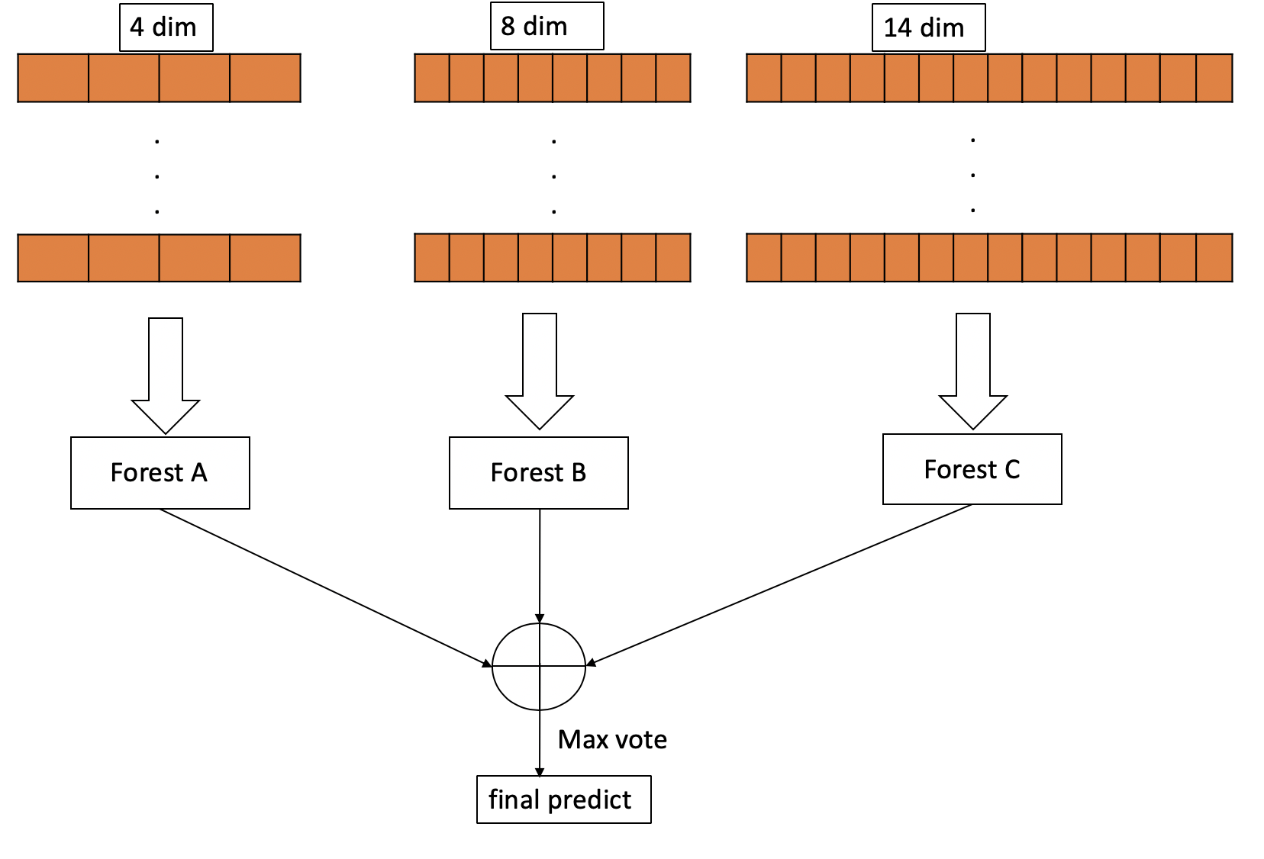
Method – FS with single decision tree
After feature-selective algorithm has generated new training data sets, each data set will be used to train a single decision tree, and by using the max vote principle we can get the final prediction result.
Figure A: framework of ensemble learning with feature-selective algorithm

Slide 6
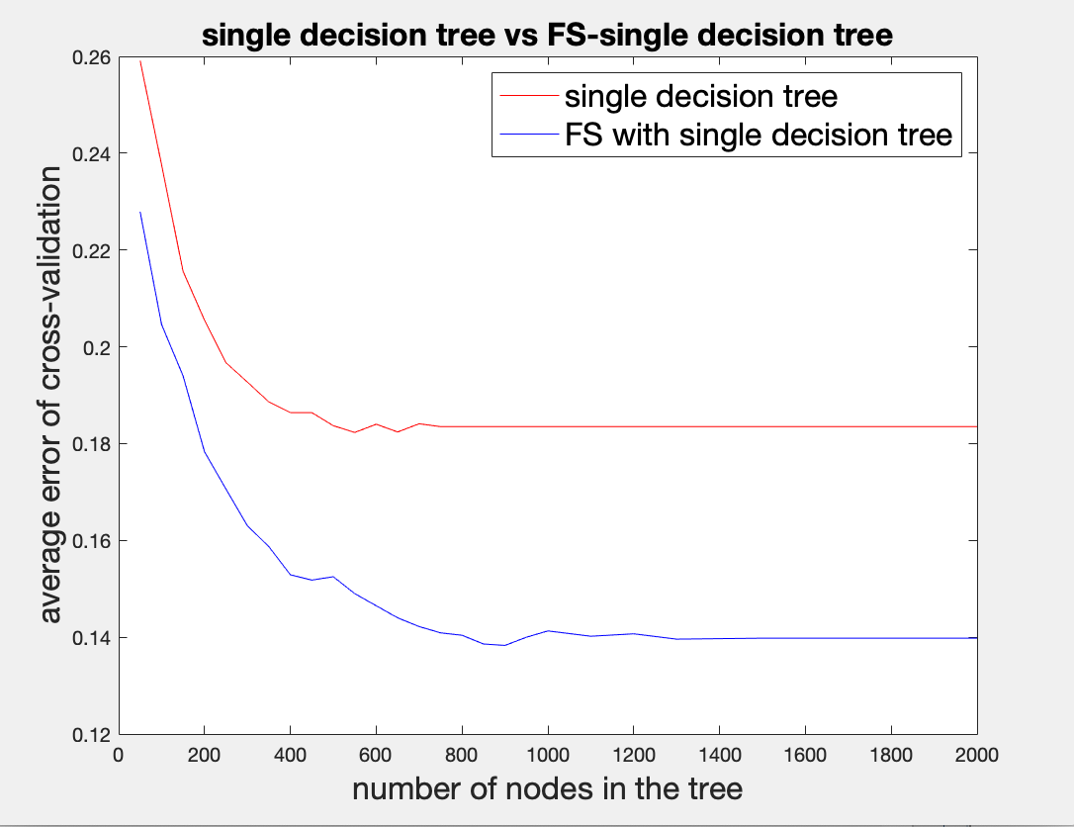
Experiments- single decision tree
We use 10-fold cross-validation on the training data, and average error rate is the metric.
For decision trees with the same number of nodes, single decision tree will perform better if integrated with feature-selective algorithm, which gives a smaller average error.
Besides, as the number of nodes becomes larger, the average error rate will converge to a constant, which indicates there is a limit of prediction ability for the model.
Figure A: single decision tree vs FS-single decision tree

Slide 7
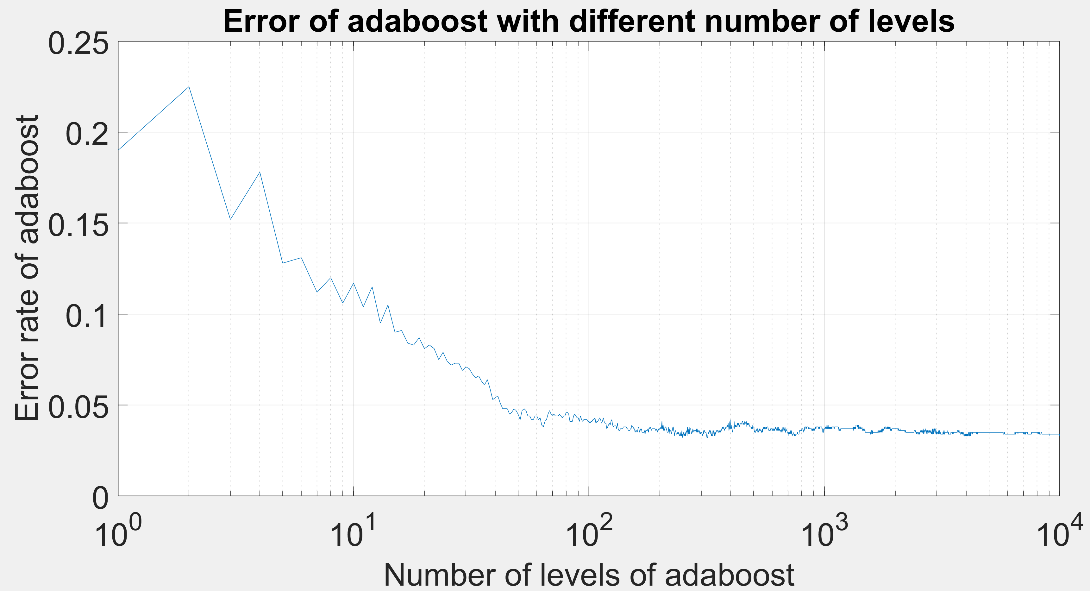
Experiments-Adaboost implementation
We used the first 10% of the entire data as testing data and used the rest as training data.
We did not specify when to stop splitting decision tree of every level. so the default configurations of MATLAB function 'fitctree’ are applied.
We want to optimize a hyperparameter, number of levels, of Adaboost. The optimization process is shown as follows.
It is demonstrated that when the number of levels is larger than 1000, the error rate of Adaboost on testing data converges to about 3.5%.
Figure A. Error of Adaboost with the number of its levels increasing

Slide 8
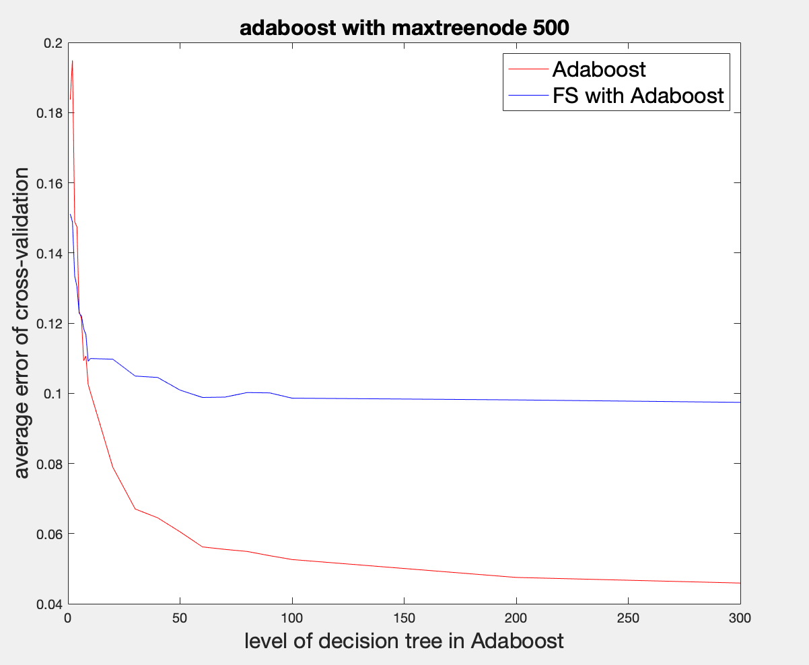
Experiments-Adaboost & FS
In this experiment, we devise the Adaboost algorithm with at most 500 splits for the tree on each level, and the maximum level number is 300, based on previous experiment results.
When level is less than 5, FS algorithm can help to augment prediction ability, but when the number of levels gets bigger, FS will be useless.
Figure A. Adaboost vs Adaboost integrated with FS when the number of levels increases from 1 to 300

Slide 9
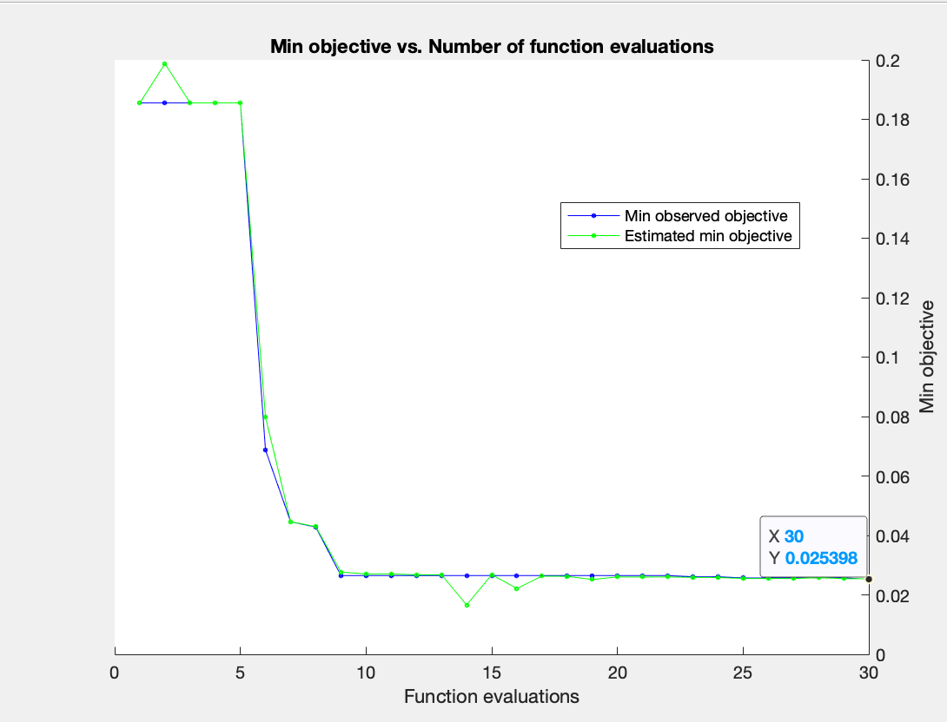
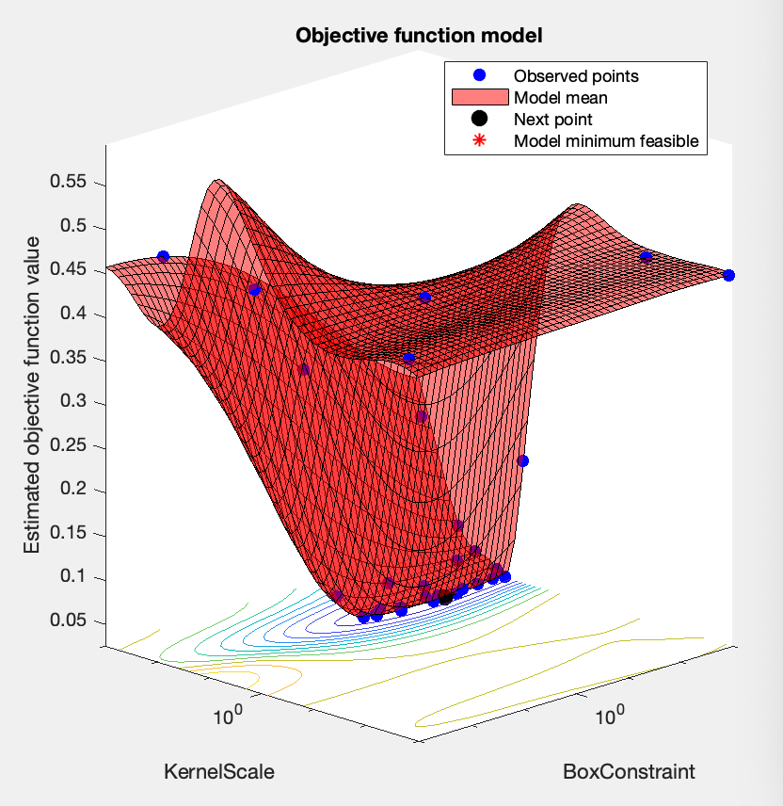
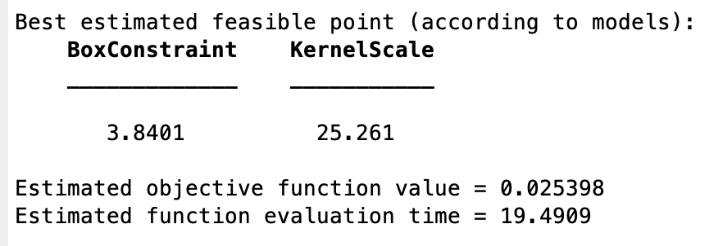
Experiments-SVM(rbf kernel)
Using SVM classifier with hyperparameter optimization gives a minimum error rate of 2.5398%.
All the hype-parameters will be used to generate a series of SVM classifiers.
figure C: the best hyperparameter pair
figure A: min objective optimization
figure B: hyperparameter optimization

Slide 10


Test results on Kaggle
Then we use the entire training data set to train SVM, FS-SVM, single decision tree, FS-single decision tree and Adaboost. Then we use our models to do predictions based on the testing data (unlabeled) and submit them to Kaggle.
model | SVM(rbf) | FS&SVM(rbf) | Single tree( 500 splits) | FS & Single tree(500 splits) | Adaboost(2000 levels)
Score(accuracy) | 0.97405 | 0.89061 | 0.80899 | 0.83138 | 0.95706
https://www.kaggle.com/c/compomicssummer2018/submissions

Slide 11
Conclusions & code link
From the predictions on testing data set, we can conclude this new feature selective method can help to improve the performance of some weak classifiers, such as the single decision tree.
In this eye state prediction task, SVM performs the best among all the models, and Adaboost is a good prediction classifier as well.
Git-Hub link https://github.com/ZouYao0720/final-project-.git

Slide 12
References
Nassr Alsaeedi* and Dieter Wloka “Real-Time Eyeblink Detector and Eye State Classifier for Virtual Reality (VR) Headsets (Head-Mounted Displays, HMDs)” Sensors (Basel). 2019 Mar; 19(5): 1121.
Królak, A. & Strumiłło, P. Univ Access Inf Soc (2012) 11: 409. https://doi.org/10.1007/s10209-011-0256-6
Noman, Md, et al. "Mobile-based Eye-Blink Detection Performance Analysis on Android Platform." Frontiers in ICT 5 (2018): 4.
Rihana, S., P. Damien, and T. Moujaess. "EEG-Eye blink detection system for brain computer interface." Converging Clinical and Engineering Research on Neurorehabilitation. Springer, Berlin, Heidelberg, 2013. 603-608.
S. Vachiravel, Eye State Prediction using EEG Signal and C4.5 Decision tree algorithm, March 2016.
Al-Taei, Ali. "Ensemble Classifier for Eye State Classification using EEG Signals." arXiv preprint arXiv:1709.08590 (2017).
Jain, Neha, et al. "Eye state prediction using EEG by supervised learning." International Journal of Science, Engineering and Technology 10 (2015).
Zhou, Zhi-Hua, and Ji Feng. "Deep Forest." arXiv preprint arXiv:1702.08835 (2017).

