Slide 1
Eye Blinking Prediction using electroencephalography(EEG)
Yao Zou & Zuchen Zhang

Slide 2
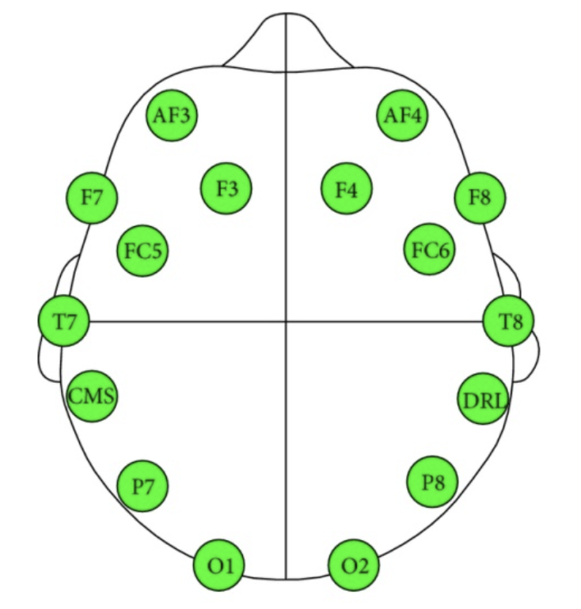
Introduction
The objective of our project is to train an optimal model for eye blinking prediction based on 14-dimensional EEG signal. There are only 2 states of eye blinking which are open and closed, so basically we should construct a binary classifier to predict eye blinking.
An Emotiv headset device with 14 sensors has been used to record brain signals. The duration time of each recording was 117 seconds. Then, the different eye states observed during each recording were manually added. Each data point consists of 14 EEG features and an eye-state class (either 0 for open, or 1 for closed).[1]
The schematic of data collection is on the right side.
Our labeled data are 10000 14-dimential observations with labels, we need to split them into training data and testing data.
schematic of data collection[2]
Notes:
[1] https://www.kaggle.com/c/compomicssummer2018/overview
[2] Rösler, Oliver, and David Suendermann. "A first step towards eye state prediction using eeg." Proc. of the AIHLS (2013).

Slide 3
Method – Feature Selective(FS)
Our training data are 14-dimensional, but to determine whether all dimensions are useful, we implement a feature selective method to generate new sequences of data from training data, and algorithm is shown as follows:
14 dim original measurement
Sliding windows
The
sequence
of
new
feature
.
.
.

Slide 4
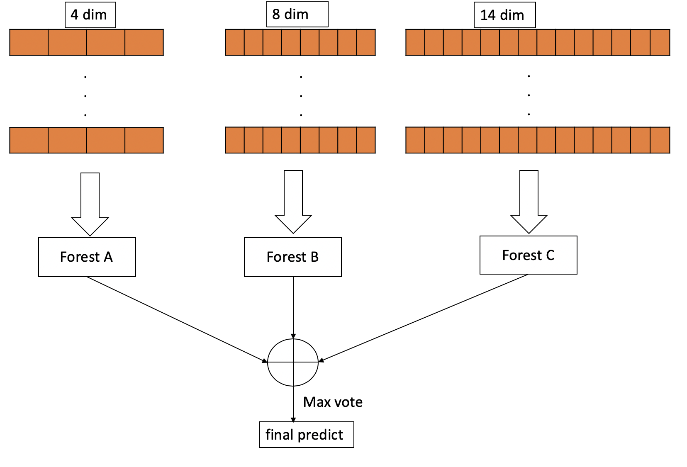
Method – FS with single decision tree
Feature Selective algorithm generates new training data sets, each data set will be used to train a single decision tree, and we can get the final prediction result by using the max vote principle .

Slide 5
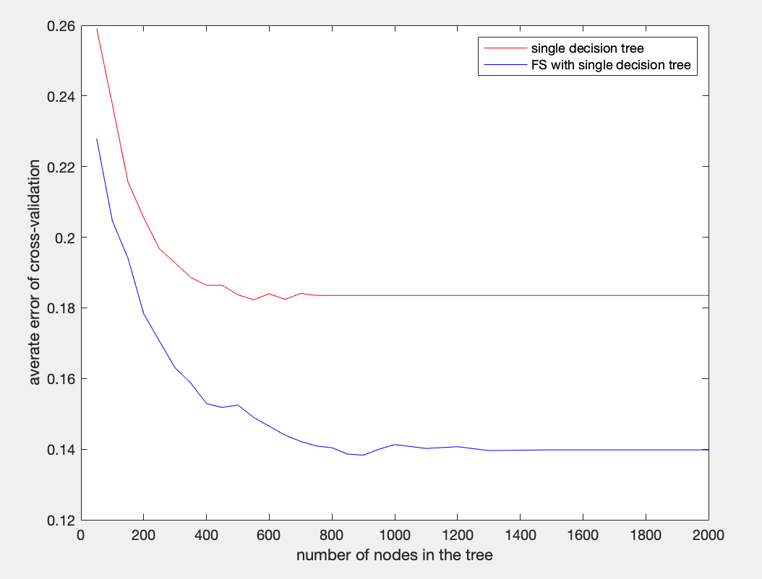
Experiments
Using 10-fold cross-validation on the training data, average error rate is the metric.
For the same split nodes in the decision tree, with feature selective algorithm, single decision tree performs better.

Slide 6
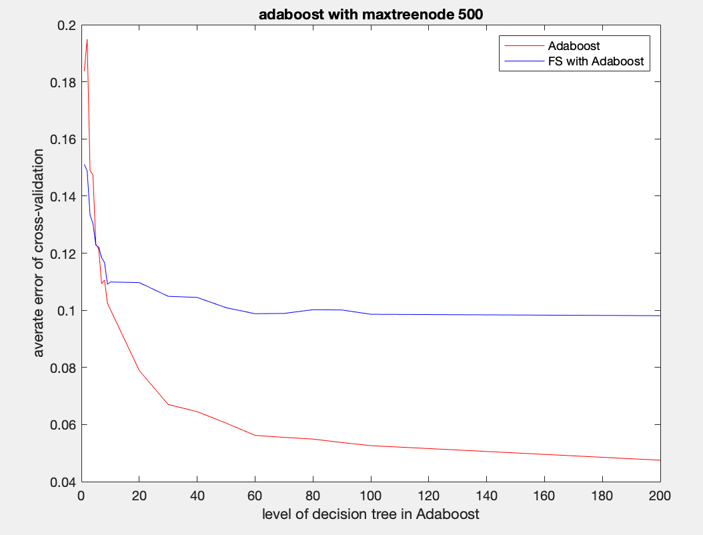
Experiments
In this experiment, we did not specify maximum number of splits in each decision tree of Adaboost. We calculated error of 2 methods in term of levels of decision trees in Adaboost.
When level is less then 5, FS algorithm can help to augment predicting ability, but when there are more levels, FS will be useless.

Slide 7
Test in Kaggle
We fully test models of SVM, single decision tree, FS single decision tree, Adaboost.
model | SVM(Linear) | FS&SVM(Linear) | Single tree | FS & Single tree(500 splits) | Adaboost(500 levels)
score | 0.5 | 0.53962 | 0.80899 | 0.83138 | 0.95611

Slide 8
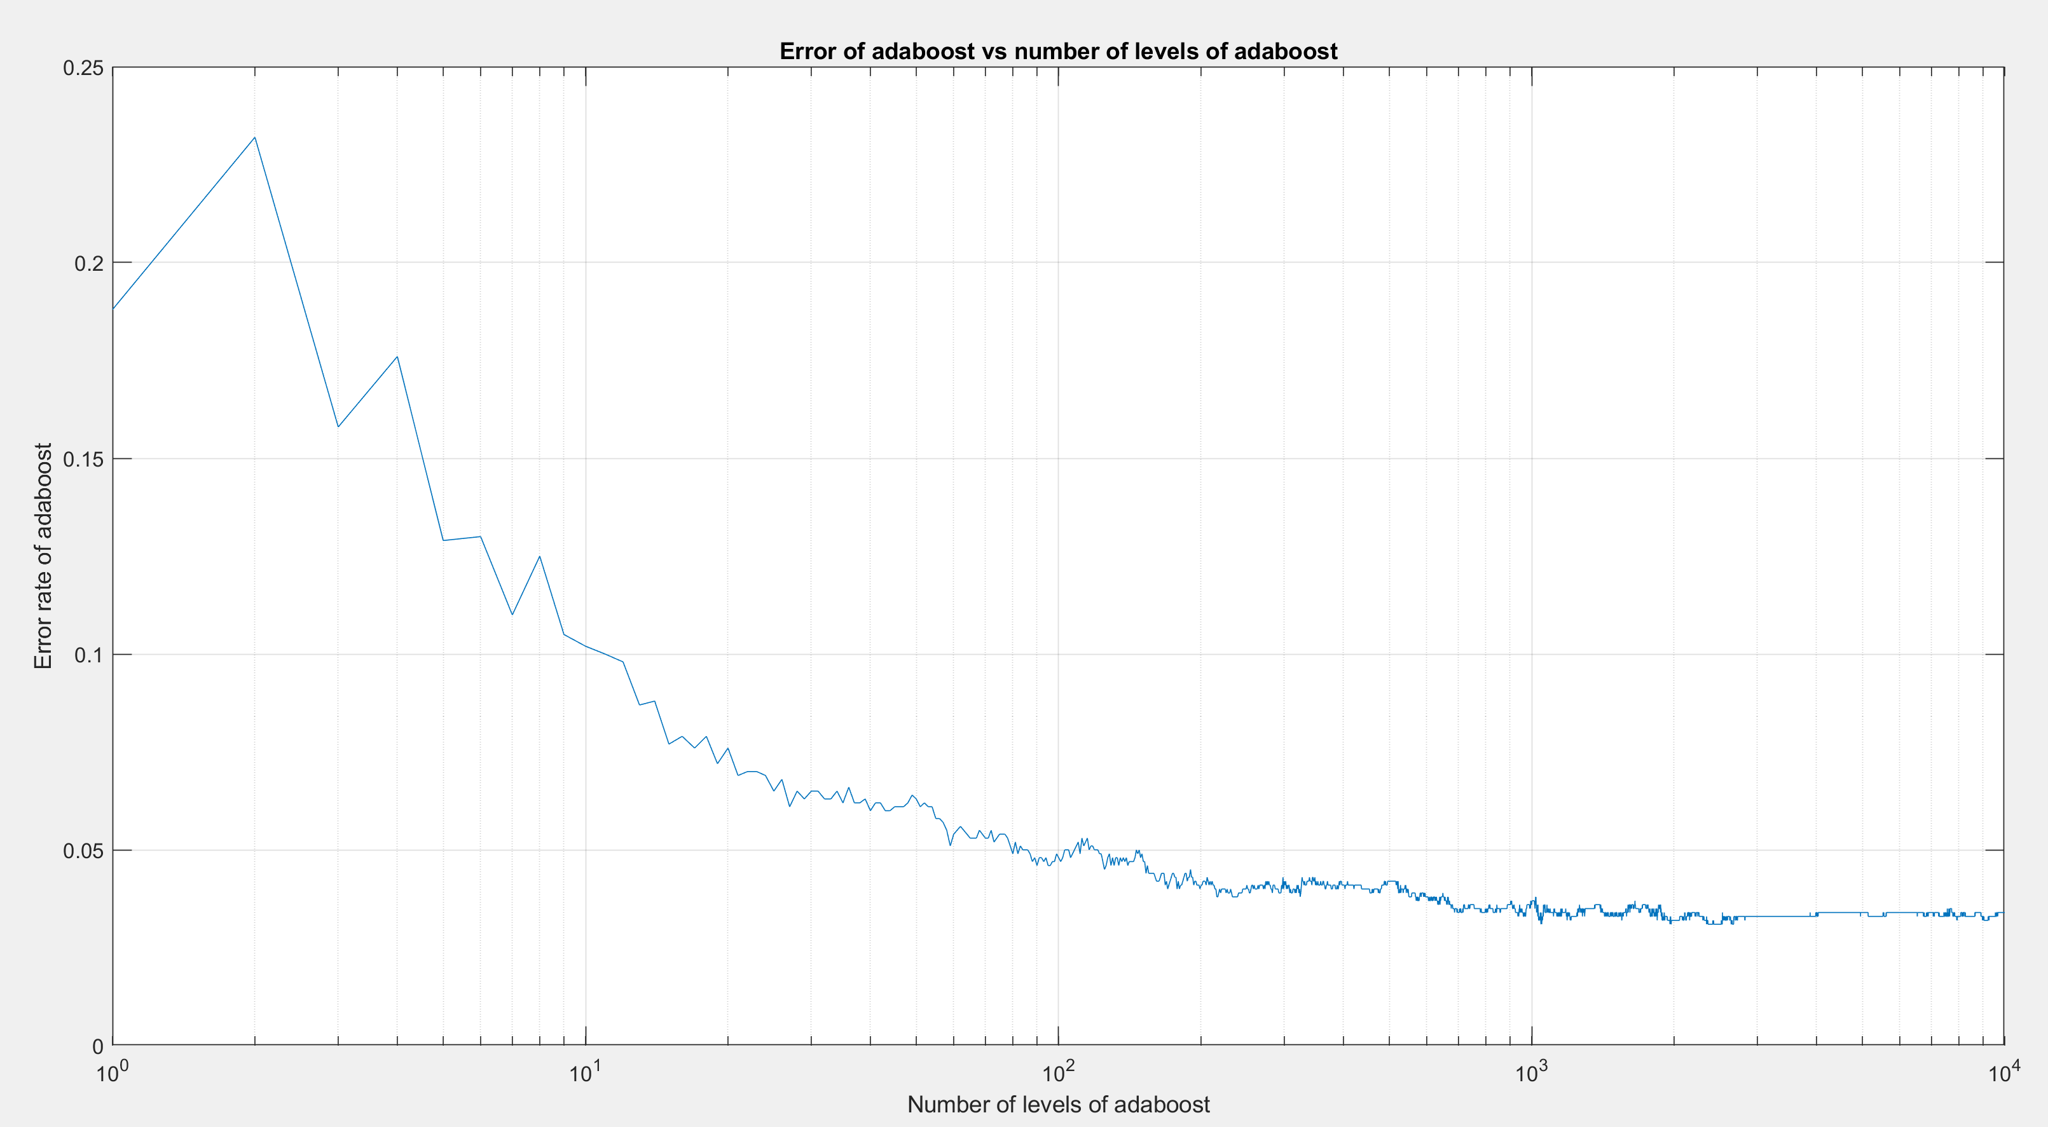

Adaboost implementation
We used the first 10% of the entire data as testing data and used the rest as training data.
We did not specify when to stop splitting decision tree of every level.
We want to optimize a hyperparameter, number of levels, of Adaboost. The optimization process is shown as follows.
It is demonstrated that when the number of levels is larger than 1000, the error rate of Adaboost on testing data converges to about 3.5%.
Based on the conclusion above, we apply 2000-level Adaboost to the test data provided by Kaggle and got the following score.
Figure A. Error of Adaboost with the number of its levels increasing

Slide 9
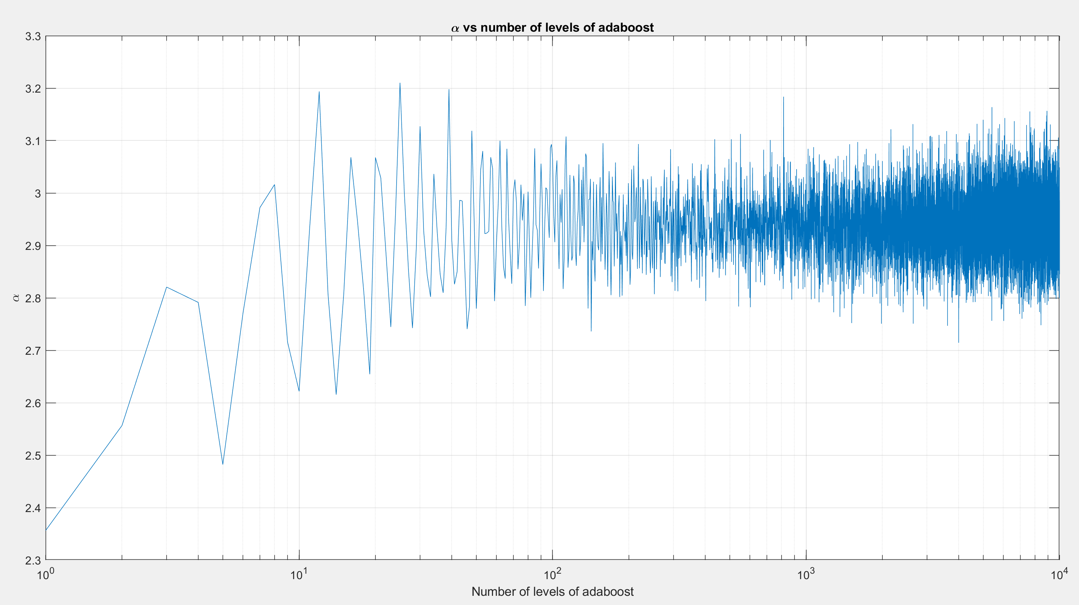
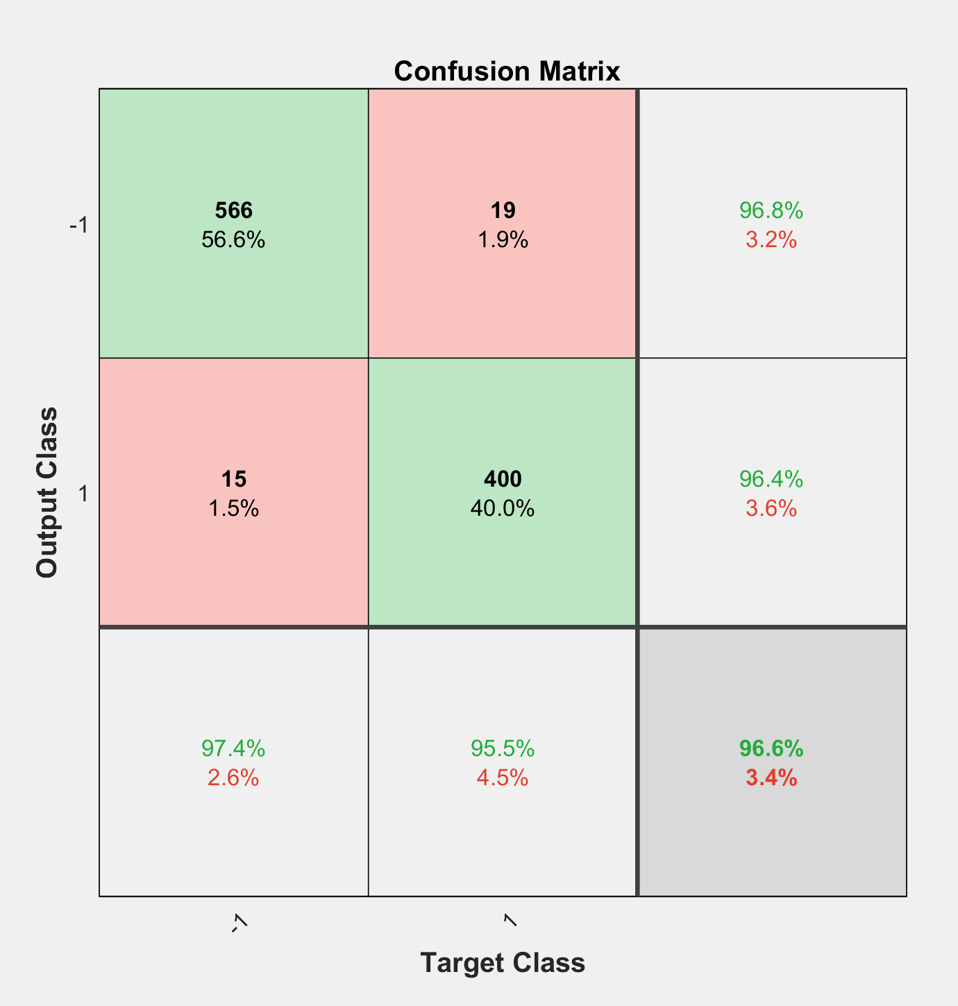
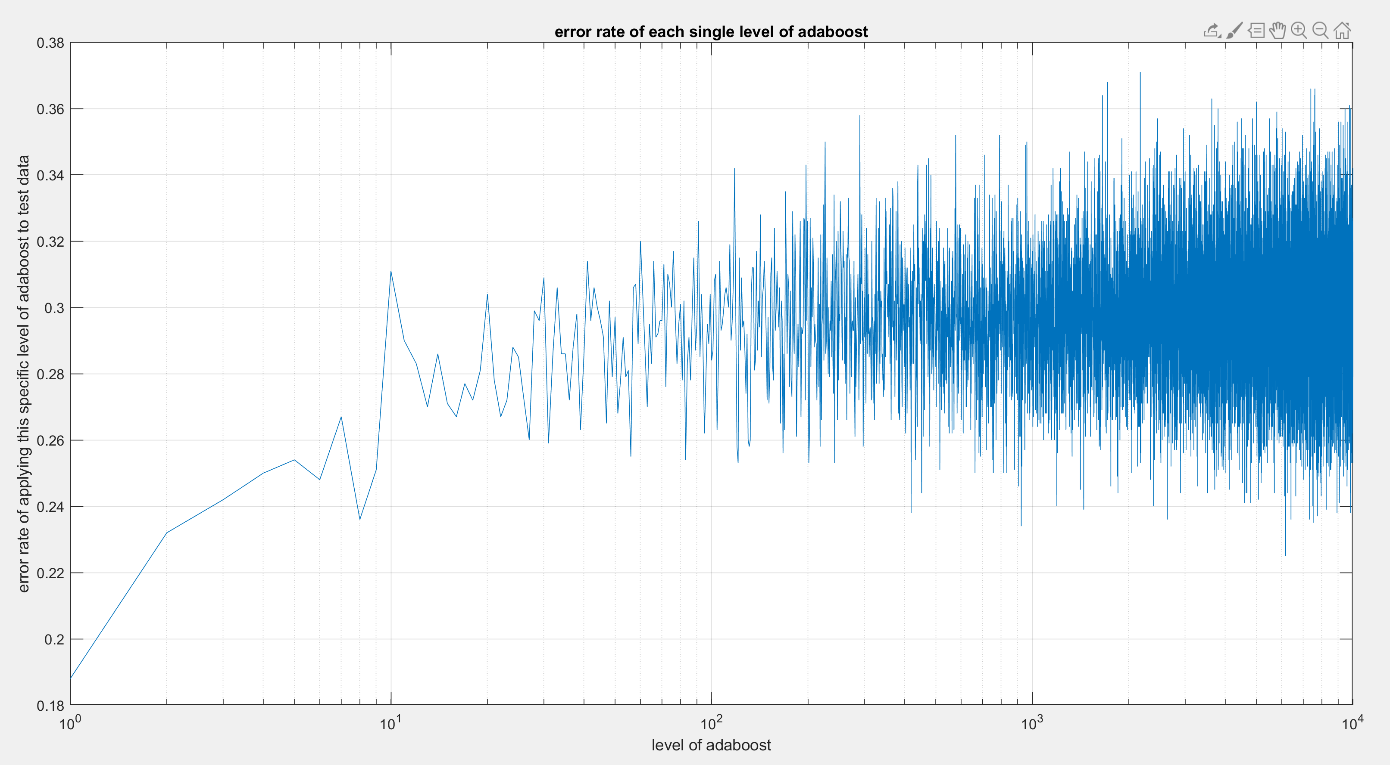
Adaboost implementation
Figure A. Alpha of every level in Adaboost
Figure A. Confusion matrix when we apply 10000-level adaboost tree to testing data
Figure A. Error rate when we apply every level of Adaboost to testing data

Slide 10
conclusion
By predicting the test data set, we can conclude this new feature selective method can help to improve the performance of some weak classifiers.
The Adaboost performs best among all the models, as well as it has much more complex structure.

Slide 11
References
[1] https://www.kaggle.com/c/compomicssummer2018/overview
[2] Rösler, Oliver, and David Suendermann. "A first step towards eye state prediction using eeg." Proc. of the AIHLS (2013).

Slide 12
Project application fields: [1]
The task of predicting human actions via brain signals takes high importance and usability in various fields such as computer games
health care and bio-medical systems
emotion tracking
smart home device controlling and internet of things
Military
detection of car driving drowsiness

