Slide 1



Real-time AWS IAM auditing & automated threat detection
Serverless · event-driven · 2 equivalent implementations (Bash & Terraform)
Zouari Omar · Cloud & Sécurité · 2026

Slide 2
AGENDA
What this deck covers
From the risk, through the architecture, to the validated result.
1
The problem
5
Risk model
Why one wrong IAM change can expose the account
CRITICAL / HIGH / MEDIUM / LOW grading
2
The solution
6
Delivery
Continuous, automated IAM supervision
Bash and Terraform, functionally equivalent
3
Architecture
7
Project cost
One event-driven, serverless pipeline
Standard on-demand rates, no Free Tier
4
How it works
8
Results
Capture, filter, analyse, act
Validated end to end on both stacks
aws-iam-monitor
01 / 10

Slide 3
THE PROBLEM
One wrong IAM change can open the whole account
Not a code bug — a permissions mistake. Harder to spot, and rarely reviewed in real time.
Backdoor identity
Privilege escalation
Weakened controls
A new user or access key created without approval — quiet, persistent access.
An over-permissive policy attached to a user, group or role.
MFA disabled, or a security policy deleted, on a privileged account.
The need: automated · near real-time · low-cost · traceable · reproducible
aws-iam-monitor
02 / 10

Slide 4
THE SOLUTION
aws-iam-monitor — continuous IAM supervision
Every sensitive IAM API call is captured, scored for risk, archived, and — when it matters — alerted.
Seconds, not days
Automatic risk grading
Nothing to run
Event-driven pipeline reacts within seconds of the API call.
Every call labelled CRITICAL / HIGH / MEDIUM / LOW, plus a source-IP check.
100% AWS managed services — no servers, pay only per event.
IAM → CloudTrail → EventBridge → Lambda → SNS · S3 · CloudWatch
aws-iam-monitor
03 / 10

Slide 5
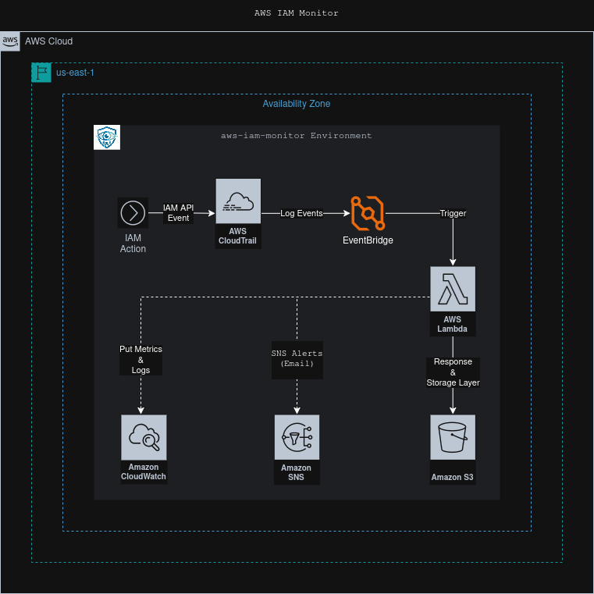
ARCHITECTURE
One event-driven pipeline
Provisioned identically by both implementations · region us-east-1 · single Availability Zone
aws-iam-monitor
04 / 10

Slide 6
HOW IT WORKS
Four steps, fully automated
1 Capture
2 Filter
3 Analyse
4 Act
CloudTrail records every IAM management API call on the account.
EventBridge matches iam.amazonaws.com events and triggers Lambda.
Lambda parses the payload, checks the source IP, classifies the risk.
Archive JSON to S3 · alert via SNS on high risk · emit CloudWatch metrics.
→
→
→
Shared Python 3.11 handler · identical detection logic in both implementations
aws-iam-monitor
05 / 10

Slide 7
RISK MODEL
Every IAM call gets a severity label
CRITICAL
DeletePolicy · DeactivateMFADevice · access from a non-whitelisted IP
HIGH
CreateUser · CreateAccessKey · AttachUserPolicy · UpdateLoginProfile
MEDIUM
CreateRole · CreateGroup · CreatePolicy · SetDefaultPolicyVersion
LOW
GetUser · ListUsers — informational, archived only
HIGH & CRITICAL → immediate SNS e-mail alert. All levels → JSON audit record in S3.
aws-iam-monitor
06 / 10

Slide 8
DELIVERY
Same architecture - pick your workflow
Bash / AWS CLI
Terraform
• Single orchestrator: ./awsctl --up all
• One command: terraform apply
• Imperative, explicit 5-stage sequence
• Declarative, order from dependency graph
• Idempotent scripts + shared helper library
• 7 reusable modules, least-privilege IAM
• Simple for small, targeted changes
• Adds optional CloudWatch alarms
Independent & functionally equivalent — same resource names, same event pattern, same policies.
aws-iam-monitor
07 / 10

Slide 9
PROJECT COST · CALCULATOR.AWS
A few dollars a month, at standard rates
AWS service
Est. / month
≈ $4
CloudTrail — 50k IAM management events
$1.00
EventBridge — AWS events, default bus
$0.00
per month (~$46 / year)
Lambda — ~50k calls · 128 MB · ~400 ms
$0.05
SNS — 50k publishes + ~500 e-mail alerts
$0.04
Light
5k / mo
≈ $2
S3 — ~10 GB storage · ~55k PUT + GET
$0.51
CloudWatch — 3 metrics · 2 alarms · 50k puts · logs
$2.13
Moderate
50k / mo
≈ $4
Data transfer — intra-region / minimal
$0.09
Heavy
500k / mo
≈ $24
Estimated total
≈ $3.82 / mo
Modeled with the AWS Pricing Calculator (calculator.aws) · Region: US East (N. Virginia) · Standard on-demand rates, AWS Free Tier not applied.
aws-iam-monitor
08 / 10

Slide 10
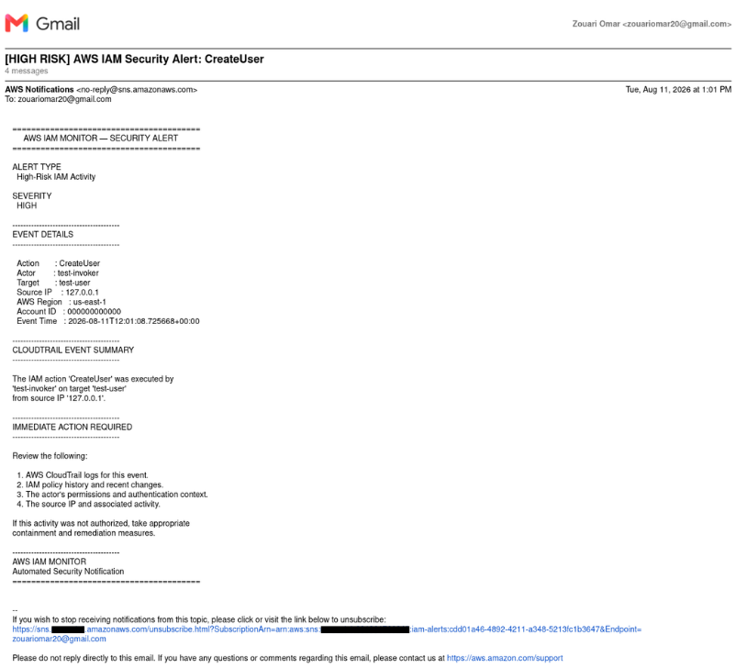
RESULTS
Validated end to end
✓
Full deploy → verify → destroy cycle passed on both implementations
✓
High-risk IAM events deliver SNS e-mail alerts within seconds
✓
Every event archived as structured JSON in S3, partitioned by date
✓
Custom AWSIAMMonitor metrics + alarms on unauthorized-IP access
SNS alert - CreateUser flagged HIGH
aws-iam-monitor
09 / 10

Slide 11

Thank you
Detect · classify · alert - before misconfiguration becomes a breach.
github.com/ZouariOmar/aws-iam-monitor

