Slide 1
AWS Overview
Overview of AWS cloud services and architecture

Slide 2
Introduction
Introduction to AWS and cloud fundamentals for technical and corporate audiences.
AWS offers scalable cloud services across compute, storage, databases, networking, security, and analytics. This presentation outlines core services, architecture patterns, and best practices for designing reliable, secure, and cost-effective solutions.

Slide 3

01
Introduction & Overview

Slide 4
What is Cloud Computing?
Cloud computing delivers on-demand IT resources over the internet with pay-as-you-go pricing.
Benefits include scalability, cost efficiency, and faster time-to-market. Deployment models: Public, Private, Hybrid. Use when elasticity, automation, and global reach are priorities.

Slide 5
AWS Global Infrastructure
AWS provides global Regions, Availability Zones (AZs), and Edge Locations for low-latency delivery.
Design for resilience using multiple AZs and Regions. Edge locations accelerate content via CloudFront and improve user experience worldwide.

Slide 6

Key Benefits & Use Cases
AWS enables rapid innovation, operational efficiency, and global scale.
Common use cases: web hosting, data lakes, AI/ML, IoT, backup/disaster recovery, and media streaming. Choose services based on latency, durability, and cost requirements.

Slide 7

02
Compute & Serverless

Slide 8
EC2, ECS, EKS Overview
EC2 provides flexible VMs; ECS and EKS orchestrate containers (managed and self-managed).
Select EC2 for full control, ECS/EKS for container workloads, and Fargate for serverless containers to reduce operational overhead.

Slide 9

AWS Lambda & Fargate
Serverless compute with Lambda enables event-driven functions; Fargate runs containers without servers.
Use Lambda for short-lived, event-based tasks and Fargate for containerized apps needing simplified operations and autoscaling.

Slide 10
Serverless Workflow Example
Example: API Gateway - Lambda - DynamoDB - S3 - EventBridge for async events.
Diagram shows request flow, error handling, and monitoring hooks. Use Idempotent functions and dead-letter queues to ensure reliability.

Slide 11

03
Storage & Databases

Slide 12
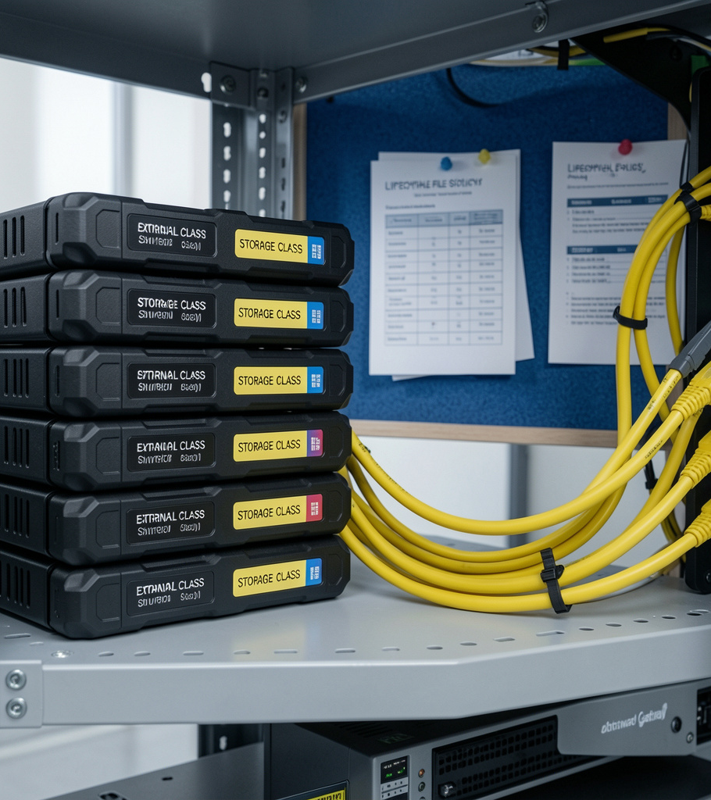
S3, EBS, EFS, FSx
S3 for object storage and data lakes; EBS for block storage attached to EC2.
Use EFS for shared file systems and FSx for high-performance Windows/Linux workloads. Consider storage class and lifecycle policies for cost.

Slide 13
RDS, Aurora, DynamoDB
RDS/Aurora for managed relational databases; DynamoDB for scalable NoSQL.
Choose Aurora for high-performance SQL, RDS for familiar engines, and DynamoDB for single-digit millisecond scale and predictable throughput.

Slide 14
Data Lakes & Analytics
Build data Lake on S3 with cataloging via Glue and querying via Athena.
Process large datasets with EMR/Kinesis and visualize with QuickSight. Optimize partitioning and compression for performance and cost.

Slide 15
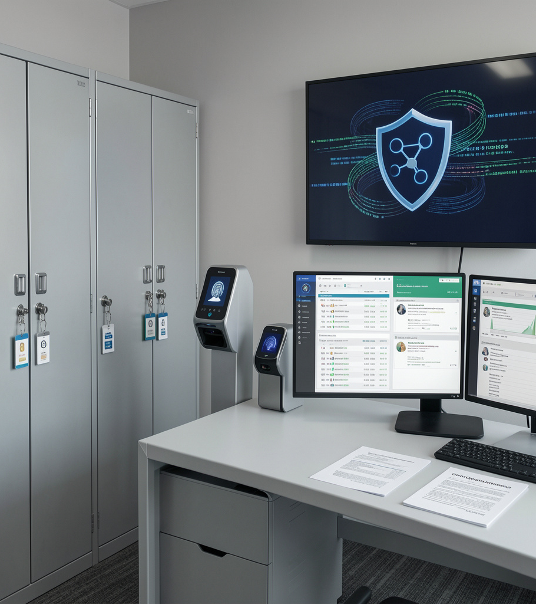
04
Security & Management

Slide 16
IAM, KMS, Shield, WAF
Use IAM for least-privilege access and roles. Protect data with KMS encryption keys.
Mitigate threats with Shield (DDoS) and WAF for application layer protections. Implement centralized policies via Organizations.

Slide 17

Monitoring: CloudWatch, CloudTrail
CloudWatch for metrics, logs, and alarms; CloudTrail for audit trails and governance.
Correlate logs, set SLA-driven alerts, and forward to centralized analytics for incident response and forensics.

Slide 18
Cost, Governance & Best Practices
Apply tagging, budgets, and Cost Explorer for visibility. Use Reserved Instances or Savings Plans for savings.
Adopt the Well-Architected Framework and automation (CloudFormation) to enforce governance and operational excellence.

Slide 19
Conclusions
Summarize core services and architectures: compute, storage, databases, networking, security, and monitoring.
Adopt best practices for resilience, security, and cost optimization. Start with a reference architecture, iterate with telemetry, and leverage managed services to accelerate outcomes.

