Slide 1

ELEC241-J
Motor and LCD hardware group project
By: Rhys, Youssef, Zubair, Promise

Slide 2
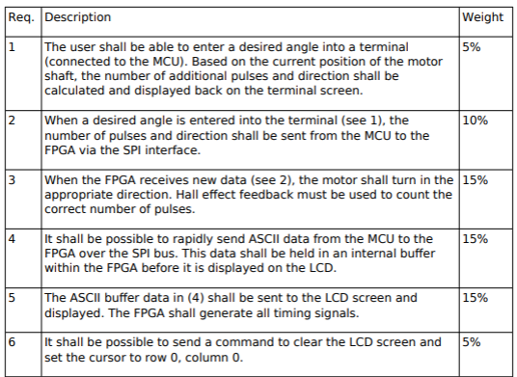
The requirements

Slide 3
How we will demonstrate our project
With each requirement, we will provide a brief overview of our methodology followed by a live demo.
Then, we will explain in much more detail using the OneNote document. This is when we will refer to any schematics, videos timing diagrams etc.

Slide 4
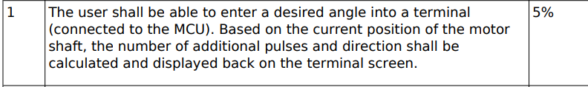
1
To test this, we shall enter a desired angle. (don’t you hit that enter just yet)

Slide 5

2
Let’s hit enter and find out

Slide 6
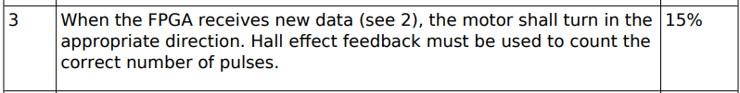
3
We will pull up a video of this soon

Slide 7


4
Over to Zubair

Slide 8
5
Well, there is something on the display.

Slide 9
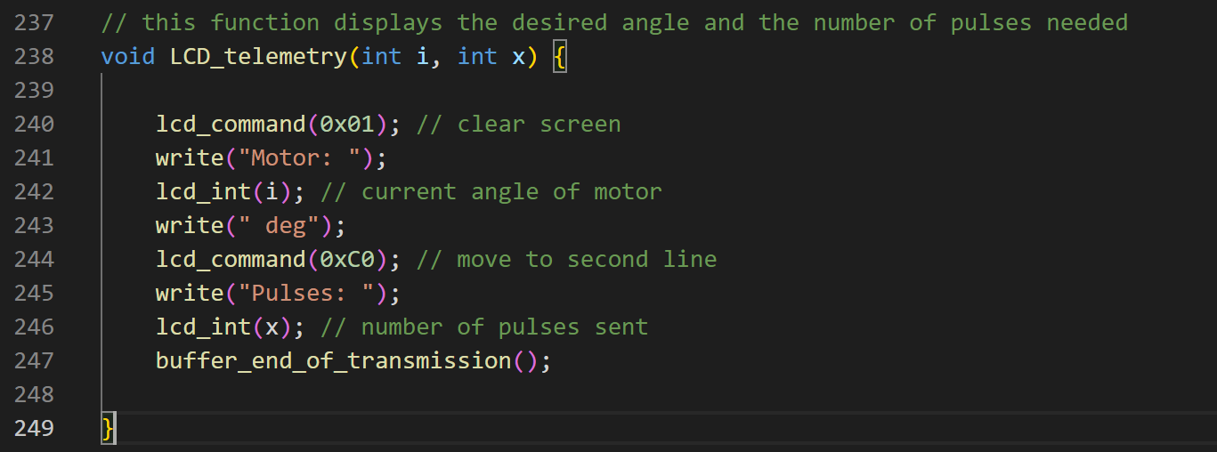
6

Slide 10
But how does the LCD work?
Over to Youssef

Slide 11

Documentation
To document what we did we used OneNote as this allows us to draw, make comments on how parts of the project performed and how we improved the design as time went on. OneNote also allows us to see each other’s design changes in real-time.

Slide 12

Collaboration
To ensure we all had the latest version of software we used GitHub.
Branching
Informative comments
The ability to merge branches
Real-life and zoom meetings
logging progress on OneNote

Slide 13
Meetings
Milestones
Discussion
Logging
Proof of kanban board being updated

