Slide 1
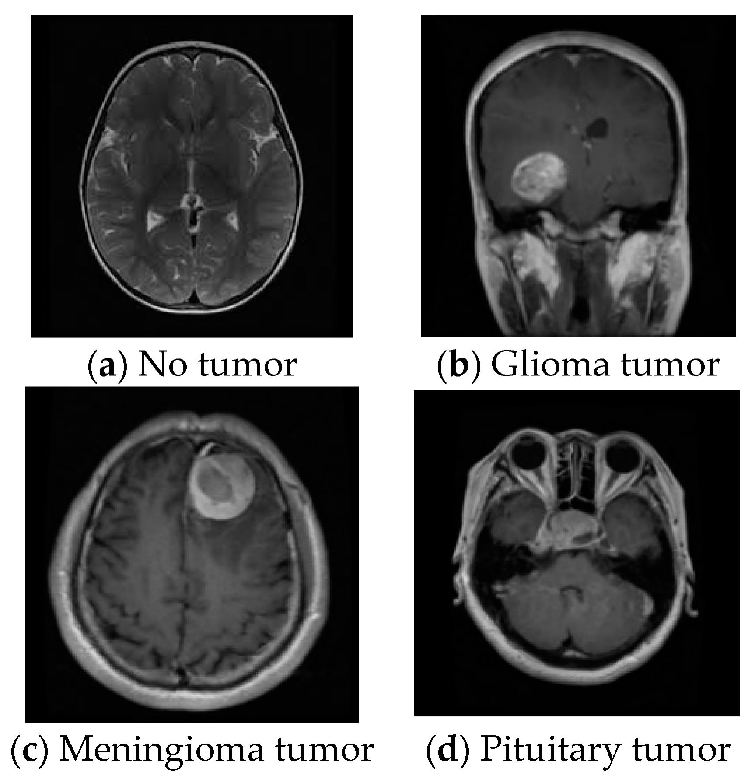


COLABS MRI tumor detection using CNN

