Slide 1
SPORTS ANALYTICS
Olympic Games — EDA, SQL Analysis & Power BI Dashboard
Created By
Zoya Farheen
1

Slide 2
SPORTS ANALYTICS
Olympic Games — EDA, SQL Analysis & Power BI Dashboard
Problem Statement
• Olympic data spans games, sports, events, athletes, regions and medals across many years.
• The raw relational data is difficult to interpret directly and requires structured analysis.
• The project transforms the data into actionable insights using SQL/EDA and an interactive Power BI dashboard.
1

Slide 3
Project Objective
What the analysis is designed to achieve
1. Explore Olympic patterns
Understand games, sports, events and participation across time.
2. Analyze athlete demographics
Study gender, age and participation by sport.
3. Evaluate regional performance
Compare NOCs/regions by participation and medal outcomes.
4. Analyze medal patterns
Identify medal trends across games, sports and regions.
5. Build an interactive dashboard
Present the analysis through KPIs, visuals, filters and navigation.
2

Slide 4
Project Deliverables
End-to-end workflow and final outputs
1. Data Preparation
2. SQL & EDA
• Normalized Olympic database with linked tables for games, cities, sports, events, athletes, regions and medals.
• Relationships established for analytical reporting.
• SQL queries for exploration, aggregation, ranking, trends and comparisons.
• EDA findings used to identify the main analytical patterns.
3. Power BI Dashboard
4. Final Reporting
• Five analytical pages: Overview, Sports & Events, Participants, Regional Analysis and Medal Analysis.
• Interactive KPIs, charts, filters and page navigation.
• MECE dashboard framework and presentation-ready analytical story.
• Project documentation and supporting deliverables.
Data → SQL → EDA → Power BI Modeling → Dashboard → Insights
3

Slide 5
EDA & SQL Analysis
Key analytical questions addressed during exploratory analysis
Olympic Games & Events
Athletes & Participation
Regions & NOCs
• Games by season and decade
• Host cities and hosting frequency
• Sports and event counts
• Event trends over time and gender distribution
• Participant gender distribution
• Age distribution and average age
• Participation by sport
• Participation trends across Olympic years
• Participating regions/NOCs by games
• Participant counts by region
• Top participating countries/regions
• Regional participation trends
Medal Analysis
EDA Outcome
• Total medals and medal types
• Gold-medal leaders
• Medals by sport
• Medal distribution across regions and games
• Exploratory analysis established the main trends and comparisons used in the Power BI dashboard.
• SQL aggregations and validation supported the analytical calculations.
4

Slide 6
Power BI Analysis
Five-page interactive dashboard and the questions it answers
1. Olympic Overview
2. Sports & Events
3. Participants
4. Regional Analysis
• Games by season and decade
• Top host cities
• Olympic events over time
• Sports by season
• Events by sport and gender
• Sport participation trends
• Participants by gender
• Age distribution
• Participation by sport
• Top regions by participation
• Participating regions over time
• Medal distribution across regions
5. Medal Analysis
Dashboard Headline KPIs
• Medals over Olympic years
• Top regions by gold medals
• Medal distribution by sport and games
Total Olympic Games • Total Sports • Total Events Total Participants • Total Medals
Overall Dashboard Value
Combines historical trends, athlete demographics, regional participation and medal performance in one interactive analytical story.
5

Slide 7
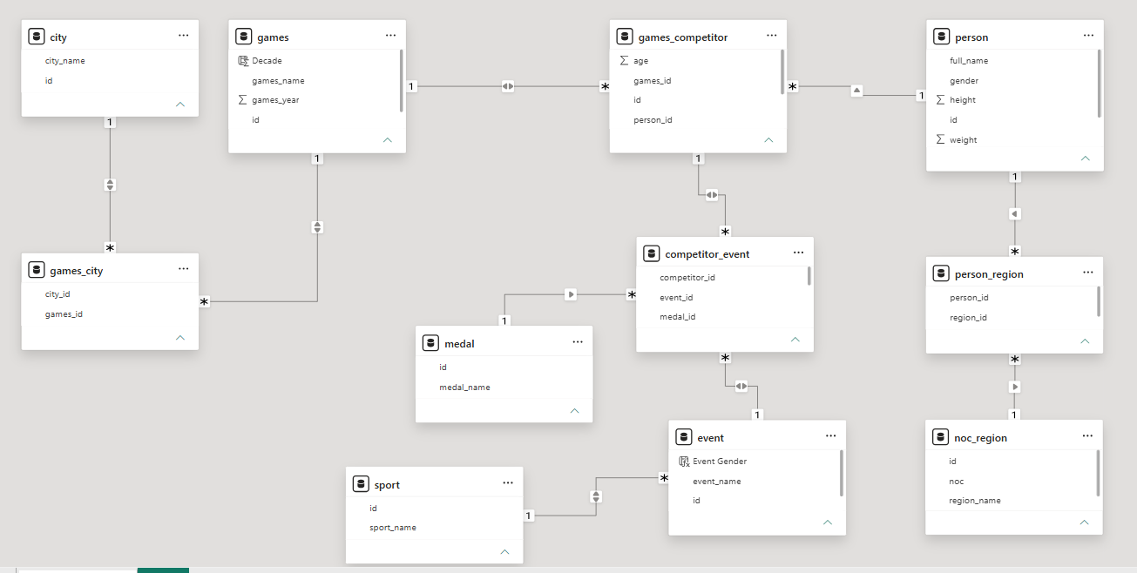
Data Model
Normalized Power BI data model used for the analysis
Core relationships connect Games → Competitors → Events/Medals and Persons → Regions, with Sports and Cities supporting analysis.
6

Slide 8
Project Repository & Deliverables
Versioned project outputs shared through GitHub
GitHub Repository
• All project deliverables have been added to the GitHub repository.
• The repository provides a centralized location for the completed project work and supporting files.
Included Project Work
Repository Benefit
• SQL queries and database analysis
• EDA outputs and analytical findings
• Power BI dashboard and report
• MECE framework / project documentation
• Presentation materials and supporting deliverables
• Keeps the project organized and reproducible.
• Makes the completed analytical workflow easier to review and share.
• Provides a single reference point for the final submission.
7

Slide 9
Conclusion
Final takeaway from the Sports Analytics project
Key Takeaway
• The project transformed a complex Olympic dataset into a structured analytical solution.
• SQL and EDA were used to explore and validate patterns across games, sports, athletes, regions and medals.
• Power BI converted these findings into an interactive five-page dashboard with focused KPIs and visual analysis.
• The final solution supports clear comparison of participation, event growth, regional representation and medal performance.
End-to-End Outcome
• Data Preparation → SQL Analysis → EDA → Power BI Modeling → Interactive Dashboard → Insights
• The project demonstrates practical skills in data analysis, relational data modeling, visualization and analytical storytelling.
8

