Slide 1



NFC 3.0
TRAVEL
EASE
ACCESSIBLE TRAVEL GUIDE FOR PEOPLE WITH DISABILITIES
DOMAIN: Social Cause | PS NUMBER: 2 | TEAM NAME: Griffin

Slide 2
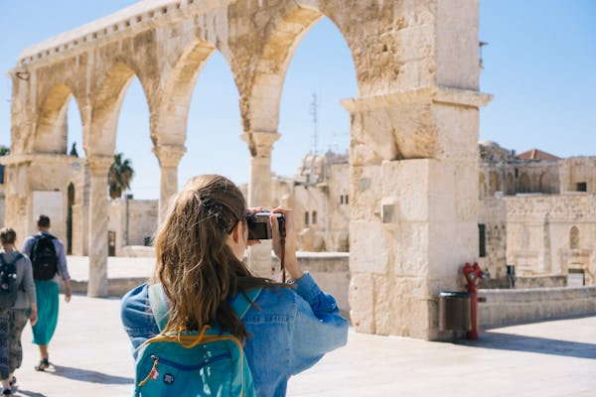
PROBLEM STATEMENT
Design and develop an Accessible Travel Guide platform for people with disabilities. The platform should provide detailed, personalized travel assistance, including accessibility information for destinations, accommodations, transport options, and other services, ensuring that people with different types of disabilities can plan trips with confidence and ease.

Slide 3
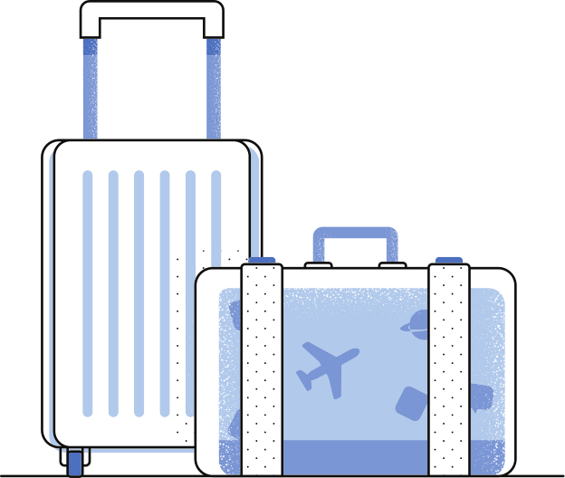
FEATURES & USP
Accessibility-Based Hotel Recommendations
Find Hotels that cater to your Accessibility needs in one go
AI Trip Planner
Your smart assistant for personalized and hassle-free travel planning
Text to Braille
Transform text into Braille effortlessly on our platform, bridging accessibility gaps for the visually impaired
Sign Language detection and Text to Sign
Tour guides/helpers can access this feature to help users
Maps Integration with multilingual voice assistant
Integrated maps for users to see their live location and path to the hotel with voice assistant
Talk-Back
TalkBack is an accessibility feature that helps people who are blind or have low vision
Our Features
Voice Chat Bot and Image analysis
Voice bot integration with image analysis for enhanced interaction and accessibility
Unique Value Propostionn
SOS Feature
Maps is integrated with an SOS Feature which will call on our default emergency contact

Slide 4

HOW WE CATER TO DIFFERENT DISABLITIES
Physical Disablities | Hotel Recommendations, Access to book a volunteer
Sensory Disabilities | Talk Back, Text to sign, text to braille, volunteer hiring, object detection
Cognitive Disabilites | AI Trip Planner, Image analysis

Slide 5






TECH STACK
Tailwind CSS

Slide 6

FUTURE ENHANCEMENT
01
Object Detection to be integrated with maps
02
Improved braille integration
03
Subscription plans

Slide 7
THANK YOU!

