Slide 1
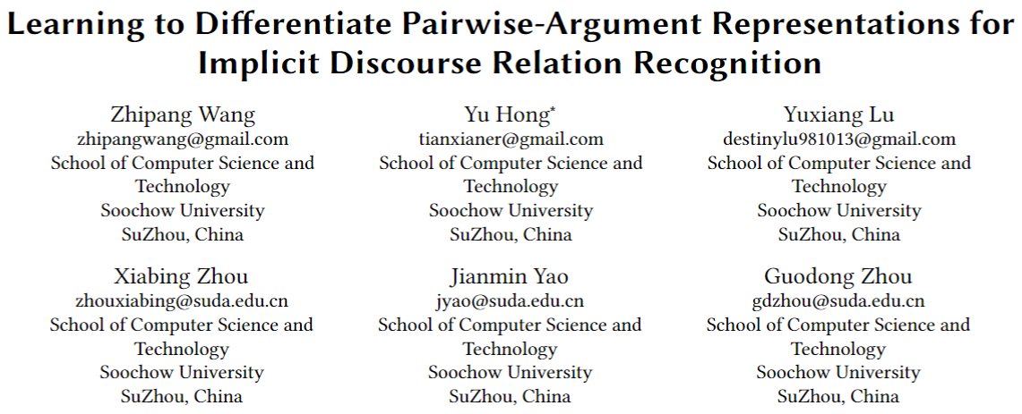
Notes:
Hello everyone, my name is Zhipang Wang. I study in Soochow University. And I'm honored to have the chance to give a presentation here today.
My paper's title is "Learning to Differentiate Pairwise-Argument Representations for Implicit Discourse Relation Recognition". I collaborated with my mentor, Yu Hong, my senior, Yuxiang Lu, and other teachers from my school to complete this paper.

Slide 2
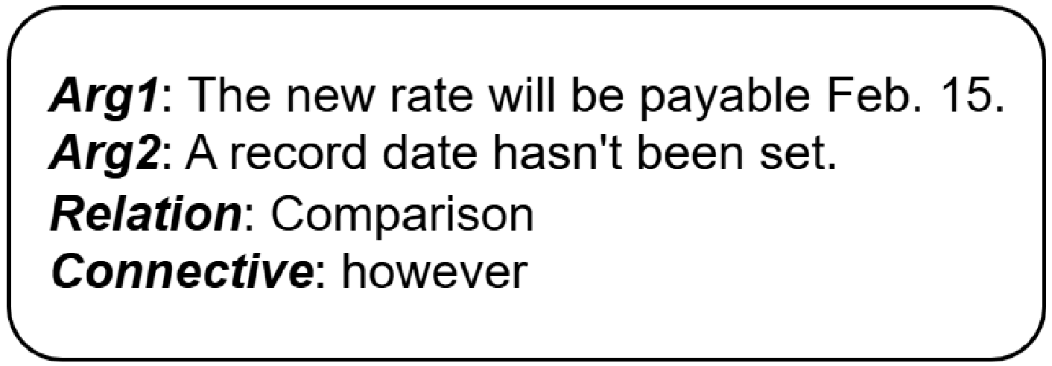
Task – Implicit Discourse Relation Recognition (IDRR)
Given a pair of text spans (arguments), which are Arg1 and Arg2
Predict their sematic Relation
Implicit Connectives are unavailable in the test set
Manually annotated implicit Connectives can be used in the train set
Figure 1: An instance of IDRR.
Notes:
Implicit Discourse Relation Recognition (IDRR) is the task of classifying the semantic relation between a pair of arguments. As shown in this figure, each sample consists of argument one, argument two, relation, and a connective. However, the implicit connectives are unavailable in the test dataset.

Slide 3
Related Work – IDRR
Feature engineering
Naïve Bayes, Support Vector Machine (SVM)
Representation learning
Convolutional Neural Network (CNN), Long Short-Term Memory (LSTM)
Transformer based model
Using Pre-trained Language Models (PLMs) as encoders
Utilization of implicit connectives
Designated connective prediction as the main task or key auxiliary task during training
Notes:
Early work relied on feature engineering, such as Naive Bayes and SVM. Then, methods based on representation learning emerged, using models like CNN and LSTM to achieve better performance.
Recent research is mainly based on transformer structures, using pre-trained language models (PLMs) as encoders and achieving state-of-the-art (SOTA) performance.
Noteworthy, the utilization of implicit connectives has become popular currently. Related works either designated connective prediction as the main task or key auxiliary task during training.

Slide 4
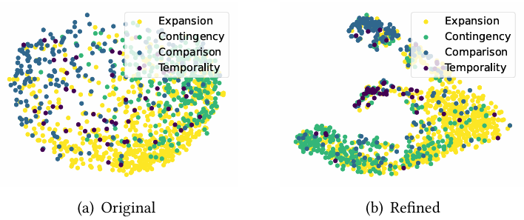
Motivation
Encoding texts into distinguishable representations to help the classification task
Demonstrate the efficacy of our approach in clarifying the representations and improving their distinguishability
Figure 2: Distributions of PDTB2.0 validation data in the feature space.
Notes:
The motivation of our research is to fine-tune the transformer encoder to obtain distinguishable semantic representations, which helps the classification task.
Here is a visualized figure that shows the difference between the original representation output by the encoder and the one refined by our approach. To visualize the representations, we applied Principal Component Analysis (PCA) to reduce their dimensionality, allowing us to plot them on a single plane.
Noticeably, the original representations are entangled and indistinguishable, whereas the refined ones form distinct clusters, each corresponding to a specific relation. This visualization demonstrates the efficacy of our approach in clarifying the representations and improving their distinguishability.

Slide 5
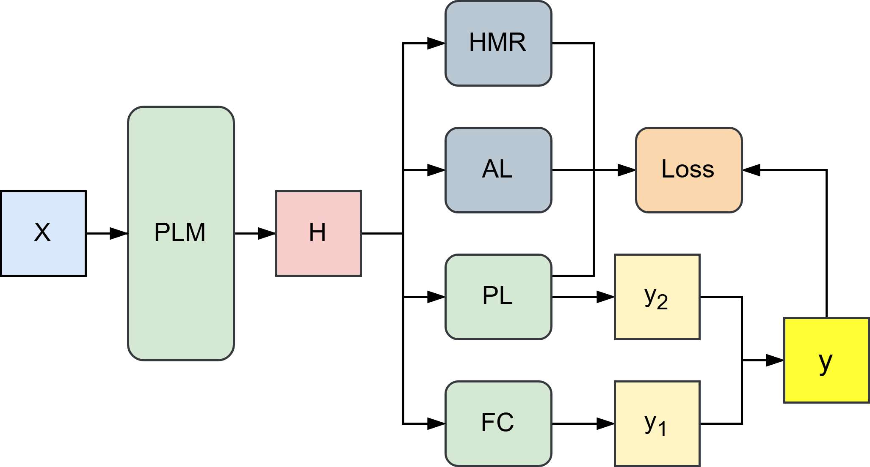


Approach
Hub-Migration based Redistribution
Adversarial Learning
Prototypical Learning
Figure 3: The overall framework of our approach.
Notes:
Now, I'd like to introduce the joint learning framework of our approach.
As shown in this figure, we utilize a pre-trained language model (PLM), such as BERT and RoBERTa, to encode the input and obtain its representation H.
We then employ three learning methods - Prototypical Learning (PL), Adversarial Learning (AL), and Hub-Migration based Redistribution (HMR) - to compute additional losses that enhance the encoder's performance.
The output of PL is combined with the output of a fully connected layer to produce the final prediction. The model computes the cross-entropy loss based on the final prediction and the ground truth.
Finally, we obtain the final loss by adding these four losses with different weights, and the final prediction is obtained by adding the output of the FC layer and PL.

Slide 6
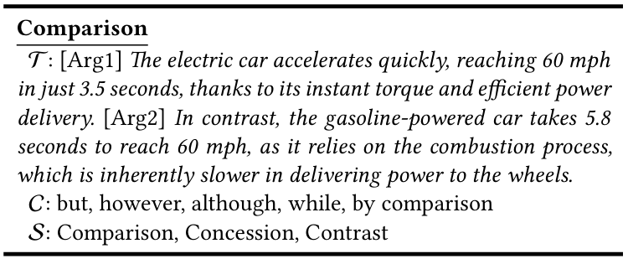

Approach – Prototypical Learning (PL)
A prototype is constructed for each relation type by concatenating typical arguments, frequently-occurred connectives, and relation senses.
Figure 4: An example of the prototype.
Notes:
Prototypical Learning is a method that calculates contrastive loss compared to the prototypical representations of the four main discourse relation types. The goal is to encourage the model to produce representations that are similar to the prototypical representations of the correct relation type.
Here's how it works:
* A prototype is constructed for each of the four relation types by concatenating typical arguments, frequently-occurred connectives, and relation senses. We can get the example from this figure.

Slide 7

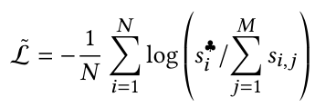

Approach – Prototypical Learning (PL)
The model computes the similarity between the input representation and the prototypical representation of each relation type.
The prototypical contrastive loss is computed in the manner of InfoNCE.
The vector consisting of similarities contributes to the final prediction.
Notes:
Then, the model computes the similarity between the input representation and the prototypical representation of each relation type.
The prototypical contrastive loss is computed using a InfoNCE loss function, which is the logarithm of the ratio between the similarity of the corresponding correct relation and the sum of all similarities.
Additionally, the vector consisting of similarities contributes to the final prediction.

Slide 8
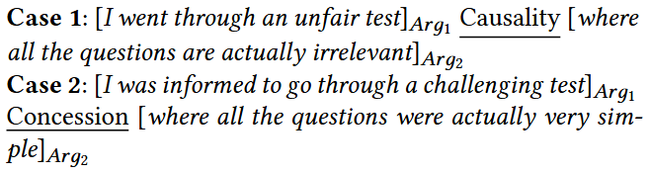
Approach – Adversarial learning(AL)
Use ChatGPT to generate a paraphrase and three adversaries for each input argument.
The paraphrase has the same relation as the original arguments, but with different wording.
The adversaries have different relations with the original arguments
Figure 5: An example of the adversary.
Notes:
Adversarial Learning is a method that generates highly distracting pairwise arguments as negative examples to improve the model's ability to recognize implicit discourse relations. The goal is to teach the model to produce distinct representations for the input arguments that are different from the representations of their adversaries.
Here's a sample illustrating how sentences can have different relations with only a few words changed.
We use ChatGPT to generate a paraphrase and three adversaries for each input argument. The paraphrase has the same relation as the original argument, but with different wording. The adversaries, on the other hand, have different relations with the original argument.

Slide 9

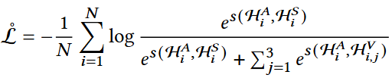
Approach – Adversarial learning(AL)
The model computes the representations of the input arguments, the paraphrase, and the adversaries.
Then, compute the adversarial loss using a contrastive loss function.
Notes:
The model computes the representation similarities between the input argument and its paraphrase and adversaries, and computes the adversarial loss using a contrastive loss function. This loss encourages the model to produce representations that are similar to the paraphrase and different from the adversaries.

Slide 10




Approach – Hub-Migration based Redistribution (HMR)
First, compute the clustering loss use Kullback-Leibler (KL) divergence.
Then, perform hub migration by freezing a hub and re-anchoring other hubs as horizontally negative, vertically positive, and vertically negative vectors of the frozen hub.
Compute the redistribution loss use KL divergence.
The total loss is the mean of the clustering loss and the redistribution loss.
Notes:
Hub-Migration based Redistribution is a method that guides the model to produce distinguishable representations from a holistic perspective. The goal is to cluster the pairwise arguments holding the same relation and put different clusters far away from each other in the feature space.
To achieve this, the model first computes the clustering loss using Kullback-Leibler (KL) divergence, which encourages the model to cluster the pairwise arguments holding the same relation. Then, the model performs hub migration by freezing a hub and re-anchoring other hubs as horizontally negative, vertically positive, and vertically negative vectors of the frozen hub. This process helps to redistribute the in-cluster examples around the hubs.
The total loss of HMR is the mean of the clustering loss and the redistribution loss. By minimizing this loss, the model learns to produce representations that are not only clustered but also well-separated, leading to improved distinguishability and performance.

Slide 11
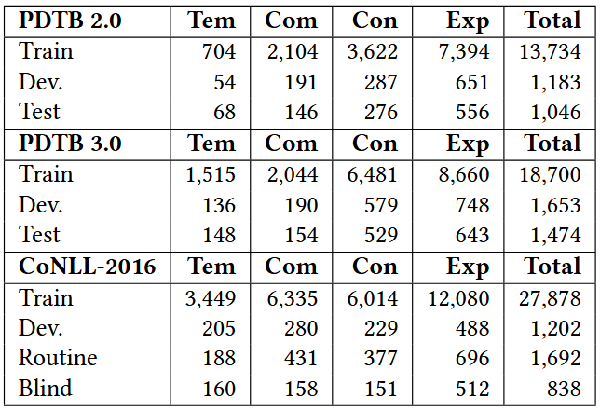
Experimentation
Datasets
PDTB2, PDTB3, CoNLL-2016
Metrics
Macro-F1, Accuracy (Acc.)
Compared models
ChatGPT
Connective-Free models
Do not use connectives during training
Connective-Exposed models
Use connectives during training
Table 1: The statistics of datasets.
Notes:
We conducted experiments on three benchmark datasets: PDTB 2.0, PDTB 3.0, and CoNLL-2016. We divided each dataset into training, development, and testing sets, following the same split as in previous work. We evaluated our approach using two main metrics: macro-F1 score and accuracy rate. We compared our approach with several baselines, including ChatGPT, connective-free models, and connective-exposed models.

Slide 12
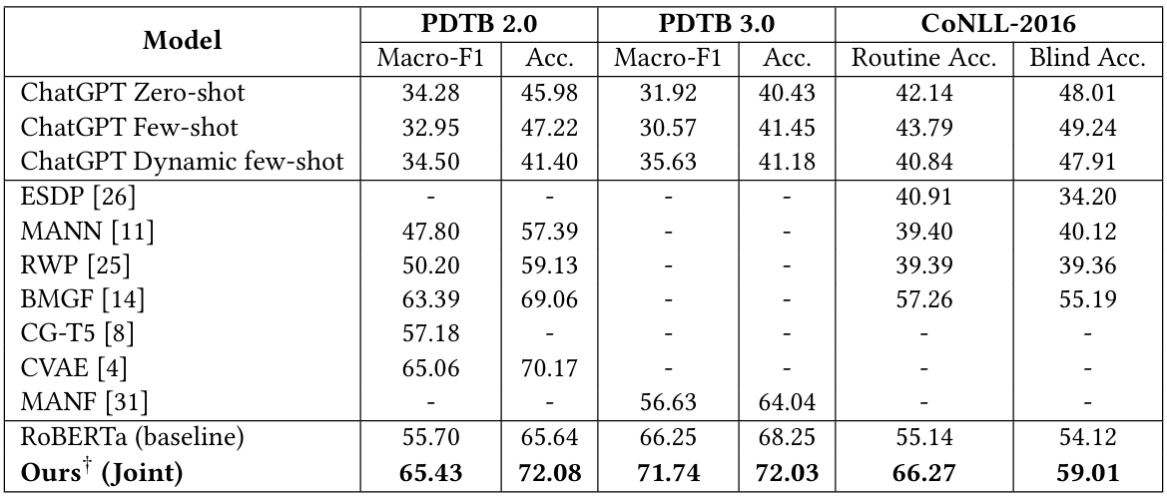
Main results (4-way classification)
SOTA performance
Table 2: Performance of IDRR. Comparison is made to ChatGPT and the connective-free models.
Notes:
From this table, it's observable that our approach achieves state-of-the-art (SOTA) performance compared to previous works, including ChatGPT and connective-free models.
ChatGPT does not show satisfactory performance without fine-tuning.

Slide 13
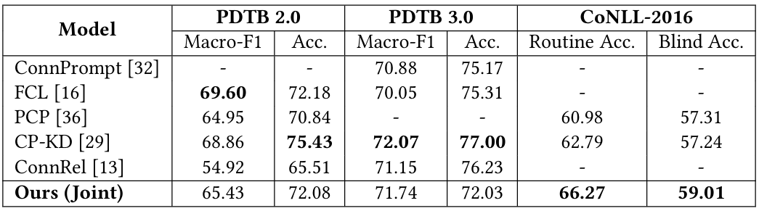
Main results (4-way classification)
Table 3: Performance of IDRR. Comparison is made to the connective-exposed models.
Achieve competitive performance
without relying on connectives during training
Notes:
In comparison to connective-exposed models, our approach achieves competitive performance. The results indicate that our approach is on par with models that utilize implicit connectives as observable hints for supervised learning. This is a notable achievement, as our approach does not rely on connectives during training.

Slide 14
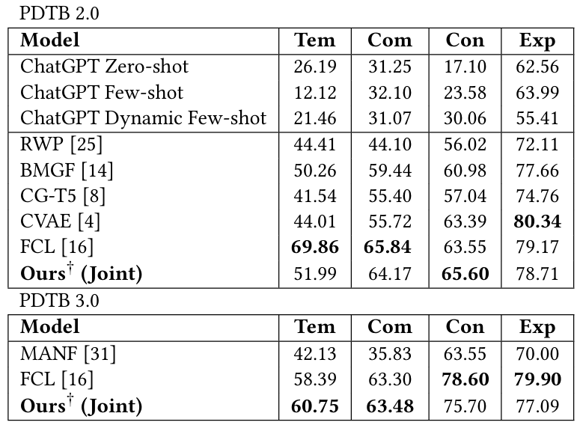
Binary classification results
Table 4: The binary IDRR result (F1-score (%)) for each main relation type.
Obtain relatively balanced F1-scores across relation types
Notes:
Here is the table showing performance on binary classification for four main relation types.
Our joint model achieves comparable performance to the connective-exposed model FCL on binary classification for the four main relation types. And notably, our model obtains relatively balanced F1-scores across the four relation types.

Slide 15
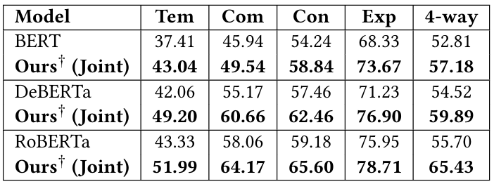
Robustness verification
Table 5: Robustness verification results.
Achieve substantial improvements across all three backbone models
Notes:
To verify the robustness of our approach, we conducted experiments using different backbone models, including BERT, DeBERTa, and RoBERTa. The results show that our joint model achieves substantial improvements across all three backbone models, demonstrating its versatility and effectiveness in enhancing the performance of various PLM-based models.

Slide 16
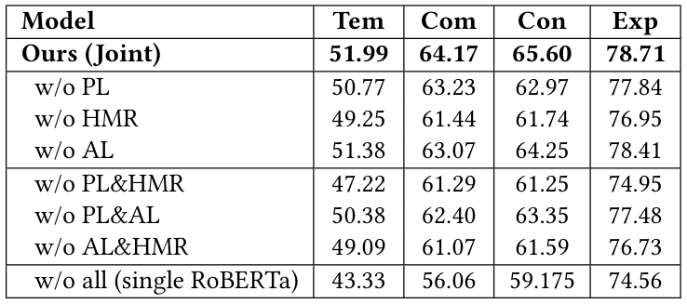
Ablation study
Combination of all three methods yields the best results
Ablating HMR causes the most severe performance degradation
Gain the most performance improvement out of HMR
Table 6: Results of ablation experiments.
Notes:
To verify the reliability of the three methods PL, AL, and HMR, we conducted an ablation study. We evaluated the performance of our joint model with each method removed individually and in combination. The results are shown in this table.
We can conclude that, ablating HMR causes the most severe performance degradation, and the model gains the most improvement of performance from HMR, indicating that HMR plays a crucial role in the joint model.
Besides, the combination of all three methods yields the best results.

Slide 17
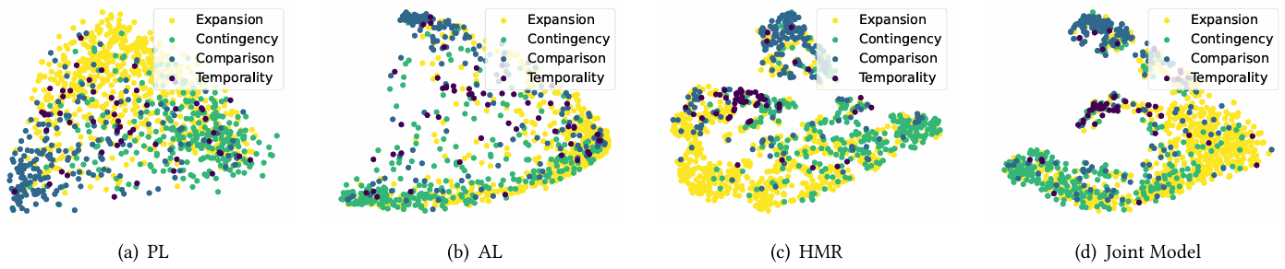
Ablation study
Figure 6: Distribution maps obtained by PL, AL, HMR, and the joint model.
PL and AL are relatively weak in differentiating samples in distribution compared to HMR
Notes:
We also visualized the distribution of samples in the feature space to further analyze the effects of each method.
These figures show that PL and AL are relatively weak in differentiating samples in distribution compared to HMR. Specifically, the samples are still entangled and indistinguishable when using PL and AL alone. In contrast, HMR effectively clusters the samples and separates them into distinct groups.
This visualization demonstrates the vital impact of HMR on the performance of the joint model.

Slide 18
Conclusion
Propose a novel joint learning approach to enhance PLM-based models
PL, AL, and HMR
Achieve SOTA performance among connective-free models and demonstrates competitive performance compared to connective-exposed models
Notes:
In conclusion, we propose a novel joint learning approach to enhance PLM-based models, which consists of three learning methods: Prototypical Learning, Adversarial Learning, and Hub-Migration based Redistribution.
Our approach achieves SOTA performance among connective-free models and demonstrates competitive performance compared to connective-exposed models.

Slide 19
Thank you for listening. Q & A
Learning to Differentiate Pairwise-Argument Representations for Implicit Discourse Relation Recognition
Zhipang Wang
zhipangwang@gmail.com
Notes:
That's all, thank you for your attention.
And I’m glad to answer any questions you may have.

Slide 20
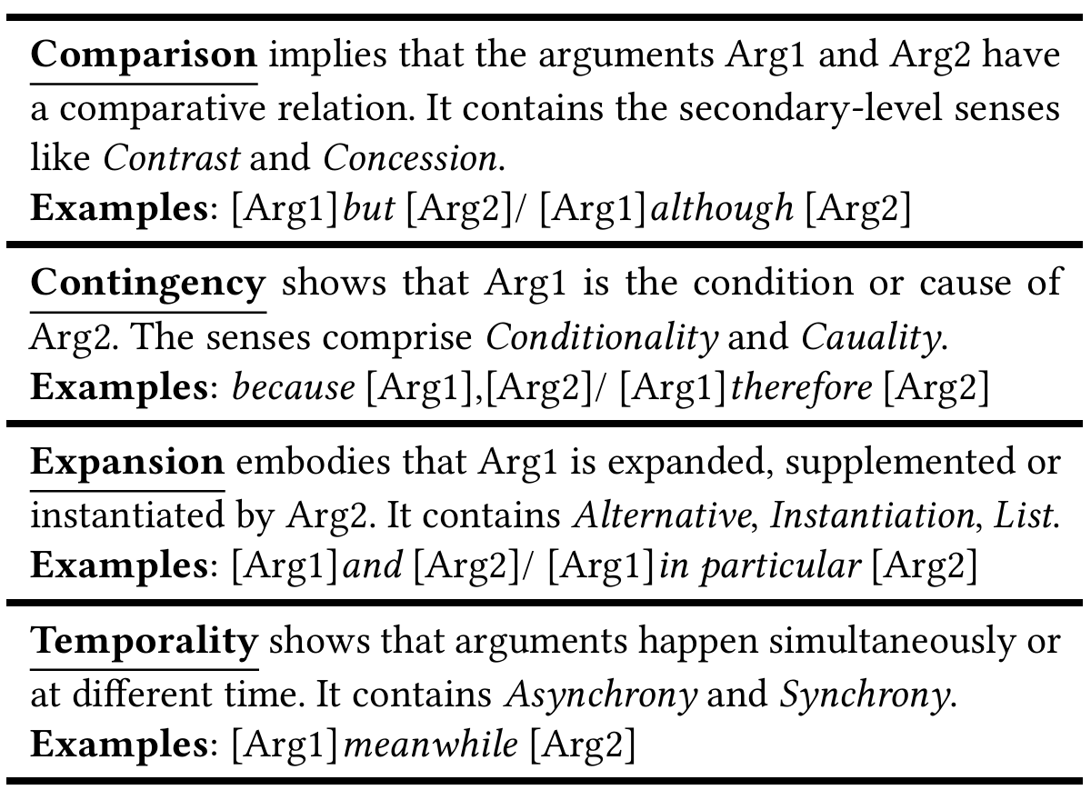
Definition of Relations

Slide 21
Prompts of ChatGPT
PL
Please generate a pair of text spans that have a {y} semantic relation.
Here are some examples:
{examples}

Slide 22
Prompts of ChatGPT
AL (paraphrase)
Argument 1:
{arg1}
Argument 2:
{arg2}
Relation:
{y}
Please generate new Argument 1 and Argument 2 that convey the same sematic relation as the originals but with distinct contexts and wording.

Slide 23
Prompts of ChatGPT
AL (adversaries)
Argument 1:
{arg1}
Argument 2:
{arg2}
Relation:
{y}
Please generate new Argument 1 and Argument 2 that maintain the original context while altering the semantic relation to convey a distinct meaning of {y*}.

Slide 24
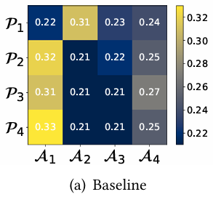

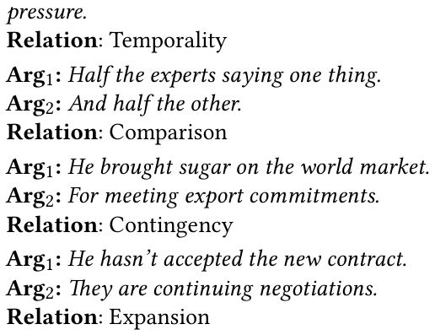
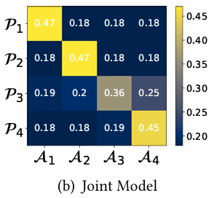
Case Study

Slide 25
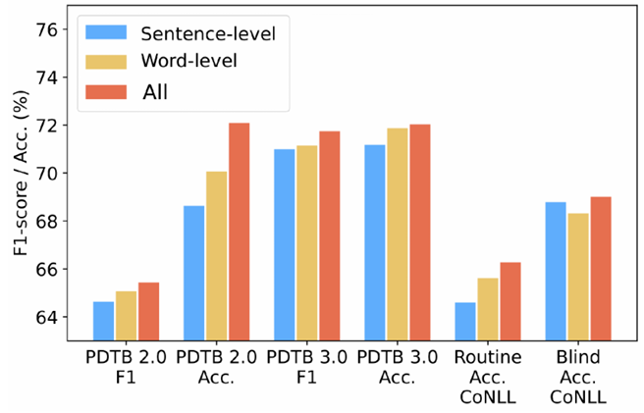
Impacts of prototypical components

