Slide 1

Welcome
Rearchitect your code
towards async/await

Slide 2

Solution Architect
Enthusiastic Software Engineer
Microsoft MVP for systems integration
@danielmarbach
particular.net/blog
planetgeek.ch
Notes:
I’m Daniel, Solution Architect…
I live in central Switzerland. If you want to know more about me listen to episode 77 of developer on fire
You can reach me on twitter under @danielmarbach
I blog on the particular blog and on my personal blog
I’m the lead behind the asyncification of NServiceBus and the ecosystem around it
I regularly contribute back ideas and code changes to asyncify the .NET OSS libraries and frameworks out there. So far I contributed to Entity Framework, RabbitMQ, Marten, MassTransit, Quartz.NET and many more

Slide 3
Why async is the future
How to gradually move your
code towards async / await
The toolbelt for an async ninja
Goals
target

Slide 4
Premise
Notes:
Basic knowledge of async/await in Csharp
Of course there is also reactive programming which has its own benefits and drawbacks, I will focus on Task-based APIs only without involving reactive programming models in this talk

Slide 5
Intro
Phases
WrapUp
Notes:
This webinar is divided into three parts
Terminology
Code and WrapUp including Q&A

Slide 6
Intro
Phases
WrapUp
Notes:
Intro

Slide 7
cast
The die
is
Notes:
Fasten your seatbelts. Asynchronous programming with async/await is coming more and more. Especially in the cloud enabled world of today and tomorrow more and more third party libraries and framework will move to async only APIs. As soon as your code starts integrating with this APIs it needs to move to async/await as well if you want to avoid the async over sync blocking mega disaster.

Slide 8
async function chainAnimationsPromise(elem, animations) {
let ret = null;
try {
for(const anim of animations) {
ret = await anim(elem);
}
catch(e) { /* ignore and keep going */ }
return ret;
}
javascript
ES2015
$ npm install babel-plugin-syntax-async-functions $ npm install babel-plugin-transform-async-to-generator
Notes:
Maybe only 1-2 samples with fewer slides
Dart 1.9 has it, Python 3.5 and higher has it

Slide 9
using (var client = new HttpClient()) {
var response = await client.GetAsync("api/products/1");
if (response.IsSuccessStatusCode)
{
var product = await response.Content.ReadAsAsync<Product>();
}
}
httpclient
Notes:
https://msdn.microsoft.com/en-us/library/system.net.http.httpclient.aspx
Only provides asynchronous APIs

Slide 10
var queryable = client.CreateDocumentQuery<Entity>(...) .AsDocumentQuery();
while (queryable.HasMoreResults)
{
foreach(var e in await queryable.ExecuteNextAsync<Entity>())
{
// Iterate through entities
}
}
Azure SDK
Notes:
For legacy reasons:
There are still synchronous APIs provided, but most love goes into asynchronous APIs. Sometimes synchronous APIs behave differently than asynchronous APIs. Bugs get fixed on sync APIs mostly.
Newcomer PaaS services:
Like DocumentDB (except for some parts of the querying APIs) or ServiceFabric have almost only async APIs
https://msdn.microsoft.com/en-us/library/microsoft.azure.documents.client.documentclient_methods.aspx

Slide 11

async
event-driven
Notes:
Async in the real world can be compared to me doing the laundry. I put my dirty clothes into the machine and select the program or timer and let the machine do its work. Until the laundry is done, indicated by a beep of the machine, I can carry on with other things like reading the newspaper, playing with my kid…
So I, the worker, am free until signal indicates external task is done
This is very similar to software
Asynchronous program
dispatches tasks to devices that can take care of themselves, leaving the program free to do something else until it receives a signal that the results are finished
Asynchronous programming should be used for external operations which support event-driven callbacks when they are done.
Usually that is the case for IO-bound work.
For example on windows IOCompletionPorts signal the result of a IO operation back to the initiator of the operation
Async operation can be more efficient, since the worker initiating the work are not blocked.

Slide 12

Task
uniform
Notes:
System.Threading.Task is an abstraction layer which represents both CPU bound and IO-bound operations as a uniformed API
Represents the state and outcome of an asynchronous operation executed now, later or never
This is very similar to washing clothes.
If Task represents an IO-bound operation then, we could compare it to

Slide 13
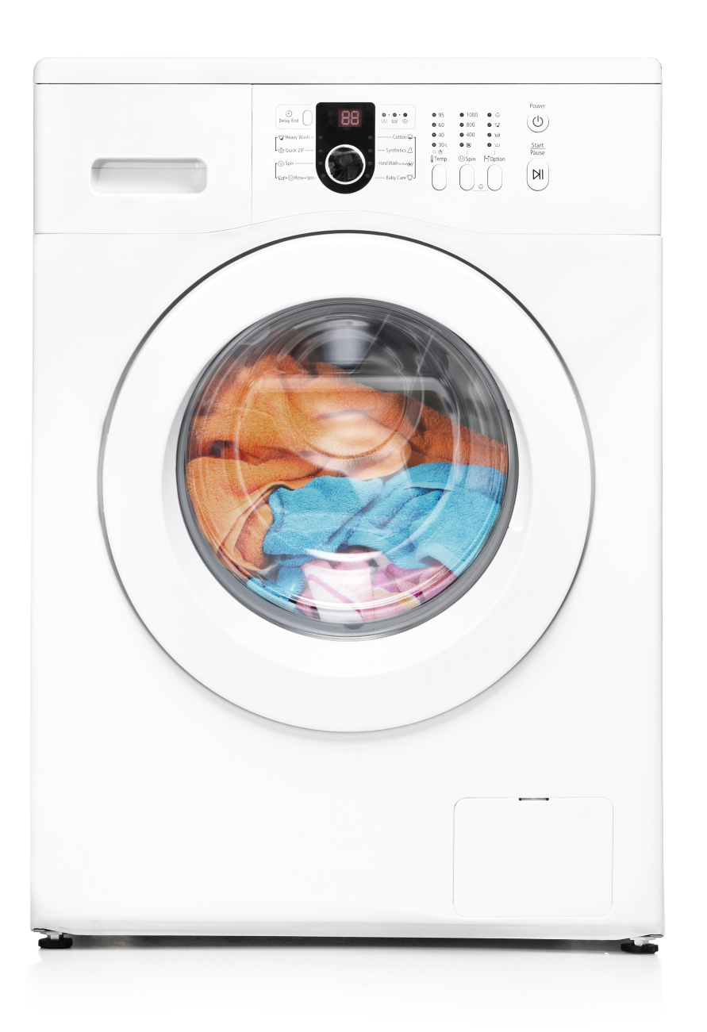
Task
IO-bound
Notes:
The laundry machine
So the state of the task representing the laundry machine would be running, not running, completed
The outcome should be clean clothes
I can late start the machine with a timer, or the machine can decide to run a health check before the process starts
It is also possible that because of failures the machine never starts
Or even more likely my wife cancels the process because yet again I’ve chosen the wrong temperature
The CPU-bound task

Slide 14

Task
CPU-bound
Notes:
Can be compared to me doing the laundry manually
No matter whether the task is IO or CPU bound, Threads are the workers responsible for getting Tasks done that are scheduled
But with CPU bound tasks the worker thread is blocked
So that means a thread can only handle one CPU-bound task at a time
In contrast
A thread can handle multiple IO-bound tasks concurrently
In order to leverage these Task based APIs we need to apply the async/await best practices. Two of the three rules are

Slide 15
Recap
Use async Task instead of async void
Async all the way, don’t mix blocking and asynchronous code
best-practices
Notes:
Use async Task instead of async void. Task becomes the new void. Async void methods are evil. They interrupt the asynchronous flow, because the calling thread is entering the block of until it reaches the first await statement and then the operation is successfully executed for the calling thread.
they are of fire & forget nature. Any exceptions raised inside async void methods cannot be observed by the caller (unless you do fancy things with SynchronizationContexts)
Async all the way, means we cannot mix blocking with asynchronous code. As shown by many blog posts, talks etc. around async / await best practices (btw. You can watch my webinar recordings which I show how to access at the end of this talk if you don’t know what I’m talking about) if we mix blocking with asynchronous code we will not only be unnecessarily capturing the worker thread but also expose our code to potential deadlocks.
If we follow the rules above, the async task returning APIs ripple through the whole call stack.

Slide 16
viral
Async / await
is
Notes:
Async /await is viral. Like a highly infectious deceases it starts spreading all over the place as soon as you have it.

Slide 17
but
Notes:
But

Slide 18
It kicks your
servers
butt
Notes:
It kicks your servers butt
On a server every thread that can be freed up is worth freeing up. On a server the comparison has to be done between asynchronous code and parallel code. Asynchronous code blow parallel code out of the water.
In order to understand why we need to explore how windows handles compute bound work and IO-bound work. We have two thread pools

Slide 19

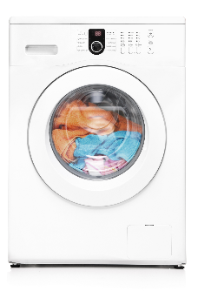
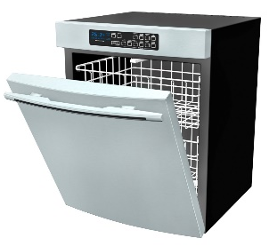
Worker Threadpool
IO Threadpool
Task.Run
Task.Factory.StartNew
Parallel.For
Parallel.ForEach
await iobound
iobound.FireForget()
Notes:
Parallel / Compute bound blocking work happens on the worker thread pool. Things like Task.Run, Factory.StartNew, Parallel.For schedule tasks on the worker thread pool. On the other hand if we schedule Compute bound work the worker thread pool will start expanding its worker threads. This phase is called ramp up phase. Ramping up more worker threads is expensive. The thread injection rate is limited.
async can handle bursting traffic better; the IOCP is "always-on", so to speak. IO-bound work is scheduled on the IO-thread pool. The IO-bound thread pool has a fixed number of worker threads (usually number of cores) which can work concurrently on thousands of IO-bound tasks. The point of IOCP is to efficiently offload IO work from user code to kernel and driver and hardware and not to bother the user code until the IO work is done. To achieve that, the user code layer registers for being notified of the IO operation to be complete. That notification occurs in form of a callback on an IO thread, which is a pool thread managed by the IO system that is made available to the user code.
Next slide!

Slide 20
Worker Threadpool
IO Threadpool
Task.Run
Task.Factory.StartNew
Parallel.For
Parallel.ForEach
await iobound
iobound.FireForget()
Notes:
As IO typically takes very long and compute work is comparatively cheap, the goal of the IO system is to keep the thread count low (ideally one per core) and schedule all callbacks (and thus execution of interleaved user code) on that one thread. That means that, ideally, all work gets serialized and there minimal context switching as the OS scheduler owns the thread. async uses much less memory allocation (and that's where most of the scalability benefits come from): the amount of memory saved by freeing up a thread (and its massive stack) dwarfs the amount of memory used for all the async structures combined.
Interestingly, if you examine each request in isolation, it would actually be (slightly) slower than the synchronous version (since there is the extra kernel transition, etc); but the scalability more than makes up for it.
Also, from the server perspective, So, if you compare asynchrony to synchrony - just looking at one method or one request - then synchrony makes more sense. But if you compare asynchrony to parallelism - looking at the server as a whole - then asynchrony generally wins.

Slide 21
NServiceBus
26 times
Azure Service Bus
6 times
Azure Storage Queues
MSMQ
3 times
more message throughput
https://github.com/Particular/EndToEnd/tree/master/src/PerformanceTests
Notes:
Attention the results may vary drastically depending on the azure latency and the hardware used on prem for MSMQ.
And this is only raw throughput measured. Everything else is also asynchronous like persistence, file transfers and so on. We also see much better ressource usage like using less threads more efficiently. Less CPU usage while high IO usage…
If you don’t believe me go have a look end2end
So if we want to benefit from asynchronous programming we have to (next slide)

Slide 22
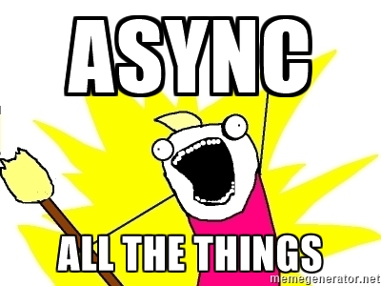
Notes:
ASYNC ALL THE THINGS
In order to approach the asyncification in a structure way I’ll show you a four phased approach for evolving your code-base towards async/await today.

Slide 23
identify
ExPlore
overcome
bring together
Notes:
In the identification phase, we classify the components which would benefit from async/await.
In the exploration phase, we discover potential road blockers which might hinder the async/await adoption.
In the obstacle phase, we learn to redesign parts of the code to remove the previously identified road blockers.
In the bring-it-together phase, we gradually move the components which benefit the most from async/await to a full asynchronous API. Small steps. No Big Bang.

Slide 24
Intro
Phases
WrapUp
Notes:
Phases

Slide 25
identify
ExPlore
overcome
bring together
Notes:
In the identification phase we identifiy all components which truly benefit from async/await.

Slide 26

Identify
IO-bound
Notes:
As we have learned in the introduction section

Slide 27
Configuration
Scanning
Pipeline
…
NServiceBus
Transport
Serialization
Persistence
…
IO-bound

Slide 28
identify
ExPlore
overcome
bring together

Slide 29
High-level Spike
Explore
IO-bound
Low-level Spike
Notes:
One way to do it is timeboxing Efferent and Afferent coupling?

Slide 30
High-level Spike
ConnectionFactory
Connection
RabbitMQ Client
Model
Consumers
IO-bound
github.com/rabbitmq/rabbitmq-dotnet-client/pull/151

Slide 31
RabbitMQ Client
Protocol
IO-bound
MessageBuilder
Content / Headers / Frames
NetworkReader/Writer
Low-level Spike
github.com/rabbitmq/rabbitmq-dotnet-client/pull/149

Slide 32

Event handlers
Locks
Monitor
Semaphore / Mutex
Auto / ManualResetEvent
Ref/Out parameters
Thread
Ambient state
IO-bound calls in 3rd Party libs
Remote Procedure Calls
watch!
Notes:
Maybe group the topics??
Maybe repeat again

Slide 33
Event handler

Slide 34

Event handlers
public delegate void EventHandler(object sender, EventArgs e);
public delegate void EventHandler<TEventArgs>(object sender, TEventArgs e);
watch!
async void MyEventHandler(object sender, EventArgs e)
{
await Task.Yield();
throw new InvalidOperationException();
}

Slide 35
ManualResetEvent

Slide 36
var syncEvent = new ManualResetEvent(false);
var t1 = Task.Run(() => {
syncEvent.WaitOne();
});
var t2 = Task.Run(() => {
Thread.Sleep(2000);
syncEvent.Set();
});
await Task.WhenAll(t1, t2);
ManualResetEvent
watch!

Slide 37

void stinks
wait smells
Remember
Async all the way means avoid blocking code
Notes:
Use another icon

Slide 38
Locks

Slide 39
locks
var locker = new object();
lock (locker)
{
await Task.Yield();
}
watch!
Error CS1996 Cannot await in the body of a lock statement
http://stackoverflow.com/questions/7612602/why-cant-i-use-the-await-operator-within-the-body-of-a-lock-statement
Notes:
Awaiting inside a lock is a recipe for producing deadlocks.
I'm sure you can see why: arbitrary code runs between the time the await returns control to the caller and the method resumes. That arbitrary code could be taking out locks that produce lock ordering inversions, and therefore deadlocks.
Worse, the code could resume on another thread (in advanced scenarios; normally you pick up again on the thread that did the await, but not necessarily) in which case the unlock would be unlocking a lock on a different thread than the thread that took out the lock.

Slide 40
Ref / Out parameters

Slide 41
Ref/Out
static async Task Out(string content, out string parameter)
{
var randomFileName = Path.GetTempFileName();
using (var writer = new StreamWriter(randomFileName))
{
await writer.WriteLineAsync(content);
}
parameter = randomFileName;
}
watch!
Error CS1988 Async methods cannot have ref or out parameters

Slide 42
Ambient state

Slide 43
Ambient state
class ClassWithAmbientState
{
static ThreadLocal<int> ambientState = new ThreadLocal<int>(() => 1);
public void Do()
{
ambientState.Value++;
}
}
watch!
Notes:
Maybe just refer to my blog post

Slide 44
Ambient state
var instance = new ClassWithAmbientState();
var tasks = new Task[3];
for (int i = 0; i < 3; i++) {
tasks[i] = Task.Run(() => {
instance.Do();
Thread.Sleep(200);
instance.Do();
});
}
await Task.WhenAll(tasks);
watch!
Notes:
Maybe add RPC??

Slide 45

Older constructs bound to threads
fall apart in the async/await world
Remember
Notes:
Use another icon

Slide 46
Task
Forget thread!
think
Notes:
Stop thinking in threads. For most applications threads are no longer relevant. Think in Tasks. Rest assured the TPL runtime is heavily optimized for most production scenarios.

Slide 47
identify
ExPlore
overcome
bring together

Slide 48
Event handler

Slide 49
public delegate void EventHandler(object sender, EventArgs e);
public delegate void EventHandler<TEventArgs>(object sender, TEventArgs e);
async void MyEventHandler(object sender, EventArgs e)
{
await Task.Yield();
throw new InvalidOperationException();
}

Slide 50
Event handlers
public delegate Task AsyncEventHandler(object sender, EventArgs e);
async Task MyAsyncEventHandler(object sender, EventArgs e) { }
Fix it!
async Task MyEventHandler(object sender, EventArgs e)
{
await Task.Yield();
throw new InvalidOperationException();
}

Slide 51
Event handlers
protected virtual Task OnMyAsyncEvent() {
var invocations = handler.GetInvocationList();
var handlerTasks = new Task[invocationList.Length];
for (int i = 0; i < invocations.Length; i++) {
handlerTasks[i] = ((AsyncEventHandler)invocations[i])(...);
}
return Task.WhenAll(handlerTasks);
}
Fix it!

Slide 52
ManualResetEvent

Slide 53
var syncEvent = new ManualResetEvent(false);
var t1 = Task.Run(() => {
syncEvent.WaitOne();
});
var t2 = Task.Run(() => {
Thread.Sleep(2000);
syncEvent.Set();
});
await Task.WhenAll(t1, t2);

Slide 54
var tcs = new TaskCompletionSource<object>();
var t1 = ((Func<Task>)(async () => {
await tcs.Task;
});
var t2 = ((Func<Task>)(async () => {
await Task.Delay(2000);
tcs.TrySetResult(null);
});
await Task.WhenAll(t1, t2);
ManualResetEvent
Fix it!

Slide 55
ManualResetEvent
Works for set once events only.
For async reset events, an approach is available on github
Fix it!
https://github.com/danielmarbach/RearchitectTowardsAsyncAwait/blob/master/presentation/AsyncManualResetEvent.cs

Slide 56
Locks

Slide 57
locks
Can we change the code so that
we don’t have to await inside the lock?
Fix it!

Slide 58
var locker = new object();
lock (locker)
{
await Task.Yield();
}
Error CS1996 Cannot await in the body of a lock statement

Slide 59
locks
int sharedRessource = 0;
var semaphore = new SemaphoreSlim(1);
var tasks = new Task[3];
for (int i = 0; i < 3; i++) {
tasks[i] = ((Func<Task>) (async () => {
await semaphore.WaitAsync();
sharedRessource++;
semaphore.Release();
}}))();
}
await Task.WhenAll(tasks);
Fix it!

Slide 60
locks
using (await semaphore.LockAsync())
{
sharedRessource++;
}
Fix it!
https://github.com/danielmarbach/RearchitectTowardsAsyncAwait/blob/master/presentation/AsyncLock.cs

Slide 61
Ref / Out parameters

Slide 62
static async Task Out(string content, out string parameter)
{
var randomFileName = Path.GetTempFileName();
using (var writer = new StreamWriter(randomFileName))
{
await writer.WriteLineAsync(content);
}
parameter = randomFileName;
}
Error CS1988 Async methods cannot have ref or out parameters

Slide 63
Ref/Out
static async Task<string> Out(string content)
{
var randomFileName = Path.GetTempFileName();
using (var writer = new StreamWriter(randomFileName))
{
await writer.WriteLineAsync(content);
}
return randomFileName;
}
Fix it!

Slide 64
Ambient state

Slide 65
class ClassWithAmbientState
{
static ThreadLocal<int> ambientState = new ThreadLocal<int>(() => 1);
public void Do()
{
ambientState.Value++;
}
}

Slide 66
class ClassWithAmbientState {
static AsyncLocal<int> ambientState = new AsyncLocal<int>();
static ClassWithAmbientState() { ambientState.Value = 1; }
public void Do() {
ambientState.Value++;
}
}
Ambient state
Fix it!
Notes:
Maybe add RPC??

Slide 67
Ambient state
var instance = new ClassWithAmbientState();
var tasks = new Task[3];
for (int i = 0; i < 3; i++) {
tasks[i] = ((Func<Task>)(async () => {
instance.Do();
await Task.Delay(200).ConfigureAwait(false);
instance.Do();
}))();
}
await Task.WhenAll(tasks);
Fix it!
Notes:
Maybe add RPC??

Slide 68
Ambient state
Even better: Can we change the code so that
we float state into methods that need it?
Fix it!

Slide 69
Ambient state
var instance = new ClassWithFloatingState();
var tasks = new Task[3];
for (int i = 0; i < 3; i++) {
tasks[i] = ((Func<Task>)(async () => {
int current = 1;
current = instance.Do(current);
await Task.Delay(200).ConfigureAwait(false);
instance.Do(current);
}))();
}
await Task.WhenAll(tasks);
Fix it!
Notes:
Show output?

Slide 70
identify
ExPlore
overcome
bring together

Slide 71
High-level
Bring it together
Low-level

Slide 72
void HighLevel() {
try {
MidLevel();
} catch(InvalidOperationException) { }
}
void MidLevel() {
…
LowLevel();
…
}
void LowLevel() {
}
Bring it together

Slide 73
void HighLevel() {
try {
MidLevel();
} catch(InvalidOperationException) { }
}
void MidLevel() {
…
LowLevel().GetAwaiter().GetResult();
…
}
async Task LowLevel() {
}
Bring it together

Slide 74
Commit. Push.

Slide 75
void HighLevel() {
try {
MidLevel().GetAwaiter().GetResult();
} catch(InvalidOperationException) { }
}
async Task MidLevel() {
…
await LowLevel().ConfigureAwait(false);
…
}
async Task LowLevel() {
}
Bring it together

Slide 76
Commit. Push.

Slide 77
async Task HighLevel() {
try {
await MidLevel ().ConfigureAwait(false);;
} catch(InvalidOperationException) { }
}
async Task MidLevel() {
…
await LowLevel().ConfigureAwait(false);
…
}
async Task LowLevel() {
}
Bring it together

Slide 78
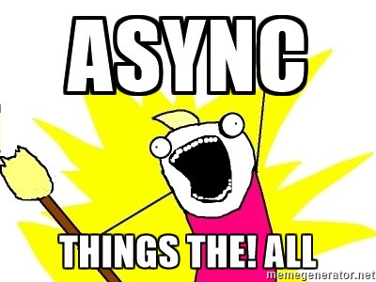
Yehaa!
Async all the way

Slide 79
Intro
Phases
WrapUp
Notes:
WrapUp

Slide 80
Use iPob to move your code
step by step towards async / await
IO-bound paths benefit from async
Uniform API of Task allows to await CPU-bound as well as IO-bound tasks
Recap
reminder

Slide 81
Slides, Links…
github.com/danielmarbach/RearchitectTowardsAsyncAwait
Notes:
Questions that can be answered in blog posts

Slide 82
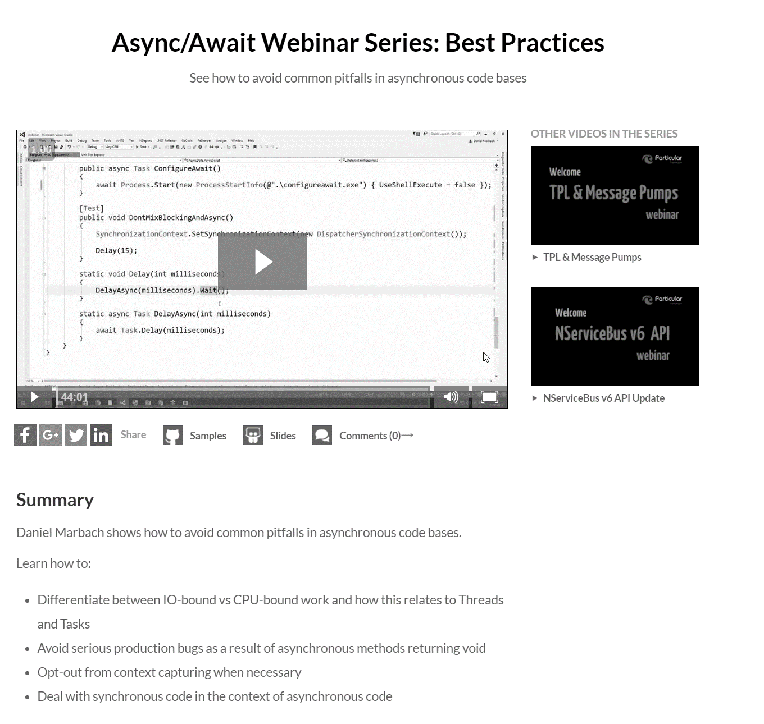
go.particular.net/ndc16.async

Slide 83
Q & A
await

Slide 84
Thanks
Notes:
Thank you very much for listening and see you next time

Slide 85


Reality

