Slide 1
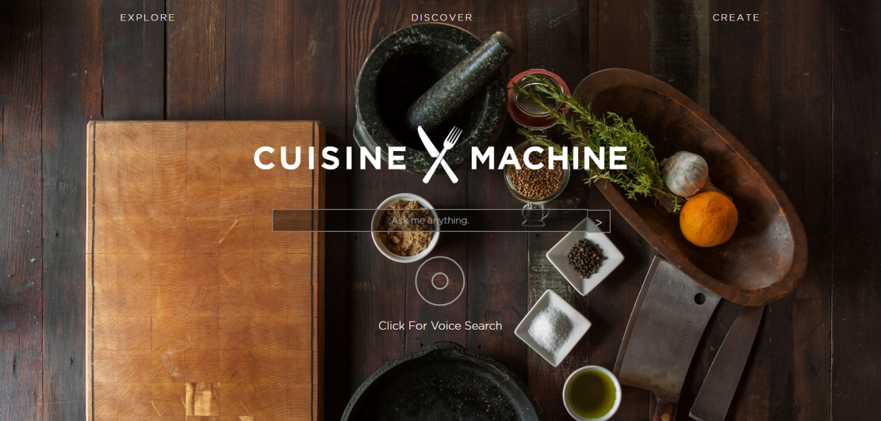
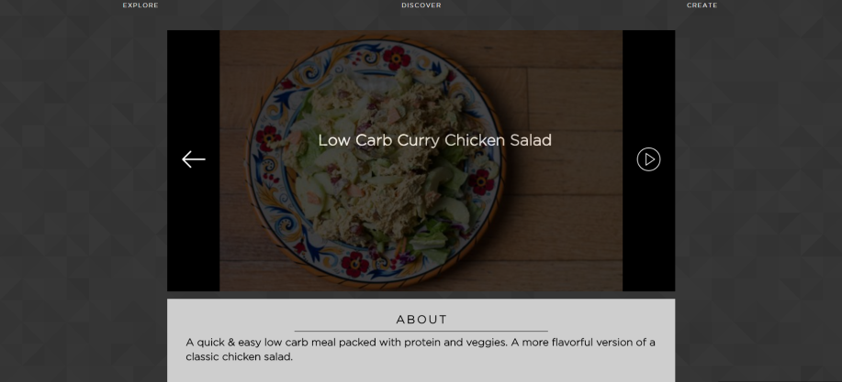
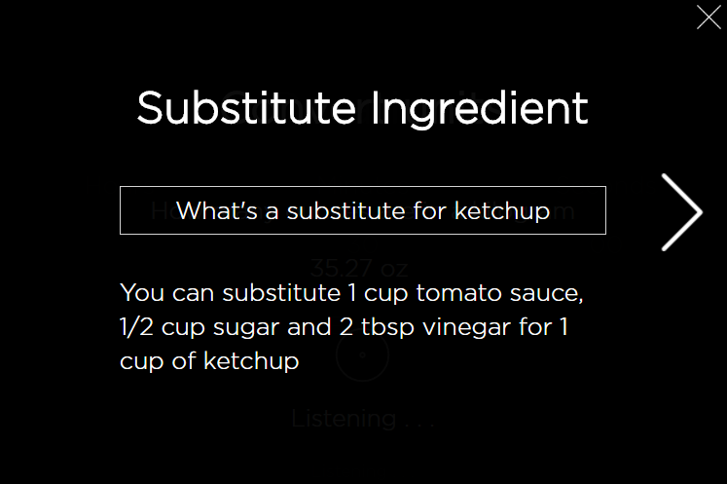
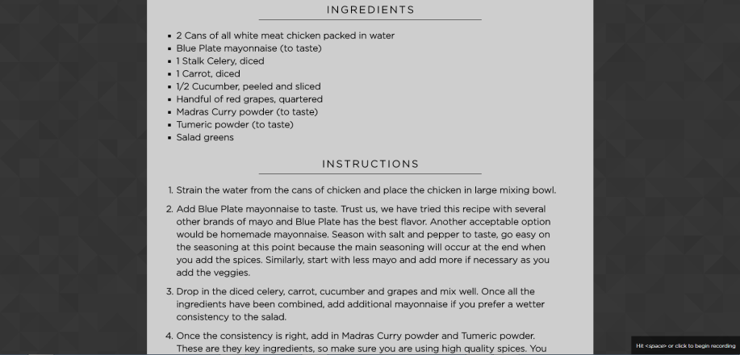
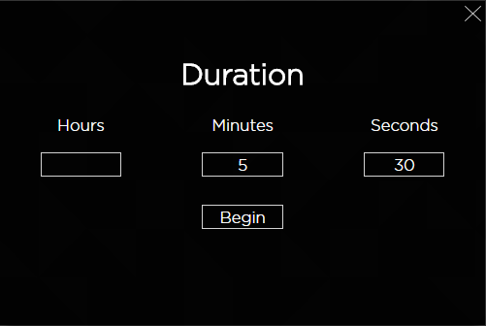
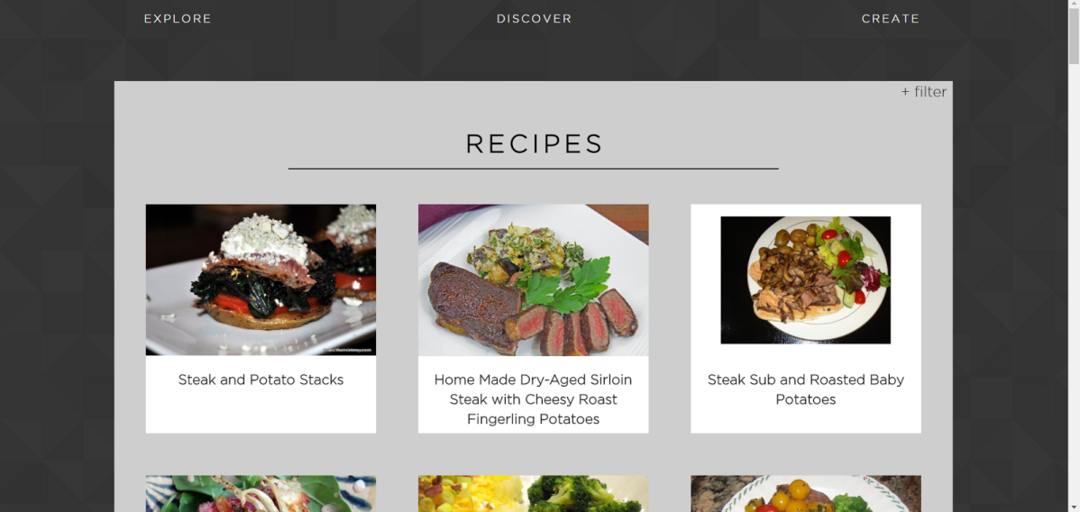
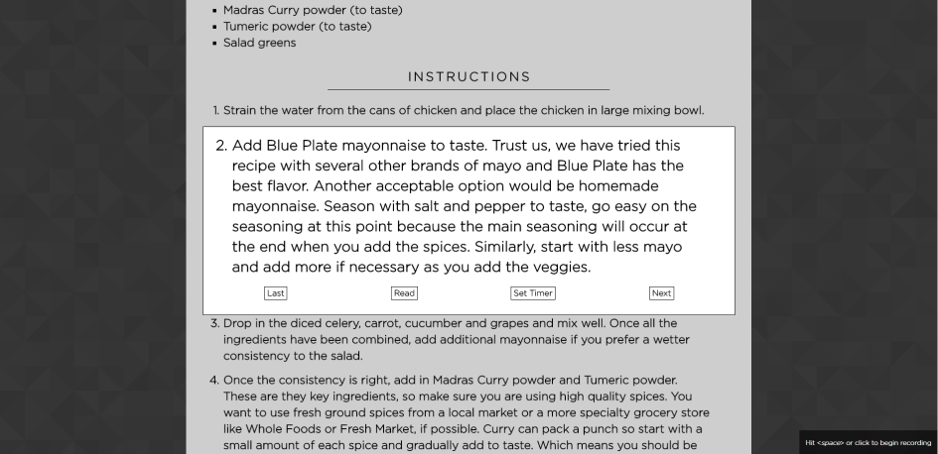
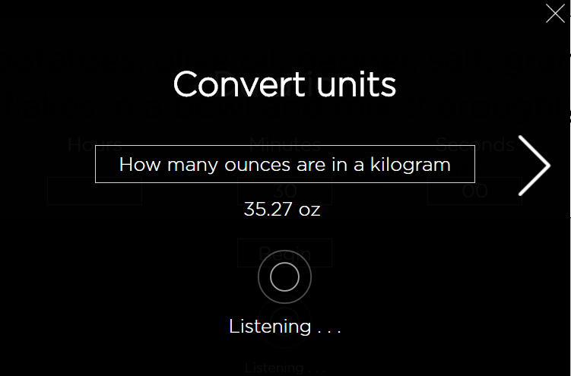
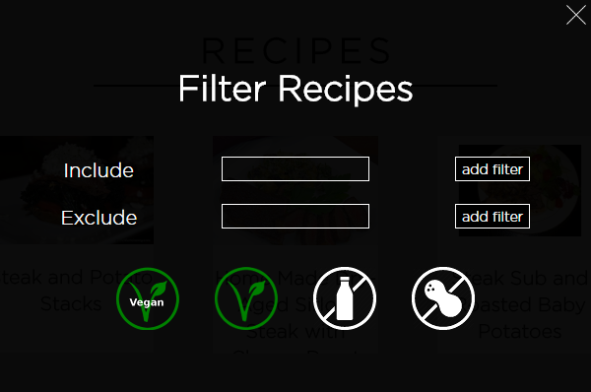
CuisineMachine
Zach Peugh, Jackson Luken, Evan Clark, Xander Wunderlich, Zhefang Zhao
–
THE OHIO STATE UNIVERSITY/ COLLEGE OF ENGINEERING/ CSE 5914
GUIDELINES
EXPLORE
CREATE
WIDGETS
Substitution
PURPOSE
Description about substitution Description about substitution
Description about substitution
Description about substitution
Description about substitution
Description about substitution
The Create page is used for… The Create page is used for… The Create page is used for…The Create page is used for…The Create page is used for… The Create page is used for… The Create page is used for…The Create page is used for…The Create page is used for… The Create page is used for… The Create page is used for.
Timer
DISCOVER
Description about the Create page.
DESIGN
Description about TimerDescription about Timer Description about Timer
Unit Conversion
The Discover page is used to peruse through the top 50 recipes matching the search query. Additionally, we have added a filter to …..
Description about spacebar activated speech enabled navigation
Description about conversion widget

