Slide 1
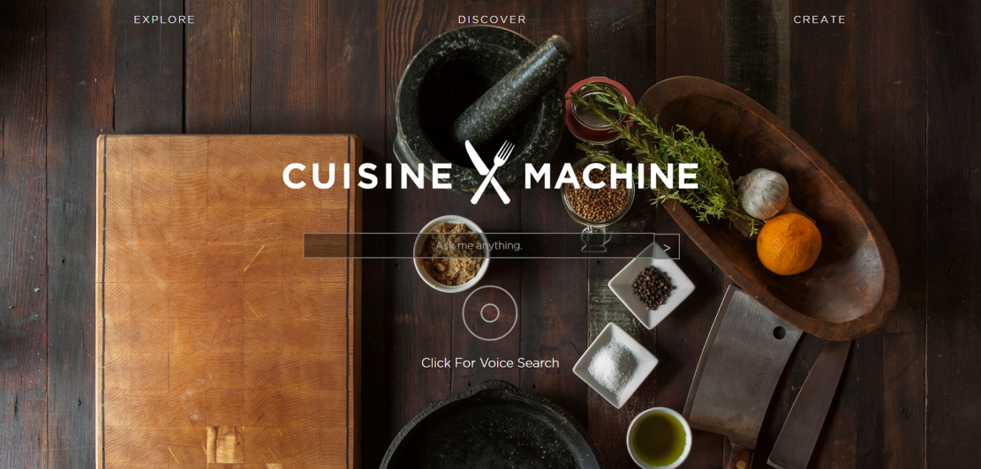
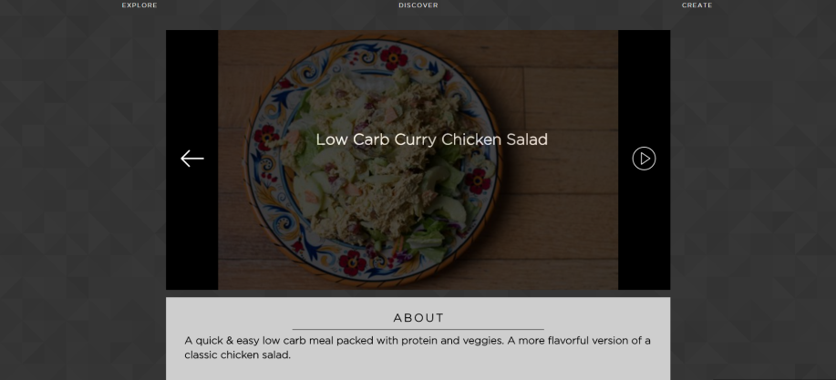
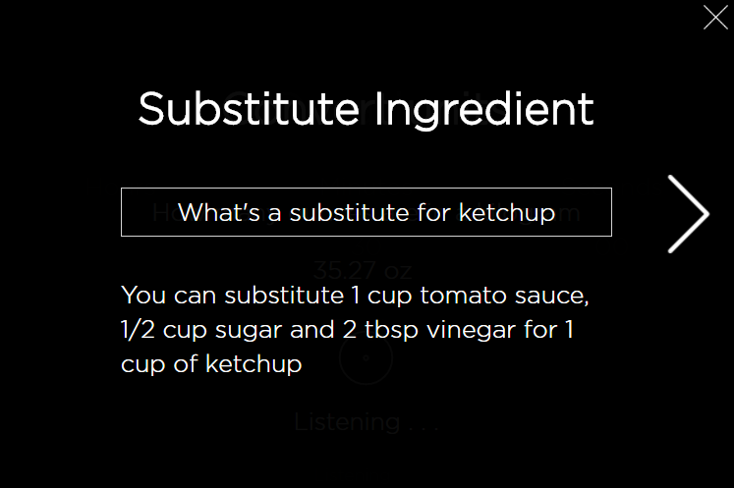
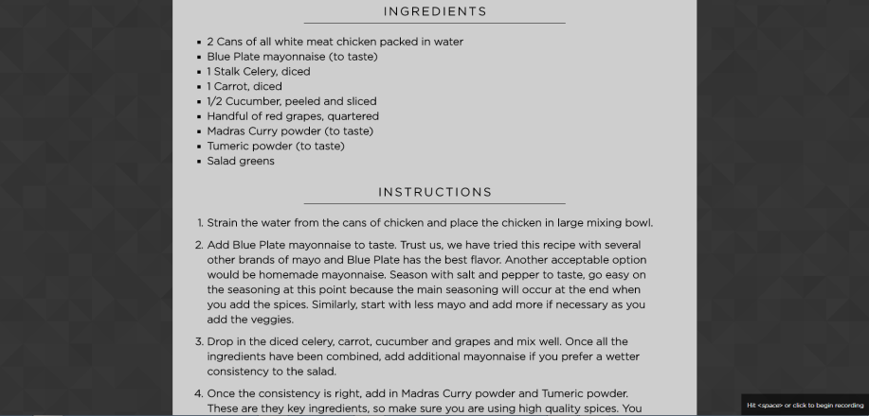
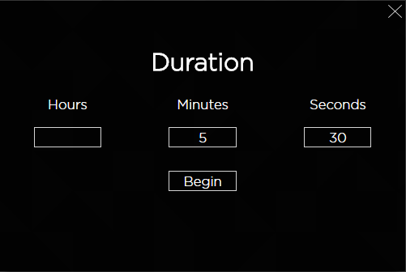
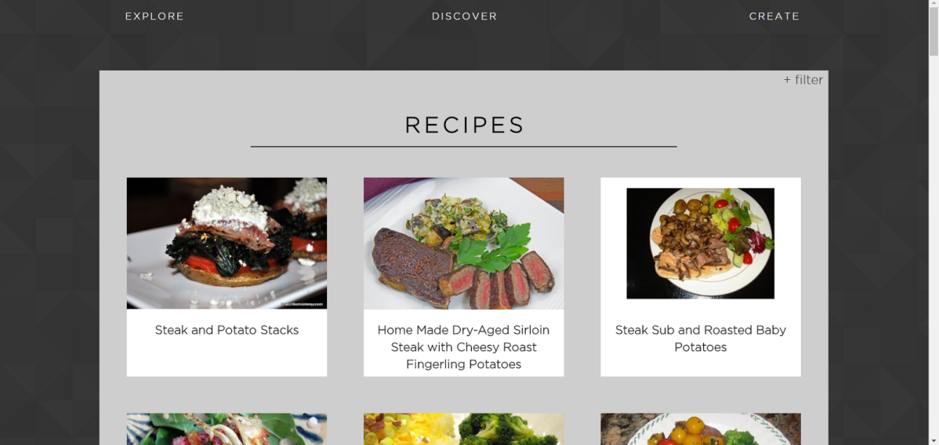

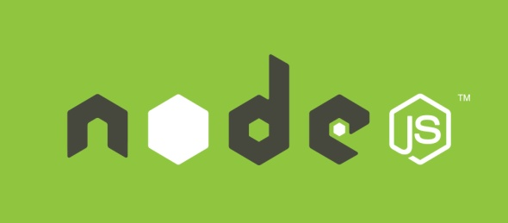
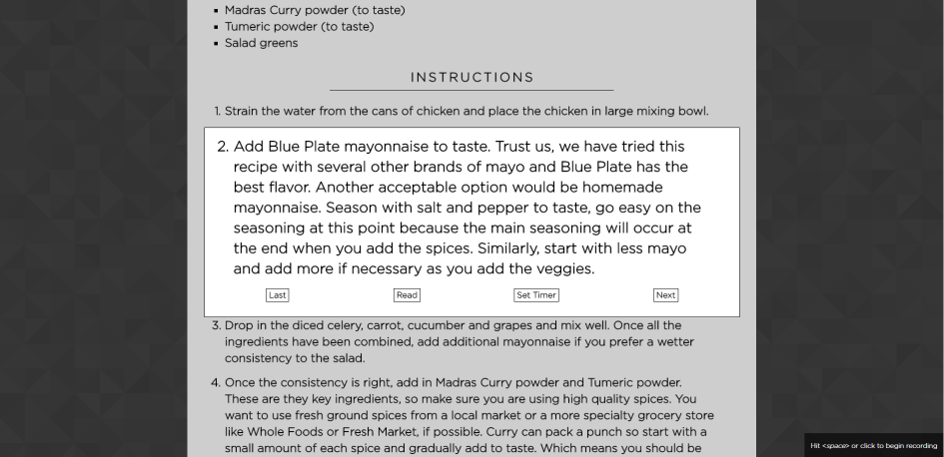



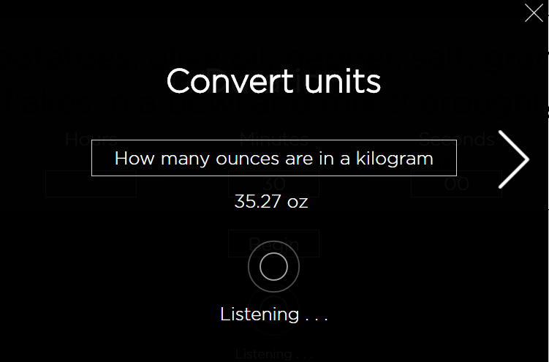
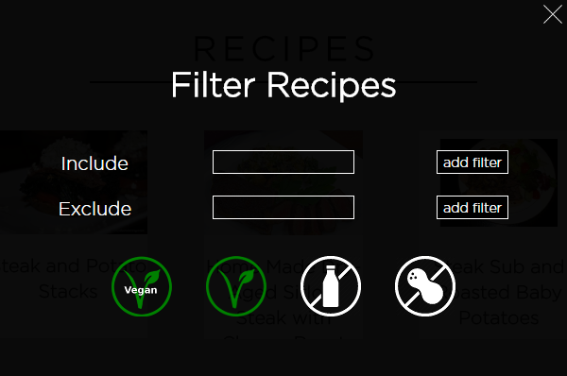
CuisineMachine
Zach Peugh, Jackson Luken, Evan Clark, Xander Wunderlich, Zhefang Zhao
–
THE OHIO STATE UNIVERSITY/ COLLEGE OF ENGINEERING/ CSE 5914
GUIDELINES
EXPLORE
CREATE
WIDGETS
For the CSE 5914 Knowledge-Based Systems Capstone class, students were to use IBM Watson’s Bluemix services in order to create an intelligent application. IBM Watson offers a variety of APIs and services, and all of them were available to students. Two of these services were required for the class: ‘Retrieve and Rank’, and ‘Natural Language Classifier’. To see a list of available services visit https://www.ibm.com/watson/developercloud/services-catalog.html
All widgets can be activated by either moving the cursor to the left edge of the page and picking them from the sidebar menu, or using the appropriate speech. They may also be closed by saying “close”, or “close window”, etc.
Substitution
PROJECT DESCRIPTION
Our team saw a great opportunity to integrate multiple IBM Watson services in order to create a virtual cooking assistant web application. We created a minimalistic, easy-to-use web application where you can search by keyword from a database of almost 40,000 recipes we scraped from the web. The application allows you to find the perfect recipe by using the Watson Retrieve and Rank backend to parse through all of the documents and return the top results based on the query you provide. After this, you are passed to the Discover page, whereupon you can look through and further filter recipes, until you find the one that suites your needs. The final step is onto the Create page, which gives you a description, ingredients, and step by step instructions. This is where the app truly shines, as all navigation can be interacted with through speech to text recognition, so you don’t have you grab the mouse with your messy hands while cooking. In addition to hands free navigation, we have included multiple voice activated widgets that will make your cooking experience seamlessly smooth.
The Explore page allows you to either type or speak a query into the main search bar. Typically, from this page a user would just type their query based on specific ingredients, style, location, etc that they want. Natural language or just keyword aggregation may be used in this input field. Additionally, questions about unit conversion, ingredient substitution, or starting a timer may also be input, and will be handled by the proper widget without further interaction necessary.
Sentences such as “what is a substitution for milk”, or “what is a milk substitute”, etc can be used to activate this widget. We have over 100 ingredients available to substitute, and if one is found then the proper scale substitution is returned.
Timer
DISCOVER
DESIGN
Once a recipe if chosen, users will be directed to the Create page. From here, users can do a final look-through of the ingredients and instructions before deciding to cook. When they are ready, they simply press the play button, or use the speech to text capability and say anything along the lines of “begin cooking”, “start”, etc.
Front-end
Client-side server
1
2
3
Sentences such as “start a timer for 5 minutes and 30 seconds”, or “start a 1 hour timer”, etc can be used to activate this widget. We have built a flexible parser to automatically get and set the time from a natural English sentence.
Once a query has been submitted that was classified as a request for recipes, users will be taken to the Discover page. The top 50 results matching your query will show up in a neatly formatted grid view with 3 items per row. You select a recipe which appeals to you most by simply clicking on it.
Unit Conversion
Watson Speech To Text
Watson Natural Language Classifier
Watson Retrieve and Rank
We decided to go with an AngularJS front-end for the user interaction, which is built on top of a lightweight Node server. When a user interacts using speech, we have a web socket that streams the audio through our Node server to the Watson Speech to Text backend. When the resulting sentence comes back, it is classified using the Watson NLC that we trained with various classes for interaction within the application. If the class returned is not the recipe retrieval class, then the results bubble back up to the Angular application where the correct implementation is done. If the class returned was for recipe retrieval, then Watson is hit a third time and the top recipes for the query are returned from the retrieve and rank service, and dealt with accordingly on the front-end.
If a user wishes to further narrow down the list of available recipes, there is a filter available . This filter butten will bring up a small popup window in the center of the screen which allows for several options. Users can make it necessary to include or exclude specific ingredients by typing them in and adding the filter. Alternatively, users can click one of four predefined filters (Vegan, Vegetarian, Dairy-free, Nut-allergy)
Once a user has began cooking, they are free to use either the click navigation, with left and right arrow keys going forward and backward through steps, or they can tap the spacebar, speak an instruction, and allow the backend to decide the proper step to take. Some examples of statements that can be said are “Go to the next step”, or “next”, etc, for heading to the next instruction. Similarly, “back a step”, or “go back”, etc can be used to go to the previous step. A built in text-to-speech function has also been added, so any step can be read aloud upon a request such as “read that to me”, or “read instruction”, etc. Beyond these navigation steps are ingredient substitution, timer, and unit conversion widgets ready to assist upon proper request.
Sentences such as “How many ounces are in a pound”, or “how many liters per gallon”, etc can be used to activate this widget. The proper conversion ratio will be displayed on screen upon request.

Slide 2
Front-end
Client-side server
1
2
3
Watson Speech To Text
Watson Natural Language Classifier
Watson Retrieve and Rank

