Slide 1

Problem Statement
Problem Statement Title: Time Table Generator
Problem Statement :
The Project, Time Table generator, is a web application (Full Stack) In MERN Stack.
UN sustainable Development Goal : Quality Education
20IT022
20IT011

Slide 2

Motivation & Scope
The project makes use of a genetic algorithm to satisfy the soft and hard constraints and generate the most optimal timetable. The web application includes a simple authentication-authorization module, and on successfull authentication the user is redirected to the admin dashboard.
On the admin dashboard the user can input the data of the college/university which is required to generate the timetable. The user must add the following details:
1. Teachers 3. Timings 5. Departments
2. Classrooms 4. Courses 6. Sections

Slide 3
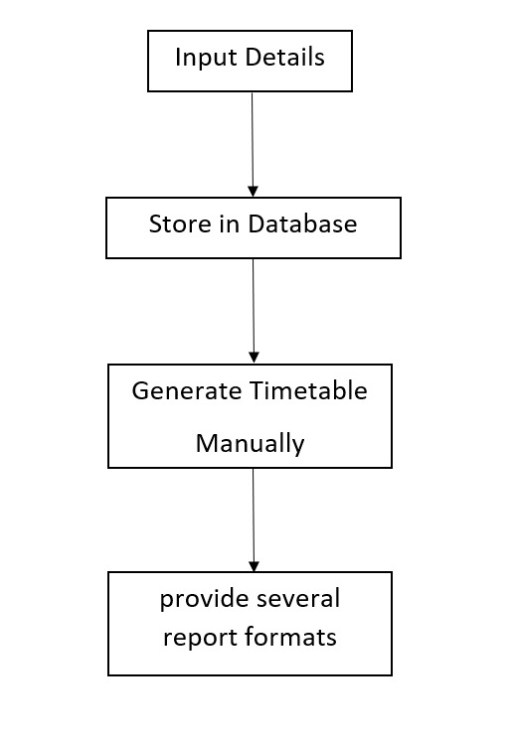
Flowchart
This project consists of several components, each responsible for performing a certain task to get the best timetables. The image below illustrates the system architecture of the project.

Slide 4
Technology used
The Technology stack that we are going to use in our project is :
React JS
Node.js
MongoDB

Slide 5
Usage
Most colleges have a number of different courses and each course has a number of subjects. Now there are limited faculties, each faculty teaching more than one subjects. So now the time table needed to schedule the faculty at provided time slots in such a way that their timings do not overlap and the time table schedule makes best use of all faculty subject demands. We use a genetic algorithm for this purpose. In our Timetable Generation algorithm we propose to utilize a timetable object.
This project is used for educational purposes and is not intended to be used commercially. We are not liable for any damages/changes done by this project.

Slide 6
Thank You

