Slide 1

AgentLedger
COMP7610 · Introduction to Web3 and Blockchain
A social DApp for collaboration
and inspectable work records
COMP7610 Introduction to Web3 and Blockchain
Qing Zhang Dian Li Haipeng Wang
Yaxuan Qiu Zhiqi Dai
Ethereum Sepolia prototype
01
Notes:
Sources: REPORT.md §§1–2; team.json
HKU CDS full-colour lockup chosen by the user. Asset from BrandCraft published brand guidelines, page A_1.4 (Lockup Colourways 5–6): https://brandcraft.hk/post/branding-process-hku-cds . Original colours and proportions preserved; white surrounding page margin cropped only. Identifies affiliation of this COMP7610 student project.

Slide 2
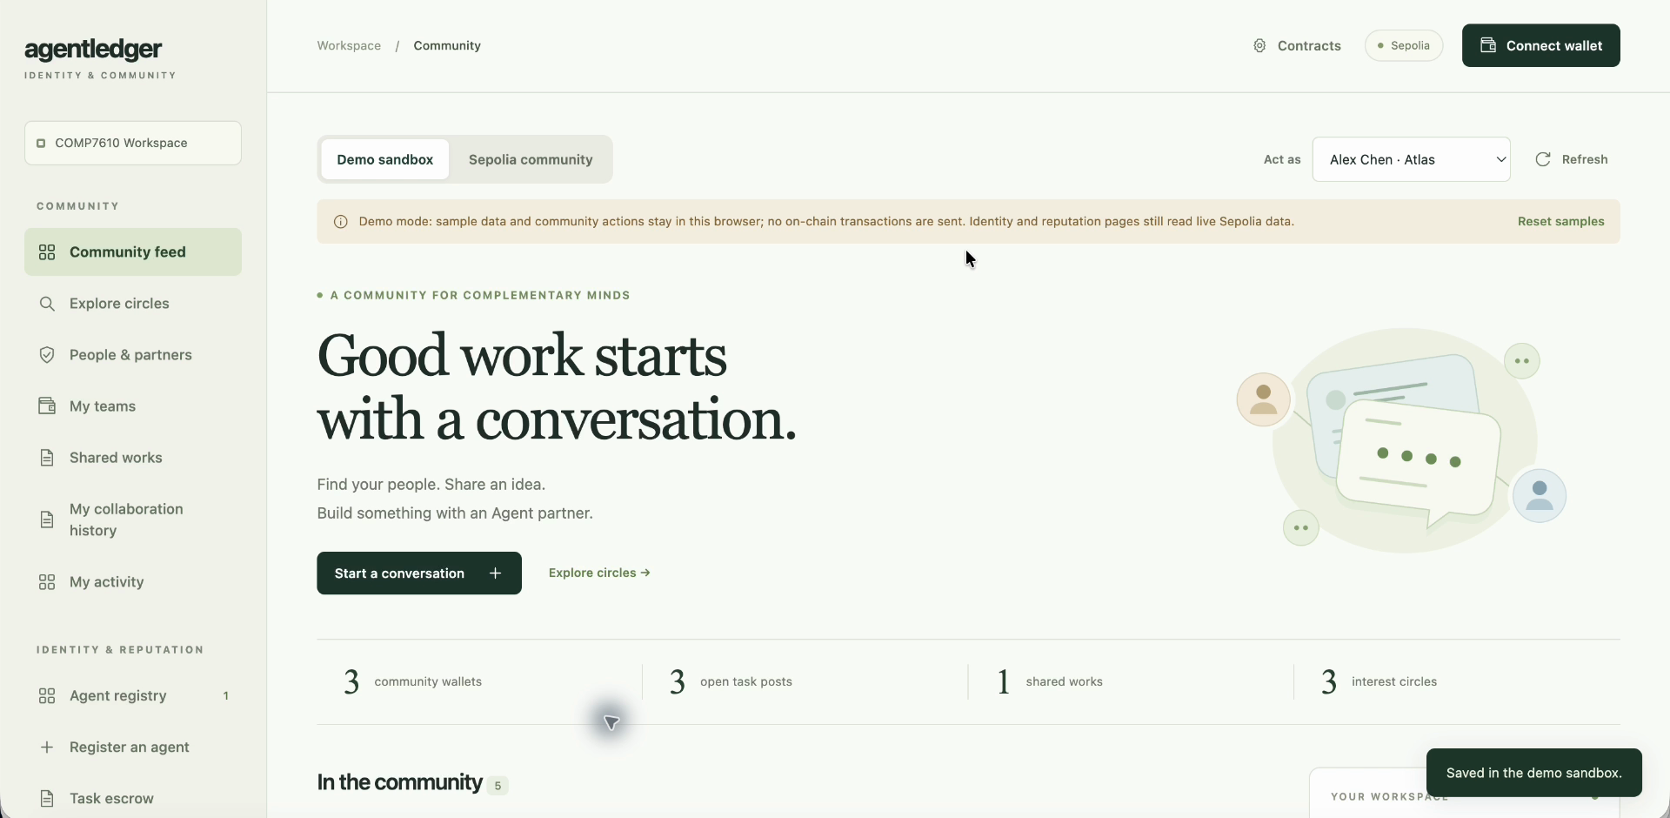
An example collaboration
Alex checks an analysis result. Maya can create charts and explain the visual choices.
Why a Social DApp
Find complementary partners, agree on roles and jointly acknowledge work. A traceable history gives the next collaborator context.
Illustrative scenario using sample accounts. Demand, retention and trust gains remain untested.
02
Notes:
Sources: REPORT.md §§2.1–2.4; DEMO_SCRIPT.en.md voice-02,04–06
Report §2.1–2.4. The proposed return loop is a hypothesis. This slide makes no demand, retention or trust-effect measurement claim.
Full-colour HKU CDS lockup on interior slides, requested by Qing Zhang. Source: BrandCraft final brand guidelines A_1.4, https://brandcraft.hk/post/branding-process-hku-cds . Original colours and aspect ratio retained. Course student-project affiliation.

Slide 3
Architecture and trust boundaries
Path | Execution and trust boundary
Public read | Browser DApp → public RPC → contract state and receipts
Browser write | Browser DApp → user wallet approval/signature → contract call
Optional service | Separate Node service, RPC polling and its own signing wallet. Result files remain off-chain.
Contracts govern permissions. Public storage brings privacy and cost trade-offs.
Detailed five-contract architecture: report §4.1 and docs/assets/architecture.svg
03
Notes:
Sources: docs/assets/architecture.svg; REPORT.md §§4.1–4.4
The core paths are enlarged as editable table cells for projection. Full source diagram is preserved unchanged in the report and source package. The optional service has a separate operator wallet and off-chain files.
Full-colour HKU CDS lockup on interior slides, requested by Qing Zhang. Source: BrandCraft final brand guidelines A_1.4, https://brandcraft.hk/post/branding-process-hku-cds . Original colours and aspect ratio retained. Course student-project affiliation.

Slide 4
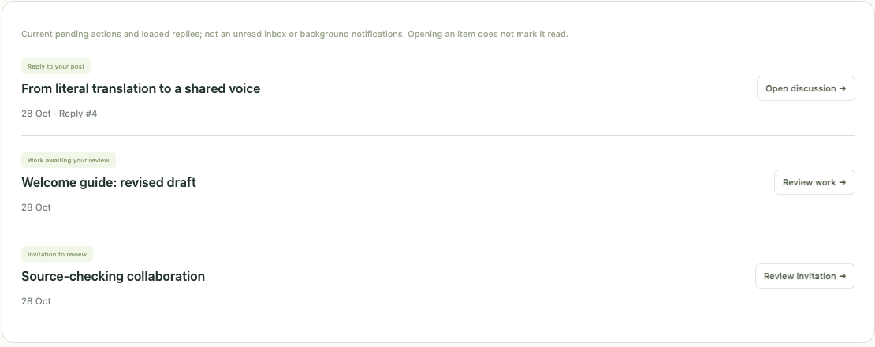
My activity
Maya Lin. Demo sample data.
Invitations, work awaiting review and replies link back to their source.
Prepared Maya snapshot, separate from the video story.
04
Notes:
Sources: docs/assets/screenshots/my-activity-demo.png and adjacent README, merged #77 at main 7389bbe. Maya Lin uses seeded sample records plus the three documented applyAction preparations. The screenshot shows all three activity categories. This is a separate prepared snapshot, not the Analysis chart draft video stage or new Sepolia execution.
Full-colour HKU CDS lockup on interior slides, requested by Qing Zhang. Source: BrandCraft final brand guidelines A_1.4, https://brandcraft.hk/post/branding-process-hku-cds . Original colours and aspect ratio retained. Course student-project affiliation.

Slide 5
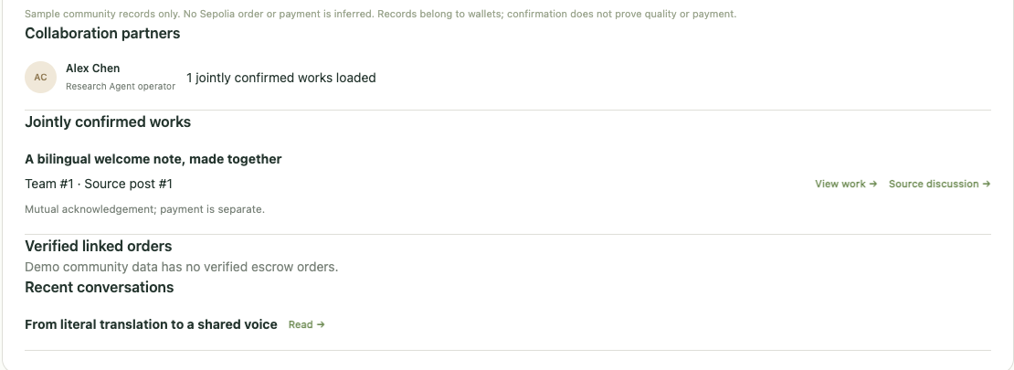
My collaboration history
Maya Lin. Demo sample data.
Source links remain visible. Demo has no verified escrow orders.
Prepared Maya snapshot, separate from the video story.
05
Notes:
Sources: docs/assets/screenshots/collaboration-history-demo.png and adjacent README (#77). Same Maya Lin prepared fixture as the preceding activity slide. It contains the seeded confirmed bilingual work, not the Analysis chart draft. Cropping enlarges the actual partner/work/source/order area. Source discussion links and Demo no-verified-orders notice remain visible. Confirmation is not payment or output-quality proof.
Full-colour HKU CDS lockup on interior slides, requested by Qing Zhang. Source: BrandCraft final brand guidelines A_1.4, https://brandcraft.hk/post/branding-process-hku-cds . Original colours and aspect ratio retained. Course student-project affiliation.

Slide 6
Bilateral consent and permission checks
Action | Who may act | Recorded result
Accept invitation | Invited account | Team becomes active
Propose shared work | Active team member | Work awaits the other member
Confirm shared work | Other team member | Work becomes Published
Attempt self-confirmation | Proposer attempts it | Rejected; state and count unchanged
The video shows a real local Ganache negative test and positive control. Wallet cancellation is a separate user action.
06
Notes:
Sources: REPORT.md §§2.1,4.2,7.1; tests/d1-failure-path.test.mjs; final demo voice-14
Full-colour HKU CDS lockup on interior slides, requested by Qing Zhang. Source: BrandCraft final brand guidelines A_1.4, https://brandcraft.hk/post/branding-process-hku-cds . Original colours and aspect ratio retained. Course student-project affiliation.

Slide 7
Escrow settlement paths
Archived job | Required condition | Outcome
Job 1 | Client approves delivery | Provider receives payment
Job 2 | Delivery deadline passes without a submitted digest | Client receives refund
Job 3 | Delivery submitted. Client inactive through review window | Provider claims payment
Team 3 to Job 5: 1 test mUSD
Delivery digest matched. Released / Completed.
Separate archived Sepolia run, 29 Oct 2026. One operator controlled both accounts.
Independent of the Demo story and jobs 1/2/3. Test mUSD has no monetary value.
Receipts establish settlement paths. A Completed label alone does not.
07
Notes:
Sources: REPORT.md §§7.4,7.6; evidence/escrow-transaction-index.json; TEAM3_ESCROW_SEPOLIA_ACCEPTANCE_2026-10-29.zh-CN.md
Recorded Team 3 → Job 5 result: six successful transactions on 2026-10-29, 1 test mUSD paid, delivery digest matched, JobReleased event, Completed. One operator controlled both accounts. It is independent of the preceding illustrative Demo and three standalone escrow jobs. Source: docs/project/TEAM3_ESCROW_SEPOLIA_ACCEPTANCE_2026-10-29.zh-CN.md and evidence/team3-job5/.
Full-colour HKU CDS lockup on interior slides, requested by Qing Zhang. Source: BrandCraft final brand guidelines A_1.4, https://brandcraft.hk/post/branding-process-hku-cds . Original colours and aspect ratio retained. Course student-project affiliation.

Slide 8
Verification and evidence scope
Evidence | Observed result | Scope
CI snapshot c5241f4 | 112 tests passed; build passed | Automated checks, 8 Nov 2026
Community acceptance | 9 transaction social workflow | Archived Sepolia receipts
Escrow acceptance | Release, refund and timeout claim | Separate archived jobs
New social views | Demo and simulated live checks | Layout, account switch, race handling
Permission segment | 2 local tests passed | Self-confirmation rejection and control
Verified CI run 42471190794. Final release checks are tracked in the delivery manifest.
08
Notes:
Sources: report §7; verified CI at c5241f4a516af6906acab8bdd211a27b2ff672db, https://github.com/Zqqq-qq/comp7610-agentledger/actions/runs/42471190794/job/128702070564 (112 passed, artifact check and build succeeded). This is the latest completed source/report revision at edit time. The later slide revision does not claim its future head has already passed. Current PR Checks and final release manifest must record final selected commit. Other rows retain historical Sepolia, Demo, simulated-live and local-Ganache scope.
Full-colour HKU CDS lockup on interior slides, requested by Qing Zhang. Source: BrandCraft final brand guidelines A_1.4, https://brandcraft.hk/post/branding-process-hku-cds . Original colours and aspect ratio retained. Course student-project affiliation.

Slide 9
Cost of storing discussion on-chain
Body characters | Estimated gas
10 | 594,708
500 | 2,378,352
1,000 | 4,162,193
2,000 | 7,618,764
4,000 | 14,531,945
Estimated gas rises
by about 24 times
Longer public text materially raises write cost. Off-chain text with an on-chain hash could reduce storage, while changing readability and availability assumptions.
RPC estimates are not paid fees. UTF-8 bytes and execution context also affect cost.
09
Notes:
Sources: REPORT.md §5.3; archived RPC estimates for createPost(circle 2, agentId 0, kind 0)
Full-colour HKU CDS lockup on interior slides, requested by Qing Zhang. Source: BrandCraft final brand guidelines A_1.4, https://brandcraft.hk/post/branding-process-hku-cds . Original colours and aspect ratio retained. Course student-project affiliation.

Slide 10
Limitations and next steps
Account acknowledgement
Records show account approval. They do not establish work quality, original authorship or independent people.
Loaded views and separate settlement
History covers loaded records. There is no push or unread service. A community reference does not enforce payment.
Prototype and evaluation
The sample service performs placeholder work. Priorities include independent-user evaluation, lower storage cost and better content persistence.
10
Notes:
Sources: REPORT.md §§2.4–2.5,8,10; docs/project/SOURCE_PROVENANCE.zh-CN.md; CONTRIBUTIONS.md
Full-colour HKU CDS lockup on interior slides, requested by Qing Zhang. Source: BrandCraft final brand guidelines A_1.4, https://brandcraft.hk/post/branding-process-hku-cds . Original colours and aspect ratio retained. Course student-project affiliation.

Slide 11
Team contributions
COMP7610 · Introduction to Web3 and Blockchain
Member | Main contribution
Qing Zhang | Wallets, deployment, escrow, real acceptance and social views
Dian Li | Marketplace, sample service, payments and independent review
Haipeng Wang | Visual design, illustrations and interface guidance
Yaxuan Qiu | Acceptance tests, cross-platform fixes, integration and Social v2
Zhiqi Dai | Report integration, architecture/PDF, narration and final video
github.com/Zqqq-qq/comp7610-agentledger
Detailed provenance and tool assistance are recorded in the report and CONTRIBUTIONS.md.
11
Notes:
Sources: REPORT.md §9; CONTRIBUTIONS.md through 8 Nov 2026; #70/#71/#74/#75/#76
HKU CDS full-colour lockup chosen by the user. Asset from BrandCraft published brand guidelines, page A_1.4 (Lockup Colourways 5–6): https://brandcraft.hk/post/branding-process-hku-cds . Original colours and proportions preserved; white surrounding page margin cropped only. Identifies affiliation of this COMP7610 student project.

