Slide 1
Team Knightshade
UW Fintech Boot Camp
Project 1
October 2021
Presented by: Eamon, Lisa, Meghan

Slide 2
Executive Summary
Is there a correlation between twitter activity and the price of bitcoin?
Our user is a person with bitcoin or another crypto currency that is looking to see if twitter can be used to predict the movement in the price of a crypto currency.
Our challenge is to see if using the skills we have learned so far, can we collect and analyze the data, in order to come to some conclusion.

Slide 3
Data Collection
Bitcoin data collection:
Used Quandl because it provided more information than the free crypto API we had used in class.
Cleaned the data in Jupyter Lab and created hvplots to compare with the tweet data
Used tableau to visualize data
Tweet data collection:
Used Snscrape which is a program found on github to collect tweets that used #bitcoin
Too much data
Collecting it and importing it to a json proved too difficult
Kevin suggested importing directly to a csv and that worked

Slide 4
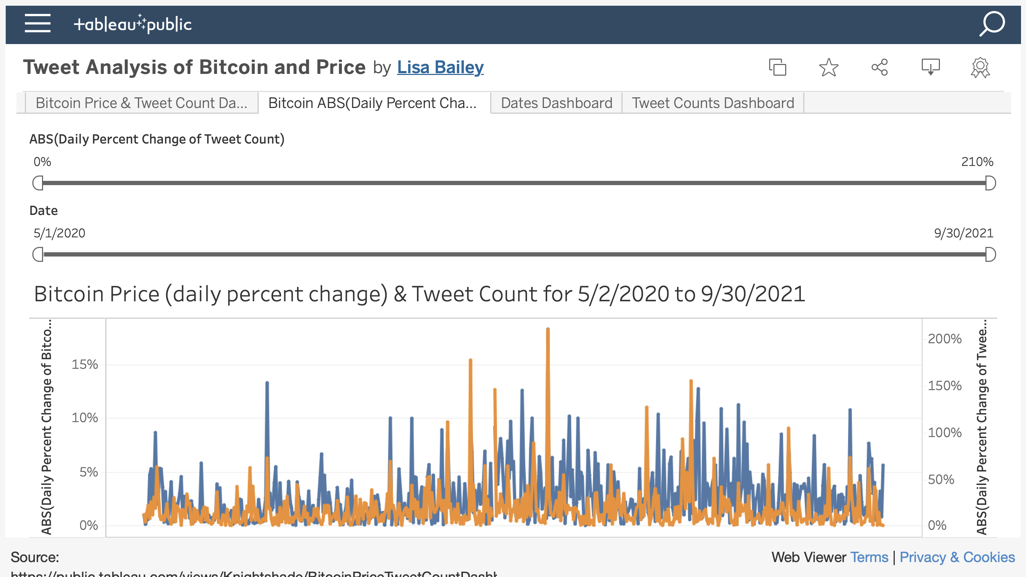

Slide 5



Demo
Take it away Eamon…

Slide 6
More Questions
If we analyzed the spikes in tweet count could we find a predictive relationship?
Is there a pattern to the relationship between bitcoin price and tweet count?
Does sentiment of the tweet change the relationship?
Are there other social media sources that would be more predictive?

Slide 7
Approach and Challenges
Lisa and Meghan focused on collecting bitcoin data
Eamon focused on the Twitter data
Biggest challenge was the twitter data and getting it into a usable form
Another challenge was processing the data get the data into a structure that we could run analysis on.
Github presented another challenge because it limited the size of the files we could upload

Slide 8
Any Questions?

Slide 9



Link: https://github.com/ZrowGz/knightshade.git

