Slide 1







STACK OVERFLOW DEVELOPER SURVEY 2019
Vitarius Zsofia
October 3, 2024

Slide 2



OUTLINE
Executive Summary
Introduction
Methodology
Results
Visualization – Charts
Dashboard
Discussion
Findings & Implications
Conclusion
Appendix

Slide 3

EXECUTIVE SUMMARY
Analysis goal
Methodology
Data gathering
Data analysis
Data visualization
Results
Discussion
Final conclusion

Slide 4

INTRODUCTION
Analyze datasets to identify trends in emerging technologies
Sources: Surveys, Job postings, Blog posts
NB: Results do not represent everyone

Slide 5

METHODOLOGY
Collecting survey data
Web Scraping
APIs
Request library
Data wrangling
Exploratory data analysis
Analysing data distributions
Handling outliers
Exploring correlations
Data visualization
Distribution, relationship, comparison of data with charts
Dashboard

Slide 6

RESULTS

Slide 7
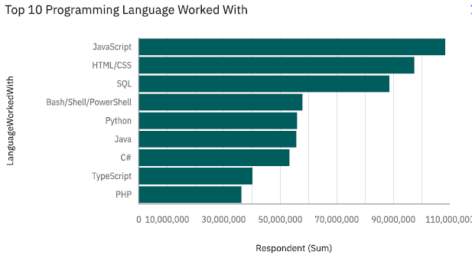
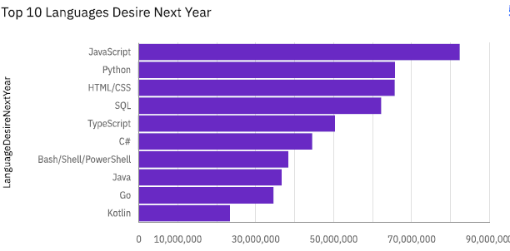
PROGRAMMING LANGUAGE TRENDS
Current Year
Next Year
<Bar chart of top 10 programming languages for the current year goes here.>
< Bar chart of top 10 programming languages for the next year goes here.>

Slide 8
PROGRAMMING LANGUAGE TRENDS - FINDINGS & IMPLICATIONS
Findings
JavaScript the most worked with programming language
HTML/ CSS is the second most popular language
SQL is the third one
Implications
JavaScript and Python continued or growing demand for professionals
HTML/CSS slight decline in future interest
SQL consistent demand suggest

Slide 9
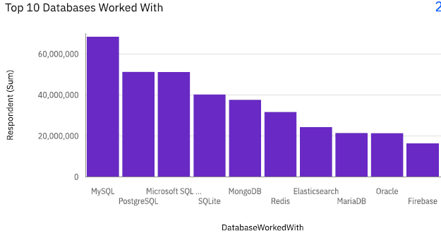
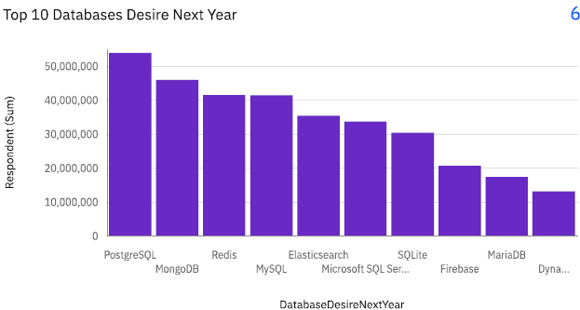
DATABASE TRENDS
Current Year
Next Year
< Bar chart of top 10 databases for the current year goes here >
< Bar chart of top 10 databases for the next year goes here.>

Slide 10
DATABASE TRENDS - FINDINGS & IMPLICATIONS
Findings
MySQL is the most frequently worked with database
Microsoft SQL in the top 3
PostgreSQL and MicrosoftSQL has almost the same usage
Implications
PostgreSQL’s rising popularity
Decline in MySQL usage
Steady demand for Redis and Mungo DB

Slide 11

DASHBOARD
GitHub link

Slide 12
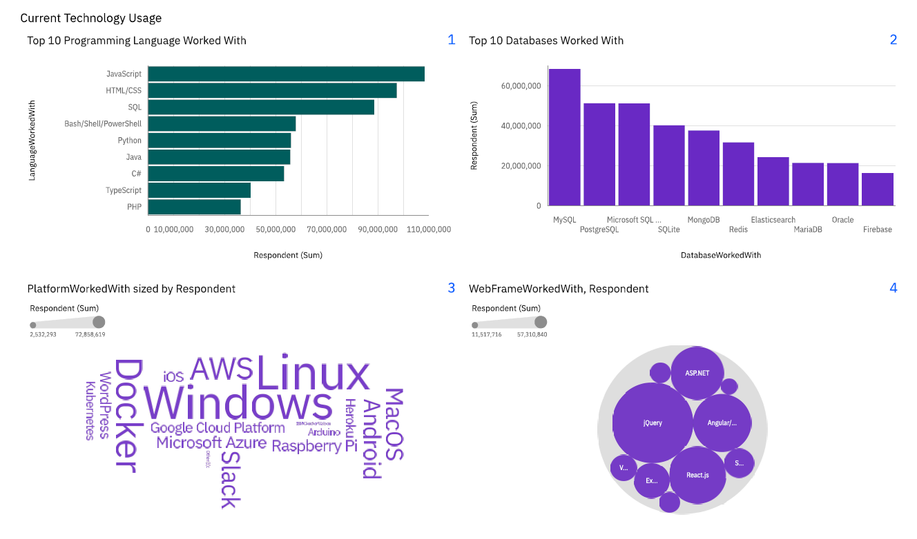
DASHBOARD TAB 1
Screenshot of dashboard tab 1 goes here

Slide 13
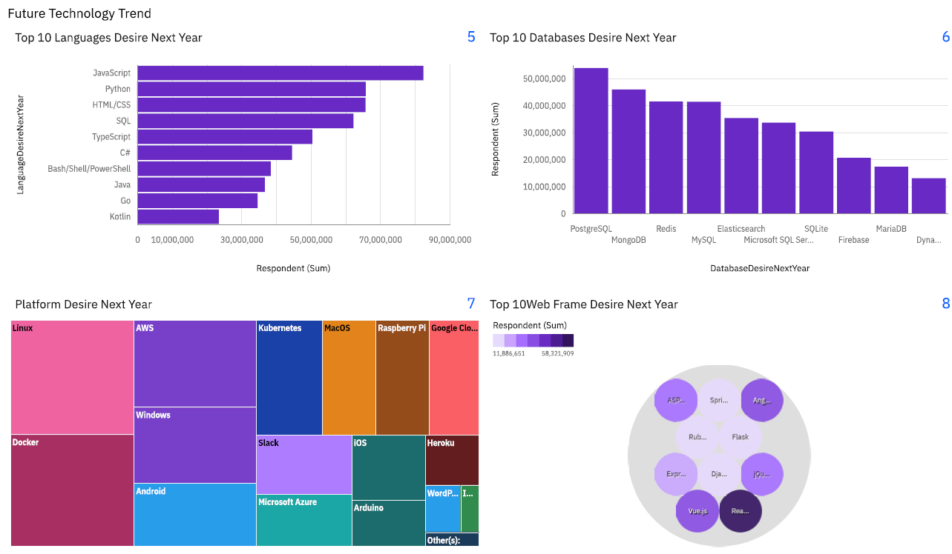
DASHBOARD TAB 2
Screenshot of dashboard tab 2 goes here

Slide 14
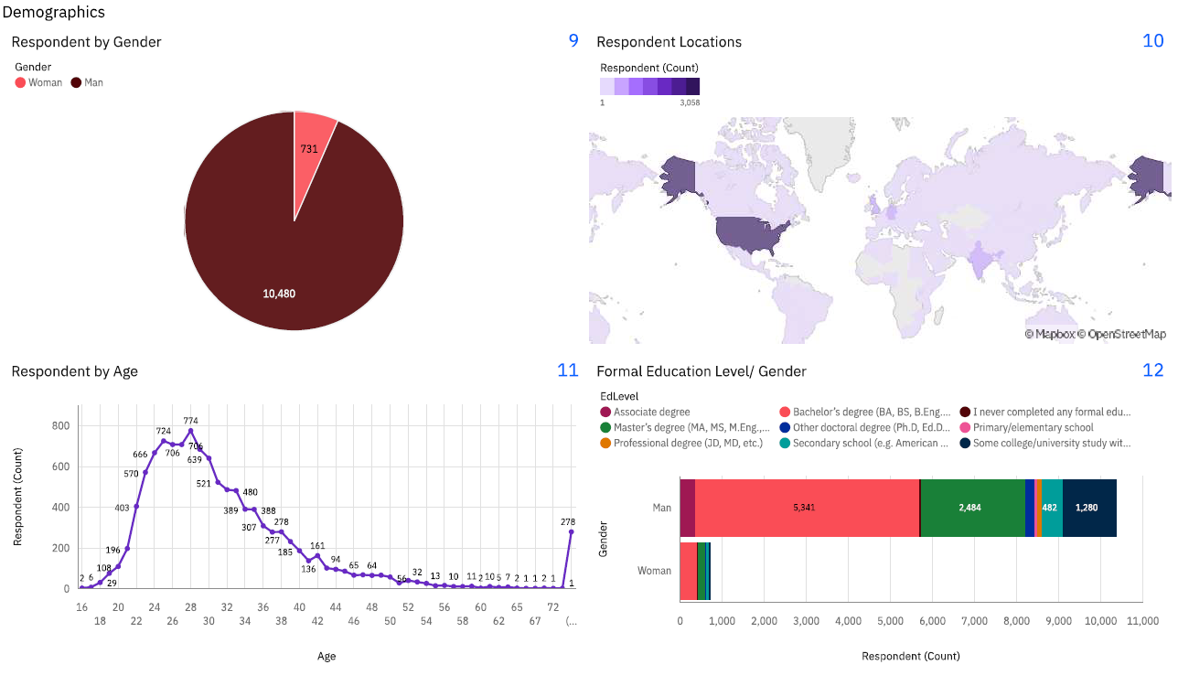
DASHBOARD TAB 3
Screenshot of dashboard tab 3 goes here

Slide 15
DISCUSSION

Slide 16
OVERALL FINDINGS & IMPLICATIONS
Findings
Increasing Linux dominance
Mostly USA respondants
Only 2% of the respondants are woman
Implications
Rising popularity of Python
AWS leading position
Implication 3

Slide 17

CONCLUSION
JavaScript and Python: The high demand for JavaScript and Python indicates their critical roles in web development, data science, and automation, suggesting these skills will remain highly valuable.
MySQL’s Reliability: MySQL’s strong presence as the most desired database highlights its reliability and continued importance in database management.
Linux Expertise: The preference for Linux underscores its significance in server management and cloud computing, indicating a sustained need for Linux skills.
Gender Imbalance: The significant majority of respondents from one gender category suggests potential gender imbalances, which could impact the generalizability of the findings and highlight the need for more inclusive practices.

Slide 18

APPENDIX

Slide 19
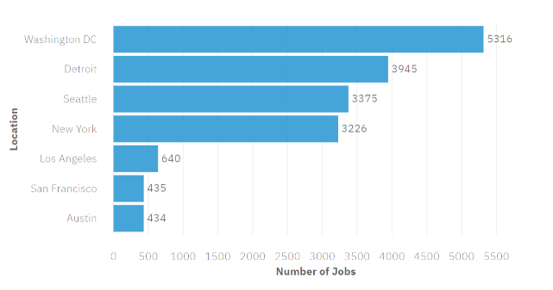
JOB POSTINGS
.

Slide 20
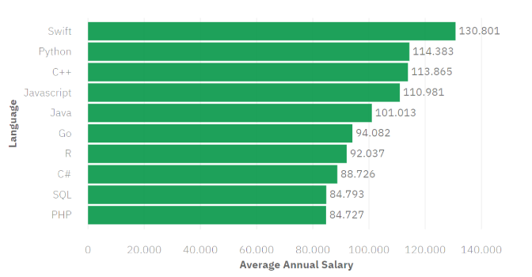
POPULAR LANGUAGES

