Slide 1


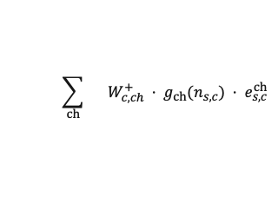
(a) Train-only
Construction
(c) Leakage-free Evidence Anchoring (LEA)
R¹, R² from GEC
Response logs R
Exact leave-one-out
Evidence construction
s
e
y
LOO statistics
Direct: edir
Count-gated
nonnegative aggregation
✓
×
1
3
1
Direct edir
1
5
0
Residual: eres
Σ
✓
✓
✂︎
2
2
1
Residual eres
Prop-1 = R¹ · edir
⋮
⋮
⋮
LOO count n
$$\sum_{ch}{ W_{c,ch}^{+} · g_{ch}(n_{s,c}) · e_{s,c}^{ch}}$$
✓
×
N
E
yₙₑ
Prop-2 = R² · edir
current response excluded
s
e
y
count n
1
3
1
Student embeddings
1
5
0
GNN state
encoder
θstate
Δθ
2
2
1
Concept embeddings
⋮
⋮
⋮
Anchored concept ability
N
E
yₙₑ
θs,c = θstate + Δθ
Q-masked mean
Exercise e
Q-matrix Q
Item co-occurrence
⋮
⋮
Item lookup
be, ae > 0
c₁
c₂
cC
Q only
R²
R¹
θe = meanQ(θs,c)
e₁
1
0
1
Multi-head
Relation Learning
e₂
0
1
0
2PL σ[ae(θe − be)]
⋮
⋮
⋮
⋮
Student co-exposure
(s,e) + Q; y ignored
eE
1
0
1
ŷ
(b) Graph Evidence Calibration (GEC)
(d) Ability & Prediction

