Slide 1
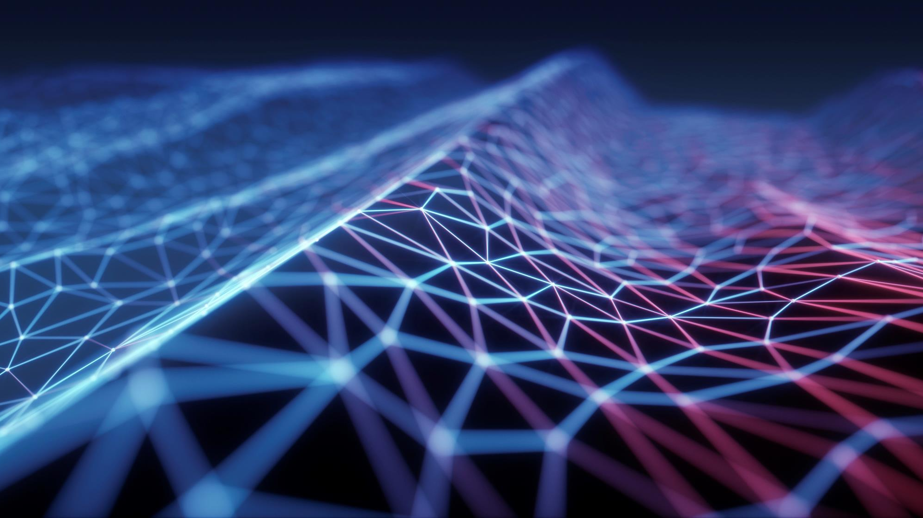
Proposal presentation
Biometric Face Recognition time management system

Slide 2
Aim
Automate Login & Log Out in the workplace
Increase security
Create a more Covid-compliant workplace
Improve and reduce administrative workload

Slide 3
Background
Why facial recognition
Biometric systems in modern society

Slide 4
Key benefit of Biometric systems
High precision
No need for physical contact
Enhance security
Can simplify payroll

Slide 5
Dark side of Biometric systems
The process of collecting data
Privacy
To expensive
Hacking

Slide 6

Technology and concept
OpenCv library
Use of Python
Django frame work
HD Camera

Slide 7
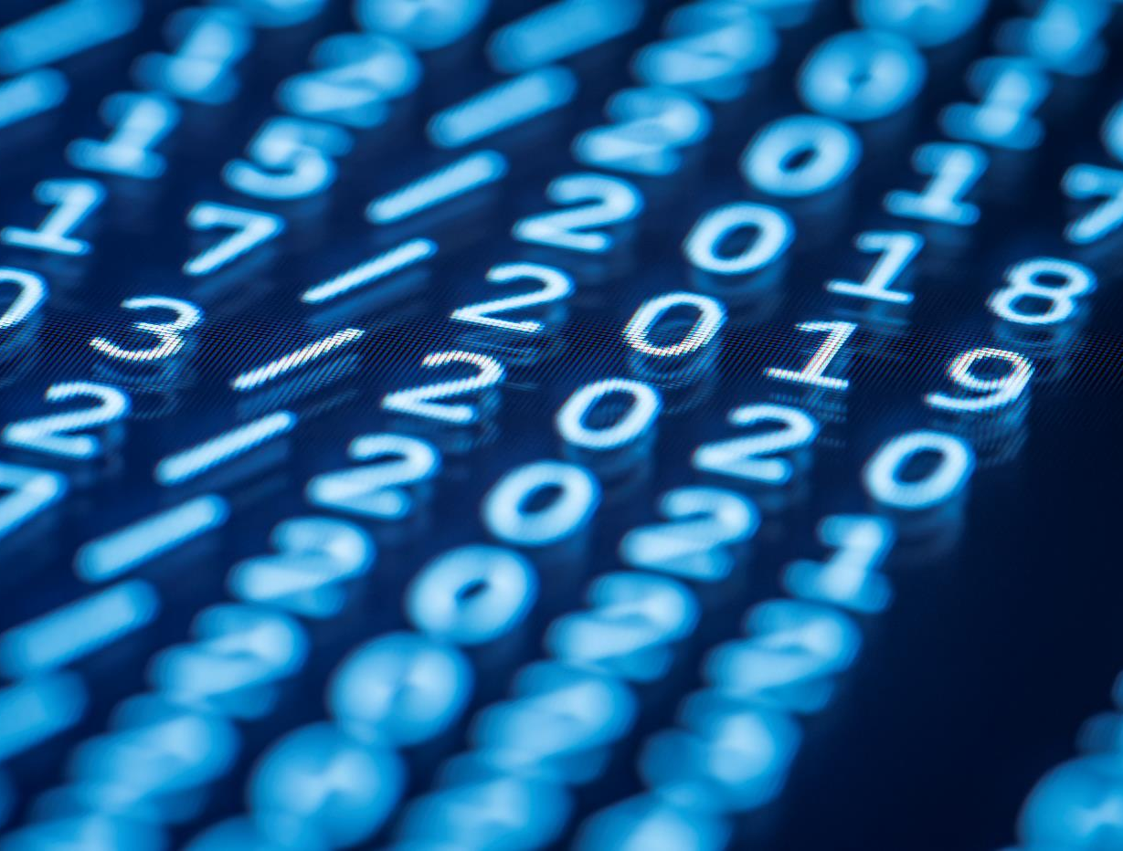
Thank You

