Slide 1

Analysis on ABC LLC’s customers
Task from boberdoo.com

Slide 2
Questions
Considering the information on closed leads, how would you describe Abc LLC's current most typical client?
Considering the information on closed leads, what customer segments should Abc LLC target to maximize their income?
How would you describe the current market potential for the segments from Question 2?
How much more should Abc LLC bid on average on the segments from Question 2 to increase their income by 30%? Would the investment pay off?

Slide 3
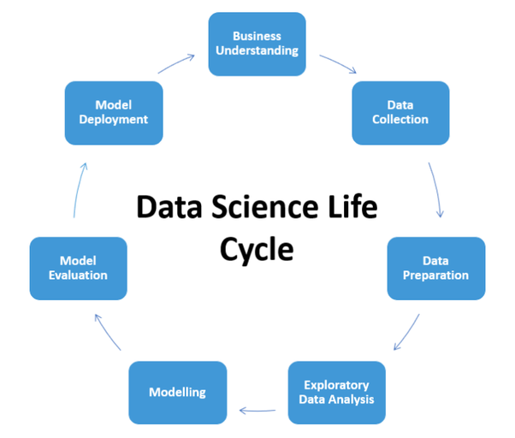

Slide 4
Business understanding
Clarifing definitions: closed lead, customer segment, market potential, income, etc.
Some remained a bit unclear:
Market potential: competition, customers’ interest, time period, product types, etc. are not considered
Income: usually means net income (that represents the total amount of earnings remaining after accounting for all expenses and additional income) -> not enough information to calculate that. Also, yearly/monthly total income? For which year (eg. calendar year, last 1 year)?

Slide 5
Data collection, preparation and exploratory analysis I.
Steps followed:
Loading data and merging into one dataframe
Data exploration/univariate analysis: checking for NaNs, outliers and distribution
Creating categorical variables (age, income) for analysis on typical client
Converting date variable to Timestamp for better handling
One-hot-encoding¹: introduction of binnary variables created from categorical features
Standardization: MinMaxScale² and RobustScaler³: considering outliers and binnary variables
1. Encoding categorical variable to binnary (0-1 values) variables. The variables number is equal to or one less than the levels of the categorical variables
2. For each value in a feature, MinMaxScaler subtracts the minimum value in the feature and then divides by the range. It doesn’t reduce the importance of outliers.
3. RobustScaler transforms the feature vector by subtracting the median and then dividing by the interquartile range (75% value — 25% value). It reduces the effects of outliers, but it does not scale the data into a predetermined interval like MinMaxScaler

Slide 6
Data collection, preparation and exploratory analysis II.
Problems
Additional information about the possible leads
What other factors have an effect on
successfull bidding,
selling health insurance and
contract size?
Info helping the evaluation of customers’ health condition and financial background could have been valuable (may raise ethical issues)
Handling possible outliers:
With respect to household income and contract size, more information would have been valuable to decide upon elimination of outliers
Binnary variables:
Introducing binnary variables made clustering more challenging

Slide 7
Analysis/Modeling
I. Most typical customer
Finding the 5 most typical customer groups based on filtering on demographics, closed leads only:
Filters: state, gender, age_c, income_c; Calculating average contract size for every group
The typical client of ABC LLC is a young adult male who lives in New York, whose household income belongs to the lowest segment of the sample and average contract size is around 740 dollars.

Slide 8
Analysis/Modeling II. Customer Segmentation I.
Hierarchical clusters:
Cluster 1: Mixed men and women (with more men), older adults, with middle HH income, having average contract size the highest, mostly from NY, MA, WA
Cluster 2: Exclusively men, middle aged, their HH income is around the median, having contract size above the median, mostly from MA, WA, NJ
Cluster 3: Exclusively women, middle aged, from low income HH, having contract size around the median, mostly from NY, WA, MA
Cluster 4: Exclusively men, youngest average age, more HH in the low income group, having contract less than average, mostly from NY, IL, OH
Targeting strategy/Opportunities:
First and fourth clusters: the lower number of successful sales there
First cluster's high average contract size
Other states like NJ and CT are present in case of more than one segment.
Gender specificity can be recognized in the sample, meaning that gender based targeting can be useful.
Number of successful sales in the younger and older adult groups may be even higher

Slide 9
Analysis/Modeling II. Customer Segmentation II. Problems
K-means algorithm provides unsatisfactory results:
K-means is for minimizing the within-cluster squared Euclidean distances between the clustered observations and the cluster centroid.
Therefore, it should only be used with data where squared Euclidean distances would be meaningful.
Hierarchical clustering is a bit arbitrary:
It requires a decision where to 'cut the tree' to get the final cluster assignments
Some domain and business knowledge is essential to determine the right number of clusters
Other Algorithms:
Considering mixed data type, other algorithms should be tried out as well, like Density-based spatial clustering of applications with noise (DBSCAN) or neural networks
Cluster characteristics highly depend on encoding and standardization method
-> Amir Ahmad and Shehroz Khan: Survey of State-of-the-Art Mixed Data Clustering Algorithms. IEEE Access ( Volume: 7 ), link: https://arxiv.org/pdf/1811.04364.pdf

Slide 10
Analysis/Modeling III. Market Potential
Segment 1:
Customer base: 5371
Estimated potential income based on average contract size : 9179039.0 USD
Segment 2:
Customer base: 19379
Estimated potential income based on average contract size : 18003091.0 USD
Segment 3:
Customer base: 30181
Estimated potential income based on average contract size : 28822855.0 USD
Segment 4:
Customer base: 19959
Estimated potential income based on average contract size : 16286544.0 USD
Problems with estimating market potential
No information on competition, customers’ interest, time period, product types, etc.
Overlaping segments make hard to calculate total market potential

Slide 11
Analysis/Modeling IV. Estimating investment for increasing yearly income I.
Univariate regression:
according to the p value, the relationship between the amount of bid and contract size is significant.
Coefficient:
The coefficient of 3.0561 means that as the max bid variable's unit increases by 1, the predicted value of contract size increases by 3.0561.
Increasing spend on bids:
ABC LLC should increase spend on bidding around 42396 USD in 2019 to meet 30% increase in income. The investment would pay off.

Slide 12
Analysis/Modeling IV. Estimating investment for increasing yearly income II. Problems
Winning a bid was not addressed in the univariate model, while contract size depends highly from this:
Win: contract size >= 0
Lose: contract size = 0
But: Multicollinarity with bids are present
Possible solution: Two-Stage Regression Analysis or Partial least squares regression.
Casual relationships: bids -> win, win -> contract size
Estimating the effect of other variables (holding them constant) on income is a must:
Product(s) characteristics
Customer characteristics
Competition

