Slide 1
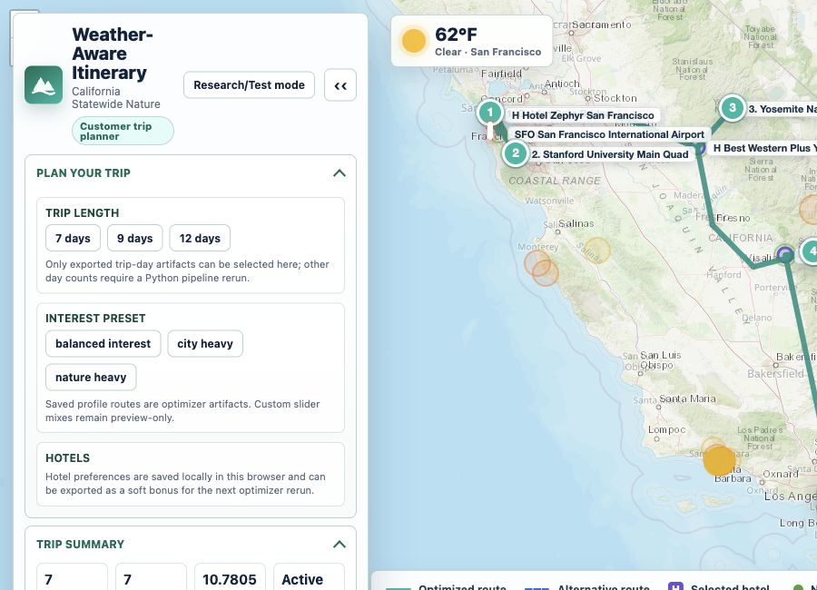
PROJECT REFRESH FOR GUOLIANG FENG
Weather-Aware Travel
Itinerary Optimization
Inspectable, solver-backed planning for multi-day trips with weather, hotels, budgets, and traveler interests.
MEETING GOAL
Refresh the current prototype, align on research framing, and choose the next concrete experiments.
Refresh
Discuss
project background + progress
blockers + next steps
Source: README.md; docs/assets/full_dashboard_preview.png
1

Slide 2
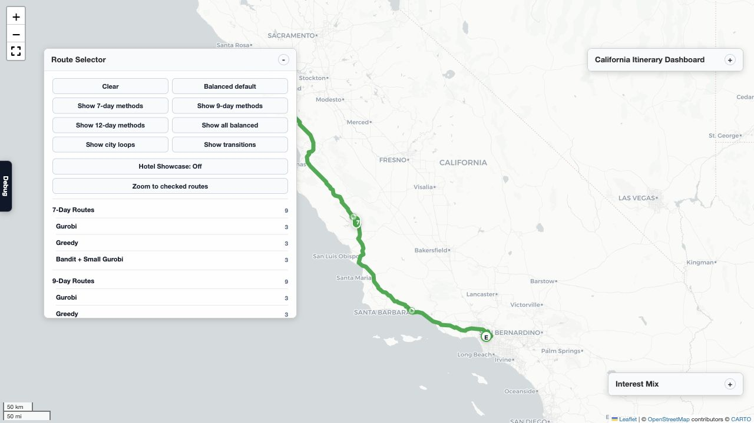
BACKGROUND
Recommendation becomes constrained planning
CORE PROBLEM
A good trip is not just top-rated attractions; it must be feasible across days.
The model jointly considers time, budget, travel, hotels/base cities, weather exposure, pace, and interests.
The first course version proved the optimization framing; the current repo packages it as a reusable research prototype.
The dashboard is an evidence surface: saved routes, hotel context, interest previews, and evaluation/debug views.
WORKING PIPELINE
Candidate + context data
Interest/weather utility
Hierarchical + bandit search
Small Gurobi repair
Dashboard evidence
Sources: README.md; report/prof_xie_progress_report.tex; report/figures/production_route_map_screenshot.png
2

Slide 3
PROGRESS SNAPSHOT
Working routes and inspection artifacts are exported
4
5
33
scenario families
interest profiles
route records
8
27
141
customer-visible options
playable route layers
dashboard/map artifacts
DEFAULT DEMO
California Statewide Nature - nature_heavy - 7-day saved route using hierarchical bandit gurobi repair.
Trip lengths in dashboard: 7, 9, 12 days; research-only route records: 25.
Sources: results/outputs/*.csv; full_interactive_dashboard/assets/route_index.json; dashboard_metrics.json
3

Slide 4
CURRENT DIRECTION
Research framing: a scoped repair claim we can test
Working claim to test: in frozen disruption scenarios, user-confirmed KEEP/REPLACE/MOVE/RELAX rules plus solver/evaluator evidence can preserve more original intent than full replanning while making each change inspectable.
Frozen snapshots
PlannerRun
PlanArtifact
EvaluationReport
ExplanationEvidence
IMPLEMENTED BASE
TESTABLE CONTRIBUTION TARGET
BOUNDARY TO KEEP CLEAR
configurable multi-day scenarios
weather/nature scoring
hierarchical Gurobi + greedy + bandit repair paths
customer/research/evaluation dashboards
minimal-change repair operations
intent preservation and edit-distance metrics
feasibility plus route-evidence gates
counterfactual repair explanations
LLM interprets and explains only
compiler maps confirmed intent to allowed fields
solver/evaluator own feasibility claims
no real-world guarantee beyond frozen model/data
Sources: docs/research_question_and_phase0_execution.md; docs/limitation_driven_itinerary_repair_method.md; docs/novelty_claim_verification.md
4

Slide 5
LITERATURE + QUESTION
The distinction: minimum verified repair, not multi-day revision
What nearby work already covers
Plain-language research question
TripTide: AI revision after disruptions, including multi-day itinerary changes.
iTIMO: ADD/DELETE/REPLACE-style modification data.
TTG / LLMAP / ITINERA: LLM-assisted trip generation and planning.
TravelEval / TripScore / TRACE: evaluation, grounding, and accountability neighbors.
TripTide asks: Can an AI revise a trip after a disruption?
This project asks: Can the system make the smallest verified change while preserving what the traveler owns and values most?
So the novelty is not "multi-day" or "AI revises a trip."
Mechanism: KEEP/MOVE/REPLACE/RELAX rules -> solver repairs only necessary parts -> evaluator certifies feasibility and explains why.
Defensible contribution: repair-process visualization for user-owned minimum-change repair, backed by solver verification and evidence-backed explanations.
Sources: Publication-Oriented Research and System Design Roadmap.pdf; Travel_Itinerary_Repair_Technical_Specification_for_Codex.md
5

Slide 6
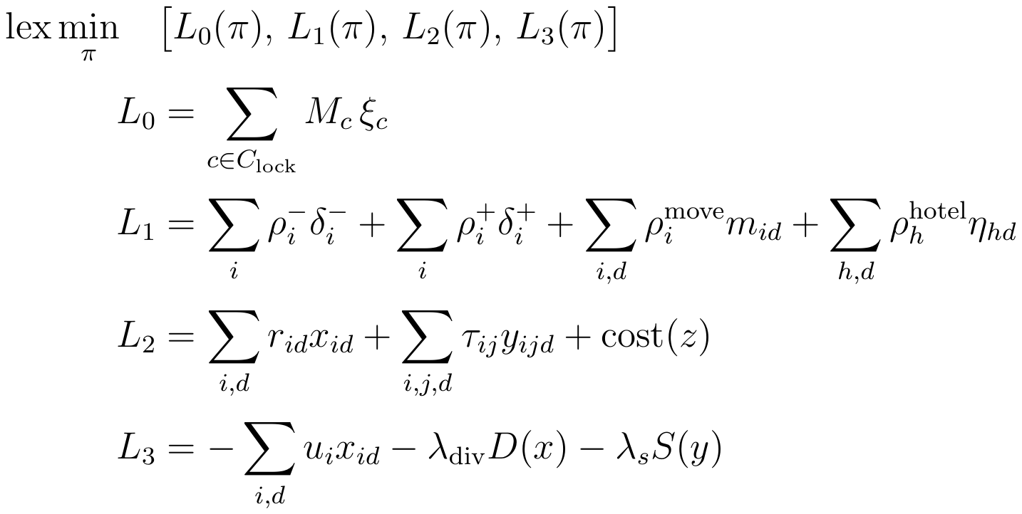
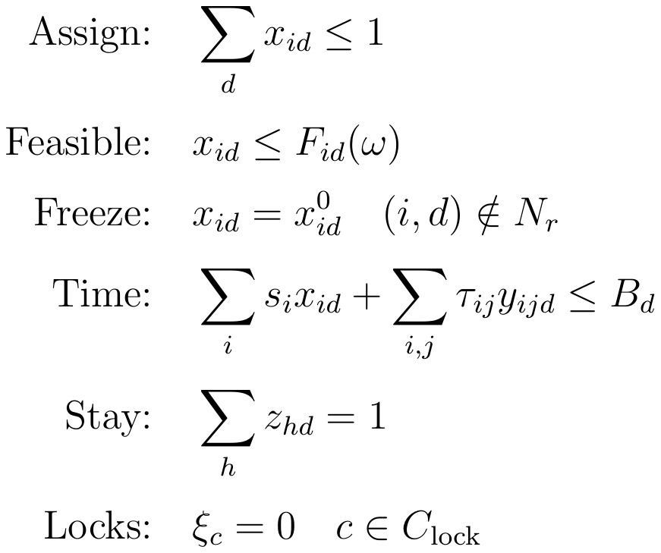
CORE MATH
The model repairs by solving objectives in priority order
Objective: choose a child plan pi, then compare plans in order
Main constraints
Priority order: locks -> smallest edit -> risk/travel/cost -> quality.
The evaluator recomputes these from the final artifact.
Takeaway: preserve user-owned commitments first; optimize trip quality only after the minimum necessary repair is certified.
Sources: Publication-Oriented Research and System Design Roadmap.pdf; Travel_Itinerary_Repair_Technical_Specification_for_Codex.md
6

Slide 7
NEXT STEP
Make the repair process visible, not the solver process
01
02
03
04
05
06
Original plan
Disruption appears
Affected days highlighted
Smallest repair proposed
Before/after differences
Accept or adjust
What the interface should explain
Preserved intent
Necessary changes
Repair size
Tradeoffs + checks
Which days, bookings, routes, or activities stayed locked.
What moved, changed, or relaxed, with a reason for each edit.
Days touched, edit count, intent retained, and disruption radius.
Risk, travel, cost, utility deltas, plus solver and evaluator pass/fail.
Optimizer evidence, behind the interface: Day 4 only was infeasible -> expanded to Days 3-5 -> verified feasible plan.
Research contribution: visualizing user-owned repair decisions while solver reasoning provides trust and auditability.
Discussion ask: choose the first repair-process screen and the validation evidence it must show.
Sources: repair-planner prototype; Travel_Itinerary_Repair_Technical_Specification_for_Codex.md; discussion framing
7

