Slide 1
Tonghe
PROUD OF THIS
A reliable version history for every data source change
A privacy dashboard should not only show the current state. It should preserve each meaningful change, keep historical risk results auditable, and remain correct when updates happen concurrently.
CREATE
EDIT
Current Data Source
VERSION 3
Latest snapshot
Customer CSV
VERSION 1
COMPARE
VERSION 2
Format
CSV
Previous risk state
Risk level
MEDIUM
VERSION 1
HISTORY
VERSION 2
Original source
01
Notes:
About 45 seconds. One contribution I am especially proud of is the backend for data source versioning. A privacy dashboard should not only show the current state of a dataset. It should preserve earlier states and their risk results, so changes remain auditable. My implementation creates immutable snapshots while also handling duplicate and concurrent updates safely.

Slide 2
A mutable record was not enough
Privacy decisions depend on what a data source looked like at a specific moment. Overwriting the current record destroys that context.
Without versioning
With immutable snapshots
Edit → overwrite
Previous metadata and risk results disappear
Edit → append a new version
Earlier states stay available for review
The goal: current data stays easy to use, while history remains trustworthy.
2
Notes:
About 55 seconds. Before this feature, a data source was just one mutable database record. Every edit replaced the previous state. For a privacy dashboard, that is a problem because the risk level and metadata may change over time. My goal was therefore to keep the current record simple for normal use, but append an immutable snapshot whenever its meaningful state changes.

Slide 3
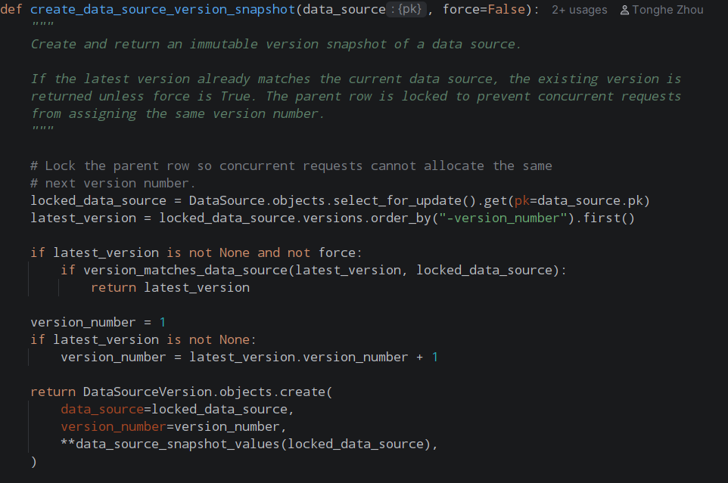
The backend owns every version number
What the code guarantees
01
LOCK
Prevent concurrent allocation
02
SKIP
Avoid duplicate snapshots
03
NUMBER
Assign latest version + 1
04
APPEND
Store the complete state
The client cannot create gaps or conflicting versions.
3
Notes:
About 60 seconds. This is the core function from my implementation. First, select_for_update locks the parent data source while the transaction is running, so concurrent requests cannot allocate the same number. Next, the backend compares the current state with the latest snapshot. If nothing meaningful changed, it returns the existing version and avoids a duplicate. Otherwise, it calculates the next version number and stores the complete snapshot. The client never controls the number, so it cannot create gaps or conflicts.

Slide 4
Edge cases define whether history can be trusted
The implementation handles the cases that usually break a first versioning design.
Scenario | Backend behavior | Why it matters
Create a data source | Store version 1 | History starts immediately
Edit a versioned field | Append version 2 | Earlier state remains intact
Send the same values again | Keep the current version | No duplicate snapshots
Two updates arrive together | Lock before allocation | No conflicting version numbers
Covered by automated backend tests
4
Notes:
About 75 seconds. The most interesting work was in the edge cases. Creation must immediately store version one. A changed edit appends the next snapshot, but a no-op update must not create noise. Concurrent requests must not receive the same number, which is why the row lock matters. I added tests for these behaviors, as well as history retrieval, project scoping, deletion, and migration of existing data.

Slide 5
WHY I AM PROUD OF IT
It turns change
into evidence.
Auditable
Reliable
Maintainable
Every meaningful state is preserved.
Transactions and locks protect ordering.
Snapshots stay stable as risk logic evolves.
Notes:
About 55 seconds. I am proud of this contribution because it is not only a visible feature. It creates trustworthy evidence. The snapshots make changes auditable, transaction and locking make the ordering reliable, and historical risk results remain stable even if the assessment algorithm changes later. For me, this was a good example of turning a user story into a robust backend design.

