Slide 1
Introduction to Machine Learning
Data Group Project

Slide 2
Machine Learning
What is machine learning:
An application of intelligence (AI) that provides systems the ability to learn and improve automatically from the experience (train-data) without being explicitly programmed
Focus on the development of computer programs that can access data and use it from themselves
Five Major Tribes:
1. Symbolic (Decision Trees, Rules), 2. Bayesians (Naïve Bayers or Markov),
3. Connectionist (Neural Networks), 4. Evolutionaries (Genetic Programs),
5. Analogizers (Support Vector Machine – SVM)
Sources: Pedre Domingos, The Master Algorithm, 2015

Slide 3
Machine Learning History
1950’s ~ 1980’s: Artificial Intelligence (early stage) - Operation on large size server
Basic decision logic
1980’s ~ 2010’s: Machine Learning (flourish) - Operation on small size server, cluster
Classification
2010’s ~ Present: Deep Learning (Breakthroughs) - GPU, Cloud Computation
Recognition (image, voice, translation, sentiment)

Slide 4
Machine Learning Model
Machine Learning Models
Supervised
Unsupervised
Reinforcement Learning
Regression
Linear
Logistic
Decision Trees
Classification
Neural
Networks
Clustering & Dimensionality Reduction
Decision Trees
Random Forest
KNN
Logistic
Naïve Bayes
SVM
Association Rule
PCA
K-Means
Hierarchical Clustering
Apriori
FP Tree
N
C
N
N
N
C
C
N
C
N
C
C
C
C
N
N
N: Numeric Data
C: Categorical Data
N

Slide 5
Method selection
Learning Regression:
Help to make predictions by learning from the existing statistical data
Find relationships between your target parameter and a set of other parameter
Philadelphia housing data:
Features consideration with market value:
– number of bedrooms, living area, location, taxable-building, taxable-land, number of stories…

Slide 6
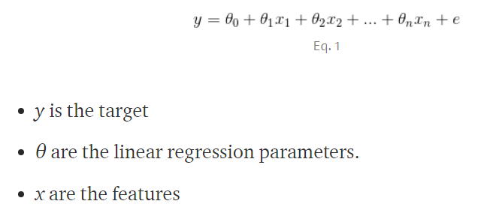
Linear Regression
Basic Theory:
y = mx + b →
y: target price (array) m: coefficient number/slope, b: intercept
X: matric of all (matrix: num_samples x num_feature_columns)
Example of price with living area: Assume 800 known house price in a given area. By applying the learning technique, we can find a set of coefficient values. Once found, plug in different area values to predict the resulting price
Train_test_split (80/20)
Source: https://yalantis.com/blog/predictive-algorithm-for-house-price/

Slide 7

Future Work
Clean all possible related housing features data, reduce the missing value effect
setup a linear regression model by applying python Sklearn library / Spark Mllib at databricks
Train and test dataset, turn all the parameters to reach with lower mean_squared_error (MSE) in linear regression model

