Slide 1
Structures
-V.Maheysh

Slide 2
Structures in C
Heterogeneous data can be grouped together by structures in C
Syntax of a struture
struct <structure name>
{
datatype element 1 ;
datatype element 2 ;
datatype element 3 ;
...... } ;
struct book
{
char name ;
float price ;
int pages ;
} b1, b2, b3 ;
struct book b1, b2, b3 ;

Slide 3
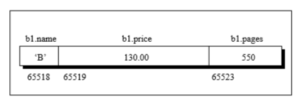
How Structure Elements are Stored
struct book
{
char name ;
float price ;
int pages ;
} ;
struct book b1 = { 'B', 130.00, 550 } ;

Slide 4
Surprise Gift Problem
Details of employees (emp ID, name, joining date and mobile number) of a company is stored and maintained by the company’s IT department. On his birthday, the GM of the company wants to give a surprise gift of Rs.5000 for his employees who joined before 01/01/2010 and whose employee id is divisible by 5. Develop an algorithm and write a C program to display the name of the employees who are eligible to receive the gift and their mobile number

Slide 5
Algorithm for Surprise Gift Problem
Read the number of employees
Read the details of the employees
Traverse the employee records
Check if emp id is divisible by 5
If it is divisible then check if the employee has joined the company before 01/01/2010
Display employee names and mobile numbers of employees if condition satisfied

Slide 6
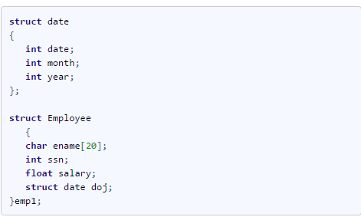
Nested Structures in C
A structure variable can be placed inside another structure

Slide 7
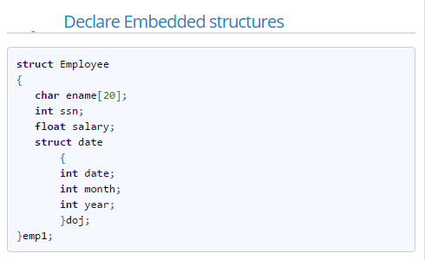

Slide 8
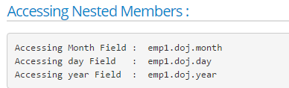

Slide 9
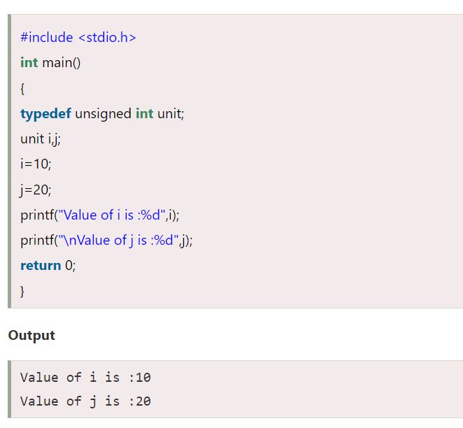
TYPEDEF
C provides a capability that enables you to assign an alternate name to a data type. This is done with a statement known as typedef.
typedef type_description type_name;

Slide 10
UNION
HW SCENARIO: In railway reservation system, identity of the person is got by either aardhar card number or voter id. Given Aardhar card number as a number and voter id as a string. Write a C program to store the details of thousands of people. It is important to store such that less memory is wasted.
A union is a special data type available in C that allows to store different data types in the same memory location.
You can define a union with many members, but only one member can contain a value at any given time.
the size of a union variable will always be the size of its largest element.

Slide 11
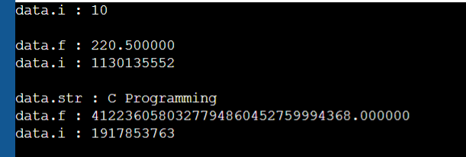
Accessing Union Members
#include <stdio.h>
#include <string.h>
union Data {
int i;
float f;
char str[20];
};
int main( ) {
union Data data;
data.i = 10;
printf( "data.i : %d\n", data.i);
data.f = 220.5;
printf( "data.f : %f\n", data.f);
printf( "data.i : %d\n \n", data.i);
strcpy( data.str, "C Programming");
printf( "data.str : %s\n", data.str);
printf( "data.f : %f\n", data.f);
printf( "data.i : %d\n", data.i);
return 0;
}

Slide 12
Malloc
The malloc() function stands for memory allocation. It is a function which is used to allocate a block of memory dynamically.
Syntax:
ptr = (cast_type *) malloc (byte_size);
ptr = (int *) malloc (50)

Slide 13
EG)
#include <stdlib.h>
int main(){
int *ptr;
ptr = malloc(15 * sizeof(*ptr)); /* a block of 15 integers */
if (ptr != NULL) {
*(ptr + 5) = 480; /* assign 480 to sixth integer */
printf("Value of the 6th integer is %d",*(ptr + 5));
}
}

Slide 14
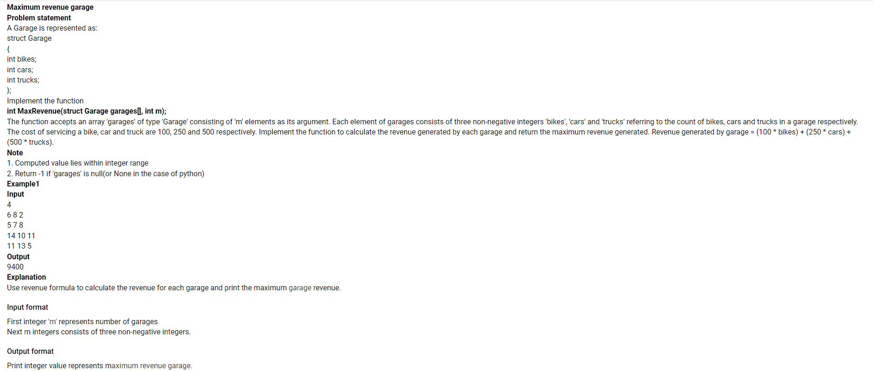
PRACTICE QSN
Sample testcases
Input 1
2
10 20 30
5 10 5
Output 1
21000
Input 2
3
1 2 12
3 4 5
7 4 2
Output 2
6600

Slide 15
References
https://www.geeksforgeeks.org/dynamic-memory-allocation-in-c-using-malloc-calloc-free-and-realloc/
https://www.programiz.com/c-programming/c-structure-examples

