Slide 1


NbetA
Presented by: Luka Zuanović (130275) Computer Engineering
Marko Pongrac (130288) Data Science
Course: Information Visualization
Date: 24.11.2025.

Slide 2
🏀 Our Vision
Interactive NBA data visualization system
Purpose: Empowering basketball fans and sports bettors with actionable insights.
Key features:
  Filter data by players, teams, seasons and statistics 🔍
  Compare historical and current performance 📊
  Identify patterns that support smarter decisions 📉
  Personalized experience to each user 👤

Slide 3

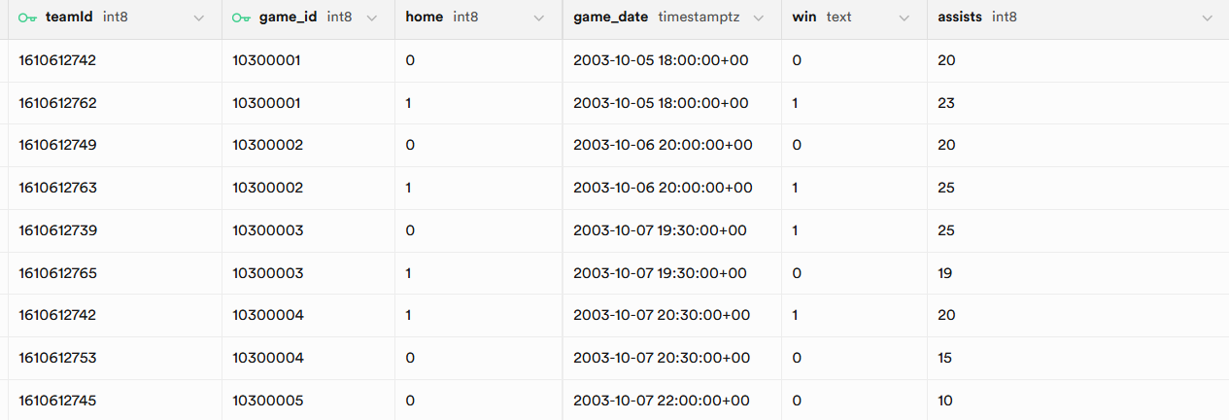
NBA Dataset (2005 – 2022)
Source:
  Wyatt Walsh – Basketball dataset
  Eoin A. Moore – Historical NBA data
Time frame: 2005 – 2022
Data coverage:
  Player statistics per game and season
  Team statistics and game results
  Trivia about teams and players

Slide 4






Tech Stack
Backend / Data Processing:
  Python, Pandas, FastApi
Visualizations / Frontend:
  React, D3.js
Data storage:
  Supabase

Slide 5
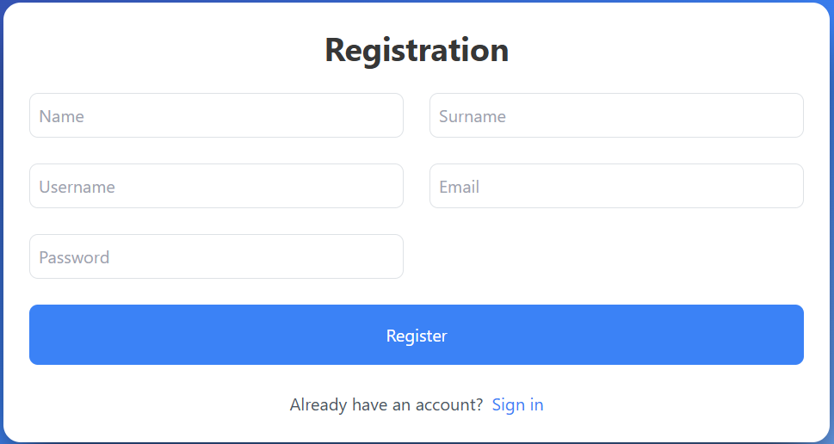
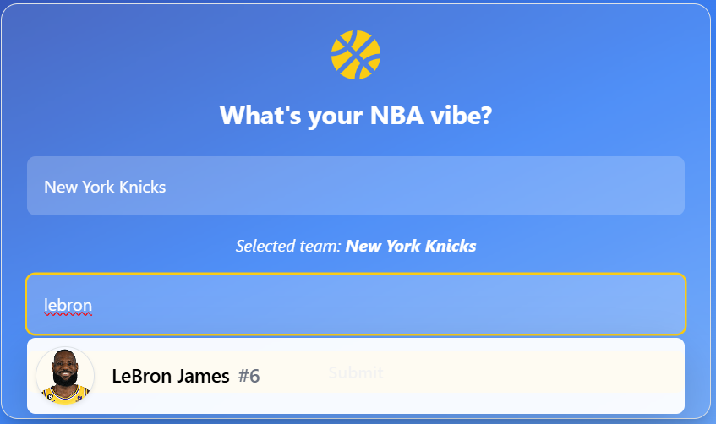
User Personalization
Users create their profile and select their favorite player and team
Personalized dashboard displays key stats for user’s choices
Makes the dashboard feel relevant to user

Slide 6
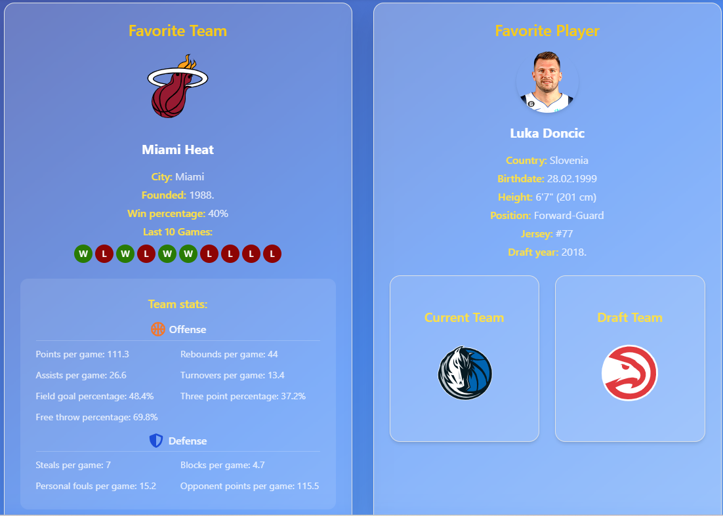
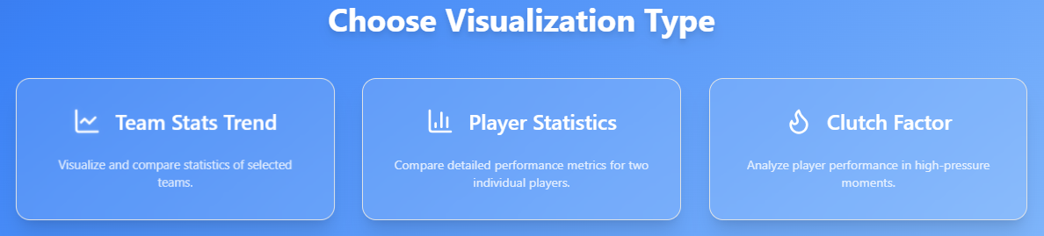
Main Dashboard
2 main parts:
  Personalized most recent data snapshot
  Visualizations menu

Slide 7
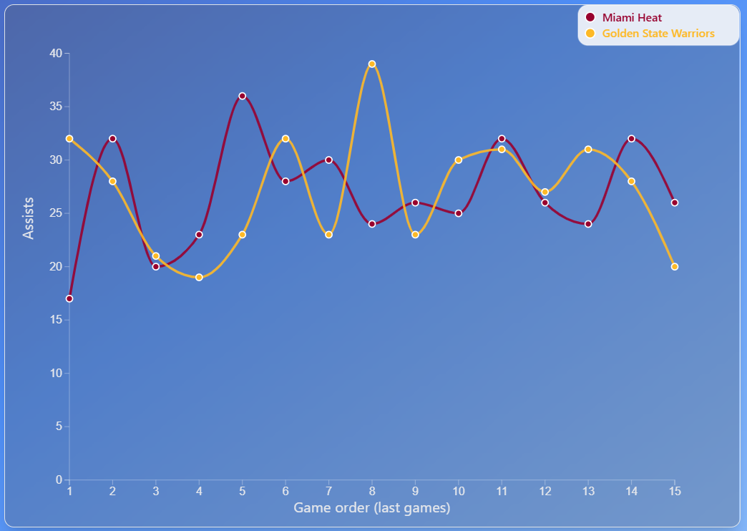
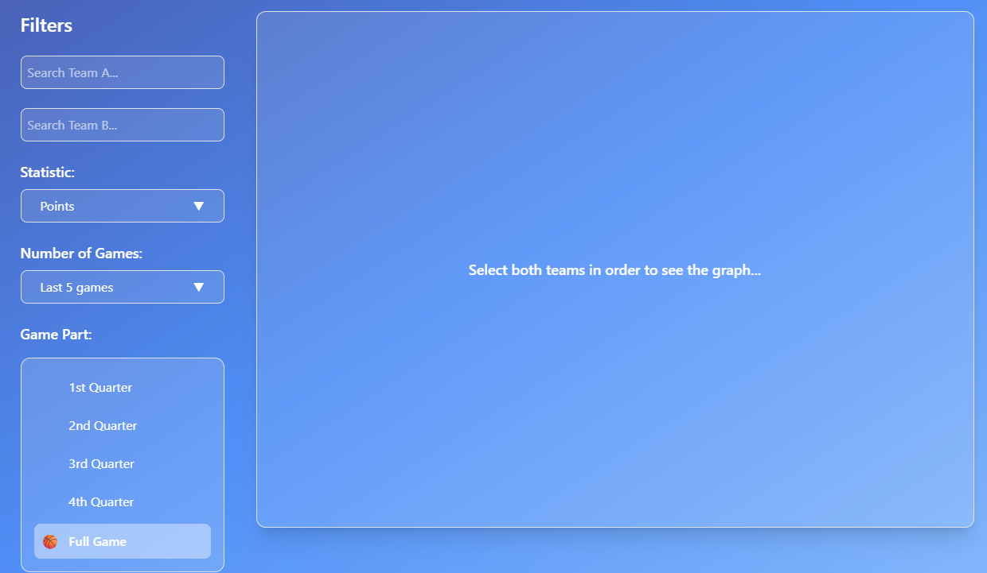
Graph 1: Team Matchup Trends
Questions:
Out of the last 15 games, which team had more assists in the 3rd last game?
How many times in the last 10 matches between teamA and teamB, has the teamA outscored teamB?

Slide 8
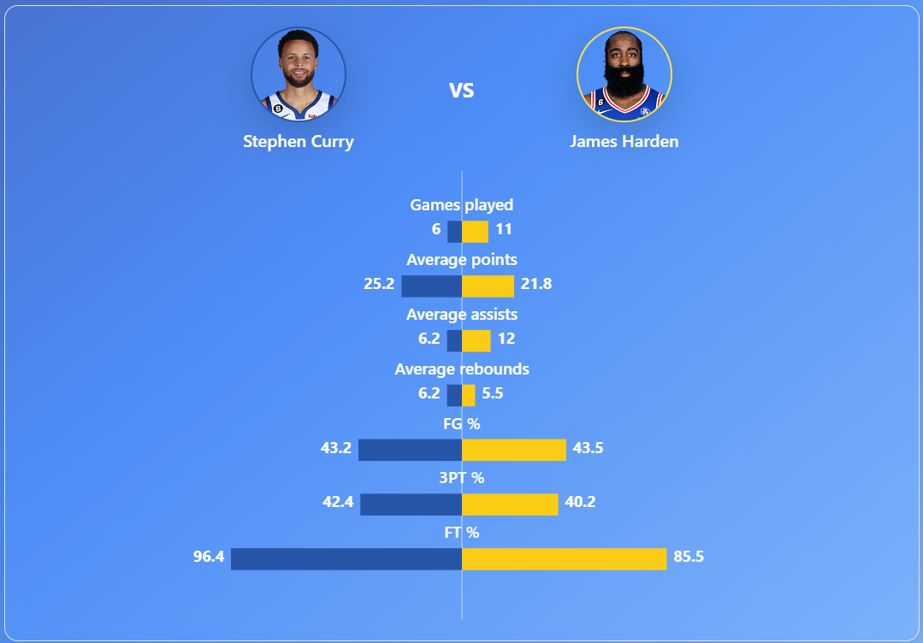
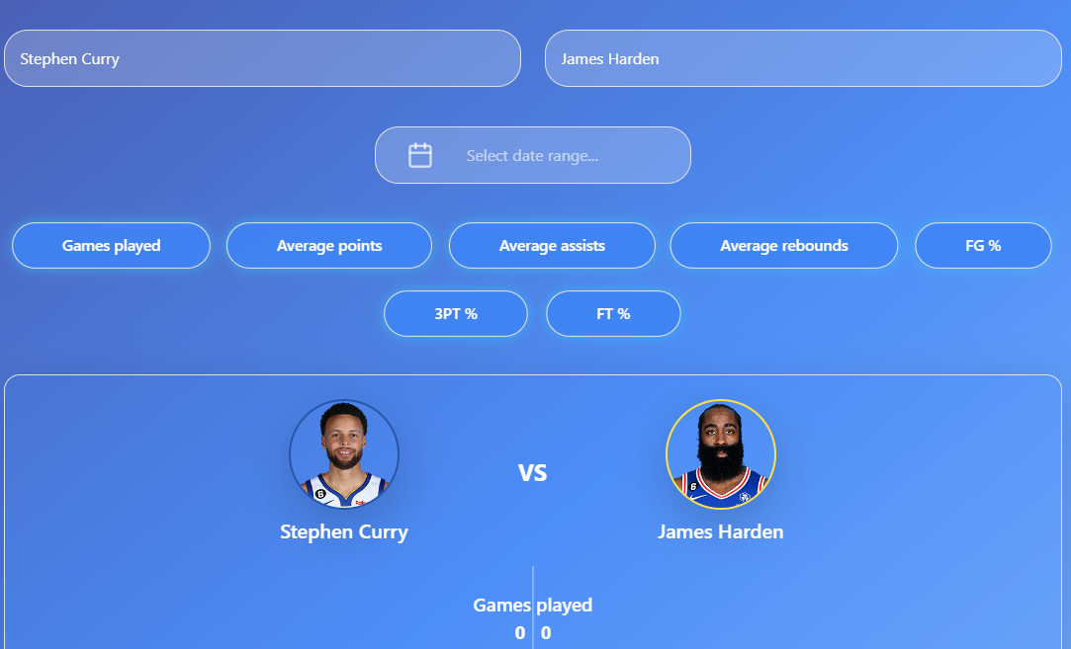
Graph 2: Player Comparison
Questions:
Within the filtered date range, how is Stephen Curry’s scoring efficiency (FG%, 3PT%, FT%) compared to James Harden’s efficiency during the same period?
2. Within the filtered date range, which player contributed more total offensive output when combining points + assists?

Slide 9
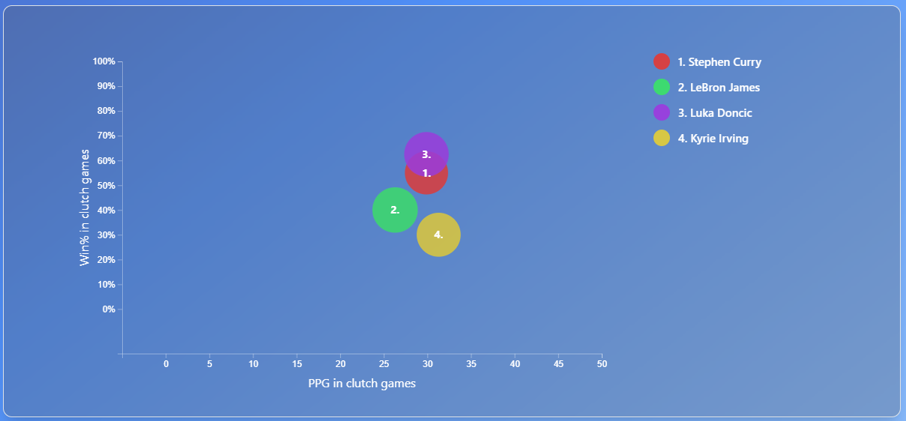

Graph 3: Clutch Factor
Questions:
Within the filtered date range, which player has the highest win percentage in clutch games?
Within the filtered date range, among the selected players, from the ones who have more than 25 PPG in clutch games, who has the lowest field goal percentage (smallest bubble)?

Slide 10

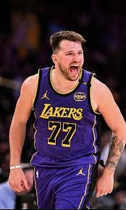
Use Cases
Fast insight into player performances ⚡
Compare historical vs. current stats 📊
Identifying trends in player/team data 📉
Support smarter betting or fantasy league decisions
Following favorite players and teams

Slide 11
Video Demo
The video demonstration can be found on the dropbox link provided

Slide 12
Conclusion
Fast access to key NBA data
Personalized user experience
Possible augmentations:
  Frequent stats updates
  Separate date filters for player comparison
  Incorporating more advanced metrics

Slide 13
Percentage of Work
Luka Zuanović (130275) => 60%
Marko Pongrac (130288) => 40%

