Slide 1


NbetA
Presented by: Luka Zuanović (130275) Computer Engineering
Marko Pongrac (130288) Data Science
Course: Information Visualization
Date: 24.11.2025.

Slide 2
🏀 Our Vision
Interactive NBA data visualization system
Purpose: Empowering basketball fans and sports bettors with actionable insights.
Key features:
  Filter data by players, teams, seasons and statistics 🔍
  Compare historical and current performance 📊
  Identify patterns that support smarter betting decisions 📉
  Personalized experience to each user 👤

Slide 3

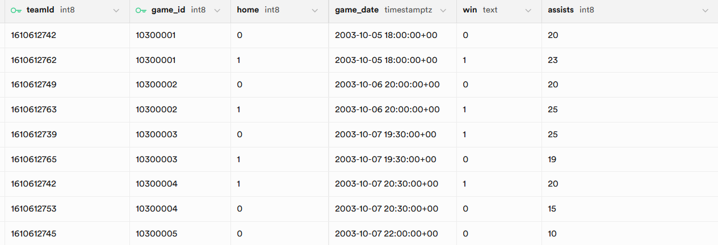
NBA Dataset (2005 – 2014)
Source:
  Wyatt Walsh – Basketball dataset
  Eoin A. Moore – Historical NBA data
Time frame: 2005 – 2022
Data coverage:
  Player statistics per game and season
  Team statistics and game results
  Trivia about teams and players

Slide 4






Tech Stack
Backend / Data Processing:
  Python, Pandas, FastApi
Visualizations / Frontend:
  React, D3.js
Data storage:
  Supabase

Slide 5
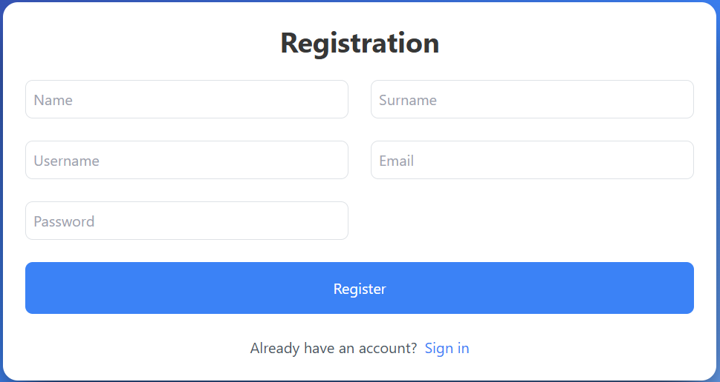
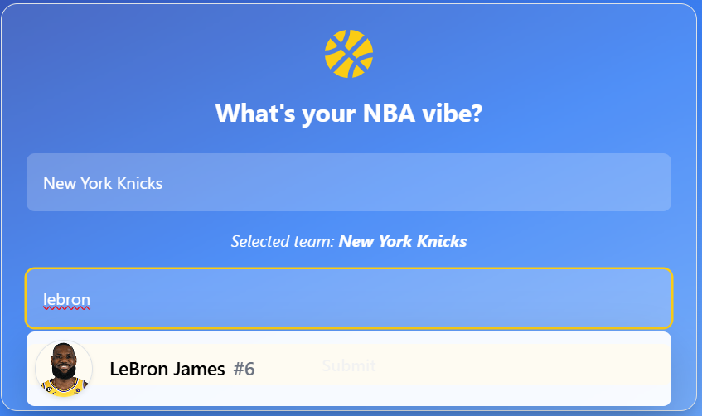
User Personalization
Users create their profile and select their favorite player and team
Personalized dashboard displays key stats for user’s choices
Makes the dashboard feel relevant to user

Slide 6
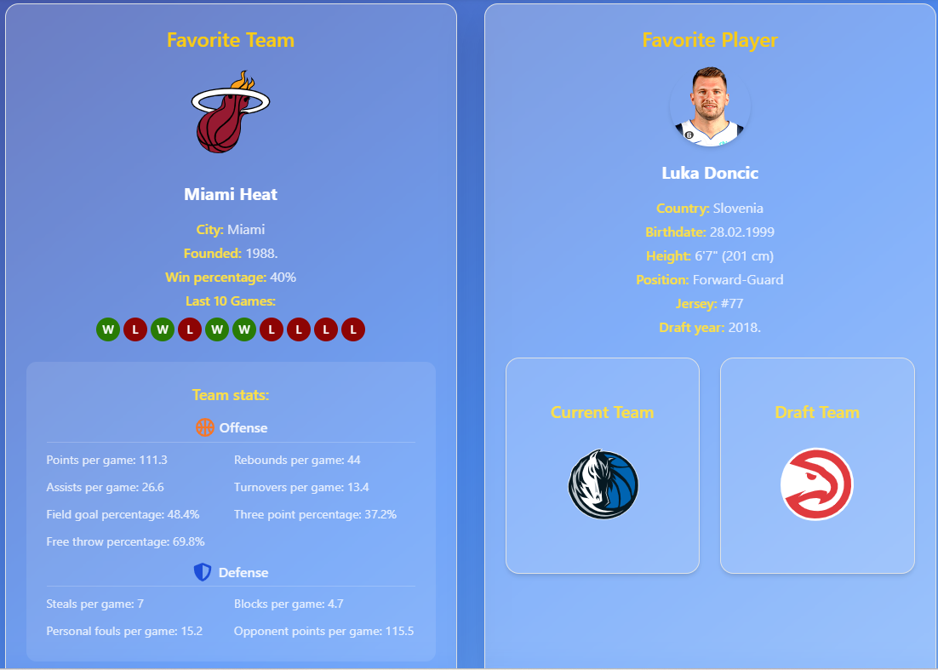
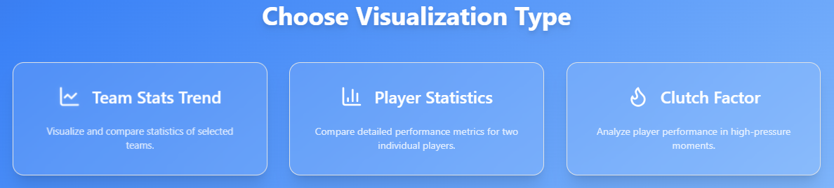
Main Dashboard
2 main parts:
  Personalized most recent data snapshot
  Visualizations menu

Slide 7
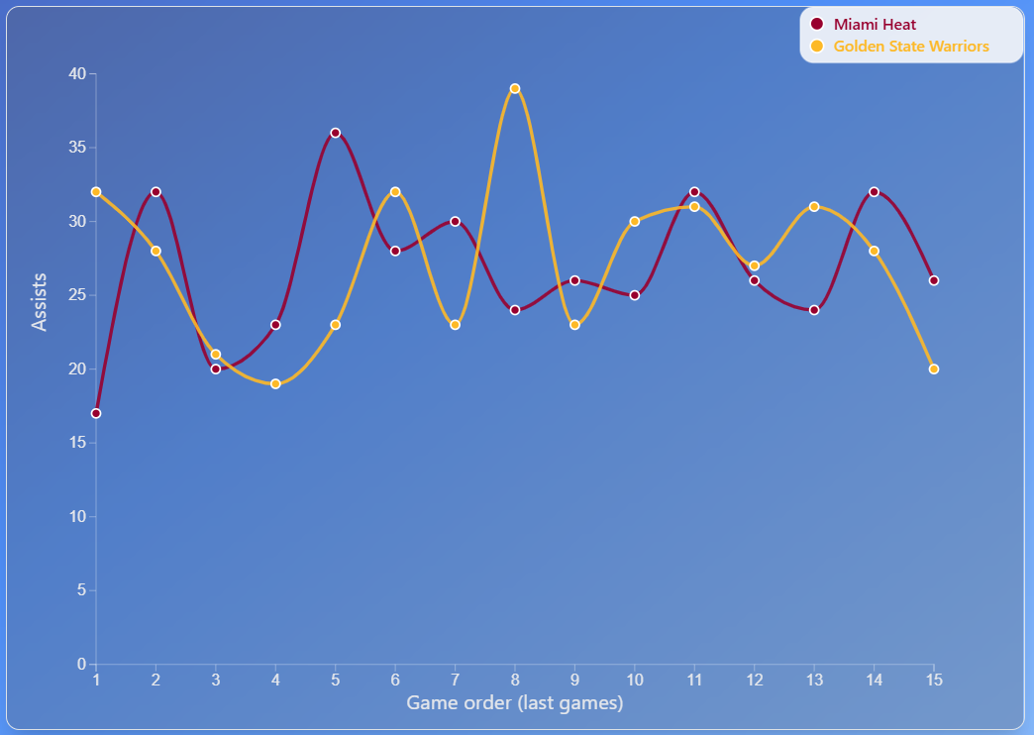
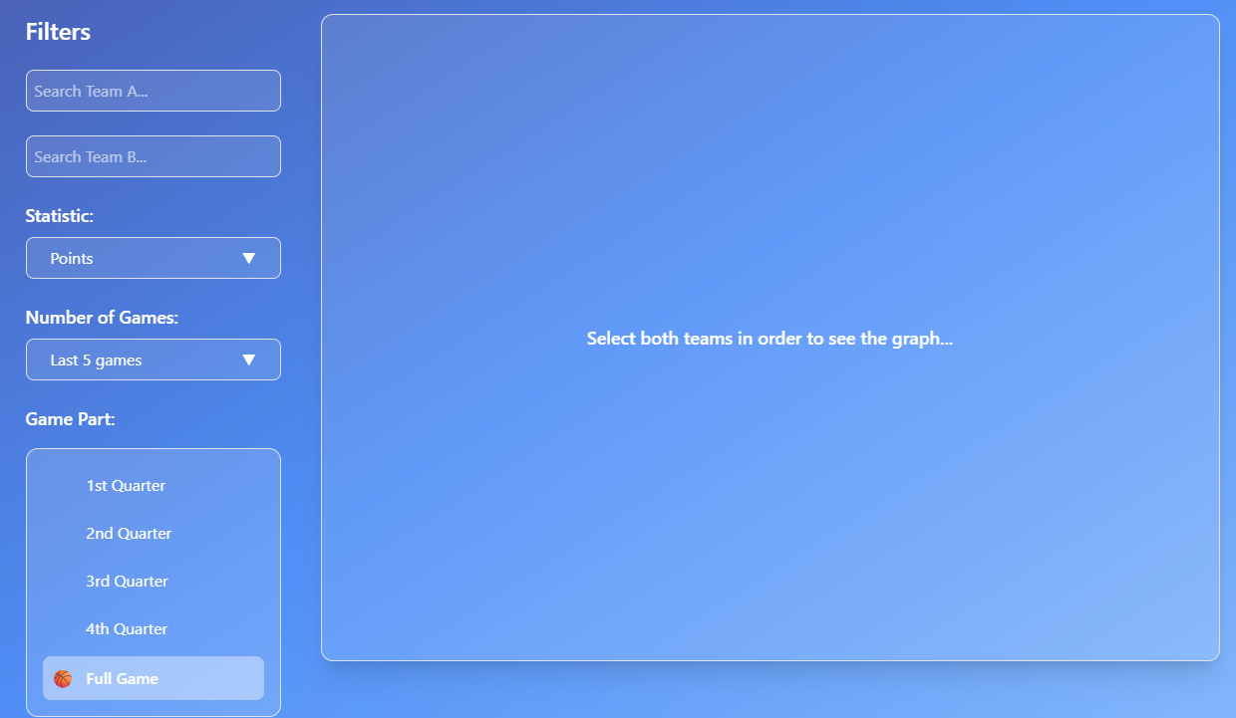
Graph 1: Team Matchup Trends

Slide 8
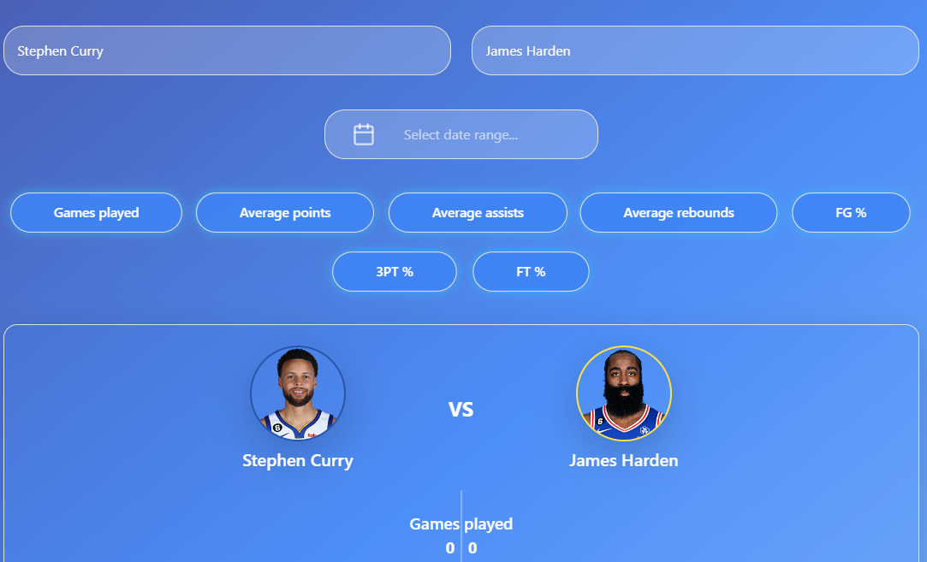
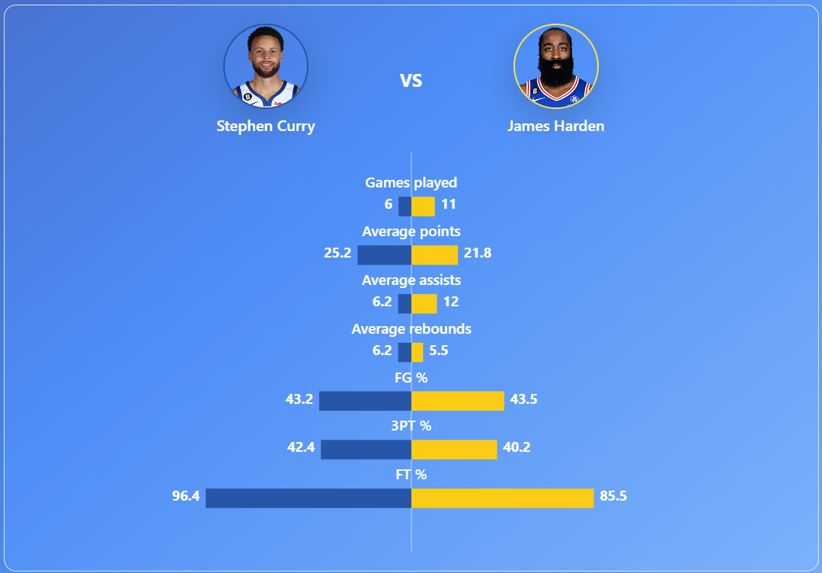
Graph 2: Player Comparison

Slide 9

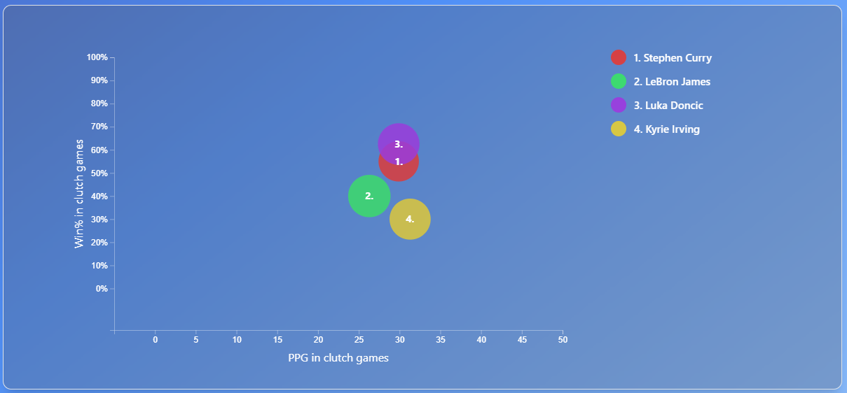
Graph 3: Clutch Factor

Slide 10


Use Cases
Fast insight into player performances ⚡
Compare historical vs. current stats 📊
Identifying trends in player/team data 📉
Support smarter betting or fantasy league decisions
Following favorite players and teams

Slide 11
Conclusion
Fast access to key NBA data
Personalized user experience
Possible augmentations:
  Frequent stats updates
  Separate date filters for player comparison
  Incorporating more advanced metrics

