Slide 1


NBA betting insights
Presented by: Luka Zuanović (130275) Computer Engineering
Marko Pongrac (130288) Data Science
Course: Information Visualization
Date: 20.10.2025.

Slide 2
🏀 Project goal
To build an interactive NBA data visualization system based on the official NBA dataset from 1947. - today
Empower basketball fans and sports bettors with actionable insights
Through dynamic and customizable visualizations, users will be able to:
Filter data by players, teams, seasons and statistics
Compare historical and current performance
Identify patterns that support smarter betting decisions

Slide 3
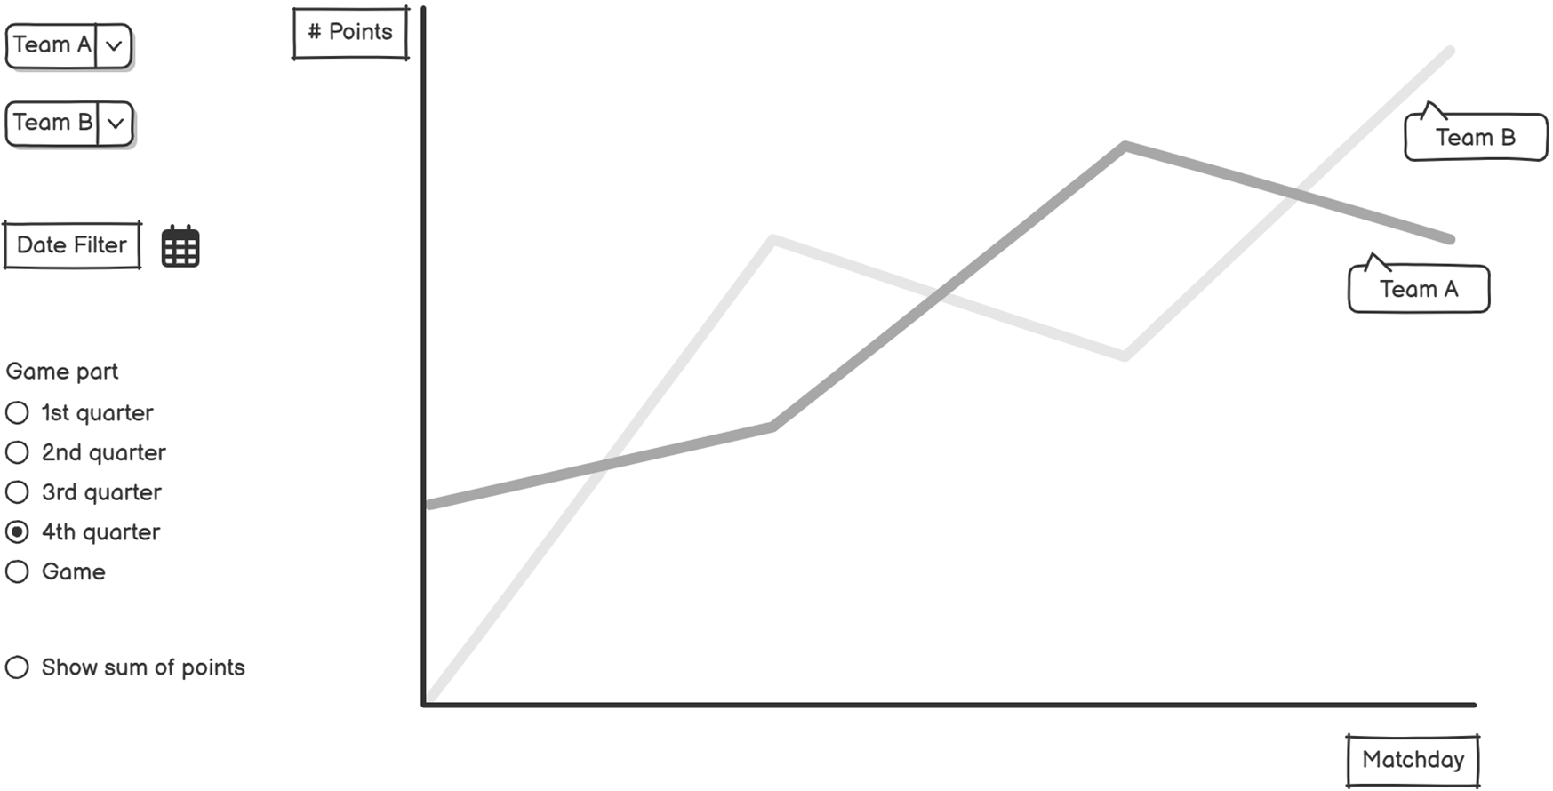

Graph: team points trend
Questions:
Which team scored more points on 21.4.2018 in the second quarter?
How many times in the last 10 matches between team A and team B was the sum of points higher than 240 points?

Slide 4
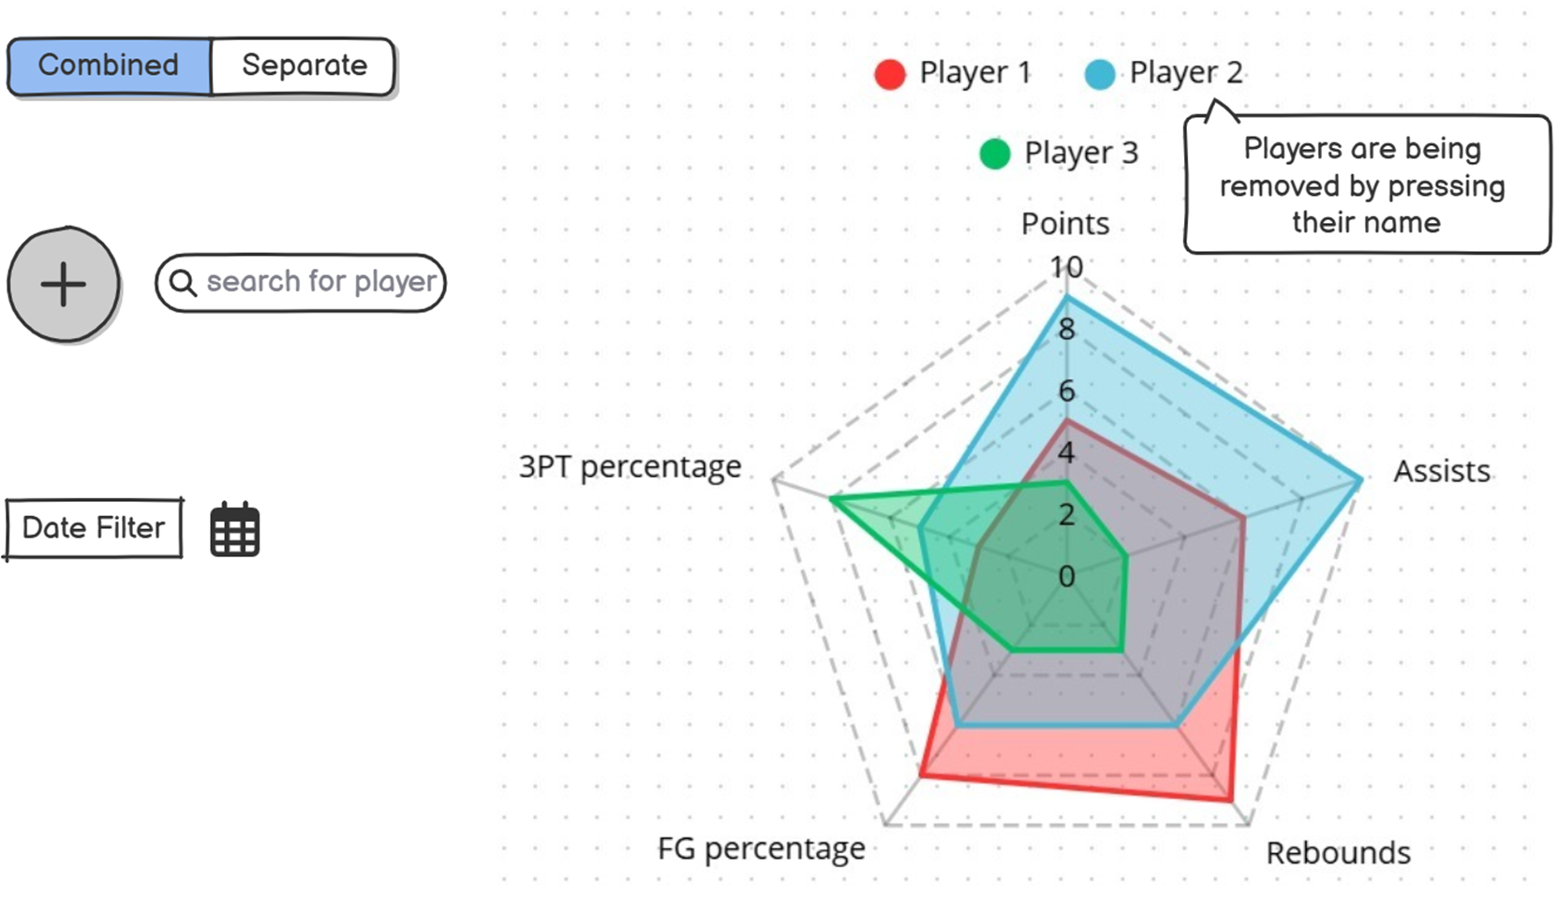

2. Graph: player statistics
Questions:
How many players that are shown on the graph had more than 6 assists average in the last month?
Which player shows the most balanced performance across all five categories?

Slide 5
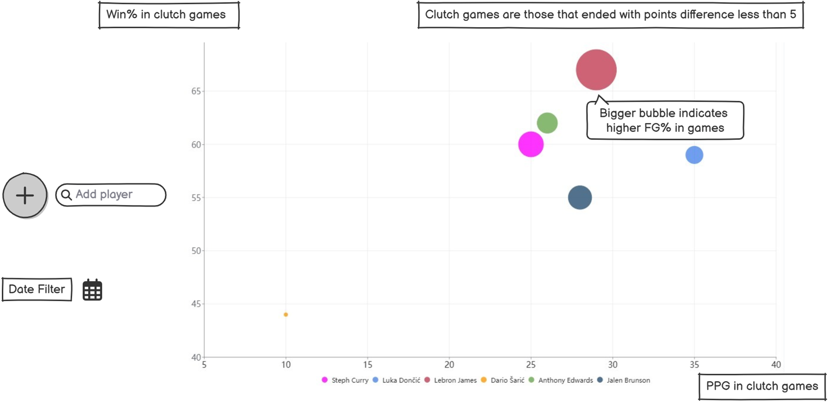

3. Graph: clutch factor
Questions:
Which player has the highest win percentage in clutch games?
Among players with more than 25 PPG in clutch games, who has the lowest field goal percentage?

