Slide 1
HOSPITAL MANAGEMENT SYSTEM(HMS)
.

Slide 2
Presentation Layout
Introduction
Motivation
Objectives
Development Process
Benefits
Limitations
Conclusion

Slide 3
Introduction
Hospital is one of the important parts of our life.
We can admit any time for disease in a hospital.
For this purpose we are prepared to make project in C language.
We have tried to implement all features of a complete registration and inventory system

Slide 4
Motivation
HMS helps us to the registration and inventory which we select.
It plays an important role in our real life but it is quite difficult to use paper based task.
Paper based task also error prone and difficult to manage.
We wish to make error free and efficient computer based HMS to the registration of a patient or employee and inventory task.

Slide 5
Objectives
Mainly it helps us to the registration and the inventory without paper works.
In this project , we know how the registration and the inventory works in the HMS.

Slide 6
Development Process
The development process composed of 5 steps:
Problem Definition
Requirement Analysis
Design
Implementation
Testing

Slide 7
Dev. Process—Problem Definition:
The project works for the fulfillment of the following features---
Adding new record .
Modifying any record.
Searching a record .
To show all record.
Delete a record.
About to HMS.
Password to enrich security.
Back from the current menu .
Exit from the HMS.

Slide 8
Dev. Process—Requirement Analysis:
SL Name of Requirements Details .
No. Requirements .
01. Add New Entry Adding New Record of Patient or Employee and Inventory
02. Modify Any Entry Modifying Any Record of Patient or Employee and Inventory
03. Search Any Entry Searching Any Record of Patient or Employee and Inventory
04. View All Record Viewing All Record of Patient or Employee and Inventor
05. Delete Any Record Delete Any Record of Patient or Employee and Inventory
06. About of HMS Showing About the Project of HMS .
07. Password Set Password for Authentication .
08. Back Menu Back From the Current Menu in the HMS .
09. Exit Exit From the Current Menu in the HMS .

Slide 9
Dev. Process—System Flowchart:
Start
Read of All Record to Patient or Employee and Inventory
Save Data in File
Is the saved data matched with system data
No
Yes
Give Record
End

Slide 10
Dev. Process—Implementation:
Input any record from user in several parts of patient or employee and inventory item.
Read all the record from the different txt file and show on the console, of the patients or the employees and Inventory item that is input from the user .
To modify can any record to file from the user on the console.
To search can any record to file from the user on the console.
To show all record from the different file on the console.
To delete any record from the file .
We can back from any menu to previous menu.
We can exit from any menu .

Slide 11
Dev. Process—Implementation: .
We can sign up and log in .
If we go log in menu without sign up then we can back first menu.
When we wrong choose then we can back previous menu.
When we choose exit option :
1. Yes (press one then we can exit)
2. No (press two then we can back main
menu.

Slide 12
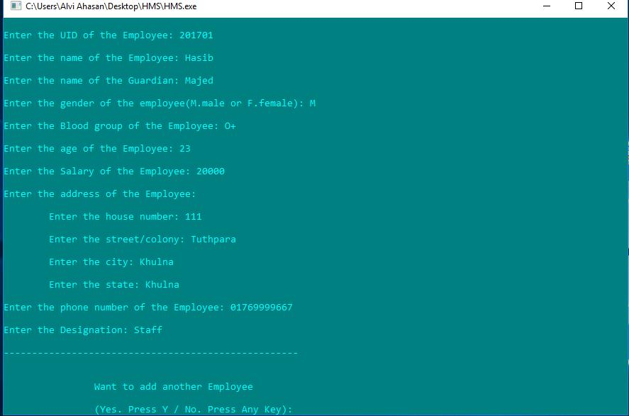
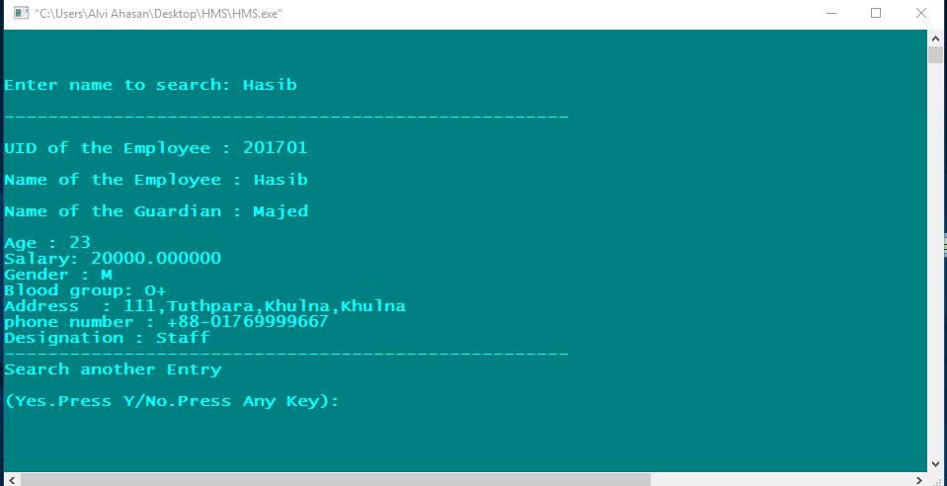
Dev. Process—Testing:
Input of a employee to record with some data (ID, name, guardian name, gender , blood group , age , salary , address , phone no. and designation ).
Input of a patient to record the same way to employee with some data (ID, name, guardian name, gender, blood group , age , address ,phone no. ,treatment record ,reference Dr name and current treatment record to modify ).
Output of a employee to record with search some data (ID, name, guardian name, gender , blood group , age , salary , address , phone no. and designation ).
Output of a patient to record with search the same way to employee with some data (ID, name, guardian name, gender, blood group , age , address ,phone no. ,treatment record ,reference Dr name and current treatment record to modify ).
[Fig: To input of employee record option]
[Fig: To output of employee record option]

Slide 13
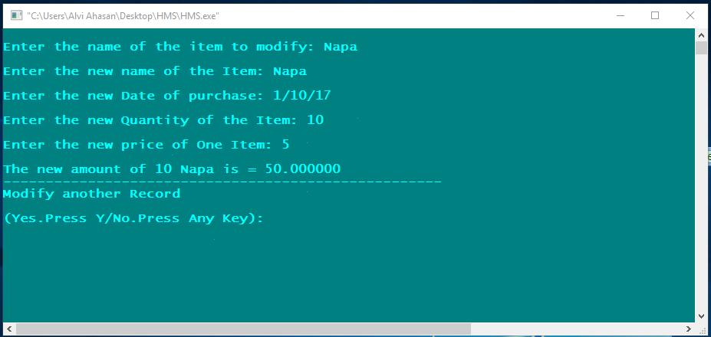
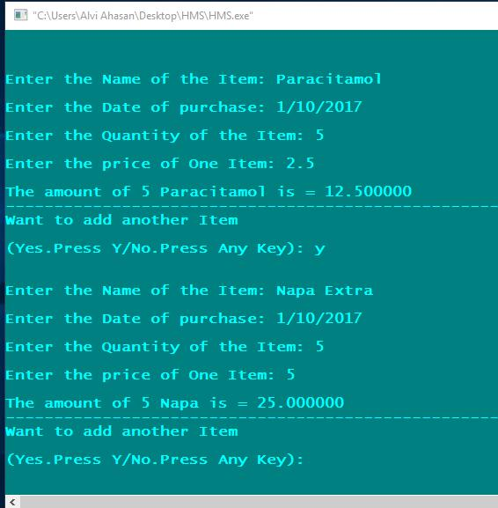
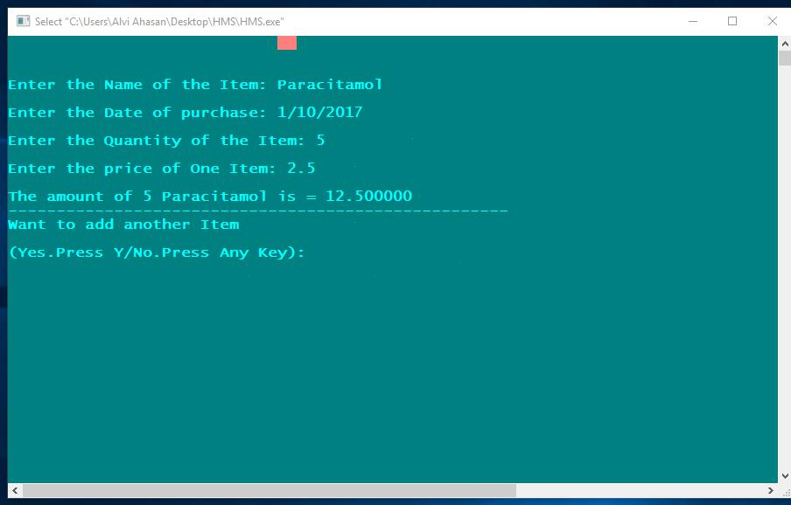
Dev. Process—Testing:
Input of a inventory item to record with some data(item name, record date, quantity of item, price of one item and show total amount of the item.
Output of all inventory item to record with some data(item name, record date, quantity of item, price of one item and show total amount of the item.
Input of another inventory item to record with some data(item name, record date, quantity of item, price of one item and show total amount of the item.

Slide 14
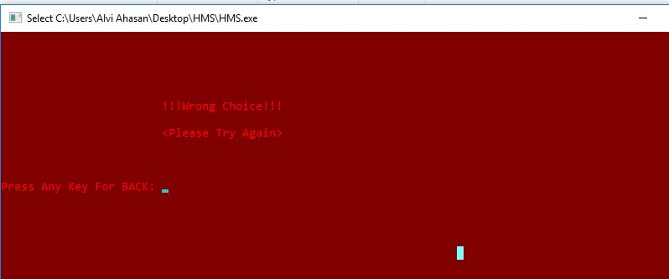
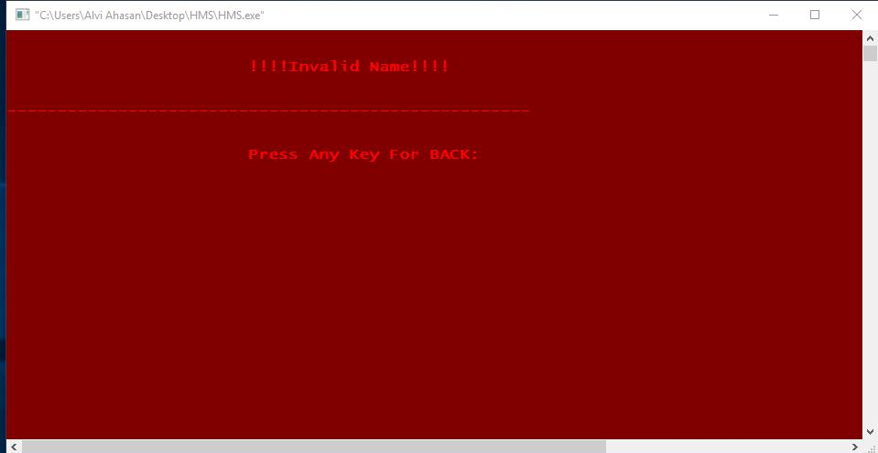
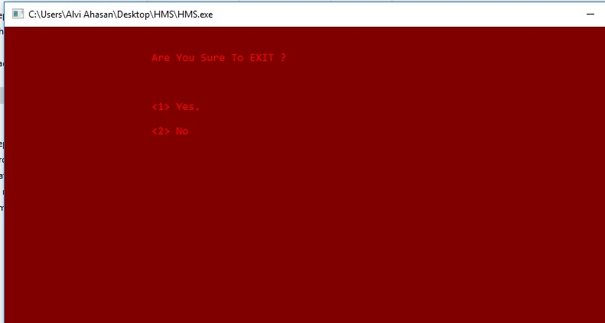
Dev. Process—Testing:
If we are choose any wrong option then show this output.
To search any record if we write any wrong name then show this output .
When we choose the option for exit from any menu then show this option.

Slide 15
Benifits:
To make a better offline Hospital Management interface.
Easy to operate.
It is less time consuming.
Very effective in offline hospital management application.
It is more faster, error free and reliable.

Slide 16
Limitations:
File System not secured at all.
Some unwanted file operation error might not be shown.
A thread operation not perform thus project may not work properly sometimes.

Slide 17
Conclusion:
The project “Hospital Management System” is a complete, decent solution for hospital management application.
We are working for further development of this application and on that note, we come the end of the project.
We are not yet experience system analyst but we are confident enough to announce that our Hospital Management application works better.

Slide 18
THANK YOU

